Slide 1
Myopia and Cataract
Abdulrahman Al-Muammar
Grand round
Sep 12/2011

Slide 2
Outline
Prevalence of myopia
Association between cataract and myopia
Clinical characteristics and outcomes of cataract surgery in high myopic patients
High myopia as a risk factor for retinal detachment after cataract extraction

Slide 3
Myopia
Myopia can be
Axial
Non-syndromic
Congenital
School
Adult
Syndromic
Refractive
Cataract
Corneal

Slide 4
Prevalence of myopia
Multiple studies have found an increase in the prevalence of myopia
In USA: between 1971-1971 and 1999-2004. Significant increase from 24% to 41.6% in rates of myopia in both men and women cohorts between the ages of 12 and 54
Vitale et al. Arch Ophthalmol 2009
In Israel: between 1990 and 2002. Significant increase from 20.03% to 28.3% in 16 to 22-year age group
Dayan et al. Invest Ophthalmol Vis Sci 2005
60% to 80% in the East
Saw SM. Clin Exp Optom 2003

Slide 5
Prevalence of myopia
www.rightdiagnosis.com/m/myopia/stats/country
In USA , 1 in 3 or 25.74% or 70 millions
An attempt to extrapolate the above prevalence rate for myopia to the populations of various countries and regions
Saudi Arabia: 6,638,660 in 25,795,938

Slide 6
Consequences of myopia
It is not only a refractive error that requires optical correction
Myopia is an important public health problem because of its frequency and the social, education, and economic consequences
In USA, the cost of correcting refractive errors with spectacles or contact lenses is estimated to be 2 billion dollars per year
It is an ocular state that is associated with an increased risk of sight threatening conditions, such as cataract, myopic macular degeneration, retinal detachment, macular hole, choroidal neovascular membrane, and glaucoma

Slide 7
Risk factors for myopia
Causes of myopia are unclear and multifactorial
Genetic
Ethnicity
Gender
Environmental
Near work
Years of education
Intelligence score
Premature and low birth weight
Unconvincing evidence
Urbanization
Height
Personality traits
Socioeconomic status
Ambient lighting
Malnutrition

Slide 8
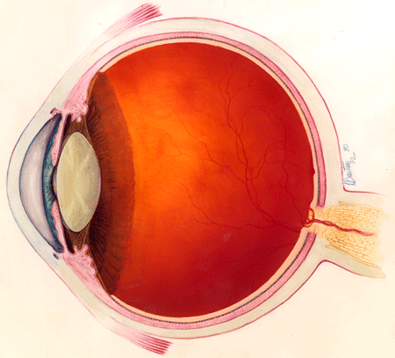
A
A
Near
A
A
Near
A
A
Distant

Slide 9
A
A
A
A

Slide 10
Risk factors for myopia
Causes of myopia are unclear and multifactorial
Genetic
Ethnicity
Gender
Environmental
Near work
Years of education
Intelligence score
Premature and low birth weight
Unconvincing evidence
Urbanization
Height
Personality traits
Socioeconomic status
Ambient lighting
Malnutrition

Slide 11
Preventive measures in myopia
Eliminating near work
Refractive
Bifocal spectacles
Pharmacological
Atropine
Pirenzepine
Overnight hard contact lenses
Outdoor activity
Intraocular pressure reduction

Slide 12
Association between myopia and cataract
Many studies have suggested that increase in the axial length of the eye is associated with a lower mean age at the time of cataract surgery
Myopia is a risk factor for cataract
OR
Myopic patients are less tolerant to cataract
Praveen et al. Eye 2010. reported that high myopia was a powerful risk factor for the development of cataracts in young patient

Slide 13
Pathogenesis of myopic cataract
Role of lipid peroxidation in the pathogenesis of myopic cataract
Oxidative damage of proteins in the lens is widely accepted as a major factor leading to cataract formation
Oxidative damage occurs earlier in diabetic and myopic patients
Retina is rich with polyunsaturated fatty acids and subjected to photic oxidative injury, especially under conditions such as diabetes and myopia associated with chronic hyopxia
High concentration of malondiadlehyde (MDA) which is a lipid peroxidative product was seen in the vitreous and lens of diabetic and myopic patients with cataract
Ferrari et al. British Journal of Ophthalmology 1996
Boscia et al. Invest Ophthalmol Vis Sci 2000
Simonelli et al. Exp Eye Res 1989

Slide 14
GSH
MDA
GSSG

Slide 15
Pathogenesis of myopic cataract
Importance of vitreous liquefaction in cataract formation
Vitrectomy replaces the gel vitreous with liquid and increases the risk for cataract
High myopia is associated with increased liquefaction of the vitreous body and has been identified as a risk factor for cataract
Stickler syndrome is associated with early cataract

Slide 16
Pathogenesis of myopic cataract
Importance of vitreous liquefaction in cataract formation
Conclusion
Vitreous liquefaction is associated with nuclear cataract but it is age dependent
Possible mechanisms:
Decrease diffusion of growth factors, ions, and metabolites because of decrease pressure gradient between vitreous and lens
Exposure of the lens to elevated level of oxygen
Increased oxidative stress in the eye may contribute to vitreous liquefaction and formation of nuclear cataract
Harcopos et al. Invest Ophthalmol Vis Sci 2005
Barbazetto et al. Exp Eye Res 2004

Slide 17
Clinical Characteristics and Outcomes of Cataract Surgery in Highly Myopic Eyes
Purpose
To evaluate the clinical characteristic and outcomes of cataract surgery in highly myopic eyes
To investigate the role of high axial length as a risk factor for RD after cataract surgery

Slide 18
Clinical Characteristics and Outcomes of Cataract Surgery in Highly Myopic Eyes
Patients and methods
Retrospective comparative case-control study
A stratified systemic sample of cataract patients who underwent cataract surgery during the period between 1998 and 2009
Medical files of selected file number were retrieved and reviewed

Slide 19
Data Collected
Pre operative data
Age
Sex
Past ocular history
Past medical history
Medications
Previous ocular surgeries
Ocular trauma
Preoperative uncorrected and best corrected visual acuity
Clarity of the cornea
Type of cataract
Fundus exam
Intraocular pressure
Axial length

Slide 20
Data collected
Intraoperative data
Date of surgery
Type of anesthesia
Surgical technique
Level of surgeon
Occurrence of ruptured posterior capsule
Vitreous loss
IOL implantation
Position of IOL implantation

Slide 21
Data collected
Postoperative data
Non corrected and best corrected visual acuity at last visit
Post operative refraction
Presence of posterior capsular pacification
Rate of Nd:YAG capsulotomy
Retinal detachment
Mean time to retinal detachment
Postoperative follow up time

Slide 22
Exclusion criteria
Age less than 20
Previous ocular surgery
Combined surgery
Ocular trauma
History of preoperative RD
Uveitis
Proliferative diabetic retinopathy
PRP done pre or post cataract surgery
Retinal diseases which predispose to RD such as stickler’s syndrome and Marfan syndrome
Less than 1 year follow up

Slide 23
Definition of myopia
Myopia can be defined by refractive or axial length
Using refractive myopia, it is difficult to differentiate between cause and effect
Most of the recent studies have used axial length as a definition for myopia
Eyes with an axial length of ≥25.00 mm have been considered as having high myopia by large number of studies

Slide 24
Results
Total withdrawn sample size was 2720
Number of eyes with high myopia (≥ 25.00 mm) that met the inclusion criteria was 352 eyes of 283 patients
500 eyes of 438 patients with axial length between 22.00 mm and ≤ 24.00 mm were selected to serve as controls

Slide 25
Results
Mean follow up duration was 45.1 (27.9) months ranging from 12 to 144 months
Follow up time:
Cases: Mean (SD), [min – max]: 46.2 (33.2), [1 – 12 Yrs]
Controls: Mean (SD), [min – max]: 47.5 (31.1), [1 – 12 Yrs]

Slide 26
Age and cataract
Variable |  | Cases | Controls | P value
 |  | No. (%) | No. (%)
Age
 | Mean (±SD) | 59.5 (11.3) | 62.3 (10.7) | < 0.0001
 | Range | (20 – 85) | (20 – 90)
The mean age of the case group was younger than that of control group
It is consistent with previous studies

Slide 27
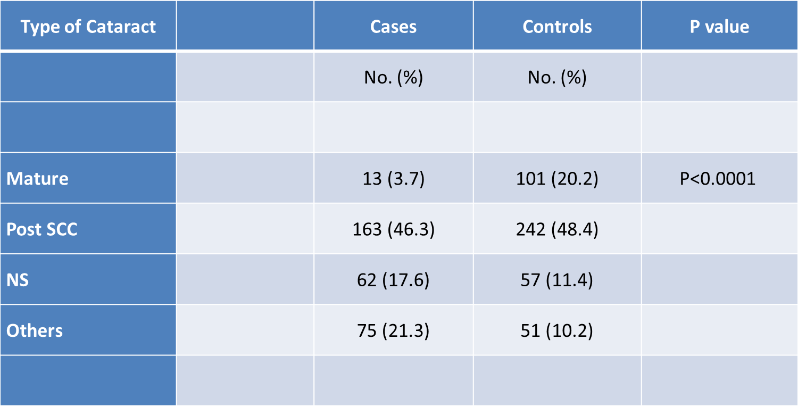
Distribution of cases and controls by type of cataract
Nuclear cataract was strongly associated with high axial myopia
Praveen Am J Ophthalmol 2008
Jeon Korean J Ophthalmol 2011
Blue Mountains Eye Study. Invest Ophthalmol Vis Sci 1999
Beaver Dam Eye Study. Invest Ophthalmol Vis Sci 2001
The association between PSC and high myopia was controversial
Blue Mountains Eye Study and Jeon et al, found PSC to be more common among high myopic eyes while Praveen et al and other studies found PSC to be more common among emmetropic eyes

Slide 28
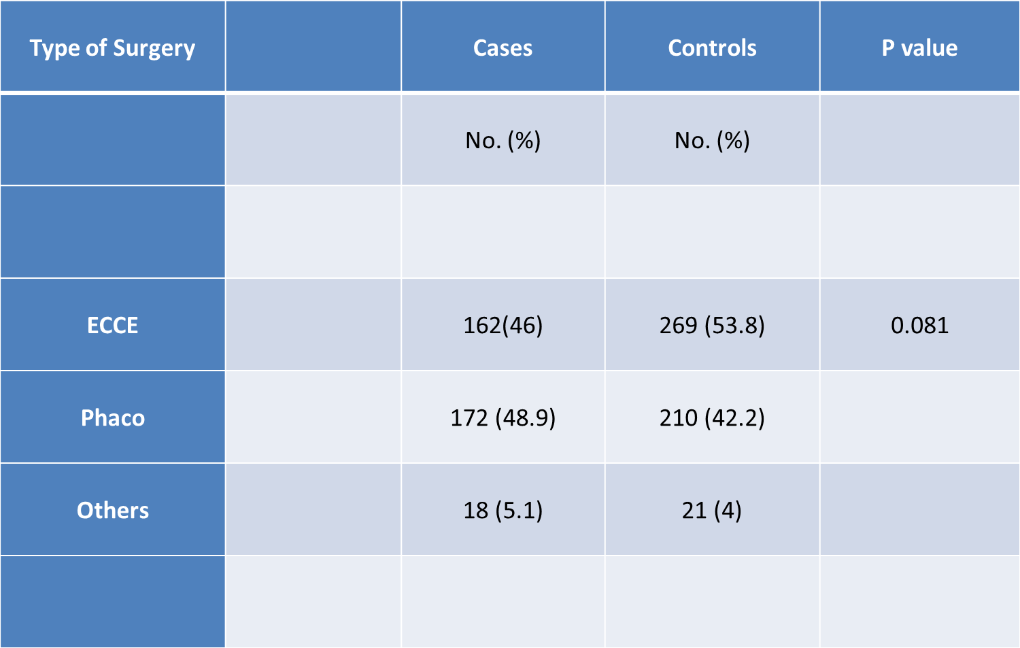
Distribution of cases and controls by type of surgery

Slide 29
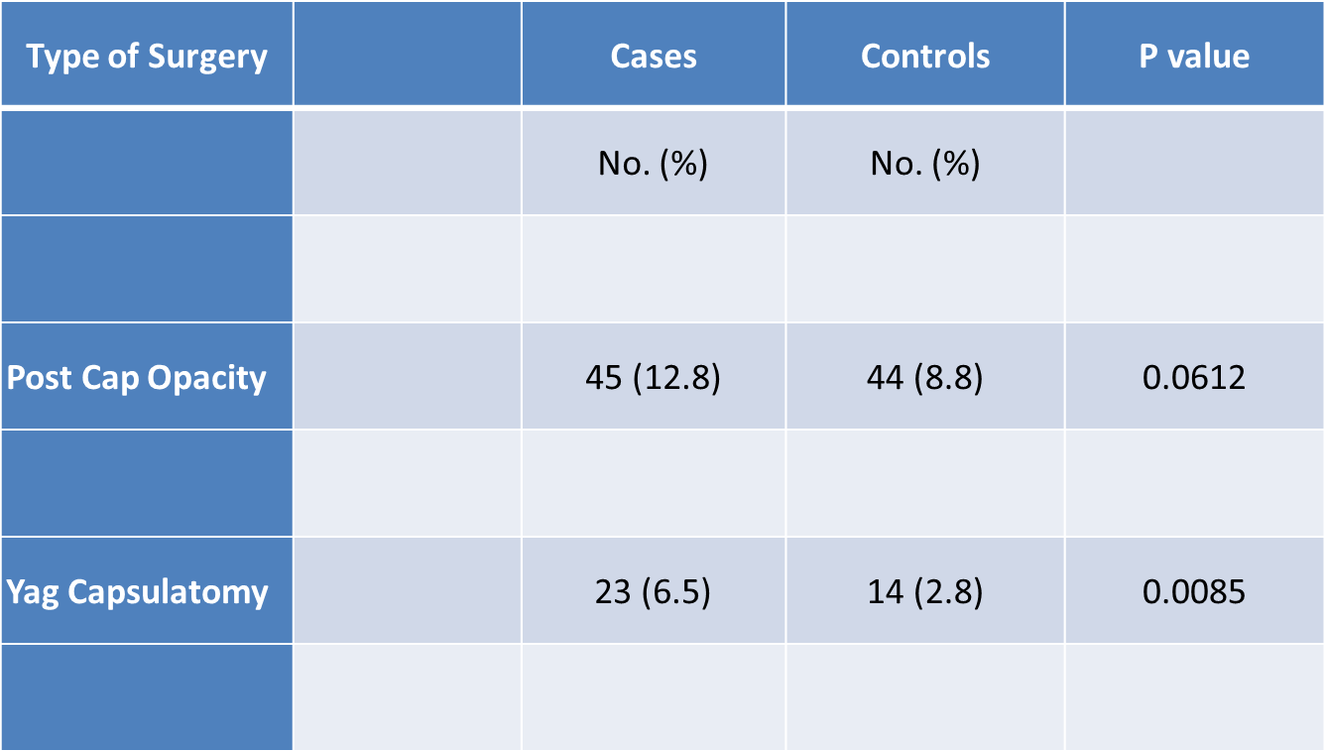
PCO and rate of YAG capsulotomy among cases and controls
High myopic eyes might be less tolerant to PCO or the nature of PCO might be denser among high myopic eyes.
Published rate of YAG capsulotomy in high myopic eyes is 20% to 50%

Slide 30
Intraoperative complications among cases and controls
Type of Surgery |  | Cases | Controls | P value
 |  | No. (%) | No. (%)
Post. Cap. Rupture |  | 14 (3.9) | 5 (1.0) | 0.0606
Vitreous loss |  | 8(2.2) | 3(0.6)
Published data reported that intraoperative vitreous loss occurred in 1% to 2% of high myopic cases

Slide 31
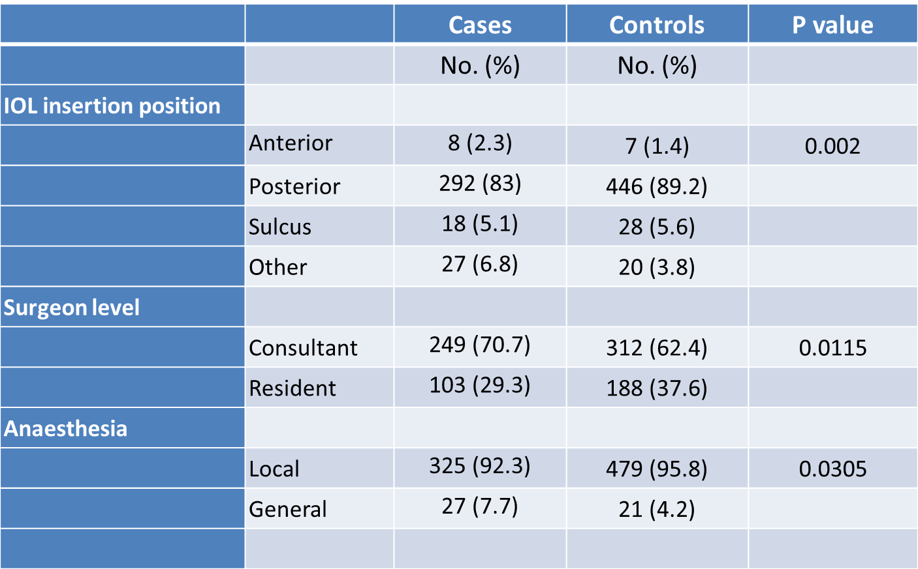
Distribution of cases and controls by surgical indices

Slide 32
Distribution of cases and controls by surgical indices
 |  | Cases | Control | P Value
 |  | NO.(%) | NO.(%)
IOL Inseration
 | Anterior | 8(2.3) | 3(0.6) | 0.002
 | Posterior | 302(85) | 470(94)
 | Sulcus | 18(5.1) | 28(5.6)
 | Aphakia | 7(1.9) | 2(0.4)
Suegeon level
 | Consultant | 249(70.7) | 312(62.4) | 0.0115
 | Resident | 103(29.3) | 188(37.6)
Anaesthesia
 | Local | 325(92.3) | 479(95.8) | 0.0305
 | General | 27(7.7) | 21(4.2)

Slide 33
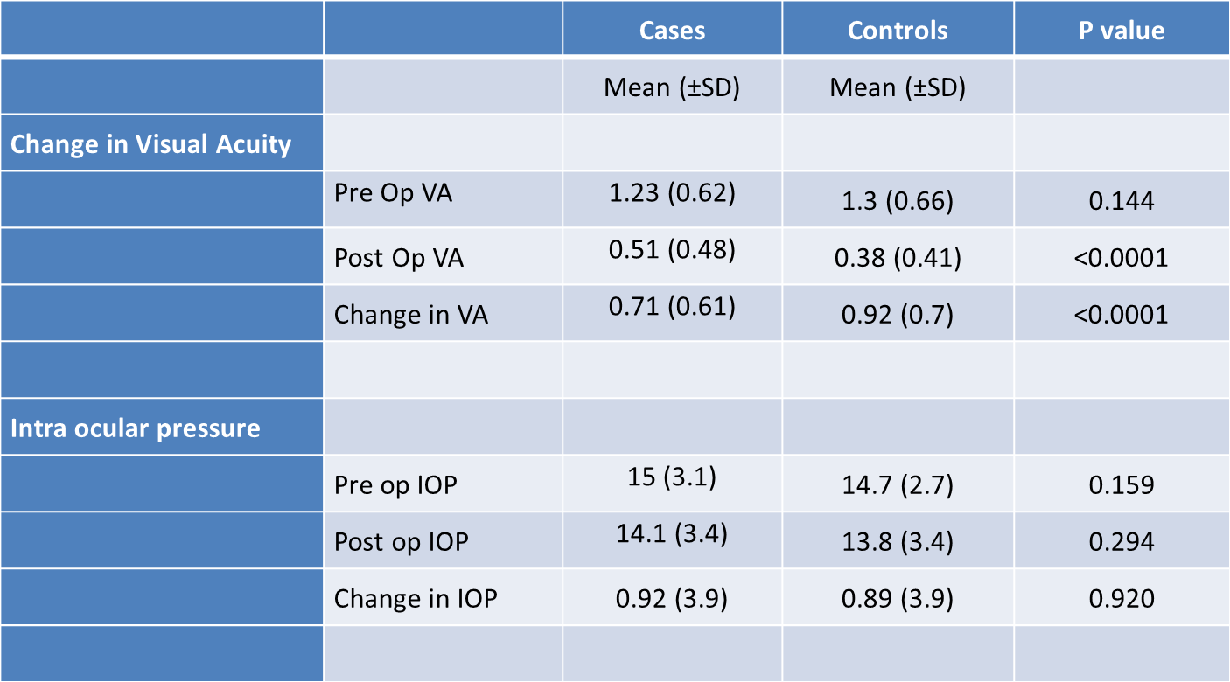
Clinical indices outcomes

Slide 34
Retinal detachment and cataract surgery
The incidence of retinal detachment either after extra-capsular cataract extraction by nuclear expression (ECCE) or phaco-emulsification has been estimated to be within the range of 0.6% to 2.7%
Potential risk factors for retinal detachment after cataract extraction include
Male sex
Younger age
Ruptured posterior capsule/vitreous loss
Presence of atrophic retinal lesion
Retinal detachment in the other eye
Nd:YAG laser capsulotomy
High axial myopia

Slide 35
Risk of RD in high myopic eyes after cataract surgery
The relationship between high axial myopia and retinal detachment after cataract extraction has been assessed and reported in many retrospective studies
There is a considerable number of studies reported that high axial myopia increases the risk of retinal detachment after cataract extraction while many other studies have not found such increase
The reported incidence varies between 0% to 8%

Slide 36
Risk of RD in high myopic eyes after cataract surgery
The main difficulties in comparing different studies come from
Various definition used for high myopia
Variation in the follow up period
Different surgical technique
Hospital setting
Ethnicity
Inclusion and exclusion criteria

Slide 37
Incidence of RD
RD across the whole group is 16/852 = 1.9%
RD among cases: 14/352 (4%)
RD among controls: 2/500 (0.4%)

Slide 38
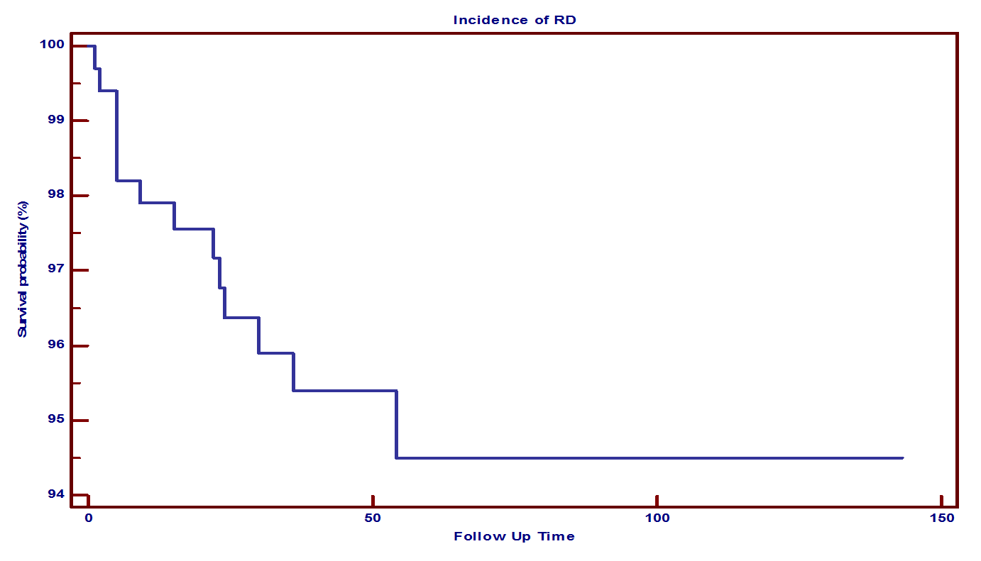
Kaplan-Maier analysis for the risk of RD
The cumulative risk of onset of RD:
2% at 12 months
3.5% at 24 months
4.4% at 48 months
5.2% at 54 months

Slide 39
Survivorship Function over follow up time
Follow Up time (M) | RD Incidence No. (%) | Probability Survive | Probability RD Event
0 - 12 | 7 (50%) | 98% | 2%
13 – 24 | 4 (28.6%) | 96.6% | 3.5%
25 – 36 | 2 (14.3%) | 95.7% | 4.4%
37 – 53 | 0 (0%) | 95.7% | 4.4%
54 + | 1 (7.1%) | 94.9% | 5.2%

Slide 40
Phacoemulsification versus ECCE
Phacoemulsification was reported to carry either similar or even lower risk than ECCE( Erie JC 2006, Nielsen NE 1993, Tielsch JM 1996, Russel M 2006, Tuft SJ 2006, Sharma MC 2003).
Javitt et al found pseudophakic RD to be higher after phacoemulsification in years soon after its introduction (Javitt JC 1992)

Slide 41
Nd:YAG capsulotomy and retinal detachment
Risk Factor | Incidence of RD | total | Unadjusted OR | P value | Adjusted OR | P value
Yag Capsulatomy
Yes | 1 (4.3) |  | 1.1 | 0.999 | 1.13 | 0.912
No̽ | 13 (4)
Laser capsulotomy was reported to increase the risk of RD 4 fold
However, it is difficult to come to conclusion from different studies regarding the risk of RD following Nd:YAG capsulotomy as using different energy might influence the changes occurring in the vitreous that may predispose to RD.

Slide 42
Ruptured posterior capsule+/- Vitreous loss
Tielsch et al 1995, reported that intraoperative posterior capsular rupture increases the risk for retinal detachment fivefold

Slide 43
Age and RD among high myopic eyes
Risk Factor | Incidence of RD | total | Unadjusted OR | P value | Adjusted OR | P value
 | No. (%)
Age
< 50 | 4 (7.1) |  | 2.2 | 0.252 | 1.72 | 0.450
≥ 50* | 10 (3.4)
A trend was found indicating association between age at surgery of younger than 50 years and an increased risk of RD

Slide 44
Gender and RD among high myopic eyes
Male gender was found by several studies to be a high risk for RD following cataract extraction (Davidson 1988, Boberg 2003 JCRS, Olsen 2000, Erie 2006, Rowe 1995, Sheu 2010)
Risk Factor | Incidence of RD | Total | Unadjusted OR | P value | Adjusted OR | P value
Sex
Male | 11 (5.5) |  | 2.9 | 0.106 | 6.8 | 0.891
Female* | 3 (2)

Slide 45
Conclusion
Cataract surgery in high myopic eyes has excellent visual outcome but less than emmetropic eyes
High myopic patients tend to have cataract surgery at younger age
The incidence of intraoperative ruptured posterior capsule and postoperative YAG capsulotomy was higher in high myopic eyes

Slide 46
Conclusion
Incidence of retinal detachment after cataract surgery is higher among high myopic eyes than emmetropic eyes
Among high myopic eyes, being male, age <50, and ruptured posterior capsule with vitreous loss increases the risk of RD
5 years cumulative risk for RD is 5.2%

Slide 47
Conclusion
Given the low incidence of postoperative RD, large number of cases are required for accurate analysis
Our findings will be helpful in estimating the risks and benefits of cataract surgery in high myopic eye
We would emphasize the importance of regular fundus examination after cataract surgery for high myopic eyes

Slide 48
Acknowledgment
Dr. Ahmed Mousa
Dr. Dora Alharkan
Dr. Sultan Alreshidi
Dr. Tariq Almudhaiyan
Dr. Mohammed Alotaibi
Ms. Sara Alsuleiman

