Slide 1
Molecular Biology
361 BCH

Slide 2
Mark Distribution/ Final Date
Total 25
Final
12
Quiz
4
Home Work
2
Reports
4
Presentation
3
Final Exam
6 Dec-2017
18-3-1439
Total
Final Exam

Slide 3
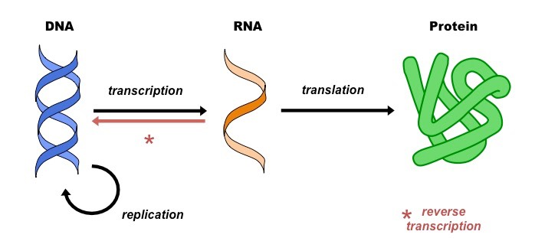
What is Molecular Biology?
"Molecular Biology" is the study of biology at the molecular level.
The interactions between the nucleic acids (DNA and RNA) and synthesis of proteins, and how these processes (replication, transcription, translation) are regulated
The techniques used for these studies are referred to as "Techniques of Molecular Biology".

Slide 4
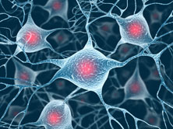
Understanding Molecular Biology-Why it is important?
You may know of someone who has been ill with a disease or disorder such as meningitis, malaria, diabetes, a type of cancer, cystic fibrosis, or Alzheimer’s disease.
All these diseases and disorders are caused by problems at a cell or molecular level.
Understanding the molecular basis of these diseases will lead to find more effective treatment

Slide 5
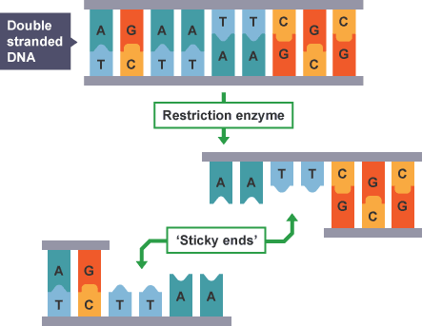
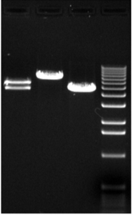
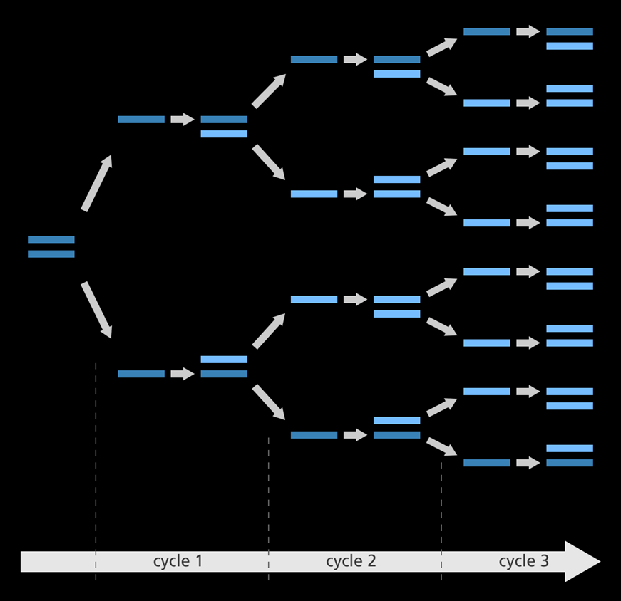
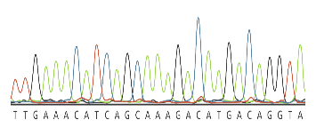
Outline
DNA Extraction From Blood
DNA Extraction From plant tissue
Characterization of the DNA
Agarose Gel Electrophoresis
Primer Design
The Polymerase Chain Reaction
Digestion of DNA with Restriction Enzyme
DNA Sequencing
Presentation
Purity and
Concentration

Slide 6
Things you need to understand as Molecular Biologist
Molecular Biologist
Basic molecular biology background and techniques
Lab Safety
Website Sources of information

Slide 7
Safety

Slide 8
Before Start Working:

Slide 9
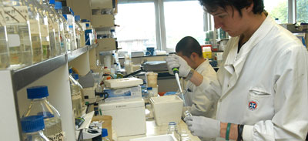
While working :

Slide 10
After the Experiment:

Slide 11
The purpose of experiment
Include + and - Controls
Prepare the protocol
Steralize working area
Use DNase and Rnase free disposable
Accurate pipetting
Work on Ice

Slide 12
Searching the scientific literature
The most fundamental skill in bioinformatics is the ability to carry out an efficient and comprehensive search of the scientific literature to find out what is known about a specific subject.

Slide 13
Some academic research tools..

Slide 14
Different types of scientific paper
Scientific Papers
Review articles
Primary research article
Primary research article: It’s a peer-reviewed report of new research on a specific question (or questions)
Review articles are also peer-reviewed, and don’t present new information, but summarizes multiple primary research articles, to give a sense of the consensus, debates, and unanswered questions within a field.
(It is better to start with it for reading new topic)

Slide 15
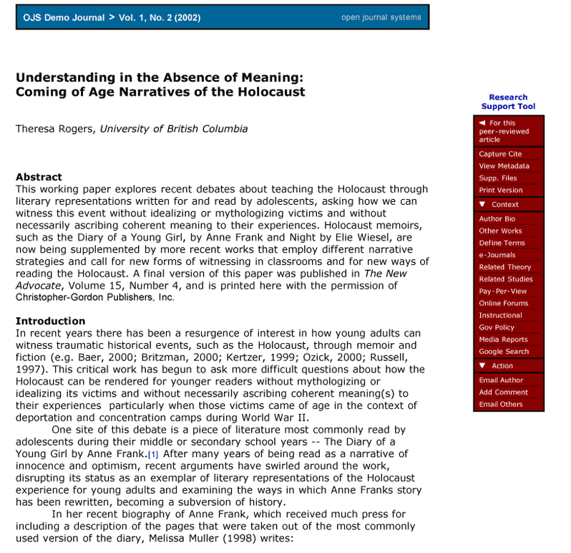
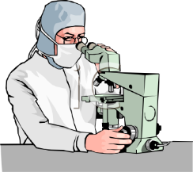
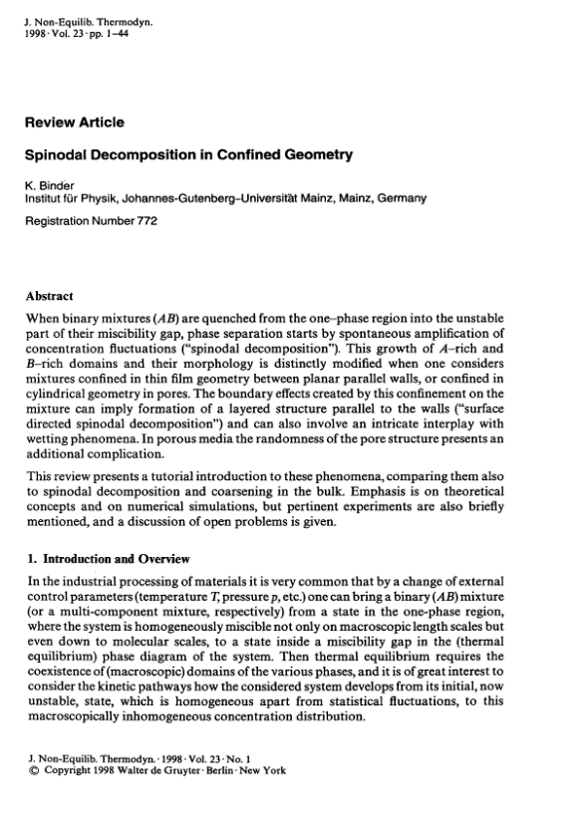
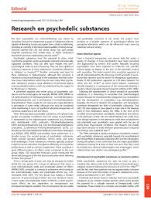
Review article
Peer research article

Slide 16
Home Work#1

