Slide 1
Applications of mathematics and statistics in financial markets
Mohammed Al-Grenees
8th February 2017

Slide 2
Percentage gains and losses
I purchase 10 stocks of stock A worth $100 each.
Stock price declines 50% in Day 1
… increases by 50% in day 2
Did I generate zero profits? Did I gain money or lose money?

Slide 3
Percentage gains and losses
Actually I lost money!
When the stock price declined by 50%, it went from $100 to $50.
In Day 2 when it increased by 50%, it increased by only $25 to $75.
Hence, overall I lost 25% even though the stock fell by 50% and then subsequently increased by 50%.
This is important lesson. Do not be confused!

Slide 4
Measuring stock returns
I bought stock A in 31.Dec.2011, then:
Year 2012: 90%
Year 2013: 10%
Year 2014: 20%
Year 2015: 30%
Year 2016: -90%
Average: 12%

Slide 5
Measuring stock returns
Because of 2016 decline, the investor lost 67% of his capital, losing SAR 673,960

Slide 6
What is a trend line?
A trend line is a line of best fit that represents a behavior of a data set over a time period to determine if there is a particular pattern.
For example, is the price line upward sloping or downward sloping?

Slide 7
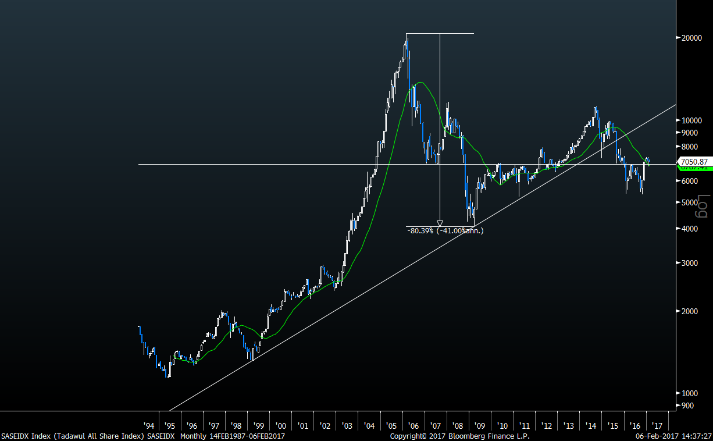
Saudi Stock Market Index

Slide 8
TASI Monthly Returns
The standard deviation is 0.25 (or 25%)

Slide 9
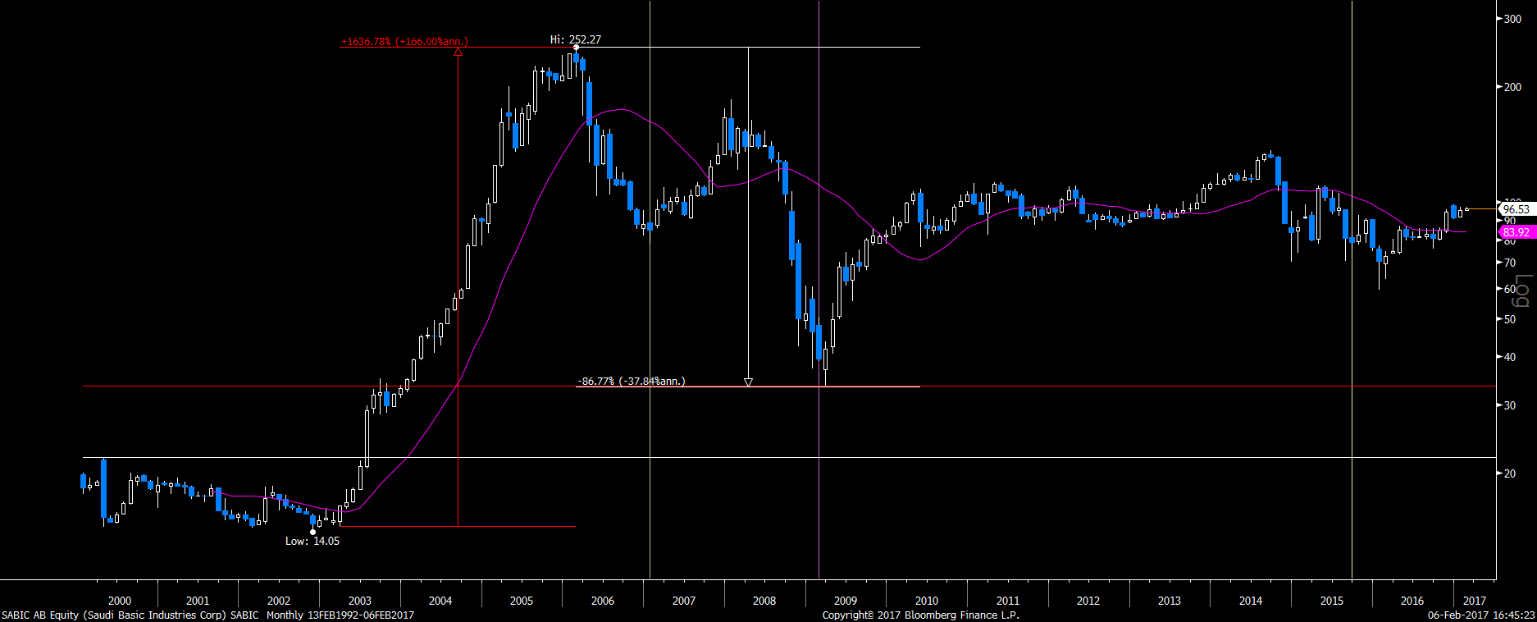
SABIC Monthly Price Performance
Beta of 1.02

Slide 10
SABIC Monthly Returns
The standard deviation is 0.36 (or 36%)

Slide 11
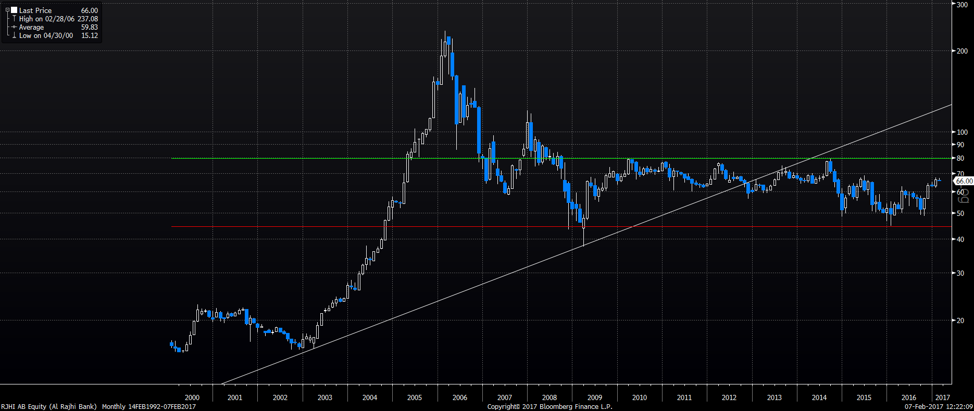
Rajhi Monthly Price Performance
Beta of 0.91

Slide 12
Rajhi Monthly Returns
The standard deviation is 0.34 (or 34%)

Slide 13
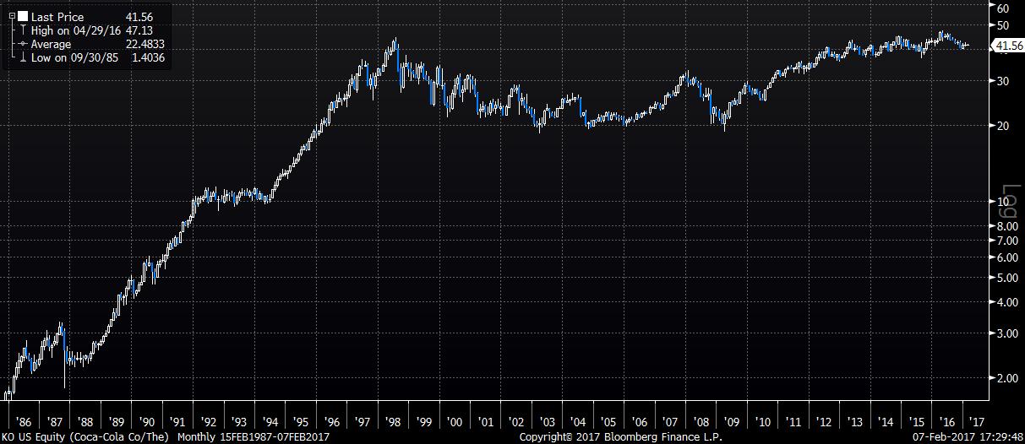
Coca-Cola Monthly Price Performance
Beta of 0.75

Slide 14
Coca-Cola Monthly Return
The standard deviation is 0.17 (or 17%)

Slide 15
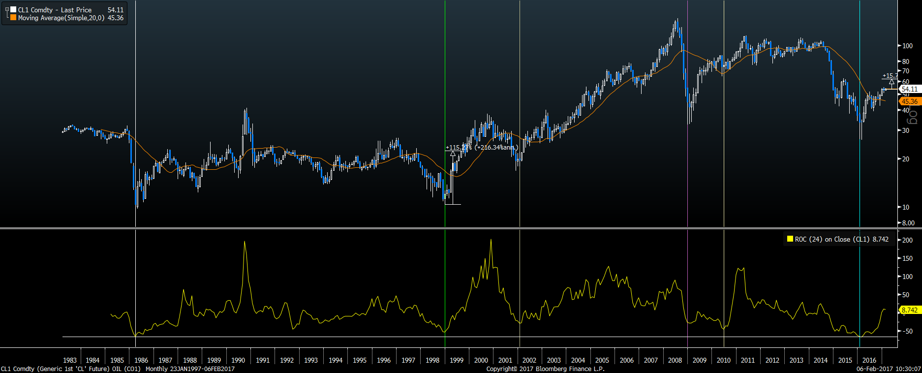
Oil Monthly Price Performance

Slide 16
Oil Monthly Returns
The standard deviation is 0.32 (or 32%)

Slide 17
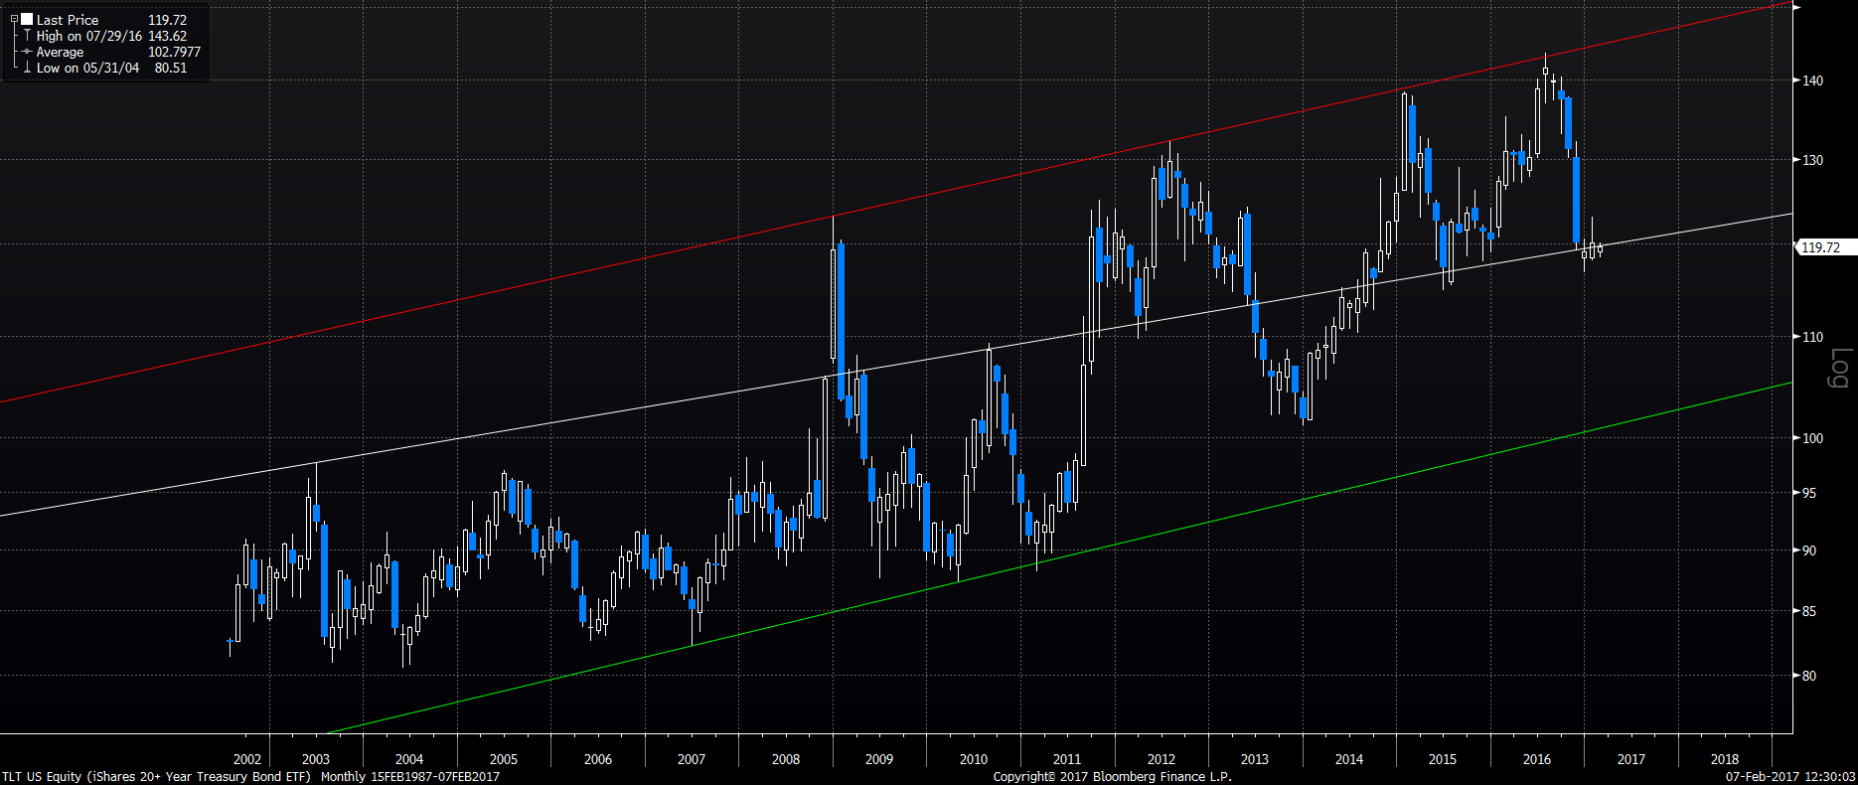
US Treasuries (20yr)

Slide 18
US Treasuries Monthly Returns
The standard deviation is 0.13 (or 13%)

Slide 19
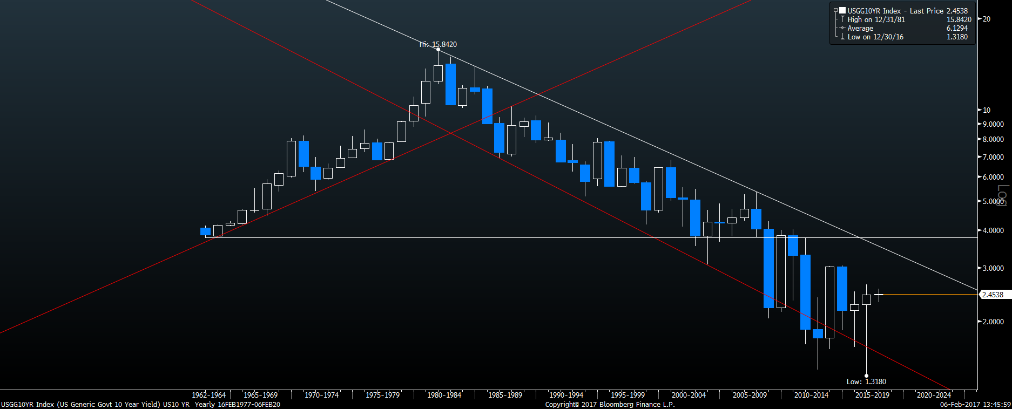
US Treasuries Yield 10-Years

Slide 20
Regression Analysis
Y=bX+a
Y is the dependent variable (sales)
X is the independent variable (GDP)
Correlation
Spurious Correlation
Beta

Slide 21
Oil and Saudi GDP 1969-1980
Correlation of 0.89

Slide 22
Oil and Saudi GDP 1981-1997
Correlation of 0.61

Slide 23
Oil and Saudi GDP 1998-2015
Correlation of 0.88

Slide 24
M1 Vs TASI

Slide 25
Historical Valuation P/E (SAUDI)

Slide 26
Historical Valuation P/B (SAUDI)

Slide 27
Historical Valuation P/E (US)

