Slide 1
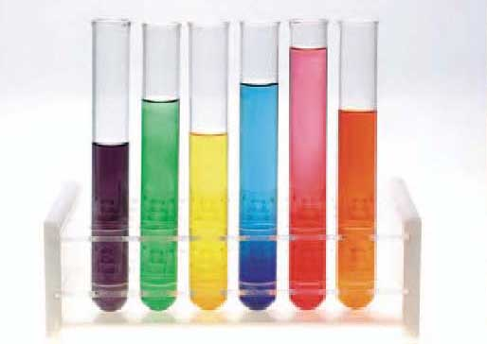
322 BCH
Method of Enzyme Assay

Slide 2
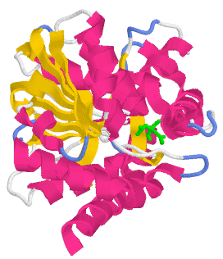
Objective
To study the different methods for determining enzyme activity.
Use these method in diagnosis of certain diseases

Slide 3
How to follow a reaction?
Enzyme assays: Are laboratory methods for measuring enzymatic activity.
Enzyme assays measure either the consumption of substrate or production of product over time.
Different enzymes require different estimation methods depending on the type of reaction catalyzed, the nature of S and P or coenzyme.
E
S P

Slide 4
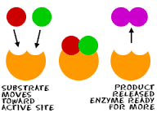
Methods of quantitatively following enzyme reactions
How to follow an enzymatic reaction?
First you must have complete knowledge about the reaction itself,
Does the substrate or product has the ability to absorb light, fluorescence, any production of gases, production of H+?
After that you can use this properties to detect the reaction

Slide 5
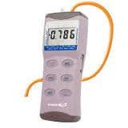
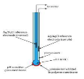
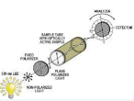
Methods of quantitatively following enzyme reactions
Fluorescence methods
Using fluorometer
Manometric methods
Using manometer.
Eletrode Methods
Using a pH meter
Polarimetric Method
polarimeter
Spectrophotometric methods

Slide 6
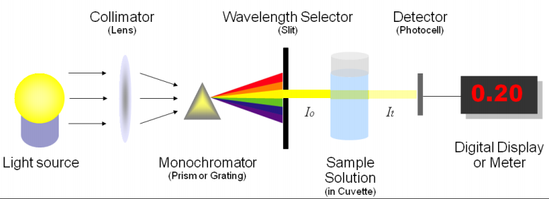
Spectrophotometric methods
In spectrophotometric assays, you follow the course of the reaction by measuring a change in how much light the assay solution absorbs.

Slide 7
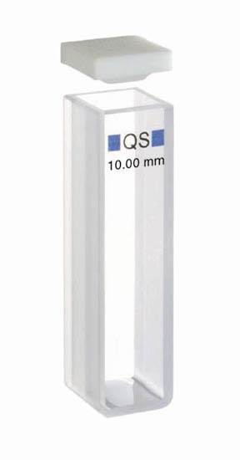
Spectrophotometric methods.
Wavelength in this instrument is divided into:
-If the sample absorb Invisible light (ultraviolet “UV”) from 100 to 360 nm
[Quartz cuvette are used]
-If the sample absorb Visible range (400 -700 nm)
[Glass or plastic cuvette are used]
[ If the light is in the visible region you can actually see a change in the color of the assay, these are called colorimetric assays ]
What is blank solution?
It is a solution that contains everything except the compound to be measured.

Slide 8
When the Spectrophotometric methods ^{can be used?}
1- cases in which product absorb but not the substrate.
e.g.
Fumarate malate
2- the Co-enzyme undergoes change in absorption upon reduction or oxidation
Oxidized form Reduced form
NAD NADH
NADP NADPH
Light
^{Fumarate hydratase}
UV. Light (340 nm)
If reduced form was product: increase the absorbance / min
If reduced form was substrate : decrease the absorbance / min

Slide 9
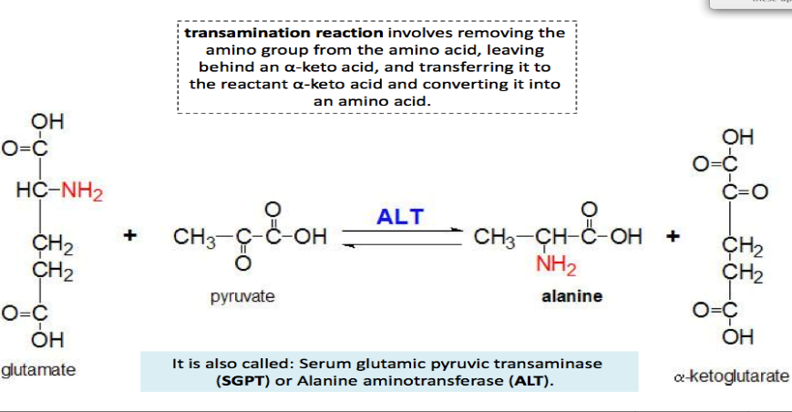
If Substrate and Product can not absorb light? What is the solution?
Example:

Slide 10
Alanine transaminase (ALT)
ALT is an enzyme that catalyzes a type of reaction (transamination) between an amino acid and α-keto acid.
It is important in the production of various amino acids.

Slide 11
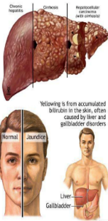
ALT diagnostic importance
ALT is found in serum (at low level) but is most commonly is found in liver.
thus , an elevated level ALT is a sensitive index of acute hepatocellular injury.
Elevated serum ALT level are found in hepatitis, cirrhosis , and obstructive jaundice.
NORMAL RANGE OF ALT:
( up to 42 ) U/L → males ( up to 32 ) U/L → females

Slide 12
We will measure ALT in Serum using continues assay and then discontinues assay
Enzyme assays can be split into two types:
Continuous assays,
where the assay gives a continuous reading of activity.
Discontinuous (Endpoint) assays,
Where the reaction is stopped and then the concentration of substrates/products determined.

Slide 13
Continuous Assay
The reading will be continues (1 min for 3 min).
Because nether the S nor P can absorb light, the following can be done: First we will add the enzyme to the Substrate
Alanine + α- ketoglutarate → Pyruvate + glutamate
Another enzyme (LDH) and NADH+H+ will be added:
Pyruvate + NADH+H⁺ → L-Lactate+ NAD⁺ +H₂O
The absorbance at 340nm is measured each minute without stopping the reaction, resulting in decreased readings due to the oxidation of NADH

Slide 14
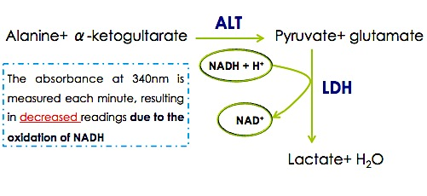
Principle

Slide 15
Method
Pipette into clean and dry test tubes:
ALT Reagent | 3 ml
Pre-warm at 37°C for 3 minutes and add
Serum Sample | 0.2 ml
Mix and incubated at 37 °C for 1 minute, then read absorbance ( at 340 nm against distilled water ) every minute for 3 minutes) and determine ∆A/min
Choose the following on the spectrophotometer:
2) Applications → 2) Simple Kinetics → wave length (340 nm) → Seconds → Duration (180 sec = 3 min) → Intervals (60 sec= 1 min) → Print Data Table (off) → Press start (2 times)

Slide 16
Results
ΔA/min=((A1-A2)+(A2-A3))/2 | Absorbance 340nm |  | Time
 |  | A1 | 1 min
 |  | A2 | 2 min
 |  | A3 | 3 min
Calculations
ALT Activity ( U/L) = ΔA/min x 1768
^{ALT Activity (U/L) =}

Slide 17
In this method ALT catalyzes the following reaction
Alanine + a-ketoglutarate → pyruvate + glutamate
ALT is assayed by following formation of pyruvate.
The addition of acidic 2,4-dinitrophenylhydrazine (DNPH) lead to the formation of 2,4-dinitrophenylhydrazone, then NaOH will be added So that it may be measured at 546nm.
Discontinuous Assay

Slide 18
Reaction
Alanine + a-ketoglutarate → pyruvate + glutamate
2,4-dinitrophenylhydrazine
2,4-dinitrophenylhydrazone
This assay as an example of colorimetric\ endpoint assay
Why colorimetric? Because it will give a brown color
Normal Range: 10-40 units per liter (U/L)

Slide 19
Method:
 |  | BLANK | SAMPLE
ALT Reagent |  | 0.5 ml | 0.5 ml
Pre-warm at 37 °C for 5 minutes and add:
Distilled Water | 0.1 ml |  | -
Serum Sample | - |  | 0.1 ml
Mix, and incubate at 37 °C for exactly 20 minutes , and add:
Color Reagent (DNPH) | 0.5 ml |  | 0.5 ml
Mix, and return at 37 °C for exactly 10 minutes, then add:
Color Developer (NaOH) | 5.0 ml |  | 5.0 ml
Mix, and return to 37 °C for exactly 5 minutes. Read absorbance of all tubes at 546nm against blank.

Slide 20
Precautions
COLOR REAGENT contains 1 N Hydrochloric acid which causes burns.
COLOR DEVELOPER contains 0.5 N Sodium hydroxide which is corrosive.
In case of contact, flush affected area with large amounts of water. Seek medical attention.

Slide 21
Results:
The data shown in the table is used to convert absorbance at 546 nm into enzymatic activity in U/L of serum.
Draw graph using the data in table with absorbance on the Y- axis and enzymatic activity in U/L on the X-axis.
Note: Don’t forget title of the graph “Standard Curve” and the x- axis and y- axis with their units
Absorbance at 546 nm | ALT activity (U/L)
0.025 | 2.5
0.050 | 5.5
0.075 | 9
0.100 | 12
0.125 | 17
0.150 | 21
0.175 | 25
0.2 | 30
0.225 | 35
0.250 | 41
-Absorbance at 546 nm = ………
-ALT (SGPT) activity (from graph)= …………U/L

Slide 22
Discussion
Mention the diagnostic importance of ALT
Explain the difference in the principle of each ALT assay.
Compare your result with ALT normal range [in males], and diagnose the patient's state (what disease could the patient have or not).

