Slide 1
Bacterial Structure (Lab 3)
Rana Alqusumi

Slide 2
Essential Bacterial Structures
Cell wall.
Cell membrane.
Cytoplasm.
Nuclear material.

Slide 3
Particular Bacterial Structures
Capsule.
Flagella.
Pili.
Fimbriae.
Spore.

Slide 4
Bacterial Structure (Capsule)

Slide 5
Cell Envelope
Glycocalyx :
some extracellular material secreted by many bacterial cells in the form of:
capsule :
attached tightly to the bacterium and has definite boundaries.
slime layer :
loosely associated with the bacterium and can be easily washed of.

Slide 6
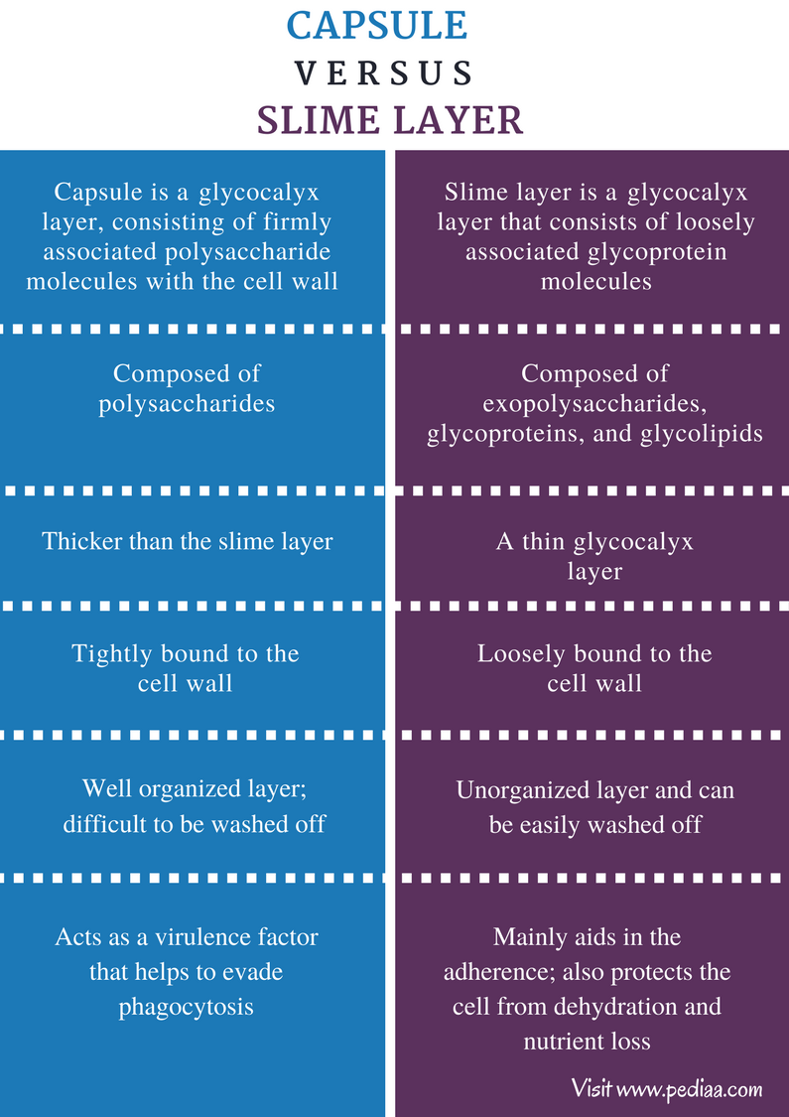

Slide 7
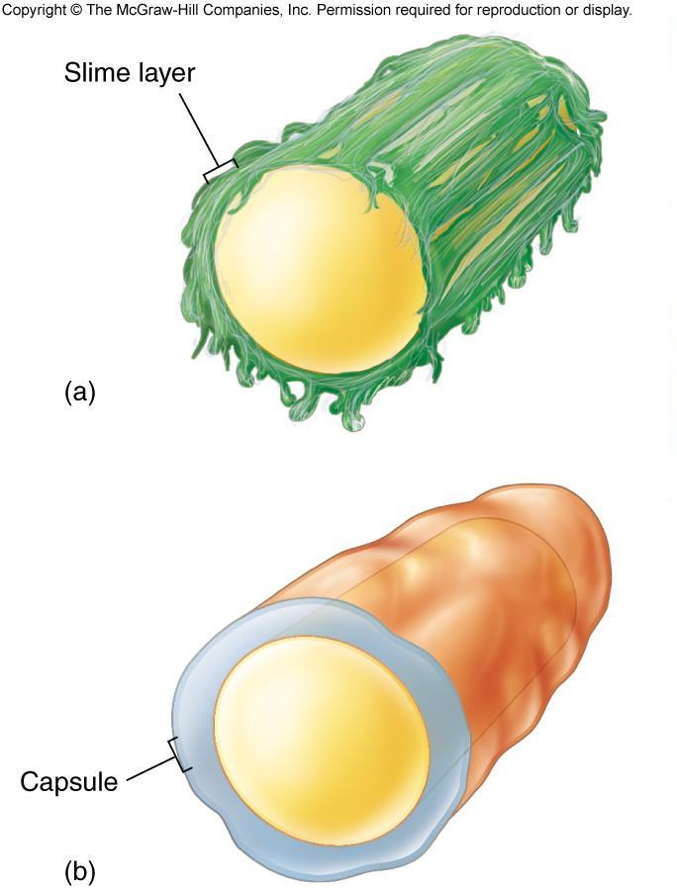

Slide 8
Capsule
A capsule is a gelatinous outer layer that is secreted by the cell and that surrounds and adheres to the cell wall. It is not common to all organisms.
Cells that have a heavy capsule are generally virulent and capable of producing disease, since the structure protects bacteria against the normal phagocytic activities of host cells.

Slide 9
Capsule Staining
The capsule stain uses two reagents:
Primary Stain:
Crystal Violet (1% aqueous) A violet stain is applied to a non–heat-fixed smear. At this point, the cell and the capsular material will take on the dark color.

Slide 10
Capsule Staining
Decolorizing Agent:
Copper Sulfate (20%) Because the capsule is nonionic, unlike the bacterial cell, the primary stain adheres to the capsule but does not bind to it.
In the capsule staining method, copper sulfate is used as a decolorizing agent rather than water.
The copper sulfate washes the purple primary stain out of the capsular material without removing the stain bound to the cell wall. At the same time, the decolorized capsule absorbs the copper sulfate, and the capsule will now appear blue in contrast to the deep purple color of the cell.

Slide 12
Capsule Stain (Anthony Method)
Materials:
Culture:
48-hour-old cultures of bacteria.
Reagents:
1% crystal violet and 20% copper sulfate.
Equipment:
Bunsen burner,
Inoculating loop or needle,
Glass slides.
Microscope.

Slide 13
Capsule Stain (Anthony Method)
Procedure:
Steps 1–5 are pictured in Figure 13.5.
Obtain one clean glass slide. Place several drops of crystal violet stain on the slide.
Using aseptic technique, add three loopfuls of a culture to the stain and gently mix with the inoculating loop.
With a clean glass slide, spread the mixture over the entire surface of the slide to create a very thin smear. Let stand for 5 to 7 minutes. Allow smears to air-dry. Note: Do not heat fix.
Wash smears with 20% copper sulfate solution.
Gently blot dry and examine under oil immersion.

Slide 15
Reference
James G. Cappuccino, Natalie Sherman. 2014. Microbiology a laboratory manual. 10th ed.
https://fac.ksu.edu.sa/sites/default/files/362mic-lab3.pdf

