Slide 1
Chapter 14 Franchising, Licensing, and Harvesting: Cashing in Your Brand

Slide 2
Chapter Learning Objectives
1. Assess how you want to grow your business and eventually exit from it.
2. Describe how businesses use licensing to profit from their brands.
3. Explain how a business can be franchised.
4. Use methods of valuing a business.
5. Compare five ways to harvest a business.

Slide 3
What Do You Want from Your Business?
Just as people start businesses for a variety of reasons and have different goals and objectives, they also have different reasons for leaving them—and different ways of doing so.
Some entrepreneurs enjoy the stability and earnings associated with carrying on a successful business they have established.
Regardless of which route you choose, your business plan should clearly state your intentions.

Slide 4
Continuing the Business for the Family
The multigenerational family-owned-and-operated business best exemplifies the company that provides continued employment and wealth to an entrepreneur and his relatives.
Malden Mills, a company located in Lawrence, Massachusetts, that continued to pay its employees while rebuilding following a fire.
This was an example of a firm that was operated as a closely held private company for three generations and had a clear interest in maintaining employment in its community.

Slide 5
Growth through Diversification
diversification - the addition of product or service offerings beyond a business’s core product or service.
By diversifying your operations, you will be increasing the potential for sales.
To a budding entrepreneur or a seasoned executive, diversification can be the way to get more market share.
Focusing, in contrast, attracts the right employees to a company and reinforces its strength in the marketplace.

Slide 6
Growth through Licensing and Franchising
licensing - renting your brand or other intellectual property to increase sales.
replication strategy - a way for a business to obtain money by letting others copy its success formula for a fee.
It is important that you are aware of the possibilities offered by franchising and licensing from the moment you start your business.
Stay organized and try to develop a foolproof operational system.
Notes:
Someday hundreds, or even thousands, of entrepreneurs might be eager to buy or rent that franchising system from you.

Slide 7
Focus Your Brand
line extension - using an established brand to promote different kinds of products.
A brand identifies the products or services of a company and differentiates them from those of competitors—representing the company’s promise to deliver consistently a specific set of benefits to its customers.
Customers who buy Liz Claiborne clothes, for example, expect classic styling suitable for the workplace.
Notes:
They have come to trust that brand to meet their needs.

Slide 8
Focus Your Brand
Many companies known for one type of merchandise, such as Adidas with its athletic shoes, have applied their brand with disastrous results— such as Adidas cologne.
Sneakers and cologne were not a good association.
Bic, known for its pens, branched into panty hose and had a similar failure.
Notes:
They have come to trust that brand to meet their needs.

Slide 9
When Licensing Can Be Effective
Licensing is effective when the licensor is confident that the company name will be enhanced by the licensee’s use of it.
If Coca-Cola licensed its name to a T-shirt manufacturer that wanted to print its logo on T-shirts, Coca-Cola would get free advertising as well as royalties.
Licensing, if not handled carefully, can damage your brand.
For example, if the T-shirt maker used the Coca-Cola logo on T-shirts that contained obscene messages, the company’s reputation would be tarnished.
Notes:
A company can profitably license its brand when it has a core group of loyal customers.

Slide 10
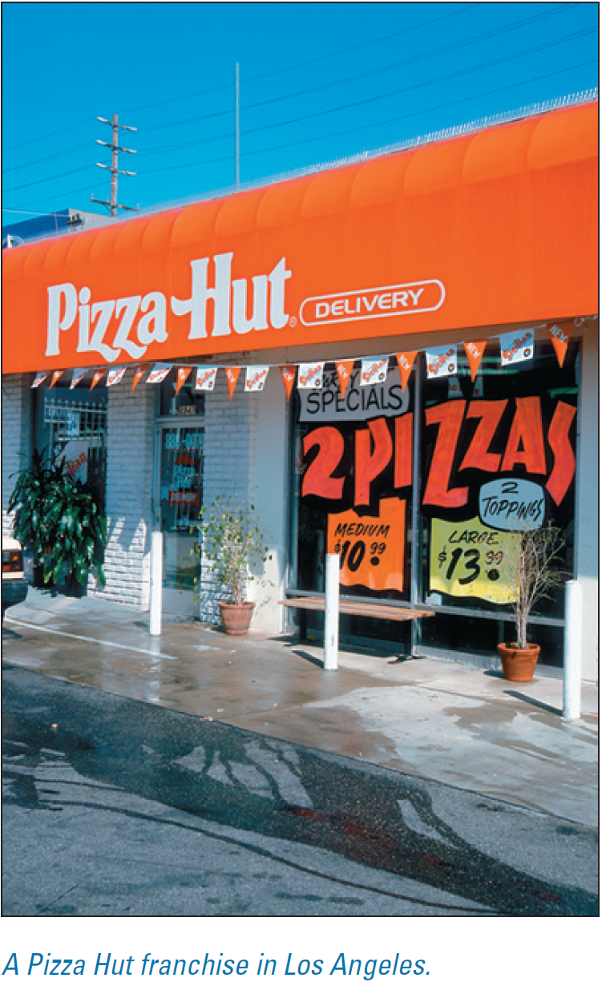
Franchising Revisited from the Franchisor Perspective
As discussed in Chapter 1, a franchise is a business that markets a product or service in the manner prescribed by the parent business.
One way for you to start a business would be to secure a franchise; you also could develop a concept and a business operation that could be reproduced and licensed to other entrepreneurs.
They would buy the right to run the business in the way you prescribed and pay you a franchise fee and royalties.

Slide 11
Franchising Revisited from the Franchisor Perspective
There are both benefits and drawbacks to being a franchisor:
The benefits include:
growth with minimal capital investment;
lower marketing and promotional costs; and
royalties.
The drawbacks to the franchisor include:
the potential for a tarnished franchise reputation if a franchisee disregards the training and fails to operate the business properly;
difficulty securing qualified franchisees;
payment issues and lawsuits from franchisees that do not experience success; and
costs and challenges due to the many federal and state regulations regarding franchising.

Slide 12
How a McDonald’s Franchise Works
McDonald’s was developed by Ray Kroc, who had persuaded the McDonald brothers to let him become the franchising agent for their highly successful hamburger restaurant in San Bernardino, California, in 1955.
Kroc’s great insight was to realize that the people who bought McDonald’s franchises would need extensive training and support in order to make the food taste like that of the original restaurant.
Kroc timed and measured everything exactly. McDonald’s franchisees are taught precisely how many minutes to fry potatoes and when to turn a burger, among a host of other details.

Slide 13
How a McDonald’s Franchise Works
A McDonald’s franchisee owns the restaurant, but agrees to market the food under the McDonald’s name and trademark following the precise methods developed by the company.
In return, the franchisee knows that he or she is investing in a proven, successful business concept.
The franchisee also benefits from use of the McDonald’s trademark and from the management training, marketing, national advertising, and promotional assistance provided by the parent company.
McDonald’s, as franchisor, receives a franchise fee and royalties.
Notes:
Everything is spelled out in the franchise agreement.

Slide 14
Do Your Research before You Franchise
Although franchising has existed in the United States since the Singer Sewing Machine Company first developed it in the 1850s, its popularity has exploded over the last several decades.
The number of individual franchises has grown to approximately 750,000, with thousands of franchisors in the market space.
Before you get involved in franchising your business, consult with a franchise attorney and carry out extensive research.
The International Franchise Association (http://www.franchise.org) provides considerable information for franchisors, including a prospective franchise forum.

Slide 15
Do Your Research before You Franchise
To better understand the franchisee perspective, you can visit the American Association of Franchisees and Dealers at http://www.aafd.org.
You must offer products or services that are sufficiently original and create unique marketing strategies to justify the cost of the franchise.
Part of the process of franchising a business will be to create a franchise agreement, which is the contract between the franchisor and franchisee.
This contract establishes the standards that assure uniformity of product (or service) throughout the franchise chain.

Slide 16
Harvesting and Exiting Options
harvesting - the act of selling, taking public, or merging a company to yield proceeds for the owner(s).
Licensing and franchising are possible growth strategies for entrepreneurs who want to stay in a business.
For those who do not wish to continue their businesses, harvesting and exiting are options.

Slide 17
When to Harvest Your Business
There may come a time in the life of your firm when you will want to close or leave it.
Unlike replication, the entrepreneur is usually no longer involved once the business is harvested; he or she walks away with cash, stock, or a combination of the two.
The founding entrepreneur may also work in the reorganized company for a specified time period.

Slide 18
When to Harvest Your Business
In William Petty’s article on harvesting,4 he quotes Steven Covey, author of The Seven Habits of Highly Effective People, who writes that a key to being effective in life is “beginning with the end in mind.”
To that, Petty adds, “If the entrepreneur’s goal with the venture is only to provide a living, then the exit or harvest strategy is of no concern.
But if the goal is to create value for the owners and the other stakeholders in the company, a harvest strategy is absolutely mandatory.”

Slide 19
When to Harvest Your Business
It usually requires at least 10 years to build a company of sufficient value to harvest.
Make the timing of harvesting part of the plans for your business.
The harvest strategy is important to the investors because it lets them know up front how their investment will eventually be turned into cash or stock.

Slide 20
When to Harvest Your Business
Liquidation - the sale of all assets of a business concurrent with its being closed.
Not every business can be harvested.
Some are loaded with debt or have not created a product or service of lasting value.
The entrepreneur can only leave such a business via liquidation (selling all the assets), closure, or bankruptcy.

Slide 21
How to Value a Business
fair market value - the price at which a property or business is valued by the marketplace; the price it would fetch on the open market.
Business valuation is both an art and a science.
A business that is profitable and likely to be so in the future can be sold for a sum that represents its net present value today.
This is net present value in action. (Most wealth is created by buying and selling assets that will have a future value.)
Notes:
Ultimately, a business is worth what others are willing to pay for it and what the owners will accept.

Slide 22
How to Value a Business
There are many ways to estimate the net present value of a business.
Value, after all, is subjective, meaning it is based on individual opinion or preference.
One person might be willing to pay a higher price than another would.
The first buyer feels more optimistic about the business’s future (and may have some personal insight in that regard) or may simply want it more than another potential buyer does.

Slide 23
How to Value a Business
Here are some methods entrepreneurs use to estimate the value of a business:

Slide 24
The Science of Valuation
There are three primary methods that buyers and sellers use:

Slide 25
The Science of Valuation
book value - valuation of a company as assets minus liabilities.
These three approaches; book value, future earnings, and market-based value are often used concurrently, and all provide helpful perspectives on a company’s value.
Despite the sophistication of these three techniques, all of them are ultimately only estimates.
Each business will have particular characteristics and special circumstances.

Slide 26
Creating Wealth by Selling a Profitable Business
As noted previously, a successful small business can usually be sold for between three and five times its yearly net profit, because the buyer expects the business to continue to keep generating income.
If you are in business for three years, however, and increase your net profit each year, your business will be worth even more.
If you are in business for three years, however, and increase your net profit each year, your business will be worth even more.

Slide 27
Creating Wealth by Selling a Profitable Business
A business with increasing yearly net profit will be considered more valuable than a business with static earnings.
Entrepreneurs establish successful businesses, sell them, and use the resulting wealth to create new enterprises and more wealth.
Entrepreneurs also use their wealth to support political, environmental, and social causes.

Slide 28
Harvesting Options
Harvesting options for exiting a business fall into five categories:

Slide 29
Harvesting Options
merger - the joining of two companies in order to share their respective strengths.
An overview of harvesting strategies should help you plan the final stage of your relationship with the company you are starting to create now.
Stewart Butterfield and Caterina Fake launched Flickr in early 2004 and sold it just over one year later to Yahoo!.
The sale price was $35 million in cash.
It would appear that the couple harvested their company very quickly, but the story begins several years earlier.

Slide 30
Harvesting Options
Harvesting options for exiting a business fall into five categories:
1. Increase the free cash flow. For the first 7 to 10 years of operation, you will want to reinvest as much profit as possible into the company in order to grow.
Advantages
• You can retain ownership of the firm with this strategy.
• You do not have to seek a buyer.
Disadvantages
• You will need a solid financial strategy to minimize taxes.
• You have to be patient, as it can take a long time.

Slide 31
Harvesting Options
Harvesting options for exiting a business fall into five categories:
2. Management buyout (MBO) In this strategy, the entrepreneur sells the firm to its managers, who raise the money via personal investments and debt.
Advantages
• Managers often want to buy the business.
• You get emotional satisfaction of selling to people you know and have trained.
Disadvantages
• If the managers buy with debt, they may never finish paying off the purchase.
• Managers may have incentives to lower the profits, if the payout to you depends on company earnings.

Slide 32
Harvesting Options
Harvesting options for exiting a business fall into five categories:
3. Employee stock ownership plan (ESOP). This strategy both provides an employee retirement plan and allows the owners to sell their stock and exit the company.
Advantages
• The ESOP has some special tax advantages; for example, the company can deduct both the principal and interest payments on the loan, and the dividends paid on any stock held in the ESOP are considered a tax-deductible expense.
• Employees will be more committed to the company’s success.
Disadvantages
• This is not a good strategy if the entrepreneur does not want the employees to have control of the company. The ESOP must extend to all employees and requires the entrepreneur to open up the company’s
books.

Slide 33
Harvesting Options
Harvesting options for exiting a business fall into five categories:
4. Merging or being acquired. Selling the company to another company can be an exit strategy for an entrepreneur who would like his or her creation to have an opportunity to grow significantly by using another company’s funds.
Advantages
• The acquiring company can realize growth that was not possible for you.
• You can exit the company at the time of the merger or acquisition or be part of the growth and exit later.
Disadvantages
• This can be an emotionally draining strategy, with a lot of ups and downs during negotiations; a sale can take over a year to finalize.

Slide 34
Harvesting Options
Harvesting options for exiting a business fall into five categories:
5. Initial public offering (IPO). An initial public offering (IPO), or “going public,” will mean selling shares of your company in the stock market.
Advantages
• An IPO can be a very profitable way to harvest your company. The market may place a large premium on your company’s value.
• Very few entrepreneurial firms ever complete an IPO, but, if successful, it can bring significant financial rewards.
Disadvantages
• An IPO is a very exciting, but stressful, all-consuming, and very expensive way to harvest a company.
• It requires a lot of work from the entrepreneur.
• Ultimately, the market determines the outcome. This overview of harvesting strategies should help you plan the final stage of your relationship with the company you are starting to create now.

Slide 35
Exit Strategy Options
Simply claiming that your business will go public one day will get a skeptical reaction from potential investors.
They understand that you cannot guarantee how they will recoup their investment or predict your exact exit strategy, but you can show you are aware that, for the vast majority of small businesses, going public is a fantasy.
Demonstrate your understanding of exit strategies by thinking through the following four basic possibilities.

Slide 36
Exit Strategy Options
Which one do you think best describes what you intend to make happen for your business?

Slide 37
Exit Strategy Options
Acquisition. Do you believe you could create a business that someone would want to buy one day?
Your exit strategy could be to create a company that would be valuable for one of your suppliers or a major competitor.
2. Earn-out. To use an earn-out strategy, you will need projected cash flow statements that show the business eventually generating a strong positive cash flow.
3. Debt/equity exchange. If your investors will be lending you money, eventually you can offer to trade equity for portions of the debt.
This will slowly reduce the interest due over time (as the face value of the loan decreases).

Slide 38
Exit Strategy Options
4. Merge. This strategy is similar to that of acquisition but, in a merger, two companies join together to share their strengths.
One company might have an extensive customer base, whereas the other might possess a distribution channel the first company needs.
Or perhaps each company is doing well in different geographical areas, and a merger would open up these respective markets to the other’s products.
Regardless, cash will change hands, and the original investors can make their shares available for sale to complete the merger.

Slide 39
Investors Will Care about Your Exit Strategy
We have emphasized that your exit strategy will be important to your investors.
Your business plan should spell out in how many years you expect them to be able to cash out and the financial data in your plan must show this.
Again, it will not be enough to mention that someday the company will go public and their share of the business will be worth “a lot” of money.
Of the thousands of new ventures launched every year in the United States, only a small percentage will ever be listed on a stock exchange.
Notes:
Most estimate that going public will happen within just four years from the business’s launch date.

