Slide 1
Chapter 9 Cash Flow and Taxes

Slide 2
Chapter Learning Objectives
1. Understand the importance of cash flow management.
2. Know the difference between cash and profits.
3. Read a cash flow statement.
4. Create a cash budget.
5. Recognize appropriate tax filing information.

Slide 3
Cash Flow: The Lifeblood of a Business
Cash is the energy that keeps your business flowing, the way electricity powers a lamp.
Without cash on hand, you will not be able to pay essential expenses, even while the income statement says you are earning a profit.
The success of your business will depend on cash from start-up through its entire existence.
Managing cash is more critical than managing sales, because sales without cash receipts are a recipe for disaster.

Slide 4
The Income Statement Does Not Show Available Cash
cash flow statement - financial report that shows the money coming into and going out of an organization.
For a business using the accrual method (rather than cash method) of accounting, sometimes the income statement shows profitability, but the business has little to no cash.
Thus, a company may show a profit and have a negative cash flow. Cash and profit are not the same.
Because the cash flow statement records inflows and outflows of money as they occur, it is a critical financial control for a business

Slide 5
Rules to Keep Cash Flowing
To avoid getting caught with insufficient cash, follow these rules:

Slide 6
Noncash Expenses Can Distort the Financial Picture
noncash expenses - adjustments to asset values not involving cash, such as depreciation.
When you depreciate an asset, you are deducting a portion of its cost from your income statement.
But you aren’t actually spending that cash; you are reducing the value of the asset.

Slide 7
The Working Capital Cycle
working capital - the value of current assets minus current liabilities.
Working capital tells you how much cash the company would have if it paid all its short-term debt with the cash it had on hand.
All other things being equal, a company with positive working capital will always outperform a company with negative working capital.
Working Capital = Current Assets − Current Liabilities
Notes:
What was left over after paying debt would be cash the company could use to build the business, fund its growth, and produce value for the shareholders.

Slide 8
The Cyclical and Seasonal Nature of Cash Flow
An entrepreneur needs a cash flow statement to determine the cash position of the business at specific points in time.
In addition to having cash flow cycles relative to specific transactions, cash flow can be seasonal for many businesses.
Meaning, that the amount of cash flowing into a business may depend on where the business is in its fiscal year.

Slide 9
Reading a Cash Flow Statement
Knowing how to read a cash flow statement will be a valuable skill for any businessperson.
Whereas income statements and balance sheets provide considerable insight into a company, the cash flow statement gives a clear picture of its cash position.
The first function of a cash flow statement is to record all sources of income.
Cash flow statements break down inflows and outflows according to whether they are related to operations, investing, or financing.

Slide 10
The Cash Flow Equation
Inflows and outflows of cash are divided into three categories:

Slide 11
The Cash Flow Equation
Operations. Money used to run the business.
2. Investment. Money going into (equity) and out of investments in the business, such as equipment, vehicles, or real estate.
3. Financing. Debt used to finance the business.
Cash Flow = Cash on Hand + Cash Receipts − Cash Disbursements

Slide 12
Forecasting Cash Flow: The Cash Budget
There are two steps to forecasting cash flow receipts:
Step 1. Project cash receipts from all possible sources.
Remember, orders are not cash receipts, because they may not become cash.
Step 2. Subtract expenditures that would need to be deducted to meet this level of cash receipts. Cash expenditures are only those expenses and purchases you will actually have to pay during the projected time period.

Slide 13
Creating a Healthy Cash Flow
Healthy cash flow management means keeping sufficient cash on hand and available to pay your bills in a timely fashion and in general to have financial resources available to you when you need them.
Most entrepreneurs struggle at various times to have sufficient cash to pay for materials, rent, and other expenses.
As a business becomes more stable and successful, deciding when and where to invest excess cash to maximize earnings at the appropriate risk level will be an important part of managing the company.

Slide 14
Managing Inventory to Manage Cash
Inventory is often one of the largest components of a company’s assets, and controlling it is a critical step in managing company cash flow.
If you buy inventory, you run the risk that no one will buy it at a price that will give you a profit or even buy it at all.
There are two other risks involved with inventory—storage costs and pilferage, which is theft of inventory.
pilferage - theft of inventory.

Slide 15
Freeing Up Cash by Reducing Inventory
Conceptually, it is clear that reducing inventory releases cash.
However, reducing inventory once accumulated is generally easier said than done.
If inventory is in the form of work-in-progress, or semi-finished goods, additional materials and labor costs may have to be invested to make it ready to sell.

Slide 16
Tracking Inventory
Keeping timely and accurate records is vital to controlling inventory costs.
Regardless of the methods you select to control your inventory levels and determine your order point(s), the process will only work effectively if you keep accurate records of what inventory you have on hand and on order.
You will also need to keep accurate track of the lead times on materials for production and inventory supplies, so that you can avoid stock-outs and overages.

Slide 17
Controlling Inventory Levels
By using one of the many available inventory control methods, you can minimize the amount of cash tied up in inventory.
Tight inventory controls reduce waste, obsolescence, and spoilage.
By managing inventory to control costs, you are also overseeing your cash flow.

Slide 18
Managing Receivables to Manage Cash
Managing your accounts receivable to generate prompt payment is another way to conserve cash.
Once you are in a business that extends credit terms to its customers, you will need to manage the timing of payments.
The sooner you collect on receivables the better, from a cash flow perspective.
Notes:
In retail trade, payments generally are made immediately (in cash) or with a slight delay (debit or credit card or check).

Slide 19
The Cash Effects of Accounts Receivable
Receivables affect cash availability.
If you are not actively invoicing and collecting the monies owed, you can rapidly find yourself with too little cash to operate your business.
You will be, in effect, lending your precious cash to your customers while they have the use of the products or services they bought.

Slide 20
The Life Cycle of Accounts Receivable
An accounts receivable has a life cycle, which will vary according to your type of business.
One tool that companies employ to manage their receivables is an “aging schedule” for accounts receivable.
By creating and updating an aging schedule on a routine basis, you can keep track of your collections and anticipate your cash flow.
Notes:
Also, aging information can help to establish a forecast of cash flow.

Slide 21
The Life Cycle of Accounts Receivable

Slide 22
The Life Cycle of Accounts Receivable
Keeping these guidelines in mind will help to maintain a balance:
Establish clear credit arrangements with customers that reflect acceptable terms for both of you.
Create comprehensive written credit and collection policies, share them with your team, and implement them.
Use collection techniques appropriate to the level of delinquency.

Slide 23
The Life Cycle of Accounts Receivable
Avoid using salespeople as collectors on their assigned accounts.
Comply with the Fair Debt Collection Practices Act, and do not use intimidation or deception in collections.
Recognize that some customers are worth “firing” as credit clientele.

Slide 24
The Financing of Accounts Receivable
factoring - receivables financing, or accessing cash for your business in exchange for offering a company the rights to the cash that will be collected from your customers.
Accounts receivable can provide a ready source of cash for your company if you are in a bind.
When you factor your receivables, you provide a list of the outstanding amounts and their status in an aging chart to the finance company, and they will offer you a percentage of each category of receivable in exchange for the right to those proceeds when collected.

Slide 25
Managing Accounts Payable to Manage Cash
credit - is the ability to borrow money. It enables you to buy something without spending cash at the time of purchase.
Once you have established a relationship with a supplier, he or she may be willing to extend credit.
If you aren’t managing your cash carefully, however, you could get caught in the squeeze between your suppliers and your customers, as described previously.
Notes:
If you get into a position where you cannot pay your suppliers, you will have no further inventory and, thus, no business.

Slide 26
Negotiating Payment
You will have multiple opportunities to negotiate vendor payments, and you should be prepared to take advantage of them when they arise.
The leverage you have to negotiate will depend on the balance of power in the relationship.
Often, new accounts have less favorable terms with vendors until they establish a solid track record.
As you become an increasingly significant customer for your vendor, you can renegotiate prices, including payment terms.

Slide 27
Timing Payables
Just as you should establish an accounts receivable aging schedule, you should also create an accounts payable aging.
The aging schedule for accounts payable will make your cash requirements clear.
You can see what is coming due, where you can benefit from discounts, and where there are problems.

Slide 28
Capital Budgeting and Cash Flow
Cash management is not only for operating cash and financing.
It also includes the planning for capital assets (fixed assets or earning assets).
The purchase of machinery, equipment and its installation, and the like requires initial cash outflows for assets and incremental working capital for new projects.
Capital budgeting will help you understand the cash flow required for investments and the expected impact on operating cash flows.

Slide 29
The Burn Rate
burn rate - the pace at which a company must spend capital before generating positive cash flow.
When you start your business, it will be normal to have a negative cash flow from operations for at least the first few months.
Because a new company will probably spend more money than it earns while it is getting off the ground, the question will be: how long can you afford to lose money?
The answer will depend on the amount of capital invested and the amount of revenue being earned.
(Cash Available + Revenue)
Negative Cash Outflow per Month
= Number of Months before Cash Runs Out

Slide 30
The Value of Money Changes over Time
When considering cash and cash flow, it is also important to evaluate the changing value of money over time.
A dollar today available for investment is worth more than a dollar tomorrow.
Cash can also grow as the money earned previously gathers interest.

Slide 31
The Future Value of Money
future value - the amount an asset will be worth a number of periods from the present.
compound interest - used with interest or rate of return and applied when earnings also accumulate interest or other returns, in addition to earnings on principal.
Interest-earning funds grow fastest in investments that offer a compound rate of return—that is, those that are calculated on interest that has already accumulated.
The formula for this is:
FV = PV (1 + i)n
Notes:
Your money will grow faster each year because you are earning interest on the interest.

Slide 32
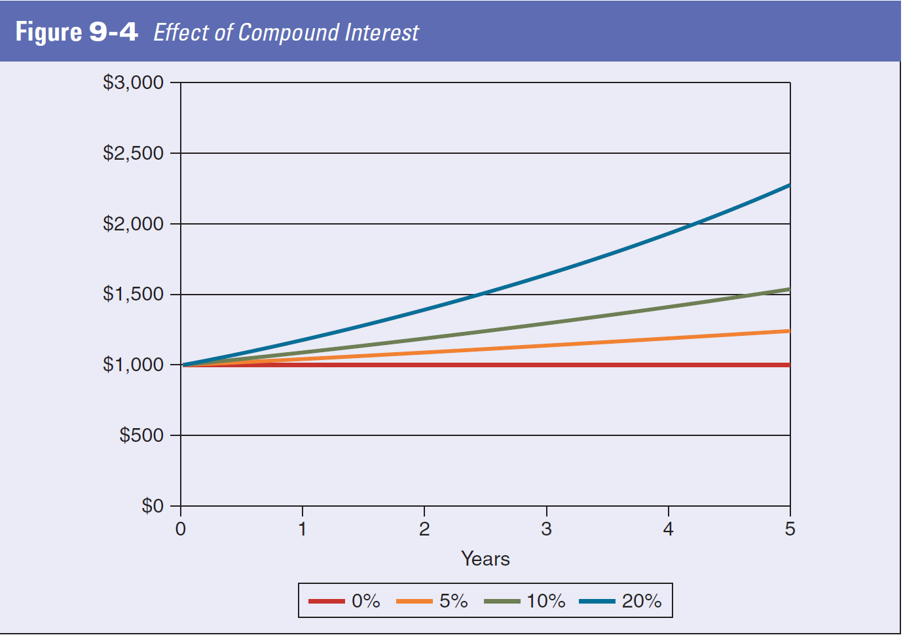
The Future Value of Money

Slide 33
The Present Value of Money
Your money is worth more to you when it is in your hand for three reasons:

Slide 34
The Present Value of Money
present value - what the future amount of an asset or other investment is worth at face value discounted back to the present.
Your money is worth more to you when it is in your hand for three reasons:
Inflation. When prices rise, a dollar tomorrow will buy less than a dollar does today.
2. Risk. When you put money into an investment, there is always some risk of losing it.
3. Opportunity. When you put money into an investment, you are giving up the opportunity to use it for what might be a better investment.

Slide 35
Taxes
Another factor that affects cash flow for a business is taxes.
Like other creditors, tax-levying bodies expect payment in a timely fashion.
More importantly, tax payments must be kept current, because some delinquencies can result in business closure and substantial personal penalties.

Slide 36
Cash Flow and Taxes
self-employment tax - federal tax that business owners are assessed on wages paid to themselves.
sales tax - an assessment levied by governments on purchases and collected by merchants.
Once your business begins making a profit, you will have to pay taxes on those profits either through your corporation or directly through personal resources, whether or not you have a positive cash flow.
As an employer, you will collect and pay all employment taxes to the appropriate government entities.
Notes:
The federal government is financed largely by personal and corporate income taxes.

Slide 37
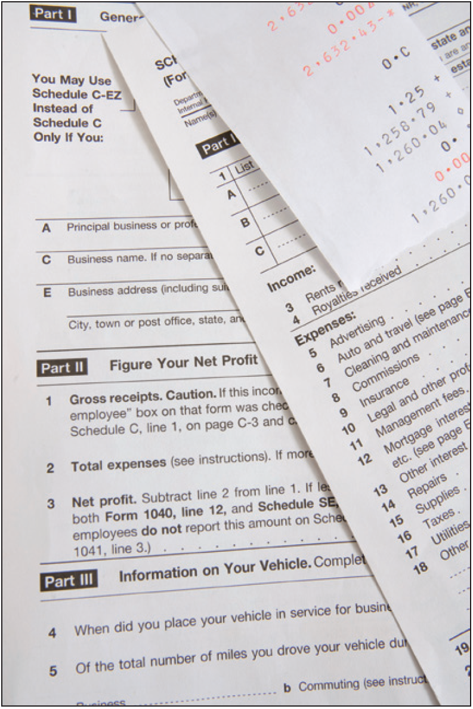
Filing Tax Returns
Corporate, partnership, and individual income tax and self-employment tax returns must be filed (mailed or submitted online) to the U.S. Internal Revenue Service (IRS) by specific dates each year.
If you file late, you may have to pay penalties and interest.
You can check the IRS Web site at http://www.irs.gov for deadlines, instructions, and forms.
File appropriate tax returns for your business
Notes:
The tax code is extremely complex.

Slide 38
Tax Issues for Different Legal Structures
The legal structure best suited to a business depends on a number of variables, which will be discussed later in this text.

Slide 39
Make Tax Time Easier by Keeping Good Records
You and your tax preparer will have an easier time if you keep accurate records throughout the year.
Mistakes on your tax return, or just the luck of the draw, could cause the IRS to audit you.
One of the best investments you can make is to hire a top-notch small business tax accountant or attorney as a consultant.
Organization is critical!

