Slide 1
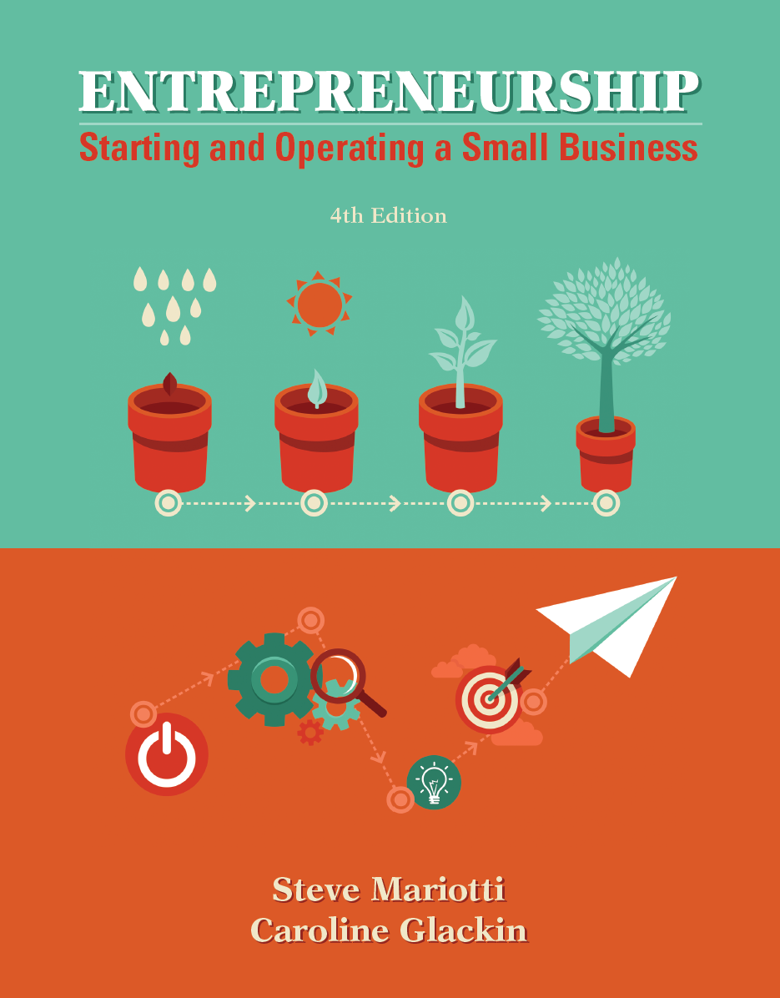
Chapter 7 Understanding and Managing Start-Up, Fixed, and Variable Costs

Slide 2
Chapter Learning Objectives
1. Calculate the investment required for business start-up.
2. Assess the variable costs of starting a business.
3. Analyze your fixed operating costs and calculate gross profit.
4. Select financial record keeping for your business.

Slide 3
What Does It Cost to Operate a Business?
To run a successful business, you will need to keep track of your costs and have more cash coming in than going out.
A business can make a profit only if the selling price per unit is greater than the cost per unit.
A litmus test for profitability is the economics of one unit (EOU), as discussed in prior chapters. It tells an entrepreneur if the business is earning a profit on each individual unit.
Many costs are associated with the establishment and growth of a small business.

Slide 4
Start-Up Investment
seed capital (start-up investment) - the one-time expense of opening a business.
There is another critical cost to discuss before establishing accounting records for your business.
We have talked about the costs of operating a business, but what about the money required to start the business?
In a restaurant, for example, start-up expenses would include stoves, refrigeration, food processors, tables, chairs, utensils, and other items that would not be replaced very often.

Slide 5
Start-Up Investment
For a hot dog stand, the start-up investment list might look like this:
Beginning inventory (hot dogs, mustard, buns, etc.) | $50
Business cards and flyers | 150
Business licenses (city and state) | 200
Hot dog cart | 2,500
Cash box and other | 100
Total start-up investment without contingency | $3,000
Contingency @ 10% of start-up investment | 300
Total start-up investment with contingency | 3,300

Slide 6
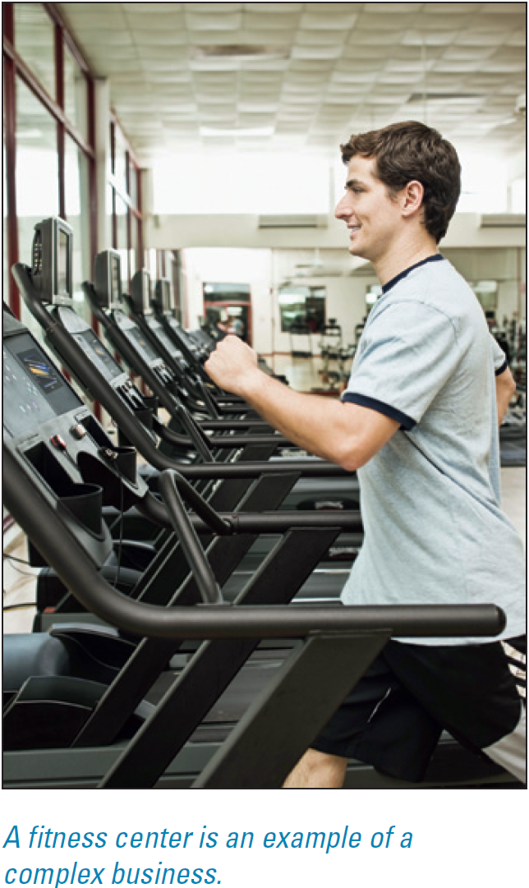
Start-Up Investment
For a more complex business, like a 24-hour franchise fitness center opening in leased space, the items would be broken down into greater detail in order to secure quotations on prices.
For example, each piece of equipment would be identified and a quote secured, assuming the franchisor does not have a preset package of equipment that a franchisee must purchase.

Slide 7
Start-Up Investment
prototype - a model or pattern that serves as an example of how a product would look and operate if it were produced.
For a manufacturing business, developing a prototype for the item being manufactured may be a major start-up cost, perhaps totaling in the millions.
Companies that specialize in creating prototypes can be found in the Thomas Register of American Manufacturers.

Slide 8
Brainstorm to Avoid Start-Up Surprises
Before starting your business, try to anticipate every possible cost by analyzing all components and possibilities.
Talk to others in your industry and ask them what start-up costs they failed to anticipate.
Research industry information and obtain quotations from potential suppliers.

Slide 9
Keep a Reserve Equal to One-Half the Start-Up Investment
cash reserve - emergency funds and a pool of cash resources.
Entrepreneurs must be prepared for the unexpected; the only good surprise is no surprise.
The reserve will provide a moderate cushion of protection if you need it.
Having a cash reserve will also allow you to take advantage of opportunities.

Slide 10
Predict the Payback Period
payback period - estimated time required to earn sufficient net cash flow to cover the start-up investment.
When compiling and analyzing start-up costs, one consideration will be how long it will take for you to earn back your start-up investment.
Payback =
Start-Up Investment
Net Cash Flow per Month

Slide 11
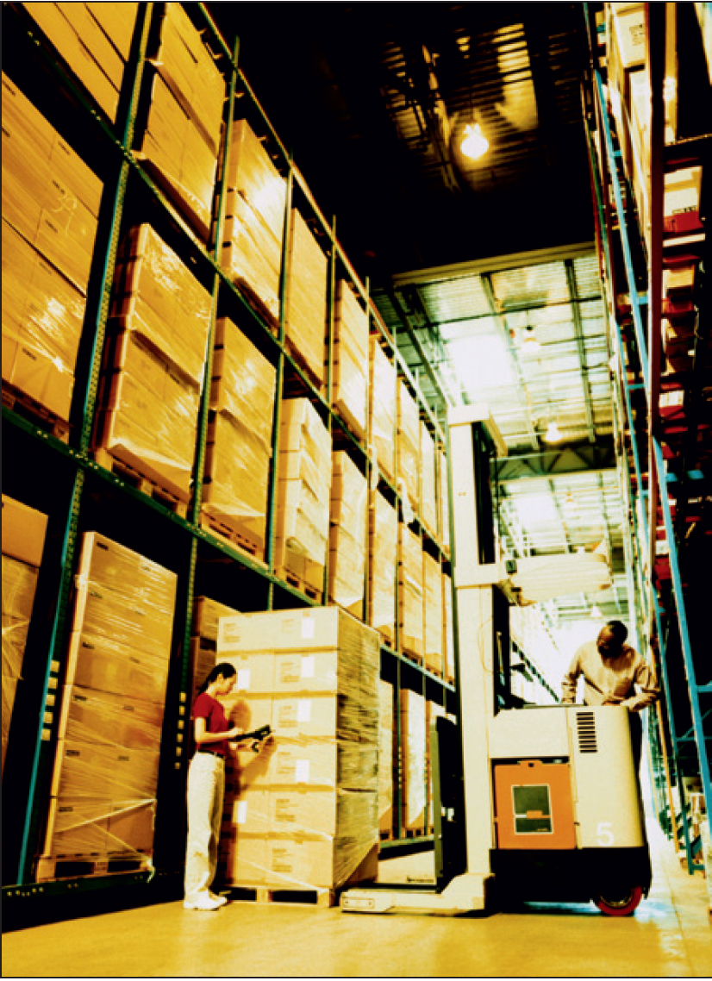
Predict the Payback Period
Knowing the payback period is important for a firm, so that the time horizon is known and timing of funds availability is clear.
However, the payback period does not take into consideration future earnings, opportunities for alternative investments, or the overall value of the company.
It is based on net cash and is a good indicator of the time needed to earn back initial disbursements.

Slide 12
Estimate Value
Financial managers use several tools to determine the current value of proposed investments, of which net present value (NPV) is widely accepted as the most theoretically sound.
Entrepreneurs can use such a technique to consider the financial returns on their initial investment.
If the NPV calculation yields a positive value, the investment will result in a positive return based on the owner’s (and investors’) required rate of return.

Slide 13
Estimate Value
NPV calculation for a business with an initial investment of $1.5 million.

Slide 14
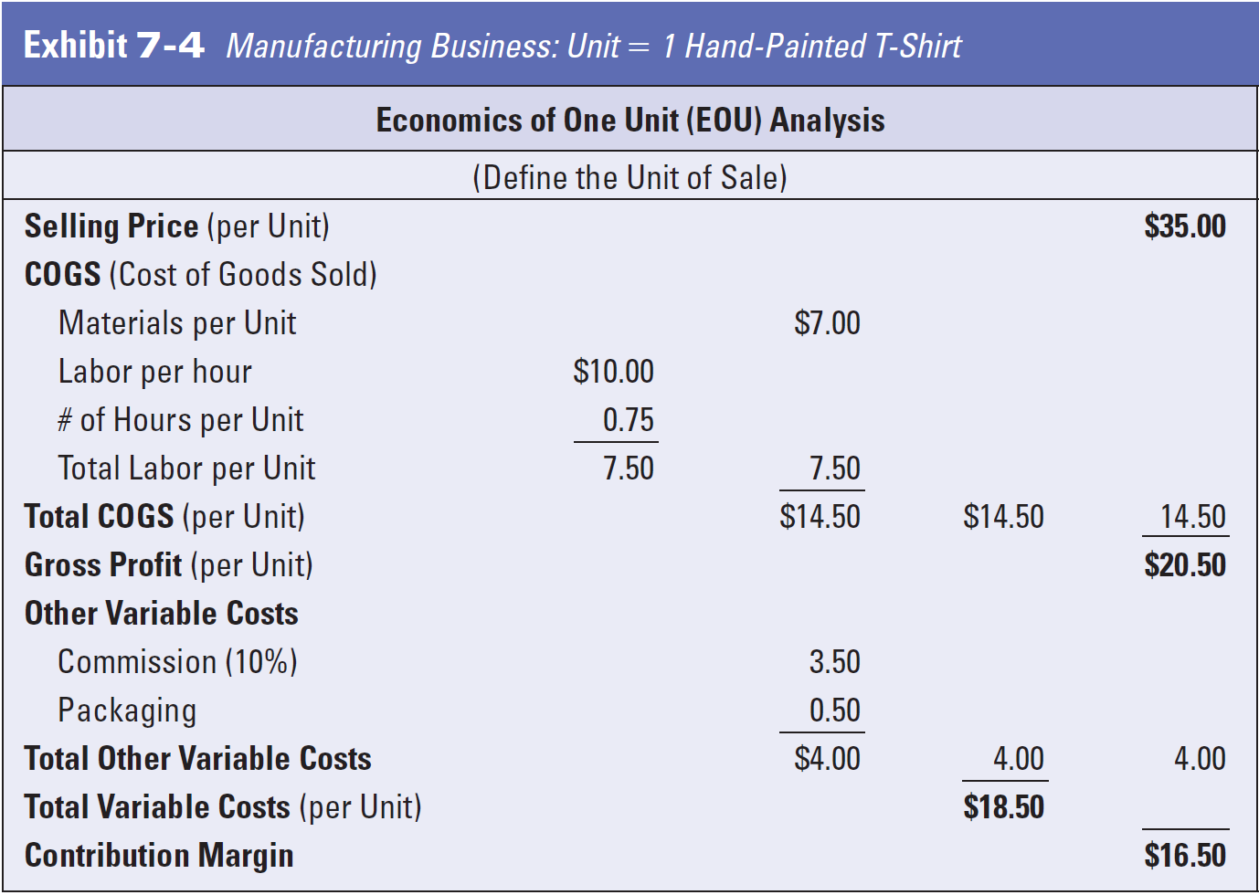
Estimate Value

Slide 15
Fixed and Variable Costs: Essential Building Blocks
Small business owners divide their costs into two categories:
variable costs - expenses that vary directly with changes in the production or sales volume.
fixed costs - expenses that must be paid regardless of whether sales are being generated.

Slide 16
Fixed and Variable Costs: Essential Building Blocks
Variable costs change with production and sales. They fall into two subcategories:
Cost of goods sold (COGS) or cost of services sold (COSS). Each is associated specifically with a single unit of sale, including:
The cost of materials used to make the product (or deliver the service)
The cost of labor used to make the product (or deliver the service)
2. Other variable costs, including:
Commissions or other compensation based on sales volume
Shipping and handling charges

Slide 17
Calculating Critical Costs
To determine the most important factors with respect to costs in your business, you can calculate critical costs.
This will help you to determine profitability and the factors that can and cannot be easily changed to impact your profits and cash flow.

Slide 18
Calculating Total Gross Profit (Contribution Margin)
contribution margin - gross profit per unit—the selling price minus total variable costs plus other variable costs.
You can use EOU to calculate whether and by how much you will come out ahead on your per-unit costs for each sale.
By using the EOU, you can figure the gross profit per unit (contribution margin per unit sold).

Slide 19
Calculating EOU When You Sell Multiple Products
Most businesses sell more than a single product, and they can also use EOU as a value measure of product profitability.
A business selling a variety of products has to create a separate EOU for each item to determine whether each is profitable.
When there are many similar products with comparable prices and cost structures, a “typical” EOU can be used.

Slide 20
Calculating EOU When You Sell Multiple Products
inventory costs - expenses associated with materials and direct labor for production until the product is sold.
What if each unit of sale is made up of a complex mix of materials and labor?
The EOU can still help you figure the COGS, other variable costs, and gross profit for the product, although the process will be more complex.

Slide 21
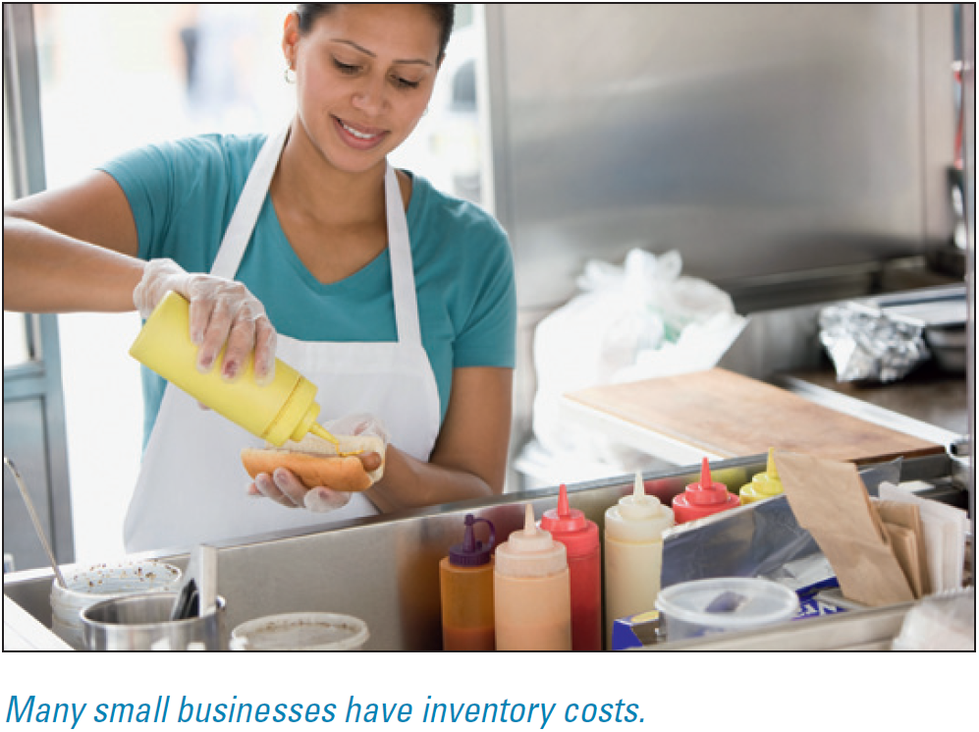
Calculating EOU When You Sell Multiple Products
Example: Denise sells sandwiches from her deli cart downtown on Saturdays. She sells each for $5.
The materials and labor that go directly into making one sandwich are the COGS.
The costs of the materials and direct labor for production are called inventory costs until the product is sold.

Slide 22
Fixed Operating Costs
fixed operating costs - expenses that do not vary with changes in the volume of production or sales.
Fixed operating costs do not change based on sales activity levels; therefore, they are not included in the EOU.
A sandwich shop has to pay the same rent each month whether it sells one turkey sandwich or a hundred.
However, the owner of the shop can change the cost of the rent by moving or can increase or decrease the advertising budget, for example.

Slide 23
Fixed Operating Costs
It is easier to remember several of the most common categories of fixed expenses by remembering the phrase:
I SAID U R + “Other FXs”
This stands for:
Insurance
Salaries (indirect labor—managers, office staff, sales force)
Advertising
Interest
Depreciation
Utilities (gas, electric, telephone, Internet access)
Rent
Other Fixed eXpenses

Slide 24
Fixed Operating Costs
depreciation - the percentage of value of an asset subtracted periodically to reflect the declining value.
It is a method used to expense (list as an expense on the income statement) costly pieces of equipment.
This issue is addressed by depreciation, which spreads the cost of an item purchased by a business over the time during which it will be in use.
If the computer server is expected to have a useful life of more than one year, then the full price should be shown as an asset and then expensed according to federal tax law and traditional accounting practice.

Slide 25
Fixed Operating Costs Do Change over Time
If you pay your restaurant manager $3,600 per month in salary, you will have to pay that amount whether the restaurant sells one meal or a thousand. The cost is fixed.
Fixed operating costs do change over time; at some point you may give your restaurant manager a raise.
Or, you might hire a new manager at a higher salary.

Slide 26
Fixed Operating Costs Do Change over Time
The word fixed does not mean the cost never changes, just that it does not change in response to units of production or sales over a relevant range of production. For instance:
Advertising. The cost of advertising will change based on decisions the entrepreneur makes about how much to spend to reach the consumer, not because of current sales (although low sales may provoke an increase in advertising).
Heating and cooling costs. The price of heating and cooling goes up or down based on the weather and utility prices, not on the amount of revenue the business earns.

Slide 27
Allocate Fixed Operating Costs Where Possible
net profit - the remainder of revenues minus fixed and variable costs and taxes.
Business owners like to know how much of their revenue will have to be used to cover the cost of goods sold and other variable costs.
Fixed operating costs can be dangerous, because they have to be paid whether or not the business has made a gross profit.
The entrepreneur should be careful about taking on fixed costs, but does not have to worry as much about variable costs because, if sales are low, the variable costs will be low as well.

Slide 28
The Dangers of Fixed Costs
If a business does not have enough sales to cover its fixed costs, it will lose money.
If losses continue and there are not sufficient cash reserves, the business will have to close.
As we have discussed, fixed costs are dangerous because they must be paid whether or not the business is making enough sales to cover them.

Slide 29
Using Accounting Records to Track Fixed and Variable Costs
Keeping accurate records of the money flowing in and out of your business will be critical to success.
Before you can create financial statements, however, you must be able to keep track of your daily business transactions.
If you develop record keeping into a habit, you will be well ahead of many businesspeople who get careless when it comes to keeping good records consistently.
Notes:
The systematic recording, reporting, and analysis of the financial transactions of a business is called accounting.

Slide 30
Three Reasons to Keep Good Records Every Day

Slide 31
Reasons to Keep Good Records Every Day
audit - a review of financial and business records to ascertain integrity and compliance with standards and laws, particularly by the U.S. Internal Revenue Service.
Another good reason to keep good records is to “Take advantage of tax deductions.”
U.S. tax law allows business owners to deduct many expenses from their taxes.
These deductions, or write-offs, are reductions in the gross amount on which taxes are calculated, and they will save you money.

Slide 32
Use Accounting Software
There are many excellent computer software programs on the market to help small business owners keep good records and generate financial statements and analytical reports.
These include Intuit QuickBooks, Microsoft Office Accounting, and Peachtree Accounting.
The URLs for the major accounting software companies are:
- Microsoft, http://www.microsoft.com
- QuickBooks, http://www.quickbooks.com
- Peachtree Software, http://www.peachtree.com

Slide 33
Use Accounting Software
Some software companies offer free products that you can try for a limited time or that are free but do not have as many features as the for-sale versions.
This is a great way to try out accounting and other business software before you buy.
The costs of these packages have dropped considerably over time, making them a better value for even the smallest companies.
Notes:
Take the time to find the software best suited to your needs.

Slide 34
Keep Receipts and Invoices
For a very small business, it is possible to work with a manual system, including a journal and files for storing records of your transactions.
As your business grows, you can add organizational tools.
However, if you are intending to grow the business beyond a handful of transactions per week, you should use a good computer-based system from the start.

Slide 35
Keep Receipts and Invoices
Whatever system you elect to use, basic records must be kept.
A receipt is a slip of paper or electronic document with the date and amount of the purchase on it. Always get a receipt for every purchase you make.
Issue a receipt for all sales, if you have a retail business, whether you create it manually or from your point-of sales system.
An invoice, or bill or statement, shows the product or service sold and the amount the customer is to pay. Your invoice becomes the customer’s receipt.
Keep a copy of each invoice in an organized fashion (i.e., numerically, alphabetically, or in order by date), and record all payments promptly.

Slide 36
Keep at Least Two Copies of Your Records
Always keep a copy of your financial records in a location away from your business, preferably in a fire-retardant safe or concrete-lined file cabinet.
If you are using software, back up your data and keep the media (CD, jump drive, external hard drive, etc.) in a different location or back up to a cloud storage location.
By having regular off-site backups you will still have your financial records, if anything happens to your journal or your business site.
Notes:
Follow federal records retention rules with these documents.

Slide 37
Use Business Checks for Business Expenses
Open a checking account to use only for your business.
It is inadvisable to comingle your personal and business funds, regardless of your business type or size. Two key things to remember:

Slide 38
Cash versus Accrual Accounting Methods
cash accounting method - a system wherein transactions are recorded when cash is paid out or received.
accrual method - accounting method wherein transactions are recorded at the time of occurrence, regardless of the transfer of cash.
Financial accounting for businesses is divided between the cash and accrual methods, and each company may select which one it will use.
Small businesses use either method, whereas large firms almost invariably use accrual accounting.

Slide 39
Recognizing Categories of Costs

