Slide 1

Chapter 6
Smart Selling and Effective
Customer Service

Slide 2
Chapter Learning Objectives
1. Explain the importance of selling based on benefits.
2. Demonstrate principles of selling to prepare effective
sales calls.
3. Plan successful sales calls.
4. Analyze and improve sales calls.
5. Recognize and arrange excellent customer service.
6. Define customer relationship management and interpret
its value.

Slide 3
Selling Skills Are Essential to Business Success
Personal selling is dealing with potential customers face to face and trying to convince them to make a purchase.
Salespeople often become successful entrepreneurs because they learn to listen to what the customer needs and wants on a daily and personal basis.

Slide 4
Selling Skills Are Essential to Business Success
Successful salespeople that became a business success
Ray Kroc, founder of McDonald’s was selling milkshake machines when he was inspired to turn the McDonald brothers’ hamburger restaurant into a national operation.
Aristotle Onassis was a wholesale tobacco salesman before becoming a multimillionaire in the shipping business.
King C. Gillette was a traveling salesman when he invented the safety razor.
W. Clement Stone started out selling newspapers at the age of six before going on to build a great fortune in the insurance industry.
Mary Kay Ash was in direct sales for 25 years before she cofounded Mary Kay Cosmetics with her son.

Slide 5
Selling Is a Great Source of Market Research
If a customer is dissatisfied, it is often the salesperson who hears the complaint.
In that sense, selling is a constant source of valuable market research.
Even if you have never sold anything in your life, you can make yourself into a fantastic salesperson.
Everyone has tried on occasion to persuade (“sell”) others to agree to something or to act a certain way.
Notes:
Personal selling will give you opportunities for ongoing market analysis.

Slide 6
Selling Is a Great Source of Market Research
Being face to face with customers and trying to sell your product may make you uncomfortable, but think of rejections as learning experiences.
Personal selling will give you opportunities for ongoing market analysis.
You will learn to look forward to sales encounters throughout your entrepreneurial career.
Notes:
Personal selling will give you opportunities for ongoing market analysis.

Slide 7
The Essence of Selling Is Teaching
The creative art of selling is teaching the customer how the features of your product or service are benefits.
Inexperienced salespeople make a common mistake: They think telling the customer about the features of a product will sell it.
The essence of selling is teaching how and why the outstanding features of your product or service will benefit your customers.

Slide 8
The Principles of Selling
Every entrepreneur has to be able to identify the benefits his or her product can provide and to make an effective sales call.
Entrepreneurs sell constantly, not just to customers but to potential investors, bankers, and people they want to hire.

Slide 9
The Principles of Selling
Commit the following selling principles to memory and you will lay the groundwork for becoming a successful salesperson.
These principles apply to any product or service:
Make a Good Personal Impression
Know Your Product or Service
Believe in Your Product or Service
Know Your Field
Know Your Customers

Slide 10
The Principles of Selling
These principles apply to any product or service (cont.):
Prepare Your Sales Presentation
Think Positively
Keep Good Records
Make No Truly “Cold Calls”
Make an Appointment
Treat Everyone You Sell to Like Gold

Slide 11
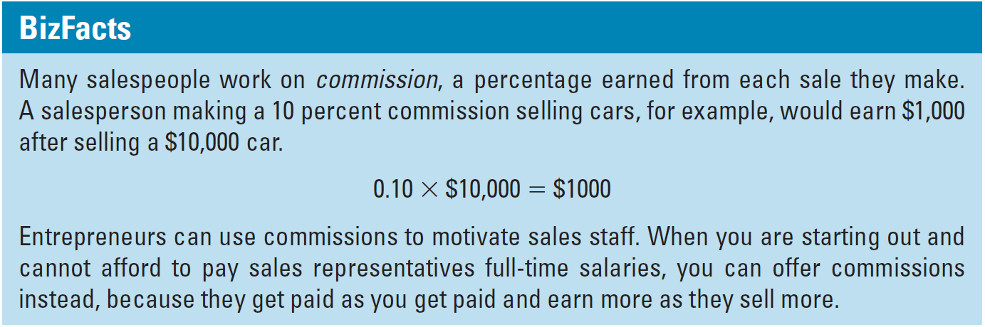
Selling Skills Are Essential to Business Success

Slide 12
The Sales Call
A sales call is an appointment with a potential customer to explain or demonstrate your product or service. During the sales call, you will want to do the following:
make the customer aware of your product or service,
make the customer want to buy that product or service, and
make the customer want to buy it from you.

Slide 13
Electronic Mail, Blogs, and Social Networks
In today’s technology-savvy environment, there are multiple methods for communicating with sales prospects. Among these options are e-mail, social networks, and blogs.
spam - unwanted Internet advertisements or e-mails.
lurk - reading messages and getting a feel for discussions on a Web site, newsgroup, or the like, without participating in the online conversation.

Slide 14
Electronic Mail, Blogs, and Social Networks
Sending e-mail or posting messages to social networks or blogs can help contact sales prospects and keep in touch with the customers you already have, but you must use these methods carefully.
If done correctly, becoming active in a social network such as LinkedIn or Facebook can lead to qualified prospects.
Let’s say you sell photographic supplies and you hear about an interesting social network for photographers, such as FotoUp. Do not blitz it with ads.

Slide 15
Prequalify Your Sales Calls
prospect - a person or organization that may be receptive
to a sales pitch.
Before calling to make an appointment for any sales call, identify and list your prospects, the people and/or organizations that may be receptive to your sales pitch.
Include everyone you can imagine, but then go through it carefully and ask:
Is this individual in my market?
Does he or she need my product?
Will my product remove a problem or source of “pain” or improve the individual’s life?
Can he or she afford it?

Slide 16

Focus on the Customer
During each call, focus on one thought: What does this customer need? Visualize your product or service fulfilling that need.
Direct selling experience can be a great foundation for an entrepreneur.

Slide 17
The Eight-Step Sales Call

Slide 18
Three Call Behaviors of Successful Salespeople

Slide 19
Analyze Your Sales Calls to Become a Star Salesperson
Every sales call is an opportunity to improve your selling skills—even if you did not make a sale. The star salesperson analyzes each call by asking:
Was I able to get the customer to open up to me? Why or why not?
Did I do or say anything that turned the customer off, or was offensive, or caused her to disbelieve me?
Which of my questions did the best job of helping the customer focus on her challenges? How can I ask better questions?

Slide 20
Analyze Your Sales Calls to Become a Star Salesperson
The star salesperson analyzes each call by asking:
Was I able to make an honest case for my product/service being the one that could solve the customer’s problem?
Did I improve my relationship with this person during the call?
Notes:
When you analyze your selling at this level of detail, you will discover important opportunities for learning and improving your selling skills.

Slide 21
Turning Objections into Advantages
Classify objections into six categories and making a list of every objection you have ever heard and then grouping them under the following headings:

Slide 22
Use Technology to Sell
Examples include:
A multimedia demonstration or presentation of your product
A Web site customers can visit to obtain updates and product facts, to share ideas, and to find technical data
Use of e-mail, blogs, and social networking to stay in touch with customers
Digital planners and calendars and sales and contact management software to keep prospect lists organized and log sales calls and customer information
Smart phones, tablets, and other technology to place orders and secure immediate responses to customer inquiries
Notes:
Use webinars and audio conferences to educate and introduce technology to sell

Slide 23
Successful Businesses Need Customers
Who Return
Making a sale to a customer is actually only the first step in your relationship with this individual.
Your real goal is not the first sale, but to develop repeat business—customers who will buy from you over and over again.
Successful companies are built on repeat business.

Slide 24
Customer Service Is Keeping Customers Happy
customer service - everything a business does to keep the customer happy.
Here are some suggestions that may work for your business:
Know your customers by name.
Deliver the product or service on time, every time.
Help customers carry their purchases to their vehicles.
Suggest a less expensive product, if it will meet the customer’s need, or offer a recommendation to a source of a product that you do not sell, if it is what they want and you cannot offer a substitute.

Slide 25
Customer Service Is Keeping Customers Happy
Here are some suggestions that may work for your business:
Provide a full refund to any customer who is dissatisfied.
Take time to listen politely and with empathy to complaints.
Provide a toll-free customer-assistance phone line that is easy to use.
Offer product or service information of interest to customers in a nonthreatening manner.

Slide 26
The Costs of Losing a Customer
There will be times when a customer may get angry at you, complain, or make demands that you believe are unreasonable.
In those times, keep in mind four main costs of losing a customer:
Notes:
Have you heard the expression “The customer is always right”?

Slide 27
Customer Complaints Are Valuable
Always acknowledge complaints and criticism and deal with them.
Do not overreact to negative comments and, above all, do not take them personally.
Always tell the truth about any negative aspect of your product or service.

Slide 28
Customer Relationship Management Systems
customer relationship management (CRM) - company-wide policies, practices, and processes a business uses with its customers to generate maximum customer satisfaction and optimal profitability.
CRM affirms that customer service is an aspect of marketing.
Your customer service must reinforce your overall marketing plan.
Through a well-designed and executed CRM system, you are reinforcing and building marketing effectiveness.

Slide 29
Why Does CRM Matter?
Customer relationship management can be the component of your business that makes it a sustainable entity.
The costs of securing new customers are significantly higher than the costs of keeping a repeat customer.
According to the Customer Service Institute, 65 percent of a company’s business comes from existing customers, and it costs five times as much to attract a new customer as it does to keep an existing one satisfied.

Slide 30
Why Does CRM Matter?
Some easy ways to collect market research as part of your customer service for retail businesses include:
Providing a short survey on a stamped postcard listing every item purchased, or directions to a Web site with a survey and reward printed on every receipt.
Asking selected customers to fill out a longer survey—again, offering a discount or prize drawing as an incentive.
Always asking standard questions when completing a sale, such as “Do you have any suggestions on how we could improve our product?”

Slide 31
Components of CRM for the Small Business
CRM has consistent components that may be incorporated across business types and sizes. The SBA offers three Golden Rules for small businesses with respect to CRM.

Slide 32
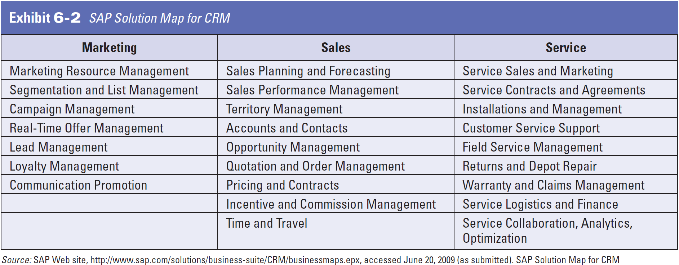
Components of CRM for the Small Business

Slide 33
Components of CRM for the Small Business
The SBA offers further advice on the components of customer care that they translate into five rules.

Slide 34
How Technology Supports CRM
database - a collection of information that is generally stored on a computer and organized for sorting and searching.
The general conception of CRM is that technology can be used to build and maintain customer relationships.
Certainly, as noted, the use of computer technology can have a significant role in CRM, but the system should be inclusive of all forms of relationship management from:
- greeting a customer on the phone,
- in-person, or even on the home page of your Web site,
- to the use of sophisticated software systems.

Slide 35
How Technology Supports CRM
With CRM, customer interactions with all parts of the company are unified and customer information is tracked, analyzed, and used to improve customer satisfaction and business profitability.
It truly is not necessary to invest in a sophisticated CRM software system to use technology to benefit your customer relationships.
You can purchase a database package to create significant gains.

Slide 36
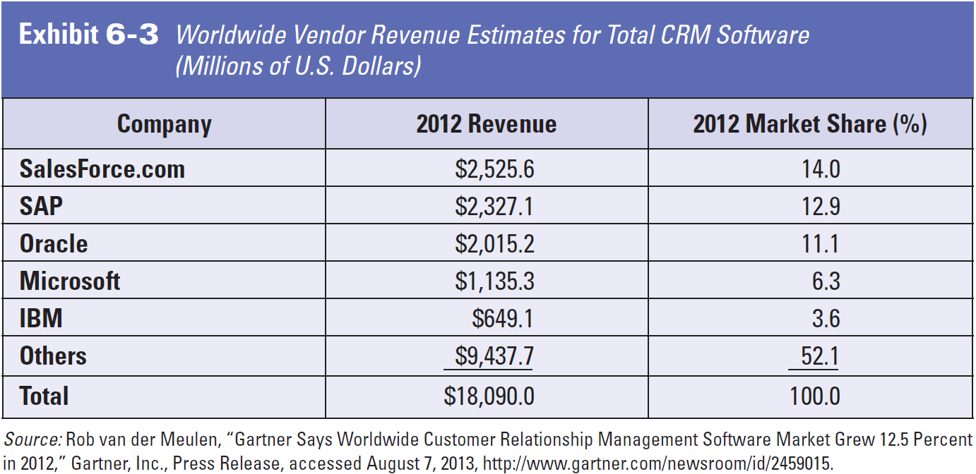
How Technology Supports CRM

Slide 37
How Technology Supports CRM
Create a database on your computer to collect any information you obtain from customers, either by using a package such as Microsoft Access or with a specialized customer software system for your industry.
Your database should include every customer you have ever had, as well as potential ones:
- friends,
- family, and
- other contacts.

Slide 38
How Technology Supports CRM
The database should include contact information:
name, e-mail address, phone and fax numbers, and mailing address,
any preferences or pertinent personal information (e.g., sizes, birthdays, family, hobbies, memberships), and
purchase and payment history.
Also, include any contact information, such as:
- when the contact was made,
- who was involved, what type of contact it was (in
person, telephone, text, social network, or e-mail),
- what was discussed, and
- when to follow up.

Slide 39
How Technology Supports CRM
As your database grows, you can make it more sophisticated by organizing it by region, customer interest, or any number of other variables, so you can send out targeted e-mails.
If you sell gourmet sauces, for example, your notes could tell you whether a customer is interested in hot sauces or dessert sauces.
Use the resources available to you to maximize your culture of focus on the customer and strong customer relationship management.
Notes:
When you add a new hot sauce to your product line, you will know whom to target with an e-mail announcement introducing it, possibly with a special offer.

Slide 40


