Slide 1
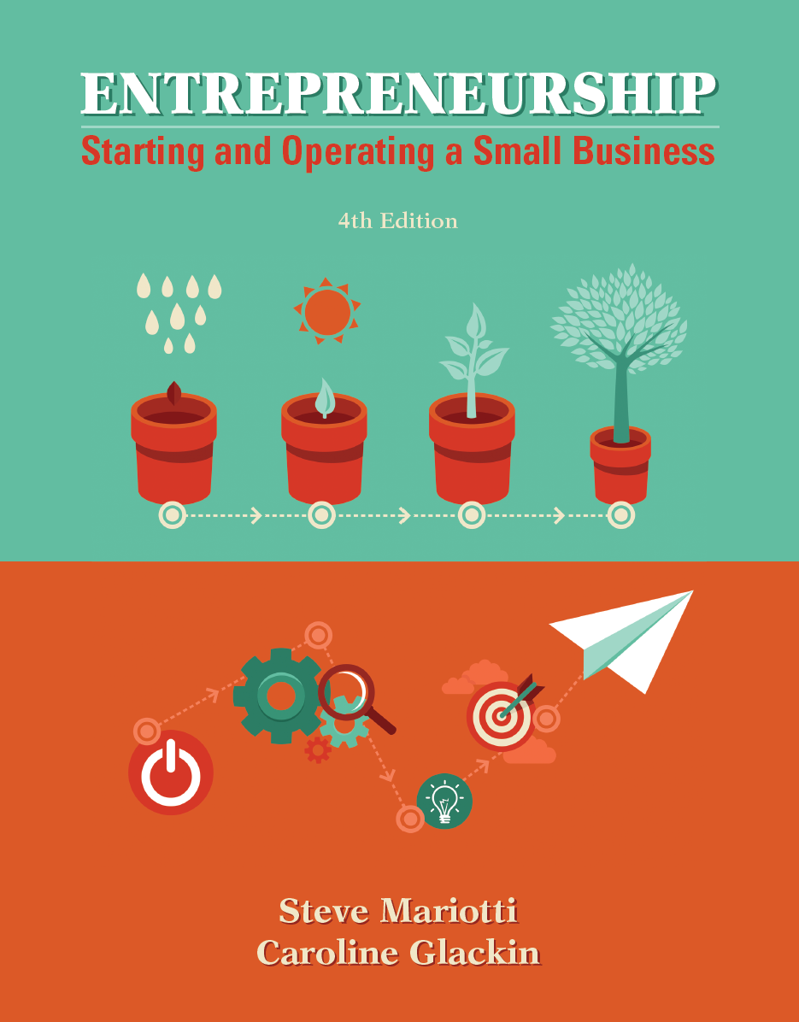
Chapter 5 Developing the Right Marketing Mix and Plan

Slide 2
Chapter Learning Objectives
1. Combine the four Ps—product, price, place, and promotion— into a marketing mix.
2. Choose the attributes of your product or service.
3. Price your products for success.
4. Find the best location for maximum efficiency and
effective distribution.

Slide 3
Chapter Learning Objectives
5. Select the mix of promotion to use for your business.
6. Add the fifth P, philanthropy, to your business.
7. Recognize the importance of a marketing plan.
8. Apply breakeven analysis to evaluate your marketing plan.

Slide 4
The Four Marketing Factors
promotion - the use of advertising and publicity to get a marketing message to customers.
The four Ps—together will communicate your marketing vision and competitive advantage to your customer.

Slide 5
Product: What Are You Selling?
Your business, no matter how humble its beginnings, may have the potential to grow into a multimillion-dollar company, so it is important that you think through every step of its development.
How you define and refine your product or service will have a tremendous impact on your ability to grow.

Slide 6
Create Your Total Product or Service Concept
A product is something that exists in nature or is made by human industry, usually to be sold, whereas a service is intangible—work, skills, or expertise provided in exchange for a fee.
Your product will be defined by its physical attributes (e.g., size, color, weight, shape), its performance characteristics (e.g., speed, strength, efficiency, durability), and its pricing, branding, and delivery.
The selection of your product or service and its branding will be a critical part of your marketing mix.

Slide 7
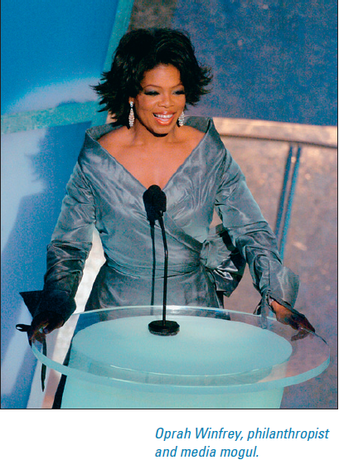
Focus Your Brand
The key to building a successful brand is to focus tightly on the primary benefit you want customers to associate with your business.
Even entertainers can become a brand.
Oprah Winfrey is among the most recognized and wealthiest celebrities in the world today.

Slide 8
Ford’s Costly Failure: The Edsel
One of the most notorious examples of a product whose failure was caused by lack of focus is the car Ford introduced in 1958, the Edsel.
Ford tried to include every kind of gadget and design element the company thought consumers might possibly want in a car.
Even millions of dollars of promotion will not make consumers buy a product they do not want.

Slide 9
Ford’s Focus on Success: The Mustang
Ford learned from the Edsel mistake, however. When it introduced the Mustang in 1964, it focused very clearly on a target market of people from 20 to 30 years old who wanted a powerful car.
Everything about the Mustang, from its design to the colors it came in, was focused on appealing to young drivers.
Interestingly, Ford tried to offer some luxury and four-door versions of the Mustang a few years later.
Sales dropped, probably because the brand had started to lose focus.
Notes:
The Mustang remains one of Ford’s stronger sellers.

Slide 10
How to Build Your Brand
You can build your own brand by following these steps:
Choose a business name that is easy to remember, describes your business, and helps establish mindshare.
Create a logo that symbolizes your business to the customer.
Develop a good reputation.
Create a brand personality.
Communicate your brand personality to your target market.

Slide 11
How to Build Your Brand
logo - short for logotype, a company trademark or sign.
trademark - any word, name, symbol, or device used by an organization to distinguish its product.

Slide 12
How to Build Your Brand
Always present yourself and your business in such a way that people will have confidence in your product or service:
Provide a high-quality product or service.
Maintain the highest ethical standards.
Define your product or service clearly. Focus.
Treat your employees well.
Make all your advertisements positive and informative.
Associate your company with a charity.
Become actively involved in your community.

Slide 13
Price: What It Says about Your Product
As reported by author Jay Conrad Levinson, a study of consumers in the furniture industry found that price came ninth when they were asked to list factors affecting their decision to make a purchase.
Confidence in the product was the number one influence on buying patterns, and quality was number two. Service was third.
Therefore, entrepreneurs should consider not only the economics but also the psychology of pricing.
Notes:
Studying the pricing strategies of your competitors will tell you a lot about the importance of psychological pricing in your market.

Slide 14
Strategies and Tactics for Effective Pricing
Pricing strategy is not a one-size-fits-all proposition.
As you define the marketing strategy for your company, including your target market(s), competitive advantages, and overall marketing mix, the range of appropriate pricing strategies emerges.
However, at its point of introduction, it may have to be priced in line with the competition until it is established as the market leader.
At the same time, mass-market products may be priced at a lower level.

Slide 15
Strategies and Tactics for Effective Pricing
Common pricing strategies include the following:
value pricing - “more for less” strategy that balances quality and price.
prestige pricing - the pricing strategy in which a firm sets high prices on its products or services to send a message of uniqueness or premium quality.
cost-plus pricing - takes the organization’s product cost and adds a desired markup.
markup pricing - a cost-plus pricing strategy in which a predetermined percentage is applied to a product’s cost to obtain its selling price.

Slide 16
Strategies and Tactics for Effective Pricing
penetration pricing - a pricing strategy that uses a low price during the early stages of a product’s life cycle to gain market share.
skimming pricing strategy - seeks to charge high prices during a product’s introductory stage, to take early profits when the product is novel and has few competitors, and then to reduce prices to more competitive levels.
meet-or-beat the competition pricing - constantly matching or undercutting the prices of the competition.

Slide 17
Strategies and Tactics for Effective Pricing
follow-the-leader pricing - a pricing strategy that is similar to a meet-or-beat-the competition method, but uses a particular competitor as the model for pricing.
personalized pricing - a dynamic pricing strategy in which the company charges a premium above the standard price for a product or service to certain customers, who will pay the extra cost.
variable pricing strategy - provides different prices for a single product or service.
price lining - the process of creating distinctive pricing levels.

Slide 18
Place: Location, Location, Location!
Regarding place, the type of business you are running will influence your choice of location and your distribution system for reaching out from that place to your customers.
Wal-Mart was the first mass-merchandise store to choose locations in rural and semirural markets.
Wal-Mart has done an efficient job of choosing locations that are ideal for attracting potential customers who are underserved by similar retailers.
This strategy has been so successful that other stores now seek to be located near a Wal-Mart.

Slide 19
Place: Location, Location, Location!
Of course, the Internet has made it possible for an entrepreneur to start a retail business out of her home and reach customers all over the world.
This has led to the belief that online stores can forgo the expense of renting a location that caters to foot traffic.
For nonretail businesses, the key to location might be cost or convenience rather than proximity to the market.
The Internet is making it easier for people who provide services—such as graphic or Web-site design, writing/editing, or accounting—to start businesses at home.

Slide 20
Key Factors in Deciding on a Location
The key factors in deciding on a location
Considerations include the following:
access for customers
access to suppliers
climate and geography
convenience
cost of facilities (rent, construction, and the like)
demographics
economic conditions and business incentives
governmental regulations and laws, including environmental impact
labor pool
proximity to competitors
visibility

Slide 21
Promotion: Advertising + Publicity
Promotion is the use of advertising and publicity to get your marketing message out to your customers.
Advertising, as discussed in Chapters 2 and 4, is paid promotion that is intended to generate increased sales of your product or service.
Publicity is free mention of a company, person, event, product, or service in media outlets, such as newspapers and magazines or on radio or television.

Slide 22
Use Integrated Marketing Communications for Success
Marketing communications promotes your business to your current and prospective customers and to those who influence purchasing and sales decisions.
All communications include an originator (source), a specific message (overt and/or subliminal), a channel for dissemination, and a target (receiver).
Promotion has expanded beyond advertising, sales promotions, and personal selling to include database marketing, sponsorships, direct marketing, alternative marketing, e-active marketing, and public relations.

Slide 23
Reinforce the Company’s Unique Selling Proposition
Your unique selling proposition (USP) becomes valuable to your organization when it is successfully communicated to your target customers and motivates initial and repeat purchasing decisions.
A unique selling proposition that is not successfully communicated is worthless.
A unique selling proposition that is successfully communicated can be priceless.

Slide 24
Promotional Planning
Vast quantities of promotional material bombard consumers and businesses daily, frequently creating unwanted clutter and noise.
Successful promotions are the result of solid planning.
For promotional planning to be integrated in the operations of your organization, all of the business’s components will need to have meaningful roles in the process.

Slide 25
Determine a Promotional Budget

Slide 26
Determine a Promotional Budget
There is no single correct way to determine your promotional budget. However, several methods can be used in combination:

Slide 27
The Advertising Advantage
The topic of advertising and advertising management has certain glamour about it.
The popular media have portrayed advertising as a fast-paced, highly creative, fun, and lucrative career choice.
At the same time, advertising itself has often been shown to be false, manipulative, deceitful, and coercive.
As with any aspect of your business, advertising has specific objectives that make it an integral component of the marketing mix.

Slide 28
The Advertising Advantage
The objectives of advertising and its management should reflect those of a comprehensive promotional plan, and successful advertising will achieve them all:
building brand and image,
providing information,
persuading,
stimulating action, and
reinforcing the purchasing decision.

Slide 29
Types of Advertising
institutional advertising - provides information about an organization, rather than a specific product, and is intended to create awareness about a firm and enhance its image.
product advertising - is designed to create awareness, interest, purchasing behavior, and post-purchase satisfaction for specific products and services.

Slide 30
Media Planning and Buying: Focus on Your Customer
An effective advertisement for a business typically concentrates on the benefit a product or service provides to the customer.
What are their reading, viewing, and listening patterns? What appeals to them? What doesn’t?
Avoid wasting money in outlets in which the audience won’t be interested in your product or service.
Combine this common-sense approach with solid research to maximize advertising effectiveness.

Slide 31
Marketing Materials Should Reinforce Your Competitive Advantage
All promotional items for your business should reflect and reinforce your marketing vision, which in turn will reinforce your competitive advantage.
They should include the name of your business, your logo, and a slogan, if you have one.
In fact, you will have a much stronger impact if all your business materials are tied together with a strong, coordinated image.
This should extend beyond your logo into the format, font style, colors, and look of your materials.

Slide 32
Sales-Promotion Solutions
Sales promotions provide another set of tools to add to the mix.
Various efforts to increase sales volume by specified levels, which either reward purchases or provide discounts, can be effective for both consumer and business-to-business marketing.
Sales-promotion solutions do not have to be complex or sophisticated to work.

Slide 33
When to Use Promotional Tools
Promotional tools are best used when the strategy calls for a highly targeted, time-limited boost in response.
They can be excellent ways to encourage new-product trials and to raise seasonal performance.
Contests and sweepstakes are a way of securing product engagement and, potentially, repeat sales.
Sampling brings the product or service message to life for the customer through experience.
Notes:
Coupons require the customer to actively seek out your product on the shelves or to contact you for the product or service.

Slide 34
Advertising Specialties
The strategic inclusion of specialty items can be an effective sales promotion tool.
The best giveaways are those that are useful, such as pens, on which prospective customers will see your business name and contact information.
Visit wholesalers, or search online to investigate discount prices on quantities of calculators, watches, pens, or other appropriate items.

Slide 35
Trade Show Exhibits
The use of trade show exhibits is a proven promotional strategy for business-to-business companies and can also succeed for certain types of consumer marketing.

Slide 36
Trade Show Exhibits

Slide 37
Mall Carts or Kiosks
For many seasonal businesses, or businesses that are working to create full-scale retail operations, mall carts or kiosks may prove effective.
Signing a multiyear lease for a retail store is not likely to make sense for a seasonal business such as a Christmas or Halloween operation.
Sometimes such businesses can find vacant retail spaces to rent for just a season, or they can partner with others to rotate in and out of a store.
In other situations, they can create a business model of changing seasonal inventory and focus.
Notes:
For many business owners, these options are not practical or desirable, and having a temporary retail location is preferable.

Slide 38
Alternative Marketing
guerilla marketing - original, unconventional, and inexpensive small-business promotional strategies.
buzz marketing - another name for word-of-mouth marketing.
edutainment - a promotion that combines education and entertainment to make a more lasting impression upon an audience.

Slide 39
Alternative Marketing
Alternative Marketing of Today:
Guerilla Marketing
Buzz Marketing
Product Placement/Branded Entertainment
Lifestyle Marketing
In-Store Marketing

Slide 40
Alternative Marketing
For example, signage, shelf placement, sampling, and “edutainment” can all play roles. Which ones are best will depend on your marketing strategy:

Slide 41
Other Media Venues

Slide 42
E-Active Marketing
e-active marketing - when the two major components of Internet marketing—e-commerce and interactive marketing—combine.
Internet advertising has grown with the expansion and adoption of Internet technology.
Not only have entrepreneurs and major corporations come to include online advertising and promotion as a regular part of the media mix, entire industry segments have evolved to serve the interactive media field.
Notes:
The number of advertising opportunities is seemingly infinite, ranging from Google to little-known sites.

Slide 43
E-Active Marketing
You can make the best use of e-active marketing approaches by marrying them with your offline efforts to create a unified approach to marketing:
Notes:
The number of advertising opportunities is seemingly infinite, ranging from Google to little-known sites.

Slide 44
E-Active Marketing

Slide 45
E-Active Marketing
brand spiraling - integrating a company’s conventional offline branding strategy with its Internet strategy by using conventional approaches to drive traffic to its online sites.
blog - (short for Web log) a journal that appears on the Internet periodically (perhaps daily) and is intended for the public.
blogosphere - the collective term used for all the blogs on the Internet.

Slide 46
E-Active Marketing
Some blog-hosting services include:
Blogger http://www.blogger.com
Medium http://www.medium.com
Twitter http://www.twitter.com (microblogging)
Tumblr http://www.tumblr.com
TypePad http://www.typepad.com
WordPress http://www.wordpress.com

Slide 47
Online Social Networks
The number and variety of online social networks has grown phenomenally in recent years and is expected to continue to do so.
Social networks such as Facebook, MySpace, and LinkedIn, as well as those for interest-specific niches (e.g., Flickr, imeem, BlackPlanet, Classmates.com, Goodreads, and MyHeritage), continue to evolve, as new uses emerge.
Advertising opportunities on these networks are more complex than those on Web sites with banner ads.

Slide 48
Online Social Networks
For many social networks, advertising and promotion are either banned or taboo.
Some users create subtle promotion through what are essentially scripted conversations on the sites.
stealth marketing - undercover, or deceptive, marketing efforts that are intended to appear as if they happened naturally.
mobile social networking - the updating of social-network sites via mobile handsets.

Slide 49
Consumer-Generated Advertising
This can include campaigns in which the company solicits advertisements from customers.
Consumer generated media (CGM) also comes in a variety of forms that are not specifically solicited by companies, such as message-board posts, blogs, and forum commentary.
Consumer-generated advertising can generate enthusiasm and engagement as well as increased loyalty.

Slide 50
Viral Marketing
viral marketing - the process of promoting a brand, product, or service through an existing social network, where a message is passed from one individual to another—much as a virus spreads.
By creatively generating interest in and excitement about your story, or an aspect of your business, you can work to create a viral campaign.
A viral campaign can be an e-mail or a video that may include hyperlinked promotions, advertisements, games, or online newsletters.
There has to be a reason for people to tell others about the message or pass it along, such as entertainment value, uniqueness, or potential financial reward.

Slide 51
Viral Marketing
Kristen Smith, Executive Director of WOMMA, suggests the following six ways to keep people talking about your company and your products:
Listen, speak, listen some more.
2. Be transparent and disclose.
3. Evaluate ROI continually.
4. Spread the word, not the manure.
5. Encourage an enterprise-wide WOMM.
6. Employ online and offline WOMM.

Slide 52
Publicity Potential
Publicity, sometimes referred to as public relations (PR) is defined as “the planned and sustained effort to establish and maintain goodwill and mutual understanding between an organization and its public.”
Consumers give publicity credibility because it is not paid for.
Publicity is important for a small business, which often has a negligible advertising budget.

Slide 53
Publicity Potential
To get publicity, you will need to mail or fax a pitch letter and a press release to the magazine, newspaper, TV station, or radio station you hope to interest.
pitch letter - correspondence designed to explain the story behind a press release, and why it would be interesting and relevant to the media outlet’s readers, listeners, or viewers.
press release - an announcement sent to the media to generate publicity that explains the “who, what, when, where, why, and how” of a story.

Slide 54
Telling the Story
Younger entrepreneurs can have an advantage here because relatively few young people start their own businesses.
You have to make the connection:
Who are you and what has happened to you or what have you done that would make you and your business an interesting story?
Did you have to overcome any obstacles to start your business?

Slide 55
Telling the Story
What about your product or service is unique? Is it something your community really needs?
When is a specific event taking place that is newsworthy or of interest for a story?
Where are you locating the business, or where is the event or activity occurring?
How has your business changed you and helped members of your community?

Slide 56
Sample Press Release
As we have said, in order to tell your story in a press release or to a reporter, you will have to answer the six basic questions: who, what, when, where, why, and how.
1. Who are you,
2. what did you do,
3. when did you do it,
4. where did you do it,
5. why did you do it, and
6. how did you do it?

Slide 57
Follow Up a Press Release
Follow up your press releases with phone calls and e-mail. Try to reach the journalists directly.
Be polite but persistent.
Do not wait for a newspaper or radio station to return your call; call again (but do not make a pest of yourself)—they receive many press releases every day.
We suggest saving all publicity you receive to show potential customers because it has enormous value.

Slide 58
Public Relations
In addition to publicity, you can build positive public relations for your company through involvement in the local community and in local, national, and international professional and business organizations that pertain to your business:

Slide 59
The Fifth P: Philanthropy
philanthropy - a concern for human and social welfare that is expressed by giving money through charities and foundations.
foundation - a not-for-profit organization that manages donated funds, which it distributes through grants to individuals or to other nonprofit organizations that help people and social causes.
not-for-profit organization - an entity formed with the intention of addressing social or other issues, with any profits going back into the organization to support its mission.

Slide 60
Cause-Related Marketing
cause-related marketing - promotional efforts inspired by a commitment to a social, environmental, or political cause.
You could donate a fixed percentage of your profits (perhaps 1 or 2 percent) to a particular charity and then publicize that fact in your marketing materials.
Encourage your employees to participate in charitable work, too.

Slide 61
Gaining Goodwill
Many entrepreneurs try to make a difference in their communities by giving money and time to organizations that help people.
goodwill - an intangible asset generated when a company does something positive that has value.

Slide 62
Not-for-Profit Organizations
Not-for-profit organizations are those whose purpose is to serve a public cause rather than to accrue profits for investors.
The Internal Revenue Service classifies nonprofits under section 501(c)(3) in the tax code.
These corporations are tax-exempt. This means they do not have to pay federal or state income taxes, and they are neither privately nor publicly owned.
Essentially, a board of directors controls the operations of a 501(c)(3) nonprofit.

Slide 63
What Entrepreneurs Have Built
Many philanthropic organizations in this country were created by entrepreneurs who wanted to do good works with some of the wealth they had earned.
Entrepreneurs have financed great museums, libraries, universities, and other important institutions.
Some foundations created by famous entrepreneurs (in addition to the Gates Foundation) include the Rockefeller Foundation, the Coleman Foundation, the Charles G. Koch Foundation, the Ford Foundation, and the Goldman Sachs Foundation.

Slide 64
You Have Something to Contribute
You may not have millions of dollars to give to your community—yet. But there are many ways you can be philanthropic that will help others, get your employees excited, and create goodwill in your community:
Pledge a percentage of your profits to a nonprofit organization you have researched, believe in, and respect.
Become a mentor to a younger entrepreneur.
Volunteer for an organization that helps your community.
Sell your product to a charity that you support at a discount.
Notes:
After reflection, you will realize that you have a lot to give.

Slide 65
Developing a Marketing Plan
The primary roles of the marketing plan include:
demonstrating to potential investors that your company can grow and offer returns,
identifying the most beneficial target markets for the organization,
evaluating the competitive and industry environments,
illustrating the pricing strategy, and
detailing the promotional plan and budget.

Slide 66
Marketing Analysis
The analysis of the market is the heart of the marketing plan.
This brings together the various strategic and tactical components of the marketing efforts into a single comprehensive section.
It is essential that the template for the sales plan include the five Ps of marketing.
The product, price, promotion, place, and philanthropy are detailed here.

Slide 67
Marketing as a Fixed Cost
Marketing is part of your business’s fixed costs.
Marketing should not be budgeted as a percentage of sales but rather as money that is needed to drive sales.
As you remember, fixed costs are those that do not vary with sales; they include utilities, salaries, advertising, insurance, interest, rent, and depreciation.

Slide 68
Calculate Your Breakeven Point
The question is this: Can you sell enough units to pay for your marketing plan?
It shows whether you will cover your fixed costs with the number of units you plan to sell.
If not, the one place you can cut costs is your marketing plan. However, you should do this with care.
Breakeven is the point at which fixed costs are recovered by sales, but variable costs are not included and no profit has yet been made.
Fixed Cost = Breakeven Units
Gross Profit per Unit

