Slide 1
Logic Gates

Slide 2
Introduction
Boolean algebra is used to model the circuitry of electronic devices.
Each input and each output of such a device can be thought of as a member of the set {0,1}.
The basic elements of circuits are called gates.
Each type of gate implements a Boolean operation.
The circuits that we will study in this chapter give output that depends only on the input, and not on the current state of the circuit. Such circuits are called combinational circuits or gating networks.

Slide 3
Basic Types of Gates
Gate | Input | Output | Figure
Inverter | A value of one Boolean variable | The complement of the value
The OR gate | The values of two or more Boolean variables | The Boolean sum of their values
The AND gate | the values of two or more Boolean variables | the Boolean product of their values

Slide 4
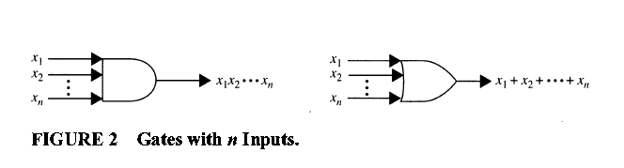
Basic Types of Gates

Slide 5
Combinations of Gates
Combinational circuits can be constructed using a combination of inverters, OR gates, and AND gates.
output from a gate may be used as input by one or more other elements
Both drawings in Figure 3 depict the circuit that produces the output

Slide 6
EXAMPLE 1
Construct circuits that produce the following outputs:

Slide 7
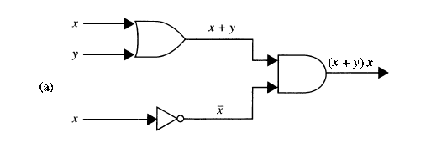
Solution

Slide 8
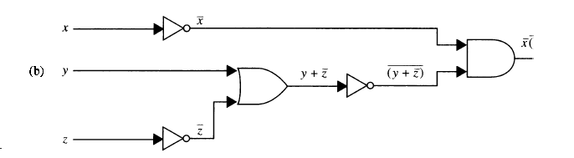
Solution

Slide 9
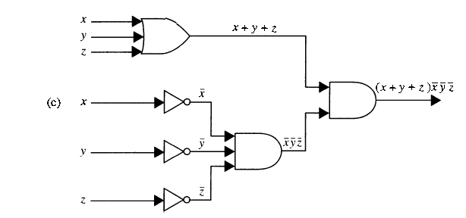
Solution

Slide 10
Homework
Page 765
1
3
5

