Slide 1
Instructor: Dr. Raja Rizwan Hussain
Subject / Course: GE105
Introduction to Engineering Design College of Engineering
King Saud University
Lecture 5
Need Analysis and
Problem Definition
Year 2019

Slide 2
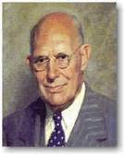
Before We Start
“If I had only one hour to save the world, I’d spend 55 min defining the problem and 5 minutes finding a solution”*
“A problem properly stated
is half-solved”
Charles Kettering (Inventor and holder of over 150 engineering patents)
Notes:
* Understanding the true nature of the problem is foundational to future planning.
Take a moment and read this quote by a well-known ‘problem solver’.
Anyone know who said this? (Einstein)
Einstein understood that having a CLEAR understanding of a problem will point us in the right direction to solutions.
As your campus moves through the Tx Continuous Improvement Process….
1) A clearly defined problem serves as the point of origin to find a campus’s needs.
2) It is the needs that influences or determines what strategies or solutions we put into place.

Slide 3
The Big Picture
Customer
Design Engineer
Communication
Communication
Communication
Communication
Product
Manufacturer

Slide 4
Importance of Communication
Design
Construction
Poor communication between the designer and the construction team lead to the collapse of the second floor
114 people died !!!*
Notes:
* Read about it here: Hyatt Regency Walkways Collapse: http://www.engineering.com/Library/ArticlesPage/tabid/85/ArticleID/175/Hyatt-Regency-Walkway-Collapse.aspx

Slide 5
Design Process
Customer needs a solution➔ (Client statement)
Analyze the Needs ➔ problem definition and formulation
System Design (Conceptual + Detailed )
System integration and product test
Properly functioning system
This lecture

Slide 6
Input | Client Need Statement
Tasks | Talk with the client (interview) Some potential users (survey) Brainstorming
Output | Problem statement Objectives Constraints Criteria
Client Statement
(Need)
Problem Definition
Clarify objectives
Identify constraints
Establish criteria
Notes:
i.e. client statement is used to produce the –engineer’s– problem definition, which involves the 3 steps mentioned above
Client statement, along with problem definition, then followed by problem formulation (discussed in a future lesson) constitute the –design engineer’s- needs analysis

Slide 7
Client’s Need Statement
First understand what the problem is (what does the customer want?)
Often, the customer does not know exactly what s/he wants nor what is achievable
Client Statements usually have limitations such as:
Bias (e.g., reconsider admission strategy; whereas the problem could be managing classrooms)
Implied solutions (e.g., replace the door; whereas another solution can be better*)
Make sure that the correct problem is being addressed
Notes:
* e.g. fix the door

Slide 8
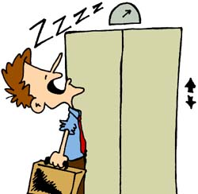
Example
Client Statement:
The residents of one of my tall buildings are complaining that the elevators are slow
Interpretation 1:
you have to install another elevator at a great expense
Interpretation 2:
Put entertainment on the main floors and provide some coffee*
Notes:
Note, how the second solution could be much cheaper, and may even bring in more customers to your business; i.e. you solved the problem by changing your management strategy

Slide 9
Problem Statement*
The statement is a very short paragraph providing answers to (What? Why? How?)
Written in the language of the customer
Normally straightforward, non-technical and non-quantifiable
Notes:
* note, problem statement and problem definition here mean –almost- the same thing, yet definition usually implies more details (statement is usually just 1 sentence).

Slide 10
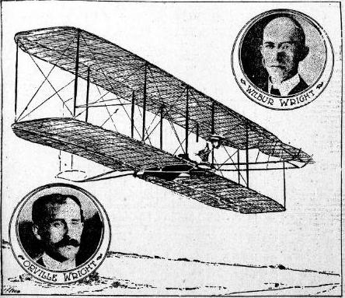
The Wright Brothers Example
The problem addressed by the Wright brothers at the turn of the 20th century was: Need a manned machine capable of achieving powered flight¹
This means that²:
They wanted to design a flying machine
It must carry a person (which rules out model aircraft)
An onboard power source must be used to take off (which eliminates hot air balloons)
Notes:
1. This is the client statement (i.e. the problem written in the customer’s, simple terms)
2. This is the –actual- problem statement (i.e. the same problem written in the design engineer’s words/format); thus, this is the first step in the need analysis

Slide 11
How to Assess Needs
Question the customer
Explore resources (gathering information)
Technical literature (books, journals, www)
Similar designs (competitors, patent search)
Search legal and regulatory restrictions
Allocation of frequency bands
Restriction on tower heights
Environmental impacts
Safety
Brainstorm
Investigate Manufacturability issues

Slide 12
Types of Specifications¹
Design Specs : provide basis for evaluating the design
(e.g., safe, light, inexpensive, simple)
Functional Specs: describe what the product must do (e.g., drilling, grinding, polishing)
Performance Specs: to judge how good is the design (e.g., speed, energy, accuracy)
Use (but don’t confuse) “Demanded” design elements and “Wished for²” design elements
Be as specific as possible by using numbers where possible (e.g., not “heavy” but “2.5 kg”)
Notes:
This is a continuation to the last slide (this is still part of the need analysis); also note that we will see later how design specs are related to design criteria
This is part of the objectives (D: primary, W: secondary)

Slide 13
Common Categories for Specifications*
Performance
Geometry
Materials
Energy
Time
Cost
Manufacturability
Standards
Safety
Transport
Ergonomics
Weight
Notes:
13
* These are discussed in the next studio session (as requirements) in more detail

Slide 14
Need Analysis Example Questions*:
Why?
How?
What?
Who?
Where?
When?
When and why do you use the product?
What do you like about existing products?
What don’t you like about other products?
What are the required functions?
Who is the product user?
Where is the product going to be used (environment)?
What are the unacceptable options/behaviors of the product?
What should the product satisfy?
What specifications do we have/know?
Are there any legal issues?
What are the human factors to be considered?
What is the expected life duration of the product?
Notes:
* This is a very important/standard/typical list of questions that you can use with almost any design for needs analysis (as part of prob. Definition/statement part)
Also note how each set of questions addresses a different part of the need analysis: e.g. Q7: prob. Statement, Q4: functional specs, Q8: objectives, etc.

Slide 15
Client statement
(Need)
Problem Definition
Clarify objectives
Identify constraints
Establish criteria
Design Objectives
Objectives are the requirements that the design is to satisfy (Specific, Measurable, Achievable, Realistic, Time bound)
Construct an Objective Tree by:
Listing objectives according to the assessed needs
Grouping the relevant objectives
Forming a hierarchical tree structure
Ladder
Safe
stable
Strong
Marketable
Inexpensive
Portable
Durable

Slide 16
The Design Objectives can be divided into:
Primary (need/must)
Secondary (wish/want)
The Primary Objective is what the customer/client really needs
Without the primary objective the design is a failure
The Secondary (less important): objectives are not necessarily specified; but can have an added value to the product (e.g., safety, simplicity, beauty)

Slide 17
Constraints
Client statement
(Need)
Problem Definition
Clarify objectives
Identify constraints
Establish criteria
Constraints are boundaries that limit the engineer’s flexibility; they form the design envelope (feasible design space)
They help to identify acceptable designs
Should be measurable
Should be answered with: True/False; Yes/No
Example: Cost <1000 SAR?
Weight <100 Kg?
Flexible system (yes/no)?

Slide 18
Sources of Constraints
Cost: cost of design, production, maintenance, support
Time: delivery dates, processing, time to market
Legal, ethical: patents, intellectual property, product reliability, safety requirements
Physical: size, weight, power, durability
Natural factors: topography, climate, resources
Company practices: parts, manufacturing processes
Human Factors/Ergonomics
Sustainability
Environment: bio-degradable materials, recycled materials, green energy

Slide 19
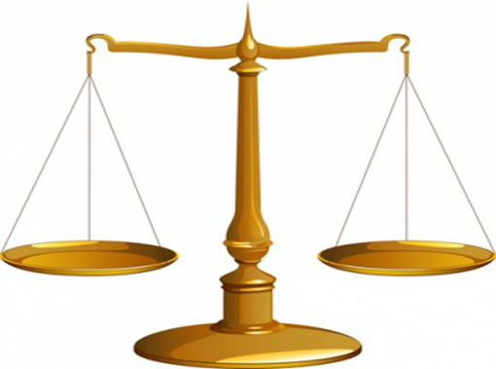
Design Criteria
Client statement
(Need)
Problem Definition
Clarify objectives
Identify constraints
Establish criteria
Criteria are indicators defining the success of achieving the objectives
Criteria define the product physical and functional characteristics
They represent descriptive adjectives that can be qualified on a given scale: examples: beautiful, low cost, low noise, smart, low weight
Might be used for judging between different designs

Slide 20
Examples of Criteria
To be qualified say on a scale 1 to 10 1 (worst) and 10 (best) 4 (average)*
High safety
Environment friendliness
Public Acceptance
Performance
Ease of operation
Durability
Cost
Ease of Maintenance
Ease of Manufacturing
Aesthetic design (Appearance)
Geometry
Physical Features
Reliability
Use Environment
Notes:
e.g. how cheap (1-10)? 6; how attractive is the appearance (1-10)? 9, etc.

Slide 21
Example: Specs for Designing an "Auto-Golfer"
Geometry | D | Single unit, 3 foot circle
Materials | W | Not degrade in rain and snow, 30ºF
Time | D | Ready to go < 14 weeks
Cost | D | ≤ $600 (exclusive of radios)
Manufacturing | W | Off-the-shelf parts as possible
Standards | D | Radios OK for regulations
Safety | D | Must pass safety review
Transport | D | Must be portable
Compactness | W | Should fit in a car or small truck
D = demand (i.e. primary obj.)
W = wish (i.e. secondary obj.)
Notes:
21
Example of Needs Analysis
Can you turn this into a problem definition and problem formulation?
Can you name the objectives (primary, secondary), constraints, and criteria, and specs (design, functional, performance) in this problem definition?

Slide 22
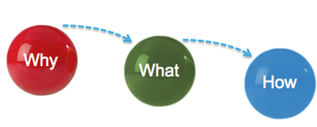
Problem Definition
Problem Definition
Objectives
Constraints
Criteria
Problem Formulation
A paragraph compiling the above points
Need Analysis
Specifications
Notes:
* Summary of what constitutes and sequence of: need analysis, problem definition, problem formulation

Slide 23
Problem Definition
Turn the problem statement into a technical, quantified problem definition
Precise description of the properties of the object being designed
Can be a long list
To summarize
Need Analysis
Needs that are well understood
A well stated objective
A list of Demanded and Wished for Specifications
A set of criteria
A set of constraints
Problem Formulation
A compiled carefully written paragraph
Notes:
Very important explanation of how to transform a need analysis into problem definition

