Slide 1
Carboxylic Acids and Their Derivatives
Dr. SHATHA I AQEEL
108 Chem

Slide 2
Learning Objectives
Chapter nine introduces carboxylic acids and their derivatives. by the end of this chapter the students will know :
The structure of carboxylic acids
The common and IUPAC nomenclature of carboxylic acids
The physical properties of carboxylic acids
The Factors affecting acidity of carboxylic acids.
The different ways to make carboxylic acids
Salt formation reactions of carboxylic acids
The nucleophilic substitution reactions at the carbonyl carbon and the specific products formed in each case.
The chemistry of carboxylic acid derivatives

Slide 3
Structure Of Carboxylic Acids
Carboxylic acids are organic acids contain one or more carboxyl group
which is a combination of carbonyl group C=O and hydroxyl group O-H
It is often written in condensed form as –CO₂H or –COOH
The general formula of a carboxylic acid is R-COOH or Ar-COOH
Carboxylic acids are classified as aliphatic or aromatic depending on the
Group which attached to the carboxylic group.
The simplest acid is formic acid R= H

Slide 4
Nomenclature of Carboxylic Acid
Common Name:
The common names of carboxylic acids all end in –ic acid.
The names are derived from Latin or Greek and relate to their natural sources.
The positions of the carbons present on the acid chain, are located by the Greek letters α indicating the carbon atom next to COOH group (C2), β (C3), etc.
IUPAC Name:
Find the longest continuous carbon chain contains the COOH group to get the root name of the parent hydrocarbon, then replace the ending -e by the suffix –oic acid.
Number the chain starting with the carbon of COOH group as C-1
Cyclic compounds containing one or more COOH groups attached to the ring are named by identifying the name of the ring followed by the word carboxylic acid.
5 4 3 2 1
C—C—C—C—C=O
δ γ β α

Slide 5
Carbon atoms | Common name | IUPAC name | Chemical formula
1 | Formic acid | Methanoic acid | HCOOH
2 | Acetic acid | Ethanoic acid | CH₃COOH
3 | Propionic acid | Propanoic acid | CH₃CH₂COOH
4 | Butyric acid | Butanoic acid | CH₃(CH₂)₂COOH
5 | Valeric acid | Pentanoic acid | CH₃(CH₂)₃COOH
Cyclopropane Cyclobutane Cyclopentane Cyclohexane
Carboxylic acid Carboxylic acid Carboxylic acid Carboxylic acid
108 Chem

Slide 6
3-Ethyl-6-methyloctan1,8-dioic acid
α-β- Dimethyl butyric acid
2,3-Dimethyl butanoic acid
Succinic acid
1,4-Butandioic acid

Slide 7
Benzoic acid Phethalic acid Isophthalic acid
Benzene carboxylic acid
Benzene-1,2-dicarboxylic acid
Benzene-1,3-dicarboxylic acid
o-Toluic acid
Terephtalic acid Salicylic acid
2- Methyl benzene carboxylic acid
Benzene-1,4-dicarboxylic acid
2-Hydroxybenzenecarboxylic acid

Slide 8
Carboxylic Acid Derivatives
Acid Chloride Ester Amide acid anhydride
1-Nomenclature of acid chloride RCOX
Derived from the carboxylic acid name by
Replace the -ic acid ending in the name of the parent acid by –yl chloride.
Ethanoyl chloride Benzoyl chloride
Acetyl chloride
Propanoyl chloride

Slide 9
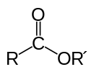
2- Nomenclature of esters
The alkyl group (R’) is written first followed by the name of the parent acid with replacing of the ending –ic acid by –ate :
Ethyl ethanoate Methyl benzoate
Ethyl acetate
Methyl propanoate

Slide 10
3-Nomenclature of anhydride
An anhydride is named by replacing the word acid in the corresponding acid by the word anhydride
If symmetrical replace “acid” with “anhydride” based on the related carboxylic acid
Unsymmetrical anhydrides— cite the two acids alphabetically
Ethanoic anhydride Benzoic anhydide Butandioic anhydride
Acetic anhydride Succinic anhydride
108 Chem

Slide 11
4- Nomenclature of amide
Replace the ending oic acid of the parent acid’s by the word amide
With unsubstituted ⎯NH₂ group , Replacing the ending oic acid of the parent acid’s by amide
Ethanamide Benzamide
Acetamide
If the N is further substituted, identify the substituent groups (preceded by “N”) and then the parent amide
N,N-Dimethylmethanamide N-Ethyl-N-methylbenzamide
N,N-Dimethylformamide

Slide 12
Cyclopentanecarboxylamide
N,N-Diethylcyclohexancarboxylamide
108 Chem

Slide 13
Physical Properties OF Carboxylic Acids
Solubility
Carboxylic acids are polar, they are capable of hydrogen bonding with water molecules.
The first four aliphatic acids are completely miscible in water. Higher members are less soluble
Aromatic acids are insoluble in water
boiling points
boiling points of carboxylic acids indicate a greater degree than alcohols
This is due to carboxylic acids usually exist as dimeric pairs by forming two intramolecular hydrogen bonds in nonpolar media

Slide 14
Acid Strength
Carboxylic acids are the most acidic simple organic compounds
also they are more acidic than phenols & alcohol
they are weak acids compared to inorganic acids (HCl or H₂SO₄ because they undergo complete dissociation)
Electron donating substituents decrease the acidity
HCOOH > CH₃COOH > CH₃CH₂COOH > CH₃CH₂CH₂CH₂COOH ( size of R group)
Whereas Electron withdrawing substituents near the carboxyl group increase the acidity
Cl₃CCOOH > Cl₂CHCOOH > ClCH₂COOH > CH₃COOH ( number of e.w.g.)
CH₃CH₂CH₂CH(Cl)COOH > CH₃CH₂CH(Cl)CH₂COOH > CH₃CH(Cl)CH₂CH₂COOH > CH₂(Cl)CH₂CH₂CH₂COOH ( position of e.w.g. relative to COOH group

Slide 15
Preparation Of Carboxylic acids
1- Oxidation Of Primary Alcohols and Aldehydes
2- Oxidation Of Alkyl Benzenes

Slide 16
3- Carbonation Of Grignard Reagents
4- Hydrolysis Of Nitriles

Slide 17
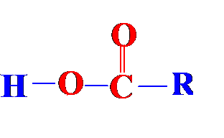
Reactions of Carboxylic Acids
1- Salts Formation

Slide 18
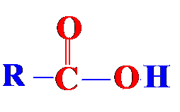
2- Substitution of hydroxyl group
or PCl₃ or PCl₅

Slide 19
Reaction of Esters
Hydrolysis
Alcoholysis
Ammonolysis
Reduction

Slide 20
Acid Chlorides: Reactions

Slide 21
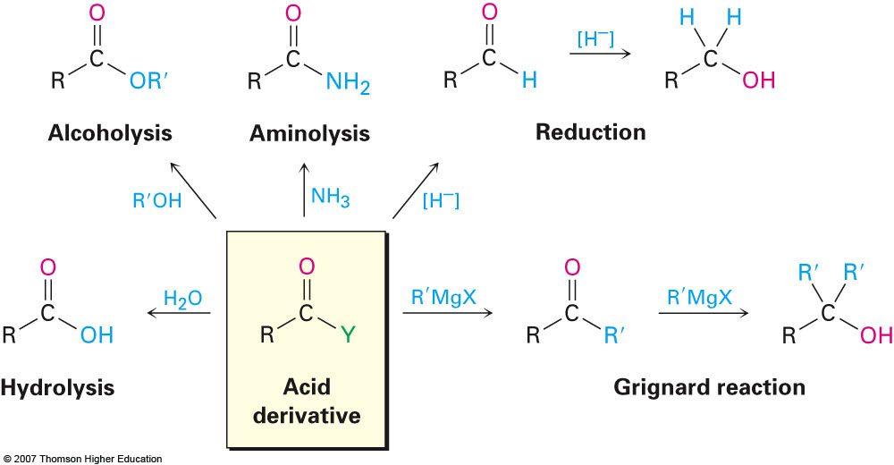
108 Chem

Slide 22
Acid anhydride: Reactions

Slide 23
Reactions of Amides

Slide 24
Thank You for your kind attention !
Questions?

