Slide 1
Chapter 9:
One- and Two-Sample Estimation Problems

Slide 2
Introduction
• Statistical inference may be divided into two major areas: estimation and tests of hypotheses.
Suppose we have a population with some unknown parameter(s).
Example: Normal(μ,σ)
μ and σ are parameters.
• We need to draw conclusions (make inferences) about the unknown parameters.
• We select samples, compute some statistics, and make inferences about the unknown parameters based on the sampling distributions of the statistics.

Slide 3
Statistical Inference
(1) Estimation of the parameters (Chapter 9)
→ Point Estimation
→ Interval Estimation (Confidence Interval)
(2) Tests of hypotheses about the parameters (Chapter 10)

Slide 4
Classical Methods of Estimation
Point Estimation:
A point estimate of some population parameter θ is a single value $\hat{θ}$ of a statistic $\hat{Θ}$. For example, the value $\overline{x}$ of the statistic $\overline{X}$computed from a sample of size n is a point estimate of the population mean μ.

Slide 5
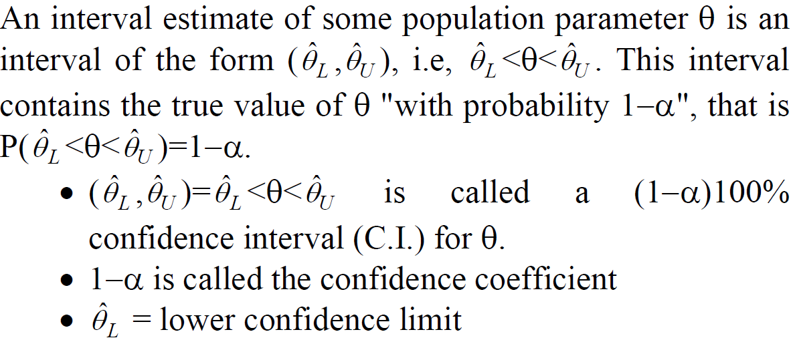
Interval Estimation (Confidence Interval = C.I.)

Slide 6
Point Estimation of the Mean (μ)
The sample mean $\overline{X}=\frac{\sum{X_{i}}}{n}$ is a "good" point estimate for μ.

Slide 7
Interval Estimation (Confidence Interval) of the Mean (μ)
(i) First Case: $σ^{2}$ is known:
Result:

Slide 8
Example
The average zinc concentration recorded from a sample of zinc measurements in 36 different locations is found to be 2.6 gram/milliliter. Find a 95% and 99% confidence interval (C.I.) for the mean zinc concentration in the river. Assume that the population standard deviation is 0.3.

Slide 9
Solution:
First, a point estimate for μ is $\overline{X}=2.6$

Slide 10
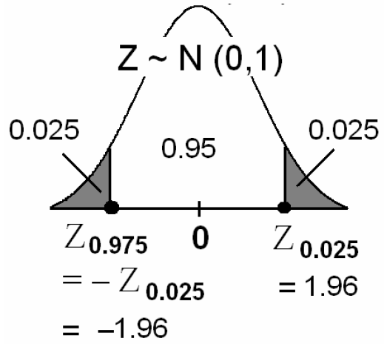
(a) We want to find 95% C.I. for μ.
α = ??
95% = (1−α)100%
⇔ 0. 95 = (1−α)
⇔ α=0.05 ⇔ α/2 = 0.025

Slide 11
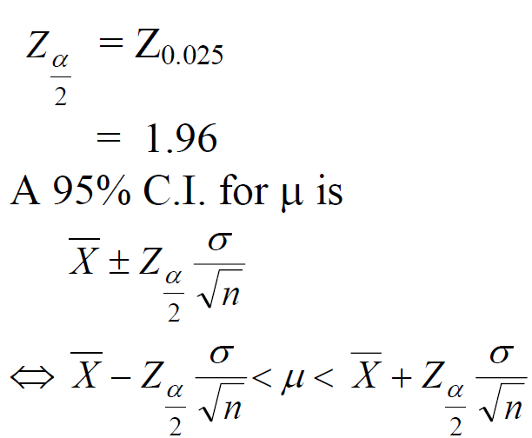
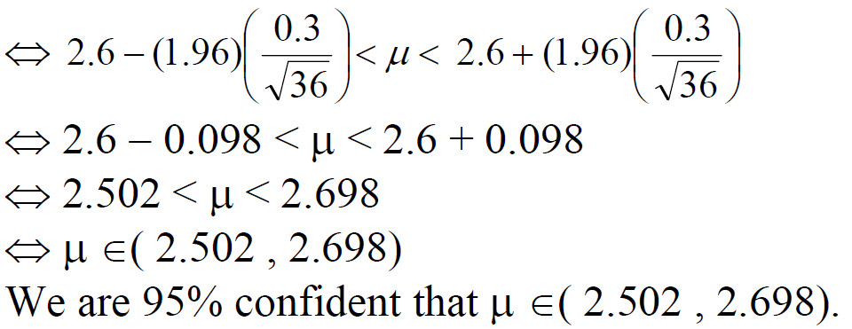

Slide 12
(b) Similarly, we can find that A 99% C.I. for μ is
2.471 < μ < 2.729
⇔ μ ∈( 2.471 , 2.729)
We are 99% confident that μ ∈( 2.471 , 2.729)
Notice that a 99% C.I. is wider that a 95% C.I.
See Ex 9.2 on page 271

Slide 13
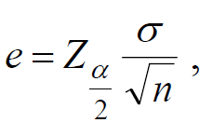
Theorem
If $\overline{X}$ is used as an estimate of μ, we can then be (1−α)100% confident that the error (in estimation) will not exceed

Slide 14
Example:
In the previous example, we are 95% confident that the sample mean $\overline{X}=2.6$ differs from the true mean μ by an amount less than

Slide 15
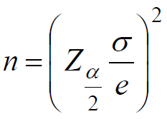
Theorem
If $\overline{X}$ is used as an estimate of μ, we can then be (1−α)100% confident that the error (in estimation) will not exceed a specified amount e when the sample size is

Slide 16
Example
How large a sample is required in the previous example if we want to be 95% confident that our estimate of μ is off by less than 0.05?

Slide 17
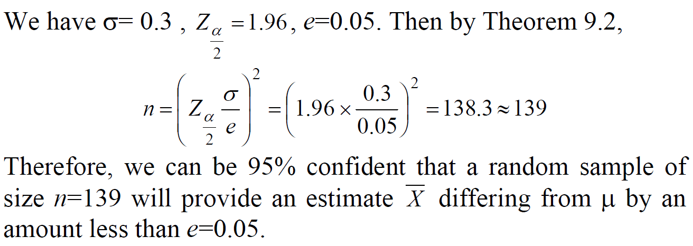
Solution:

Slide 18
Interval Estimation (Confidence Interval) of the Mean (μ)
(ii) Second Case: ${\text{σ}}^{2}$ is unknown:

Slide 19
Confidence Interval on $μ, σ^{2}$ Unknown
If $\overline{x}$ and $s$are the mean and standard deviation of a random sample from a normal population with unknown variance $σ^{2}$, a 100(1−α)% confidence interval for μ is

Slide 20
Example
The contents of 7 similar containers of sulfuric acid are 9.8, 10.2, 10.4, 9.8, 10.0, 10.2, and 9.6 liters. Find a 95% C.I. for the mean of all such containers, assuming an approximate normal distribution.

Slide 21
Solution:

Slide 22
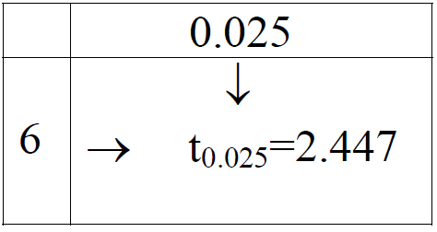
Now, we need to find a confidence interval for μ.
α = ??
95%=(1−α)100% ⇔ 0. 95=(1−α) ⇔ α=0.05 ⇔ α/2=0.025

Slide 23
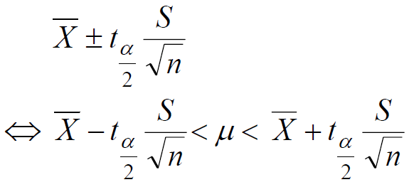
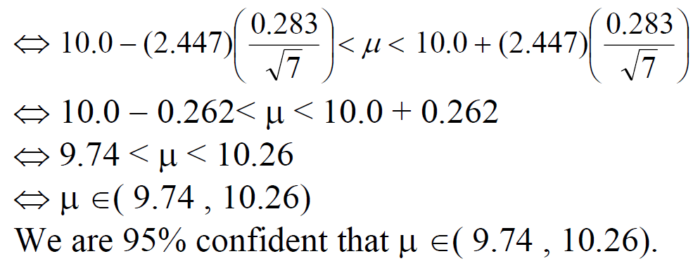
A 95% C.I. for μ is

Slide 24
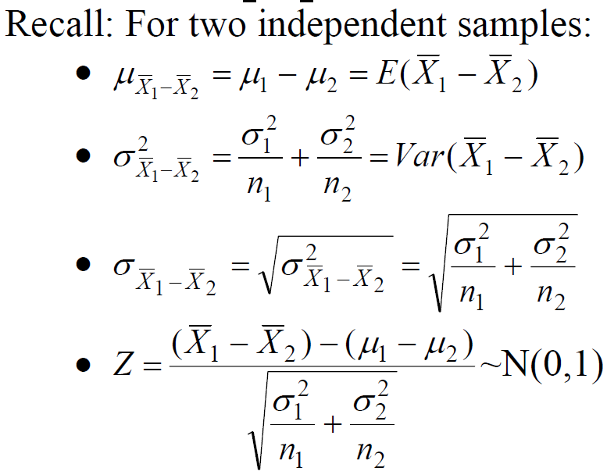
Two Samples: Estimating the Difference between Two Means $(μ_{1}−μ_{2})$

Slide 25
Point Estimation of $(μ_{1}−μ_{2})$

Slide 26
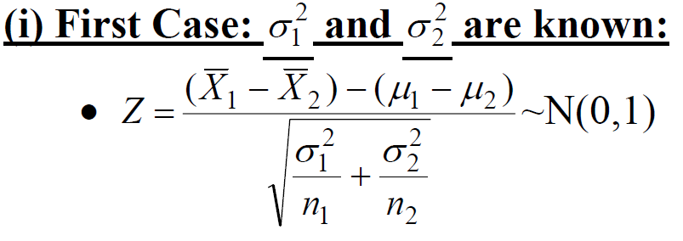
Confidence Interval of $(μ_{1}−μ_{2})$

Slide 27
Result:
a (1−α)100% confidence interval for $(μ_{1}−μ_{2})$is :

Slide 28
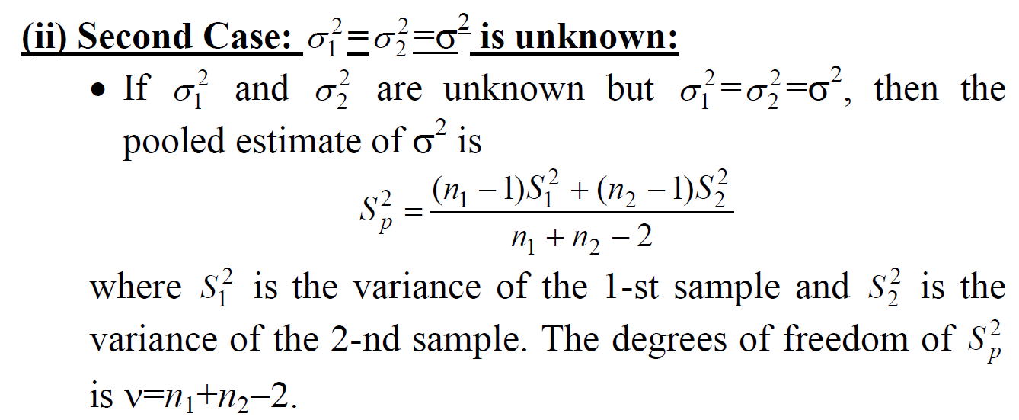

Slide 29
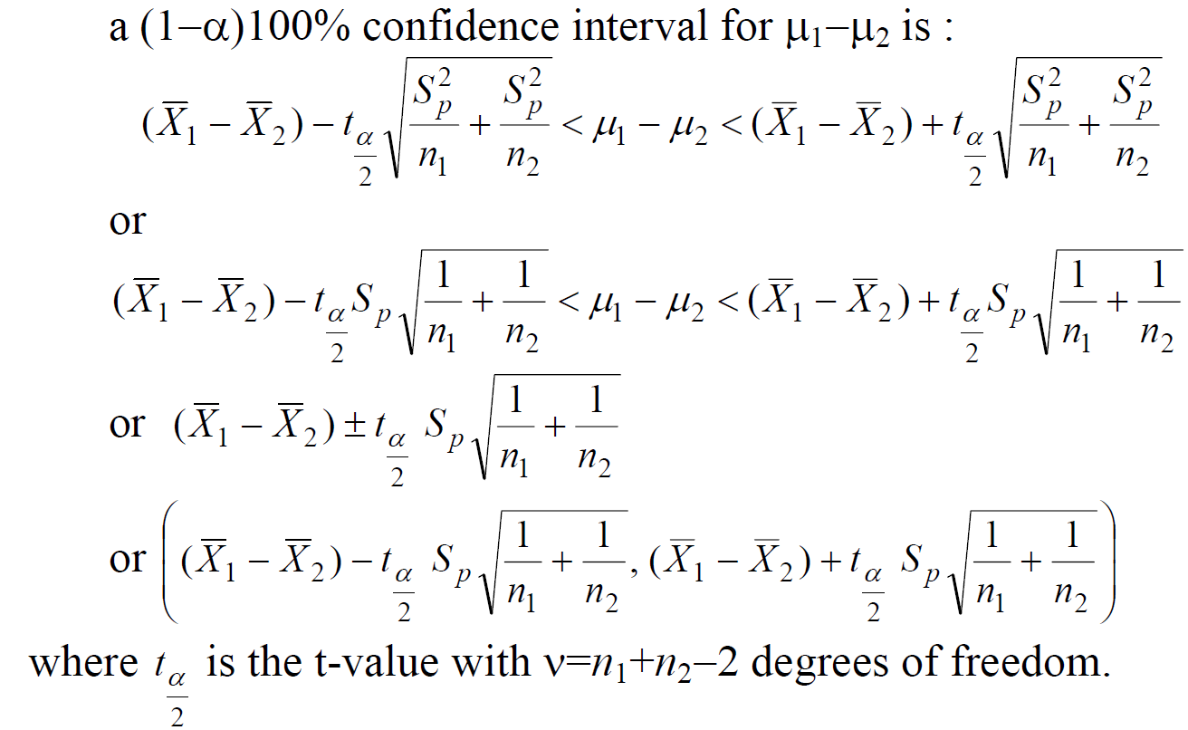
Result:

Slide 30
Example (First Case)
An experiment was conducted in which two types of engines, A and B, were compared. Gas mileage in miles per gallon was measured. 50 experiments were conducted using engine type A and 75 experiments were done for engine type B. The gasoline used and other conditions were held constant. The average gas mileage for engine A was 36 miles per gallon and the average for engine B was 42 miles per gallon. Find 96% confidence interval for $μ_{B}−μ_{A}$, where $μ_{A}$and $μ_{B}$are population mean gas mileage for engines A and B, respectively. Assume that the population standard deviations are 6 and 8 for engines A and B, respectively.

Slide 31
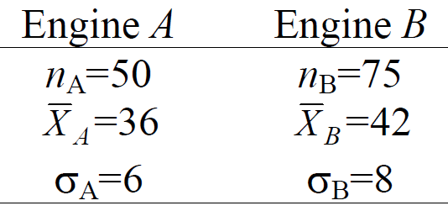
Solution:
A point estimate for $μ_{B}−μ_{A}$ is
${\overline{X}}_{B}−{\overline{X}}_{A}=42−36=6$

Slide 32
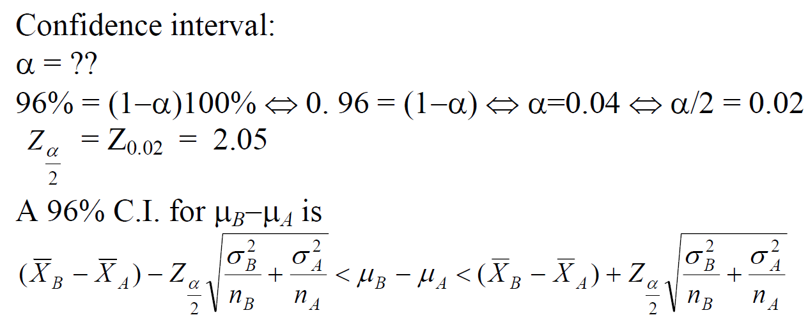

Slide 33
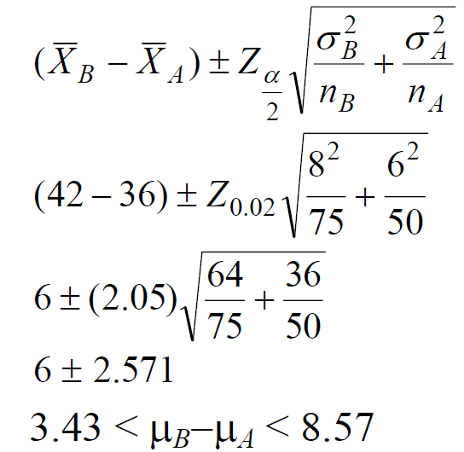
We are 96% confident that $μ_{B}−μ_{A}$∈(3.43, 8.57).

Slide 34
Example: (Second Case)
To compare the resistance of wire A with that of wire B, an experiment shows the following results based on two independent samples (original data multiplied by 1000):
Wire A: 140, 138, 143, 142, 144, 137
Wire B: 135, 140, 136, 142, 138, 140
Assuming equal variances, find 95% confidence interval for $μ_{A}−μ_{B}$ Where $μ_{A}$($μ_{B}$) is the mean resistance of wire A(B).

Slide 35
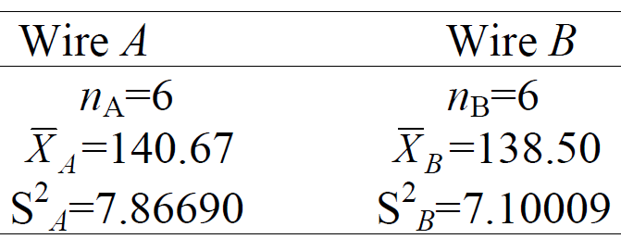
Solution:
A point estimate for $μ_{A}−μ_{B}$ is
${\overline{X}}_{A}−{\overline{X}}_{B}=\text{140.67−138.50 }\text{= }\text{2.17}$

Slide 36
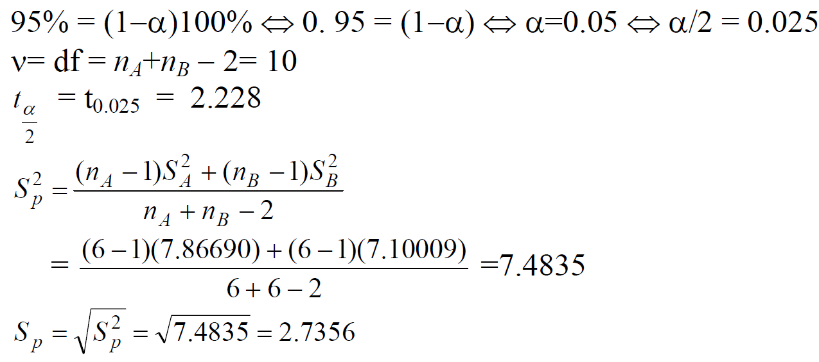
Confidence interval:

Slide 37
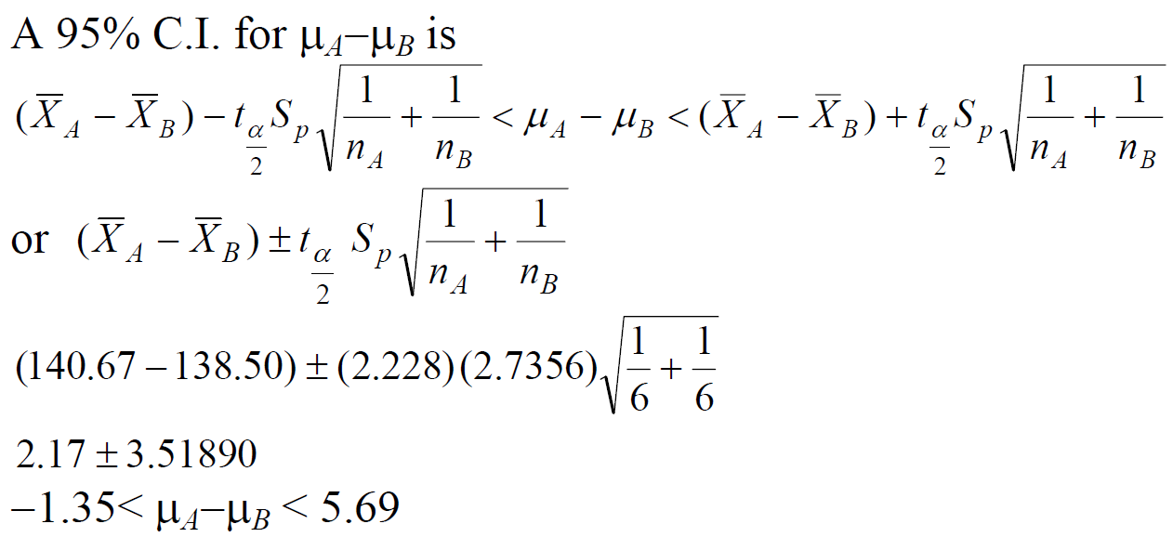
We are 95% confident that $μ_{A}−μ_{B}∈\left(−1.35,5.69\right)$

Slide 38
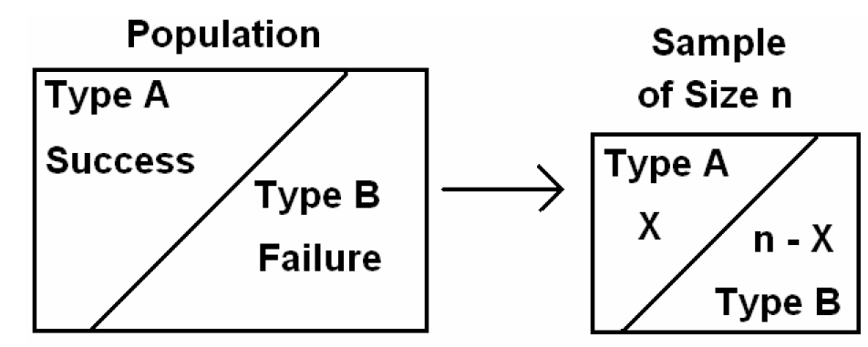
Single Sample: Estimating of a Proportion

Slide 39
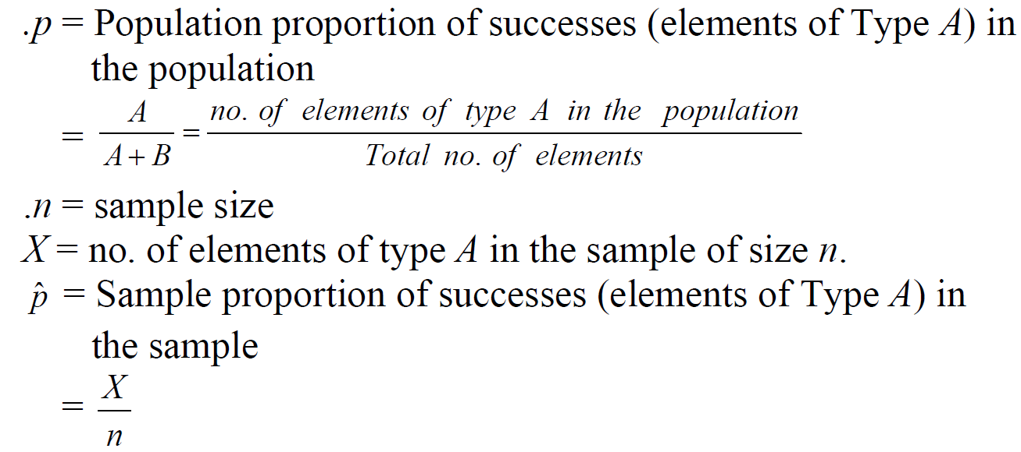

Slide 40
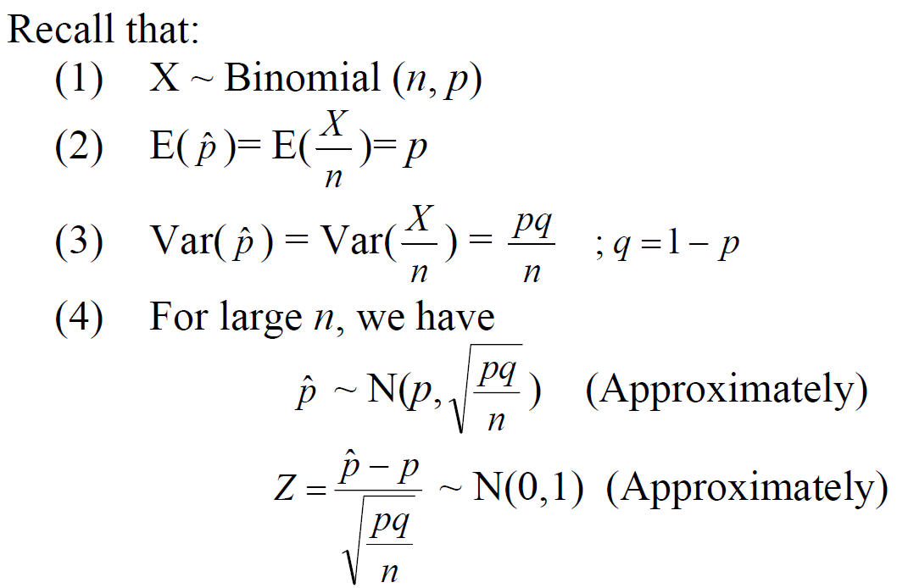

Slide 41
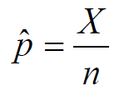
Point Estimation for $p$
A good point estimator for the population proportion $p$is given by the statistic (sample proportion):

Slide 42
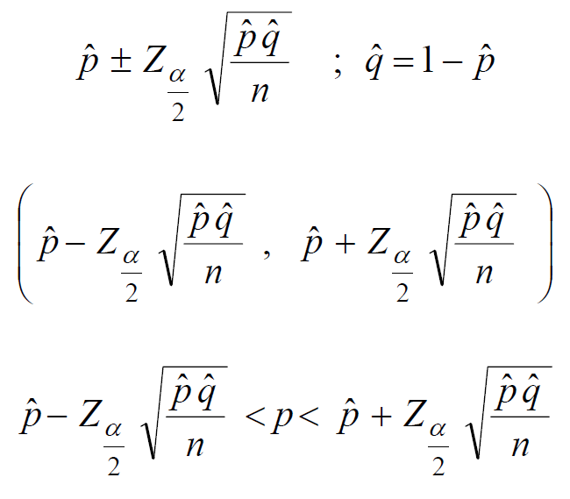
Confidence Interval for $p$
Result:
For large n, an approximate (1−α)100% confidence interval for $p$is :

Slide 43
Example
In a random sample of $n=500$ families owing television sets in the city of Hamilton, Canada, it was found that $x=340$ subscribed to HBO. Find 95% confidence interval for the actual proportion of families in this city who subscribe to HBO.

Slide 44
Solution:
$p$= proportion of families in this city who subscribe to HBO.
$n$= sample size = 500
$X$= no. of families in the sample who subscribe to HBO. = 340
$\hat{p}$= proportion of families in the sample who subscribe to HBO =$\frac{X}{n}=\frac{340}{500}=0.68$
$$\hat{q}=1−\hat{p}=1−0.68=0.32$$

Slide 45
Solution:
$p$= proportion of families in this city who subscribe to HBO.
$n$= sample size = 500
$X$= no. of families in the sample who subscribe to HBO. = 340
$\hat{p}$= proportion of families in the sample who subscribe to HBO =$\frac{X}{n}=\frac{340}{500}=0.68$
$$\hat{q}=1−\hat{p}=1−0.68=0.32$$

Slide 46
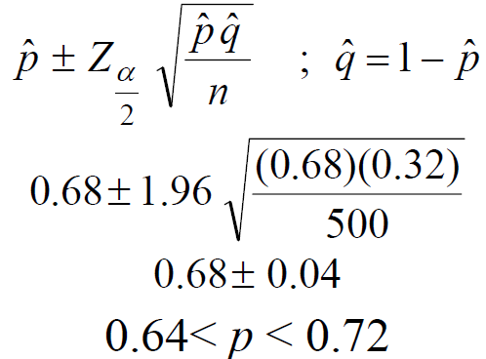
A 95% confidence interval for $p$is:
We are 95% confident that $p ∈(0.64,0.72).$

Slide 47
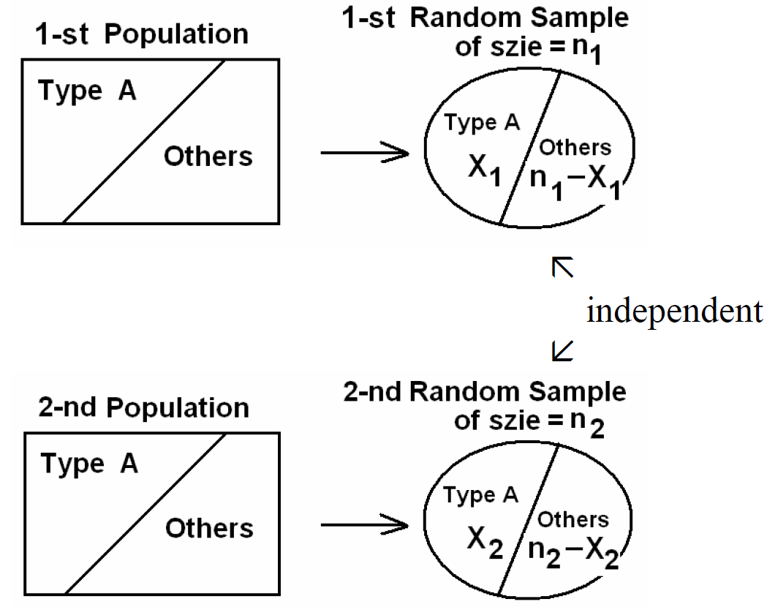
Two Samples: Estimating the Difference between Two Proportions

Slide 48
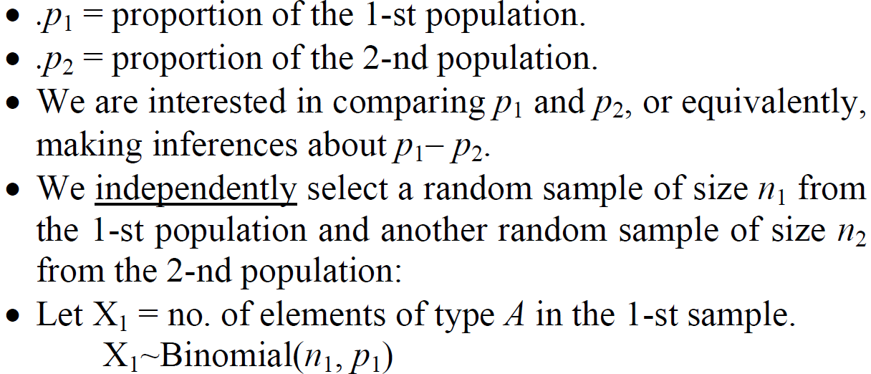
Suppose that we have two populations:

Slide 49
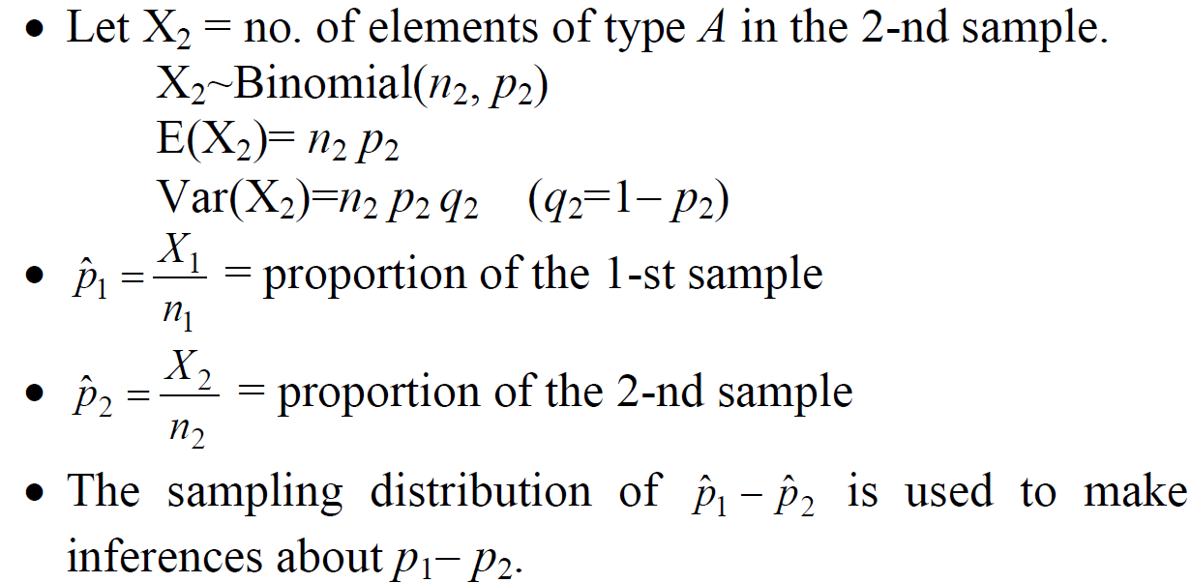

Slide 50
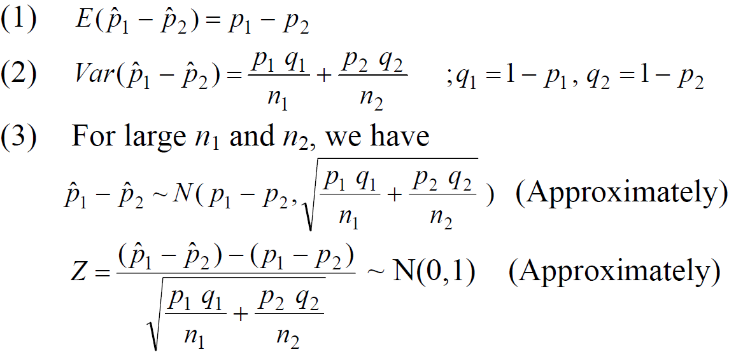
Results:

Slide 51
Point Estimation for $p_{1}−p_{2}$
A good point estimator for the difference between the two proportions, $p_{1}−p_{2}$, is given by the statistic:

Slide 52
Confidence Interval for $p_{1}−p_{2}$
Result:
For large $n_{1}$and $n_{2}$, an approximate (1−α)100% confidence interval for $p_{1}−p_{2}$is :

Slide 54
Example
A certain change in a process for manufacture of component parts is being considered. Samples are taken using both existing and the new procedure to determine if the new process results in an improvement. If 75 of 1500 items from the existing procedure were found to be defective and 80 of 2000 items from the new procedure were found to be defective, find 90% confidence interval for the true difference in the fraction of defectives between the existing and the new process.

Slide 55
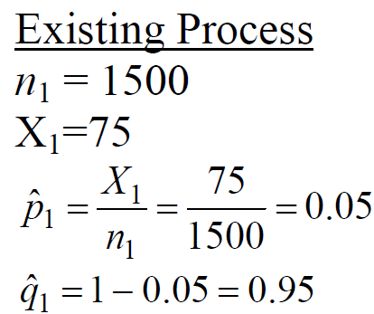
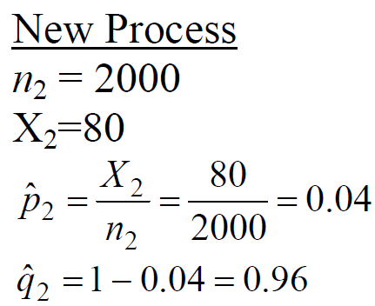
Solution

Slide 56
Point Estimation for $p_{1}−p_{2}$:
A point estimator for the difference between the two proportions, $p_{1}−p_{2}$, is:

Slide 57
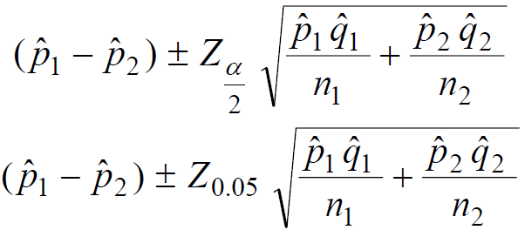
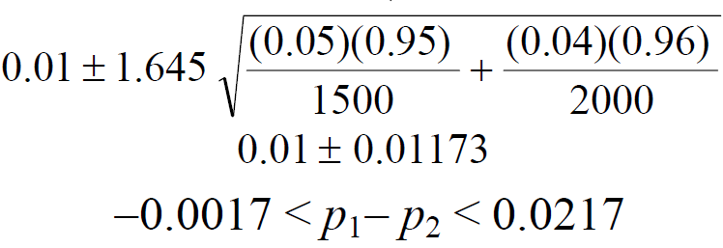
Confidence Interval for $p_{1}−p_{2}$:
A 90% confidence interval for $p_{1}−p_{2}$is :
We are 90% confident that $p_{1}−p_{2}$∈(−0.0017, 0.0217).

Slide 58
Note:
Since 0∈90% confidence interval=(−0.0017, 0.0217), there is no reason to believe that the new procedure produced a significant decrease in the proportion of defectives over the existing method ($p_{1}−p_{2}$≈ 0 ⇔ $p_{1}$≈ $p_{2}$).

