Slide 1
Genetics disorders-2

Slide 2
Numerical changes in chromosome numbers:
Aneuploidy:
Variation of a certain chromosome with in the set.
Hyperploidy: gain of chromosome
Trisomy 2n+1
Double trisomy 2n+1+1
Tetrasomy 2n+2
Hypoploidy: loss of chromosome
Monosomy 2n-1
Double monosomy 2n-1-1
Nullisomy 2n-2
Polyploidy:
Cell has more than two set of homologous chromosome.
Triploid (3n).
Tetraploid (4n).
Pentaploid (5n).

Slide 3
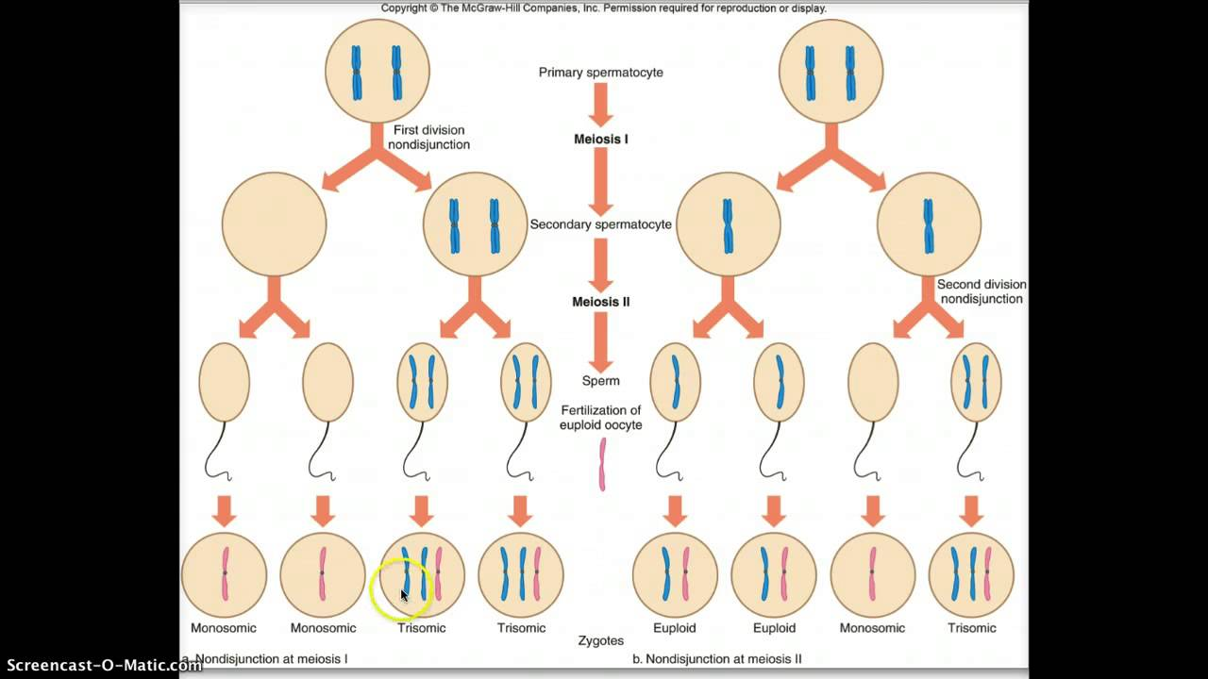
Meiotic nondisjunction produces aneuploidies

Slide 4
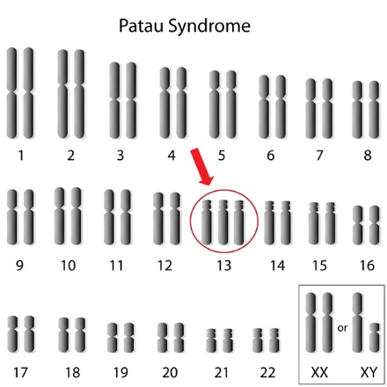
Patau’s syndrome: Trisomy-13 (XY or XX +13)
Genetic disorder in which a person has 3 copies of genetic material from chromosome 13, causing a disruption of normal development.
Trisomy 13 occurs in about 1 in 16,000 newborns. Although women of any age can have a child with trisomy 13, the chance of having a child with this condition increases as a woman gets older.
An error in cell division called nondisjunction results in a reproductive cell with an abnormal number of chromosomes.
Symptoms: Eyes poorly developed, extra finger or toes, cleft in the lip, cleft palate.

Slide 5
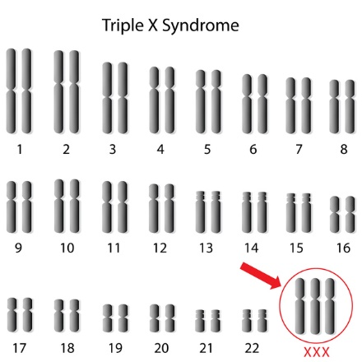
Triplo-X syndrome: (47,XXX)
Triple X syndrome results from an extra copy of X chromosome in each of a female's cells. As a result of the extra X chromosome, each cell has a total of 47 chromosomes (47,XXX).
Most cases of triple X syndrome are not inherited. The chromosomal change usually occurs as a random event during the formation of reproductive cells (eggs and sperm).
An error in cell division called nondisjunction can result in reproductive cells with an abnormal number of chromosomes.
Symptoms: Increase risk of learning disability and tall stature

Slide 6
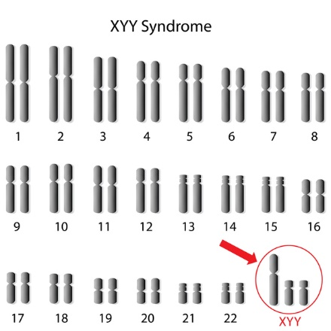
Jacobs syndrome: 47,XYY
47,XYY syndrome is caused by the presence of an extra copy of Y chromosome in each of a male's cells.
Most cases of 47,XYY syndrome are not inherited. The chromosomal change usually occurs as a random event during the formation of sperm cells
Symptoms: Delayed development of motor skills (such as sitting and walking), weak muscle tone, seizures, asthma, flat feet.

Slide 7
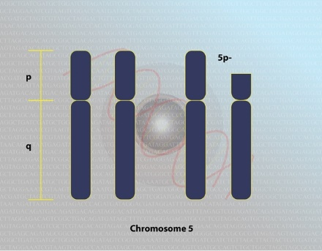
Cri-du, chat syndrome
Cri-du-chat (cat's cry) syndrome, also known as 5p- (5p minus) syndrome, is a chromosomal condition that results when a fragment of Chromosome 5 is missing.
The size of the deletion varies among affected individuals; studies suggest that larger deletions tend to result in more severe symptoms.
Most cases of cri-du-chat syndrome are not inherited. The deletion occurs most often as a random event during the formation of reproductive cells (eggs or sperm) or in early fetal development. Affected people typically have no history of the disorder in their family.
Infants with this condition often have a high-pitched cry that sounds like that of a cat.
Symptoms: intellectual disability and delayed development, small head size.

Slide 8
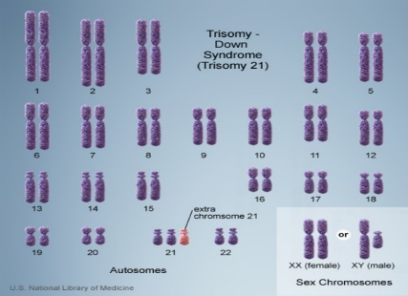
Down’s syndrome: Trisomy 21
Down syndrome result from Trisomy 21, which means each cell in the body has three copies of chromosome 21 instead of the usual two copies.
Down Syndrome is correlated with age of mother but could also be the result of nondisjunction of chromosome 21.
Symptoms: Delayed development and behavioral problems for example stubbornness, facial features, short stature increase risk of having hear and vision problem and Alzheimer.

Slide 9
Turner Syndrome ??

