Slide 1
Chapter 8:
Fundamental Sampling Distributions and Data Descriptions

Slide 2
Random Sampling
Definition 1:
A population consists of the totality of the observations with which we are concerned. (Population=Probability Distribution)
Definition 2:
A sample is a subset of a population.

Slide 3
Some Important Statistics
Definition:
Any function of the random sample $X_{1},X_{2},…,X_{n}$is called a statistic.

Slide 4
Central Tendency in the Sample
Definition:
If $X_{1},X_{2},…,X_{n}$represents a random sample of size n, then the sample mean is defined to be the statistic:

Slide 5
Note:
• $\overline{X}$is a statistic because it is a function of the random sample $X_{1},X_{2},…,X_{n}$.
• $\overline{X}$has same unit of $X_{1},X_{2},…,X_{n}$.
• $\overline{X}$measures the central tendency in the sample (location).

Slide 6
Variability in the Sample
Definition:
If $X_{1},X_{2},…,X_{n}$represents a random sample of size $n$, then the sample variance is defined to be the statistic:

Slide 7
Theorem: (Computational Formulas for $S2$)

Slide 8
Note:
• $S2$is a statistic because it is a function of the random sample $X_{1},X_{2},…,X_{n}$.
• $S2$measures the variability in the sample.

Slide 9
Definition:
The sample standard deviation is defined to be the statistic:

Slide 10
Sampling distribution
Definition:
The probability distribution of a statistic is called a sampling distribution.
Example:If $X_{1},X_{2},…,X_{n}$represents a random sample of size $n$, then the probability distribution of $\overline{X}$is called the sampling distribution of the sample mean $\overline{X}$.

Slide 11
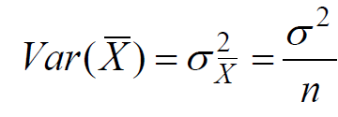
Sampling Distribution of Means
Result:
If $X_{1},X_{2},…,X_{n}$is a random sample of size $n$taken from a normal distribution with mean $μ$ and variance $σ2$, i.e. $N(μ, σ2),$then the sample mean $\overline{X}$has a normal distribution with mean
and variance

Slide 12
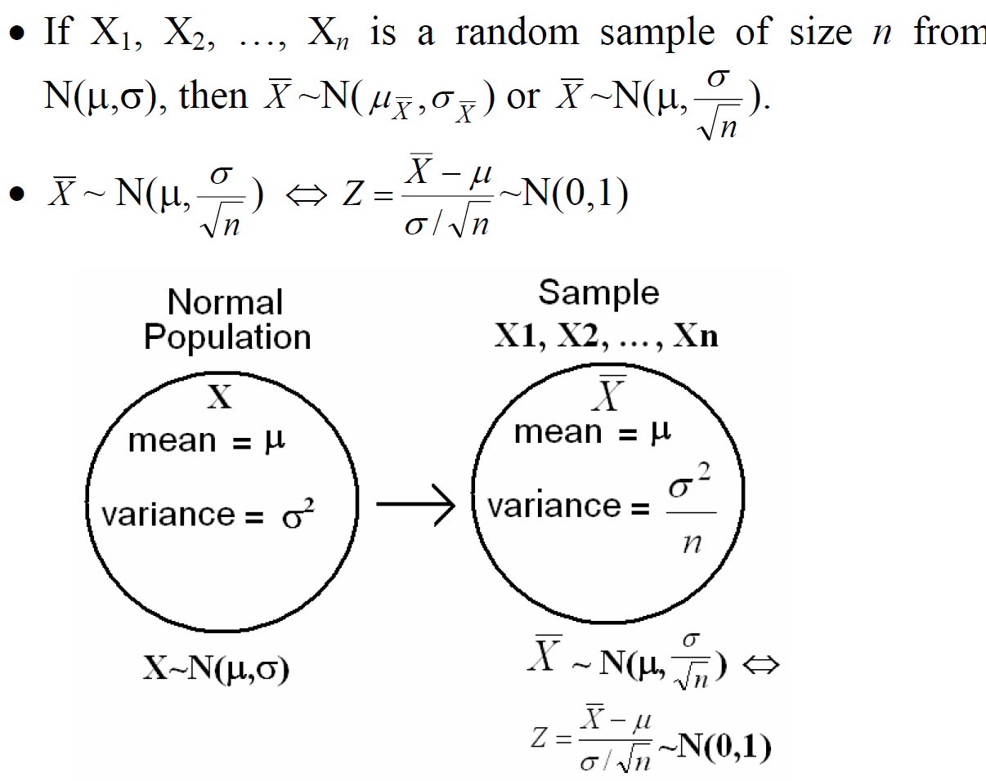

Slide 13
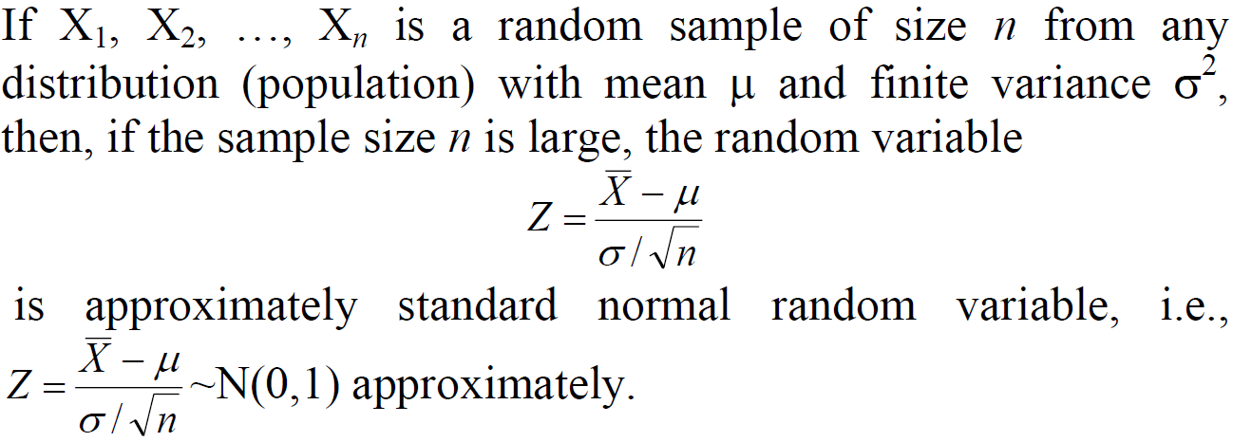
Theorem: (Central Limit Theorem)

Slide 14
Example
An electric firm manufactures light bulbs that have a length of life that is approximately normally distributed with mean equal to 800 hours and a standard deviation of 40 hours. Find the probability that a random sample of 16 bulbs will have an average life of less than 775 hours.

Slide 15
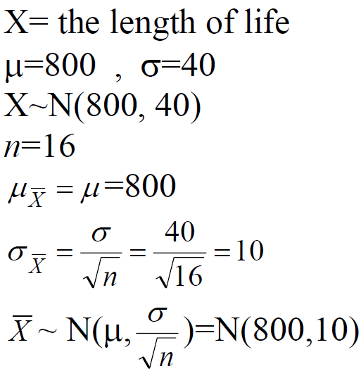
Solution:

Slide 16
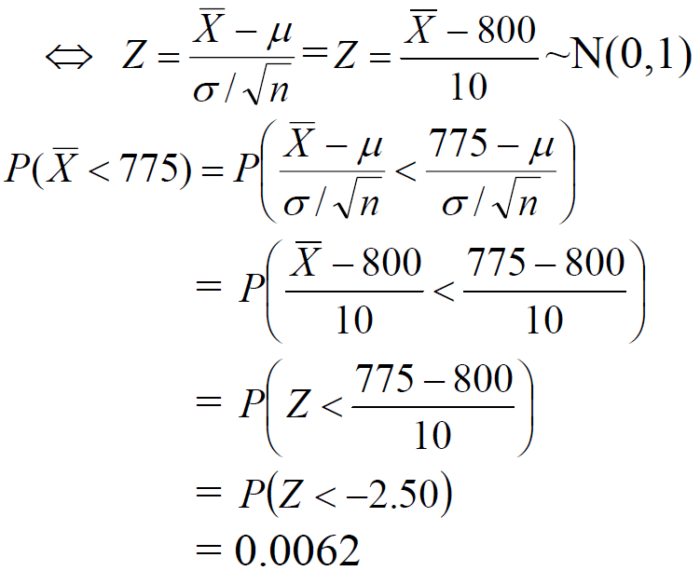

Slide 17
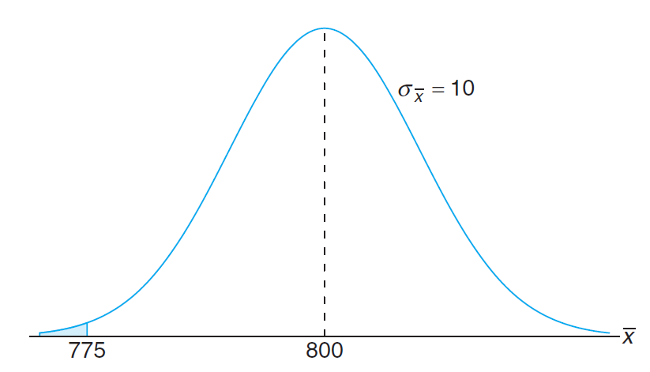

Slide 18
Sampling Distribution of the Difference between Two Means
Suppose that we have two populations:
• 1-st population with mean $μ_{1}$and variance ${σ^{2}}_{1}$
• 2-nd population with mean $μ_{2}$and variance ${σ^{2}}_{2}$
• We are interested in comparing $μ_{1}$and $μ_{2}$, or equivalently, making inferences about $μ_{1}$−$μ_{2}$.
• We independently select a random sample of size $n_{1}$from the 1-st population and another random sample of size $n_{2}$from the 2-nd population:
• Let ${\overline{X}}_{1}$be the sample mean of the 1-st sample.
• Let ${\overline{X}}_{2}$be the sample mean of the 2-nd sample.
• The sampling distribution of ${\overline{X}}_{1}−{\overline{X}}_{2}$ is used to make inferences about $μ_{1}$−$μ_{2}$.

Slide 19
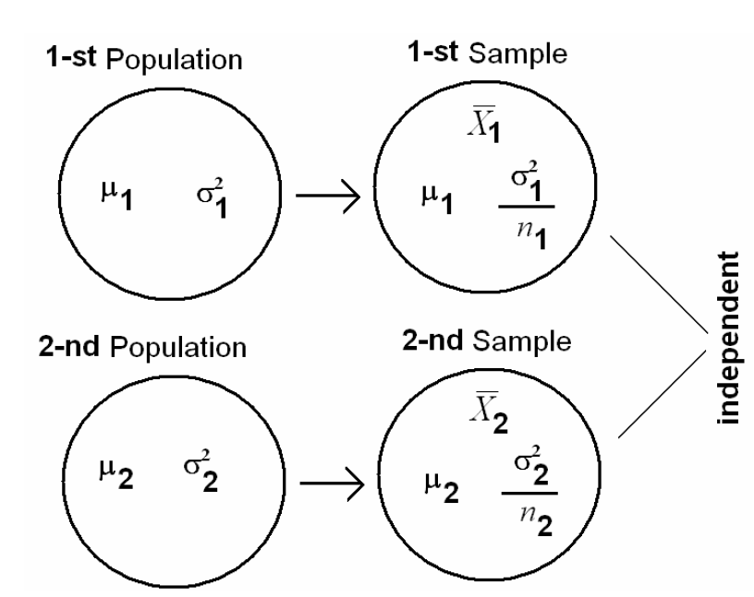

Slide 20
Theorem

Slide 21
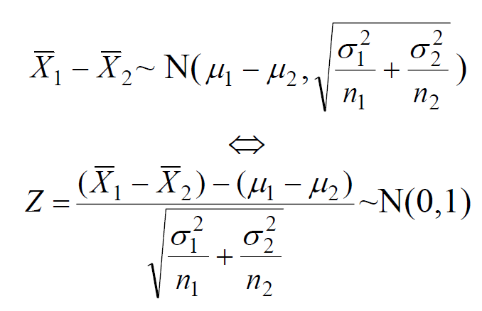
that is:

Slide 22
Note:

Slide 23
Example
The television picture tubes of manufacturer A have a mean lifetime of 6.5 years and standard deviation of 0.9 year, while those of manufacturer B have a mean lifetime of 6 years and standard deviation of 0.8 year. What is the probability that a random sample of 36 tubes from manufacturer A will have a mean lifetime that is at least 1 year more than the mean lifetime of a random sample of 49 tubes from manufacturer B ?

Slide 24
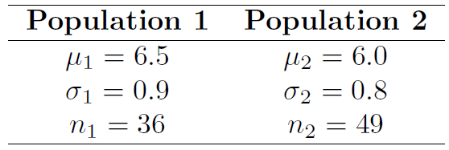
Solution:
We need to find the probability that the mean lifetime of manufacturer A is at least 1 year more than the mean lifetime of manufacturer B which is $P({\overline{X}}_{1}≥{\overline{X}}_{2}+1)$

Slide 26
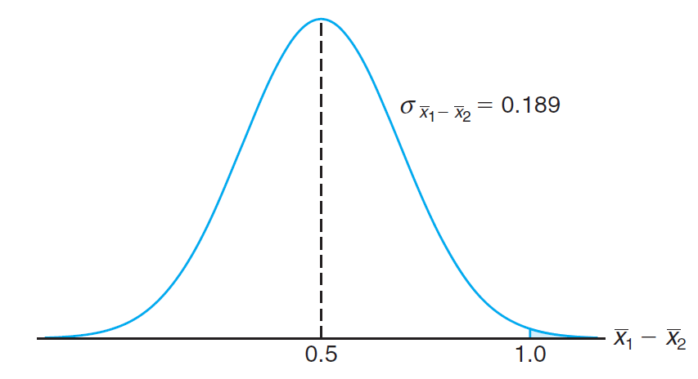

Slide 28
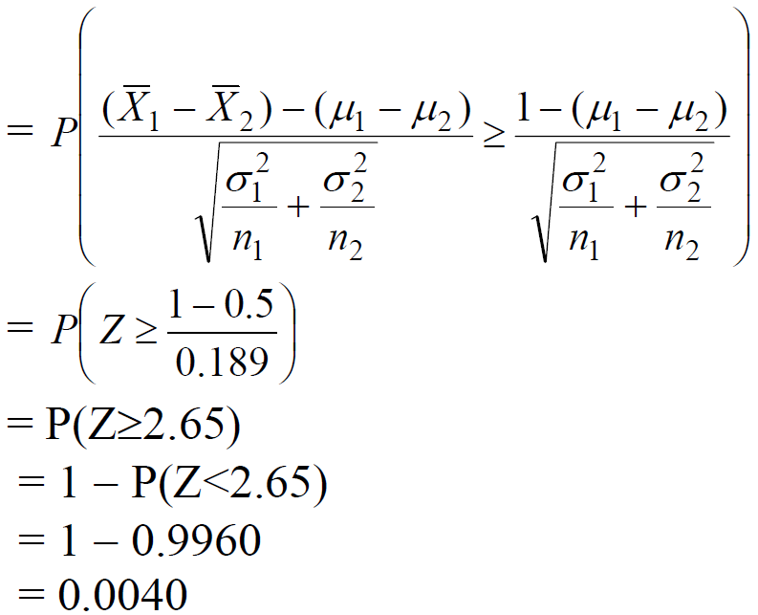

Slide 29
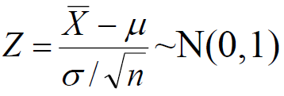
t-Distribution:
Recall that, if $X_{1},X_{2},…,X_{n}$is a random sample of size $n$from a normal distribution with mean μ and variance σ², i.e. $N(μ,σ)$, then
We can apply this result only when σ² is known!
If σ² is unknown, we replace the population variance σ² with the sample variance

Slide 30
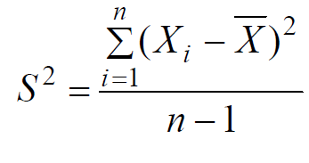
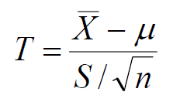
to have the following statistic

Slide 31
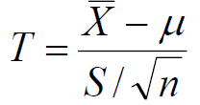
Result:
If $X_{1},X_{2},…,X_{n}$is a random sample of size $n$from a normal distribution with mean μ and variance σ², i.e. $N(μ,σ)$, then the statistic
has a t-distribution with $ν=n−1$degrees of freedom (df), and we write
$T\sim t(ν) or T\sim t(n−1).$

Slide 32
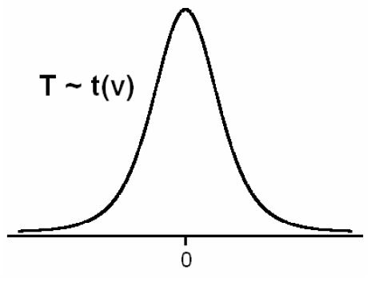
Note:
• t-distribution is a continuous distribution.
• The shape of t-distribution is similar to the shape of the standard normal distribution.

Slide 33
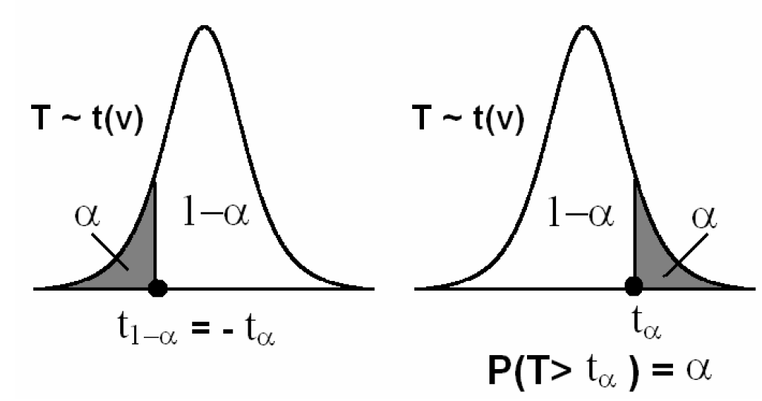
Notation:

Slide 34
• $t_{α}$= The t-value above which we find an area equal to $α$, that is $P(T>t_{α}) = α$
• Since the curve of the pdf of $T\sim t(ν)$ is symmetric about 0, we have
$t_{1−α}$= $−t_{α}$
• Values of $t_{α}$are tabulated

Slide 35
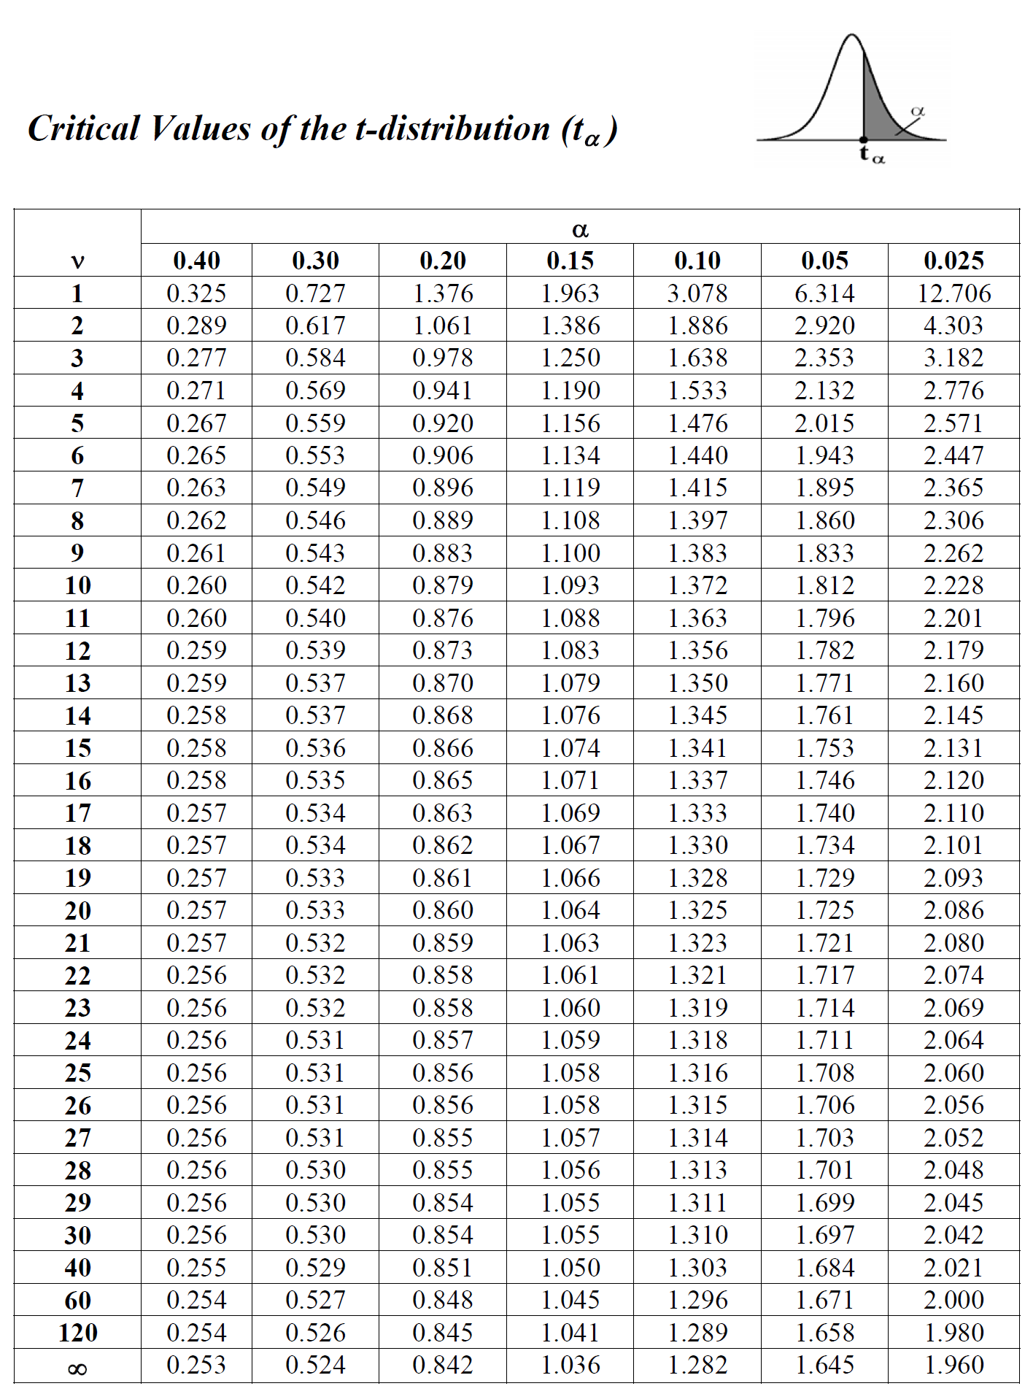

Slide 36
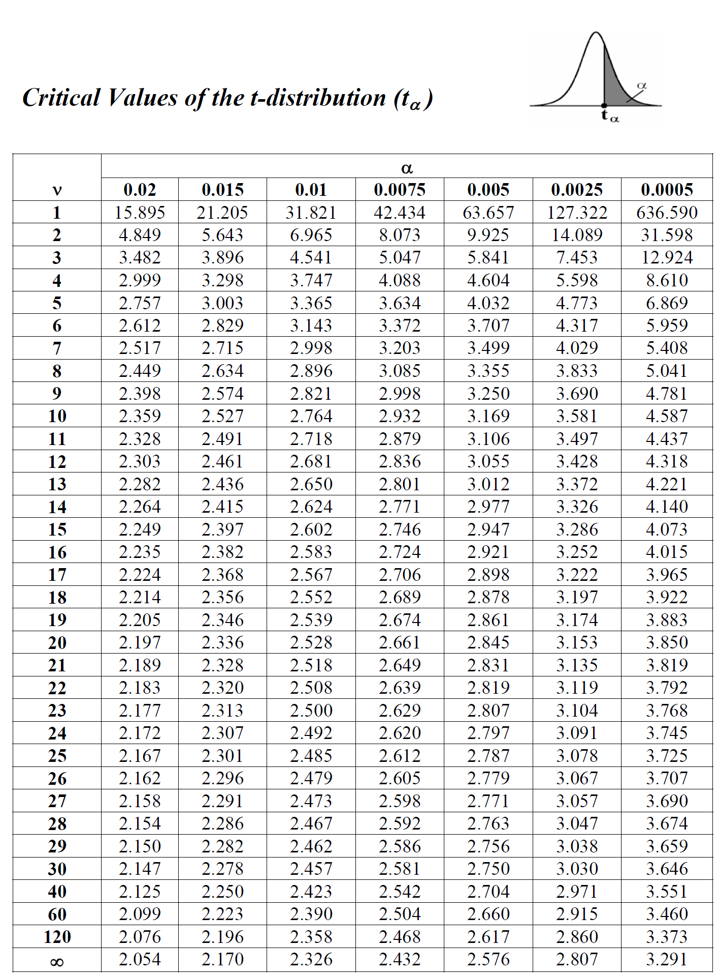

Slide 37
Example:
Find the t-value with $ν=14$ (df) that leaves an area of:
(a) 0.95 to the left.
(b) 0.95 to the right.

Slide 38
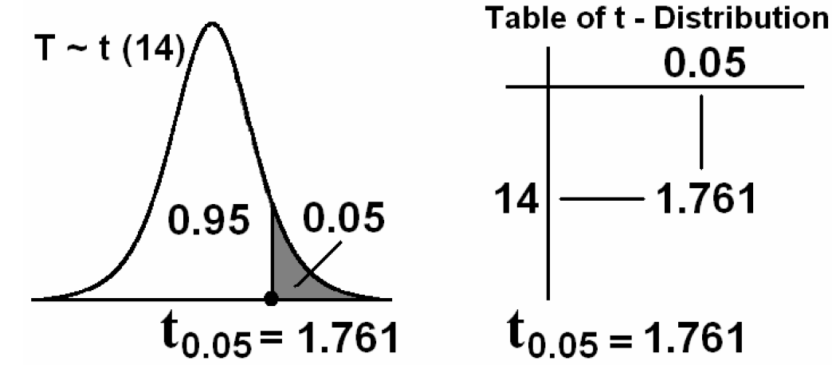
Solution:
$$ν = 14 (df); T\sim t(14)$$
(a) The t-value that leaves an area of 0.95 to the left is $t_{0.05}$= 1.761

Slide 39
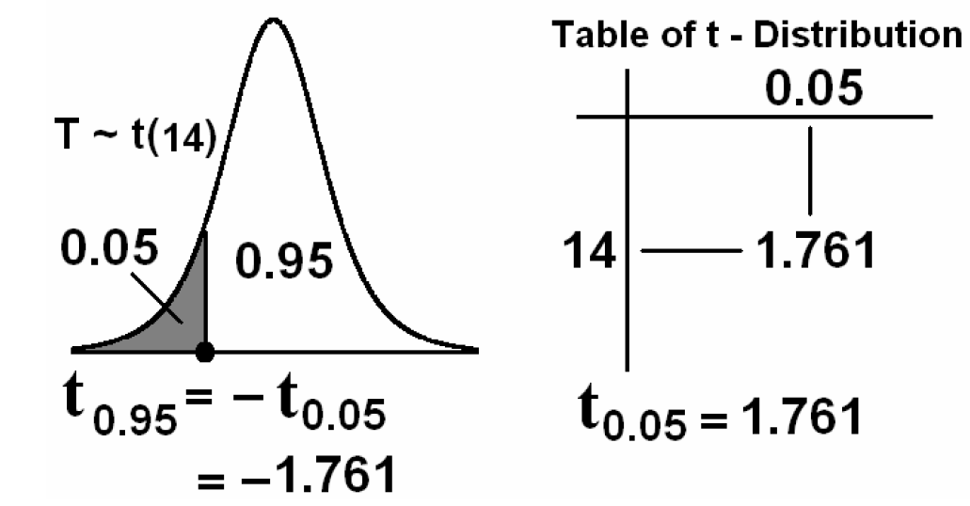
(b) The t-value that leaves an area of 0.95 to the right is
$t_{0.95}$= − $t_{1−0.95}$= − $t_{0.05}$= − 1.761

Slide 40
Example:
For $ν = 10$degrees of freedom (df), find $t_{0.10}$and $t_{0.85}$.
Solution:
$t_{0.10}$= 1.372
$t_{0.85}$= − $t_{1−0.85}$= − $t_{0.15}$= −1.093 ($t_{0.15}$= 1.093)

Slide 41
