Slide 1
ASP.NET Part 2
Lecture 7
Sara Almudauh

Slide 2
What is ASP.NET Server Control?
ASP.NET server controls
The simplest ASP.NET components
Wrap an HTML UI element, or more complex UI
Component-oriented programming model
Executed and rendered at the server side
Example of ASP.NET server controls:
<asp:Button> → <input type=“submit”>
<asp:Label> → <span>
<asp:GridView> → <table><tr><td>..

Slide 3
ASP.NET - Server Controls
Server controls are tags that are understood by the server.
There are three kinds of server controls:
HTML Server Controls - Traditional HTML tags.
Web Server Controls - New ASP.NET tags:
Basic Web Controls .
Validation Controls .
List Controls .
Rich Controls.

Slide 4
The runat Attribute
The runat attribute makes a server control a server control
This is true for both HTML and Web controls
All tags without the runat attribute are copied verbatim to the output stream (HTTP response)
<asp:TextBox ID="TextBox3" runat="server"></asp:TextBox>

Slide 5
HTML Server Controls
HTML server controls are HTML tags understood by the server.
HTML elements in ASP.NET files are, by default, treated as text.
To make these elements programmable, add a runat="server" attribute to the HTML element.
This attribute indicates that the element should be treated as a server control.
The id attribute is added to identify the server control.
The id reference can be used to manipulate the server control at run time.

Slide 6
HTML Controls
Supported controls
<a>
<img>
<form>
<table>
<tr>
<td>
<th>
<select>
<textarea>
<button>
<input type=text>
<input type=file>
<input type=submit>
<input type=button>
<input type=reset>
<input type=hidden>

Slide 7
HTML Server Controls
All HTML server controls must be within a <form> tag with the runat="server" attribute.
The runat="server" attribute indicates that the form should be processed on the server. It also indicates that the enclosed controls can be accessed by server scripts.

Slide 8
EXAMPLE
<head>
<title> Html Server Control</title>
</head>
<body>
<form id=“FormMain” runat=“server”>
<input id=“TextField” type=“text” runat=“server>
<input id=“ButtonSubmit” type=“button” runat=“server value=“submit”>
</form>
</body>

Slide 9
Web Server Controls
Web server controls are special ASP.NET tags understood by the server.
Like HTML server controls, Web server controls are also created on the server and they require a runat="server" attribute to work.
The syntax for creating a Web server control is:
<asp:control_name id="some_id" runat="server" />

Slide 11
EXAMPLE
<script runat="server"> Sub submit(Source As Object, e As EventArgs) button1.Text="You clicked me!" End Sub </script> <html> <body> <form runat="server"> <asp:Button id="button1" Text="Click me!" runat="server" OnClick="submit"/> </form> </body> </html>

Slide 12
Web Server Controls
Web Controls provide extensive properties to control display and format, e.g.
Font
BackColor, ForeColor
BorderColor, BorderStyle, BorderWidth
Style, CssClass
Height, Width
Visible, Enabled

Slide 13
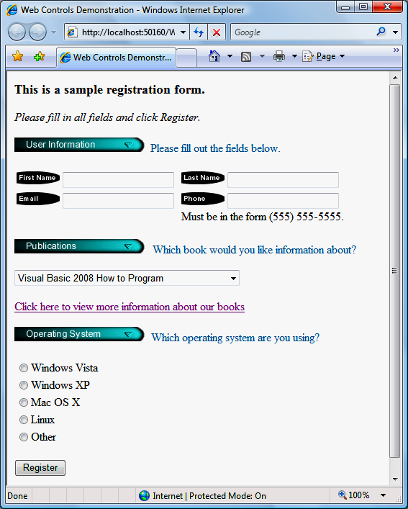
Web Controls Example
Image control
TextBox control
DropDownList control
HyperLink control
RadioButtonList
Button control

Slide 14
Basic Web Controls

Slide 15
Validation Server Controls
Validation server controls are used to validate user-input.
If the user-input does not pass validation, it will display an error message to the user.
Each validation control performs a specific type of validation (like validating against a specific value or a range of values).
By default, page validation is performed when a Button, ImageButton, or LinkButton control is clicked.
Types of user errors:
Forget to fill an important field
Submitting the wrong type of data
Submitting the data in a wrong format

Slide 16
Validation Server Controls
Most important validation controls:
RequiredFieldValidator
RangeValidator
CompareValidator
RegularExpressionValidator
ValidationSummary

Slide 17
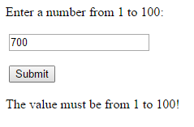
EXAMPLE
<html> <body> <form runat="server"> <p>Enter a number from 1 to 100: <asp:TextBox id="tbox1" runat="server" /> <br /><br /> <asp:Button Text="Submit" runat="server" /> </p> <p> <asp:RangeValidator ControlToValidate="tbox1" MinimumValue="1" MaximumValue="100" Type="Integer" Text="The value must be from 1 to 100!" runat="server" /> </p></form></body></html>

Slide 18
List Controls
ListBox
CheckBoxList
RadioButtonList
BulletedList
Repeater
DataList
GridView
DropDownList
ListView

Slide 19
Rich Controls
Task-specific controls
Built with multiple HTML elements
Rich functionality
Examples:
Calendar
Menu

Slide 20
ASP.NET Server Controls (Event Wiring 1)
ASP.NET Server controls have support events similar to their desktop countertops
Names Match

Slide 21
ASP Object: Cookies
A cookie is often used to identify a user.
A cookie is a small file that the server embeds on the user's computer.
It is a small piece of data sent from a website and stored in a user's web browser while the user is browsing that website.
Every time the user loads the website, the browser sends the cookie back to the server to notify the website of the user's previous activity

Slide 22
Cookies
With ASP, you can both create and retrieve cookie values.
The "Response.Cookies" command is used to create cookies.
The Response.Cookies command must appear BEFORE the <html> tag.
<% Response.Cookies("firstname")="Alex" %>

Slide 23
If a cookie contains a collection of multiple values, we say that the cookie has Keys.
In the example below, we will create a cookie collection named "user". The "user" cookie has Keys that contains information about a user:
<% Response.Cookies("user")("firstname")="John" Response.Cookies("user")("lastname")="Smith" Response.Cookies("user")("country")="Norway" Response.Cookies("user")("age")="25" %>

Slide 24
Read all Cookies
Assume that your server has sent all the cookies above to a user.
Now we want to read all the cookies sent to a user. The example below shows how to do it (note that the code below checks if a cookie has Keys with the HasKeys property):

Slide 25
<!DOCTYPE html> <html> <body> <% dim x,y for each x in Request.Cookies response.write("<p>") if Request.Cookies(x).HasKeys then for each y in Request.Cookies(x) response.write(x & ":" & y & "=" & Request.Cookies(x)(y)) response.write("<br>") next else Response.Write(x & "=" & Request.Cookies(x) & "<br>") end if response.write "</p>" next %> </body> </html>

Slide 26
output
firstname=Alex
user:firstname=John user:lastname=Smith user:country=Norway user:age=25

Slide 27
ASP Object: Session
A Session object stores information about, or change settings for a user session.
Variables stored in a Session object hold information about one single user, and are available to all pages in one application.
Common information stored in session variables are name, id, and preferences.
The server creates a new Session object for each new user, and destroys the Session object when the session expires.

Slide 28
A session starts when:
A new user requests an ASP file, and the Global.asa file includes a Session_OnStart procedure
A value is stored in a Session variable
A user requests an ASP file, and the Global.asa file uses the <object> tag to instantiate an object with session scope

Slide 29
A session ends if a user has not requested or refreshed a page in the application for a specified period. By default, this is 20 minutes.
If you want to set a timeout interval that is shorter or longer than the default, use the Timeout property.
The example below sets a timeout interval of 5 minutes
<% Session.Timeout=5 %>

Slide 30
Use the Abandon method to end a session immediately:
<% Session.Abandon %>

Slide 31
Store and Retrieve Session Variables
The most important thing about the Session object is that you can store variables in it.
The example below will set the Session variable username to "Donald Duck" and the Session variable age to "50":
<% Session("username")="Donald Duck" Session("age")=50 %>

Slide 32
When the value is stored in a session variable it can be reached from ANY page in the ASP application:
Welcome <%Response.Write(Session("username"))%>
The line above returns: "Welcome Donald Duck".

Slide 33
Remove Session Variables
The Contents collection contains all session variables.
It is possible to remove a session variable with the Remove method.
The example below removes the session variable "sale" if the value of the session variable "age" is lower than 18:
<% If Session.Contents("age")<18 then Session.Contents.Remove("sale") End If %>
To remove all variables in a session, use the RemoveAll method:
<% Session.Contents.RemoveAll() %>

Slide 34
Loop Through the Contents Collection
<% Session("username")="Donald Duck" Session("age")=50 dim i For Each i in Session.Contents Response.Write(i & "<br>") Next %>
output:
username age

Slide 35
Count property: Number of variables in session
<% dim i dim j j=Session.Contents.Count Response.Write("Session variables: " & j) For i=1 to j Response.Write(Session.Contents(i) & "<br>") Next %>

Slide 36
To add the new Global Application Class to your project:
right click the project entry in Solution Explorer.
choose Add New Item from the context menu.
You’ll see an Add New Item dialog box.
Select Global Application Class from the template list.

Slide 37
A Global Application Class contain five functions
1- Application_Start :
This function contains the Code that runs on application startup.
2- Application_End:
This function contains the Code that runs on application shutdown.
3- Application_Error :
This function contains the Code that runs when an unhandled error occurs.
4- Session_Start :
This function contains the Code that runs when a new session is started.
5- Session_End :
This function contains the Code that runs when a session ends.

Slide 38
If you want to initialize the values of variables that you will use in the session, do this:

Slide 39
For example:

Slide 40
This will appear after entering the previous data and clicking on the registration button.

Slide 41
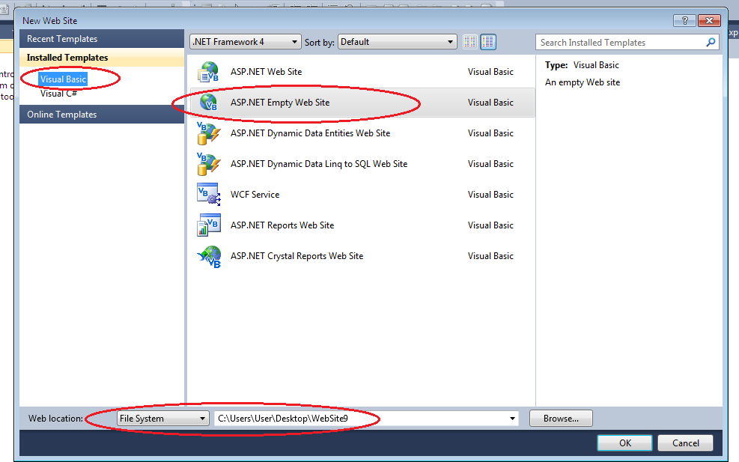
Creating an ASP.NET Web Application using Visual Studio
Step 1: Creating the Web Application Project
Select File > New Web Site... and choose ASP.NET Empty Web Site in the Templates pane.
Select File System from the drop-down list closest to Location.
Set the Language to Visual Basic, and click OK.

Slide 42
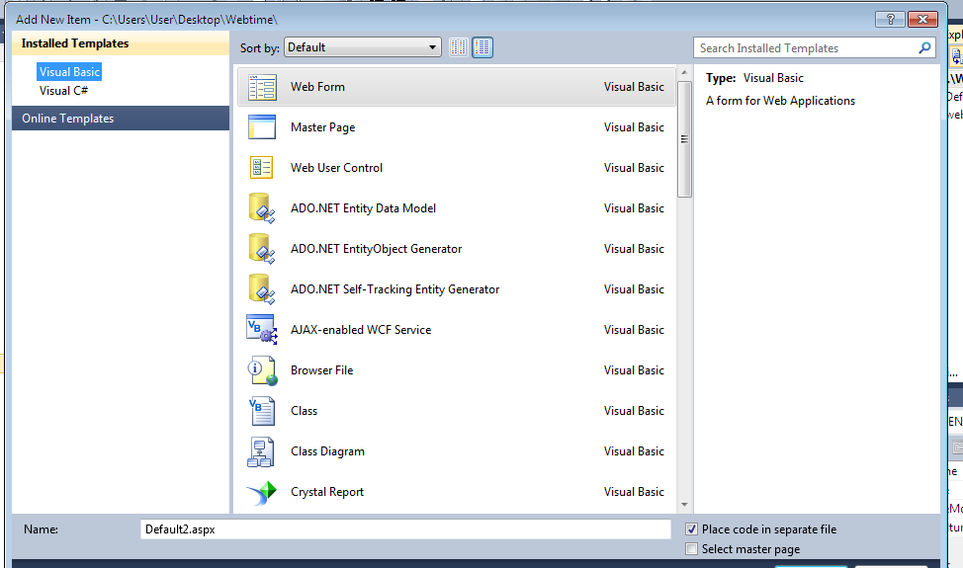
Creating an ASP.NET Web Application using Visual Studio
To add new page or web form to :
Right click in your website then select new item > Web form.

Slide 43
CSS Styling
CSS Inline Styles and Embedded Style Sheets
Visual Web Developer often generates CSS (Cascading Style SheetsTM) code to specify the presentation of an element.
In the head element of your .aspx file, the style element defines embedded style sheets.
The style element’s type attribute specifes the MIME type of its content.
The body of the style sheet declares CSS rules (styles).
A CSS rule is composed of a CSS selector and a series of property specifications separated by semicolons (;) and enclosed in curly braces ({}).
Each specification is composed of a property followed by a colon and a value.

Slide 44
Example: CSS Styling
Setting the Color of Text on a Web Form
Add CSS styles using <style>
Then apply the style in an XHTML span element using CSS styling.
The style class can then be applied to any element in the document by setting the XHTML attribute class.
Another way to apply styles is to use inline styles, which declare an individual element’s format using the XHTML attribute style.

Slide 45
CSS
WebControls.aspx
( 1 of 6 )
In the head element of your .aspx file, the style element defines embedded style sheets.

Slide 46
Questions !! ☺

