Slide 1


Slide 2



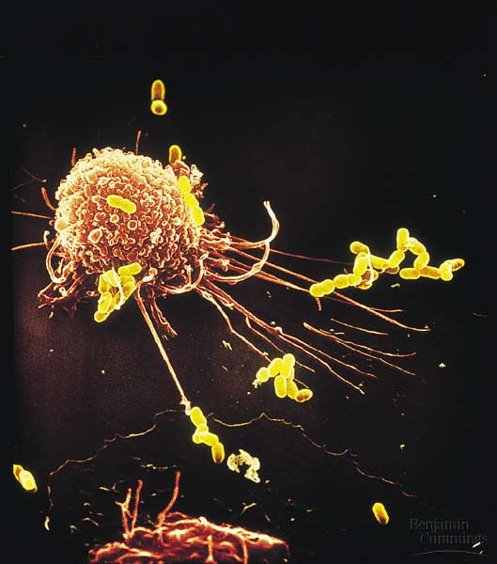
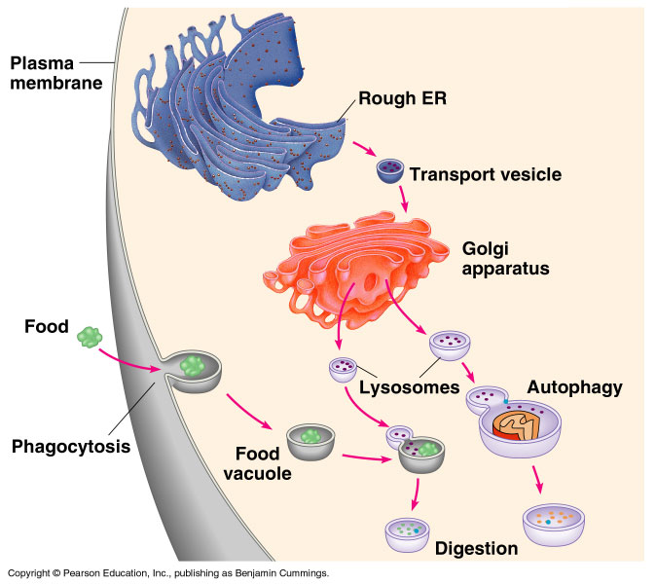
B- Eukaryotic Cell
Copyright © 2002 Pearson Education, Inc., publishing as Benjamin Cummings

Slide 3
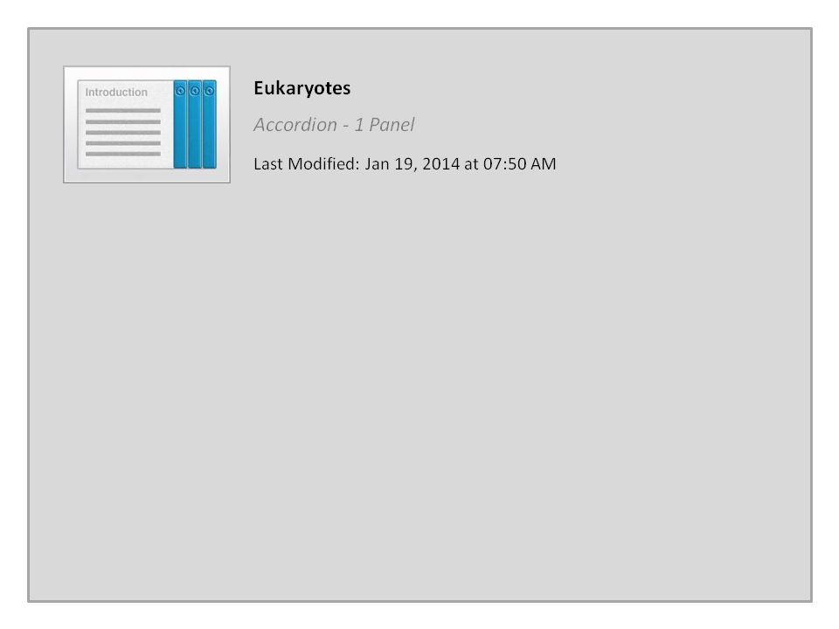
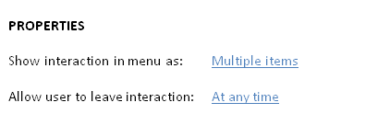


Eukaryotes

Slide 4


3- The Endomembrane System
The endoplasmic reticulum is a manufacturer membrane and performs many other biosynthetic functions.
The Golgi apparatus finishes, sorts, and ships cell products.
The Lysosomes are digestive compartments.
The Vacuoles have diverse functions in cell maintenance.
Copyright © 2002 Pearson Education, Inc., publishing as Benjamin Cummings

Slide 5
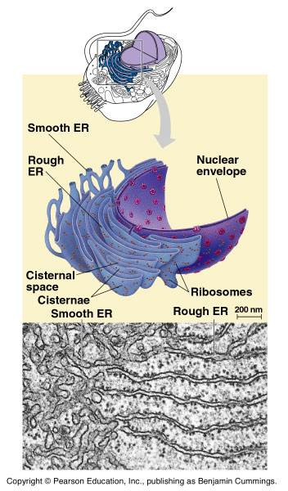
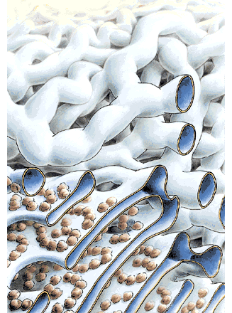
A)- The endoplasmic reticulum (ER)
(intracellular highway)
Largest internal membrane, Composed of Lipid bilayer
Serves as a system of channels from the nucleus
Functions in storage and secretion
There are two types of ER those are different in structure and function.
  Smooth ER looks smooth because it lacks ( does not have ) ribosomes.
  Rough ER looks rough because ribosomes (bound ribosomes) are attached to its outside.
Rough
Smooth

Slide 6
The endoplasmic reticulum
The smooth ER:
It is Smooth as it lacks the associated ribosomes.
It is rich in enzymes and plays a role in metabolic processes.
Its enzymes synthesize lipids (oils, phospholipids and steroids). including the sex hormones.
Extensive in the liver, it helps in detoxifying drugs and poisons.
The rough ER:
It is “rough” because of the associated ribosomes (sites of protein synthesis)
It is especially abundant in those cells that secrete proteins such as digestive glands and antibody-producing cells.
These secretory proteins are packaged in transport vesicles that carry them to their next stage.

Slide 7
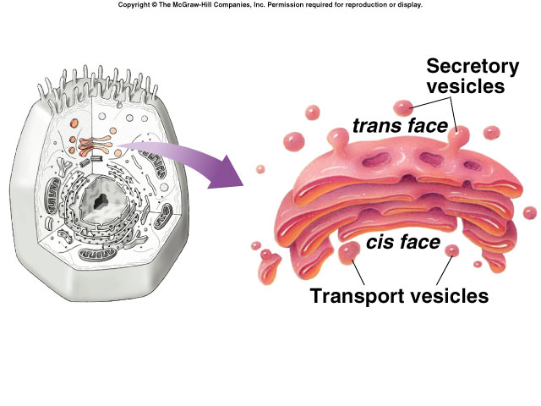
B)- Golgi apparatus: finishes, sorts, packages and ships cell products
    Collect, package, and distribute molecules synthesized at one location in the cell and utilized at another location
Many transport vesicles from the ER travel to the Golgi apparatus for modification of their contents.
The Golgi body’s function is manufacturing, warehousing, sorting (Packaging), and shipping materials to outside the cell.
The Golgi also manufactures polysaccharides.
It correctly send proteins to their respective address.
If the Golgi makes a mistake in shipping the proteins to the right address, certain functions in the cell may stop.
The Golgi apparatus is more abundant in secretory cells.

Slide 8
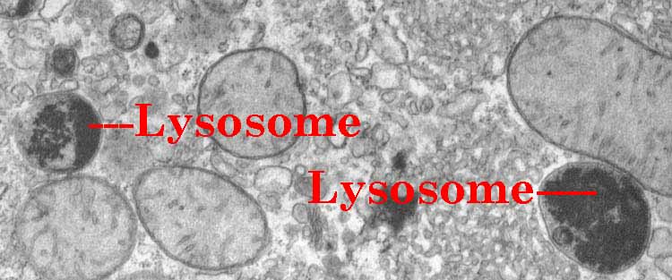
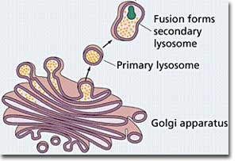
C)- Lysosomes: are digestive components
The lysosome is a membrane-bounded sac of enzymes that digests macromolecules.
Lysosomal enzymes work best at pH = 5 (acidic).
The lysosomal enzymes are synthesized by rough ER and then transferred to the Golgi then to lysosomes.

Slide 9
Function of Lysosomal enzymes
They hydrolyse proteins, fats, polysaccharides, and nucleic acids.
Can destroy the cell by autodigestion (autophagy).
Can fuse with food vacuoles to digest food, (when a food item is brought into the cell by phagocytosis).
Can also fuse with another organelle or part of the cytosol. This process of autophagy called recycling which renews the cell.
They digest unwanted particles.
They help white blood cells to destroy bacteria.

Slide 11
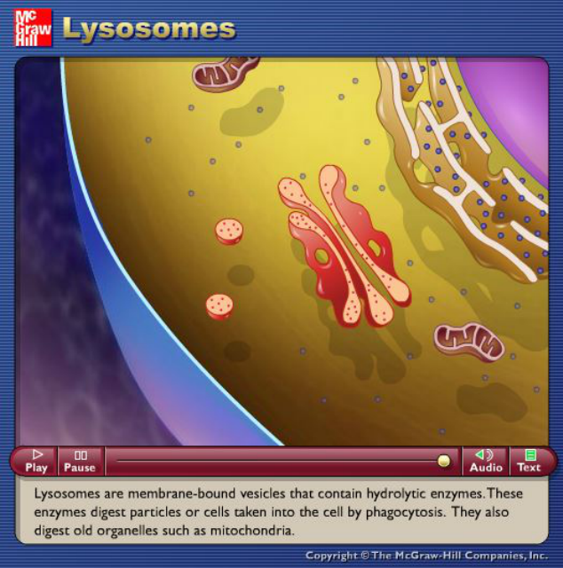
Source: http://highered.mcgraw-hill.com/olc/dl/120067/bio01.swf

Slide 12
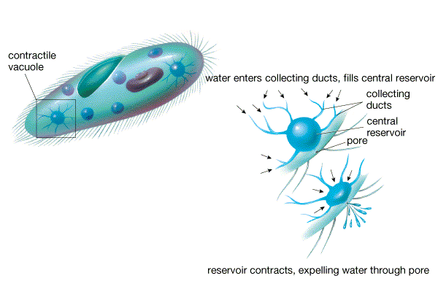
D)- Vacuoles: have diverse functions in cell maintenance
They are membrane-bound sacs with varied functions such as storage, digestion, and waste removal.
Contain water solution and help plants maintain shape.
There are different types of vacuoles including:
  Food vacuoles, from phagocytosis, fuse with lysosomes for digestion.
  Contractile vacuoles, found in freshwater protists maintains water balance by pumping excess water out of the cell.
  Central vacuoles (mature plants) stores waste, maintains turgidity.

Slide 13
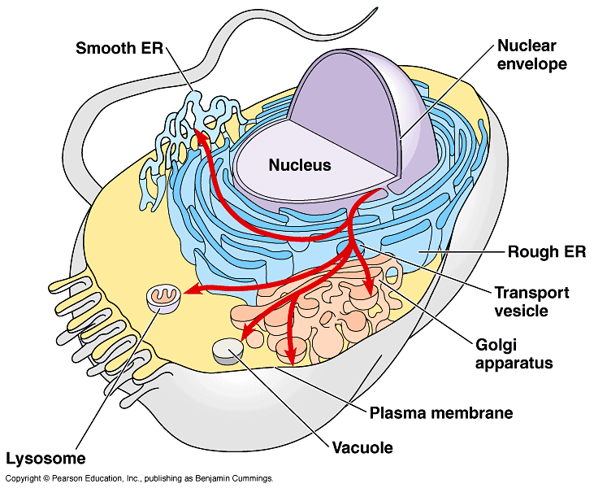
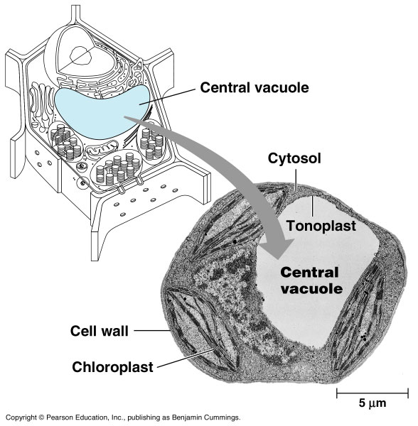

Slide 14
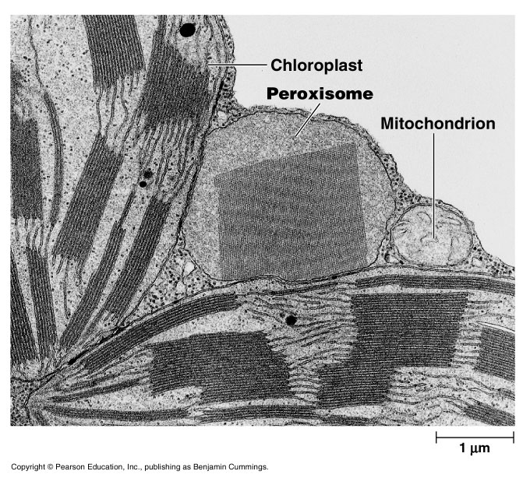
Other Membranous Organelles
A)- Peroxisomes
Peroxisomes are similar in appearance to lysosomes, but the two have different origins. Lysosomes are generally formed in the Golgi complex, whereas peroxisomes self-replicate themselves.
  Contain enzymes for degrading amino acids and fatty acids. These reactions produce a toxic hydrogen peroxide; (H₂O₂) as a byproduct of cellular metabolism.

Slide 15
Functions of peroxisomes
  1- Hydrogen peroxide (H₂O₂) is a poison, but the peroxisome has enzyme that converts H₂O₂ to water (H₂O).
  2- Some peroxisomes break fatty acids down to smaller molecules that are transported to mitochondria as fuel (cellular respiration).
  3- They detoxify alcohol and other harmful compounds. Thus, it exists extensively in the liver cells.
4- Initiate the production of phospholipids, which are typically used in the formation of membranes.

Slide 16
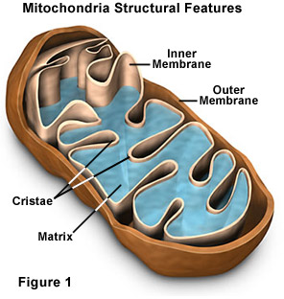
Other Membranous Organelles
B)- Mitochondria:
They are rod-shaped organelles that convert oxygen and nutrients into ATP (adenosine triphosphate) during aerobic respiration.
Mitochondria are the sites of cellular respiration,
Generating ATP from the catabolism of sugars, fats, and other fuels in the presence of oxygen.
Almost all eukaryotic cells have mitochondria.
Mitochondria and chloroplasts are mobile and move around the cell along tracks in the cytoskeleton.

Slide 17
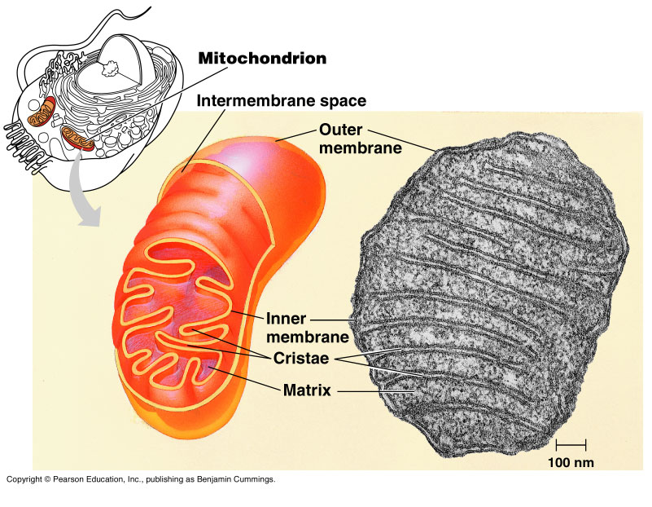
Mitochondria have a smooth outer membrane and a highly folded inner membrane forming cristae.
The inner membrane encloses the mitochondrial matrix, a fluid-filled space with DNA, ribosomes, and enzymes.
The number of mitochondria present in a cell depends upon the metabolic requirements of that cell, and may range from a single large mitochondrion to thousands of the organelles.
The mitochondrion is different from most other organelles because it has its own circular DNA (similar to the DNA of prokaryotes) and reproduces independently of the cell in which it is found.

Slide 18
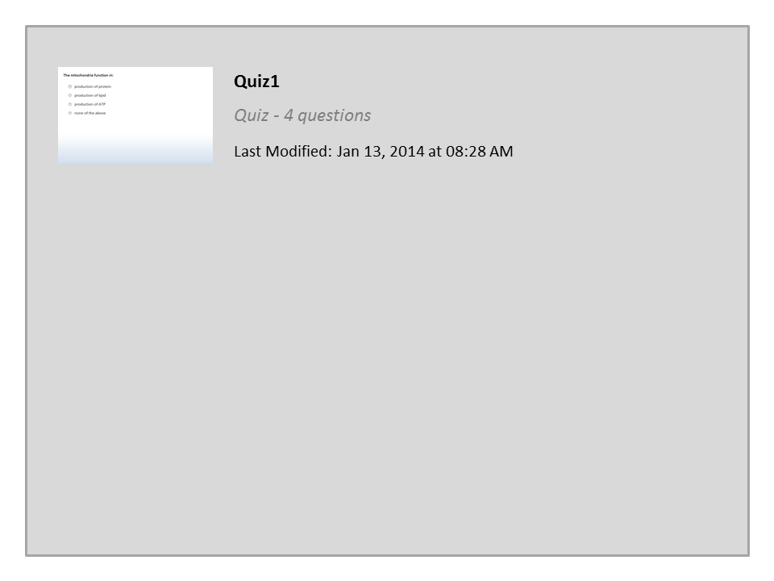
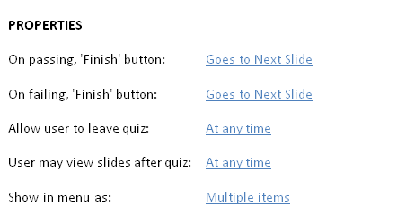

Quiz1

Slide 19




College of Science,
Zoology Department
General Animal Biology
(Zoo-145)
Prof. Ashraf M. Ahmed
aalii@ksu.edu.sa

