Slide 1

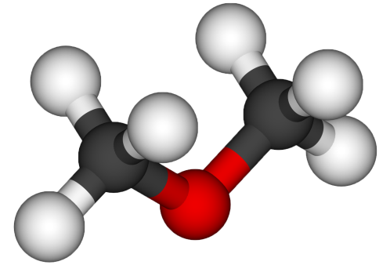
ETHERS AND EPOXIDES
Dr. Shatha I Alaqeel

Slide 2
Learning Objectives
Chapter seven discusses the following topics and by the end of this chapter the students will:
Know the structure of ethers
Know the different methods of naming ethers
Know the physical properties of ethers
Know the different methods used in preparation of ethers
Know the reactions of opened ethers with HX
Know the different methods used in synthesis of epoxides
Know the reactions of epoxides with different nucleophiles

Slide 3
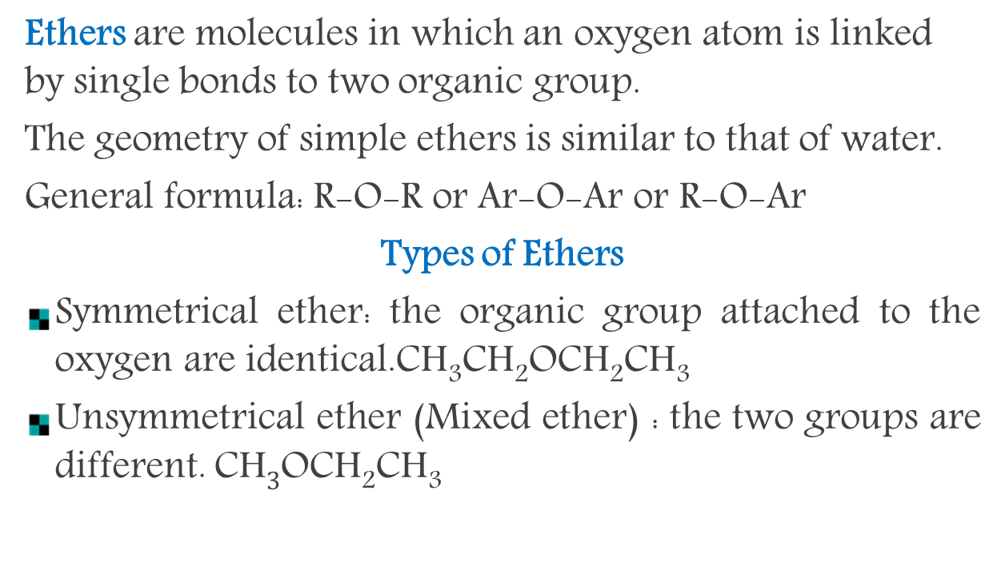
Structure and Nomenclature of Ethers
Ethers are molecules in which an oxygen atom is linked by single bonds to two organic group.
The geometry of simple ethers is similar to that of water.
General formula: R-O-R or Ar-O-Ar or R-O-Ar
Types of Ethers
Symmetrical ether: the organic group attached to the oxygen are identical.CH₃CH₂OCH₂CH₃
Unsymmetrical ether (Mixed ether) : the two groups are different. CH$3$OCH₂CH₃

Slide 4

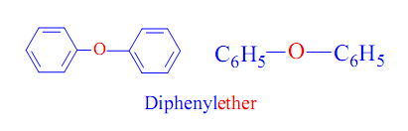
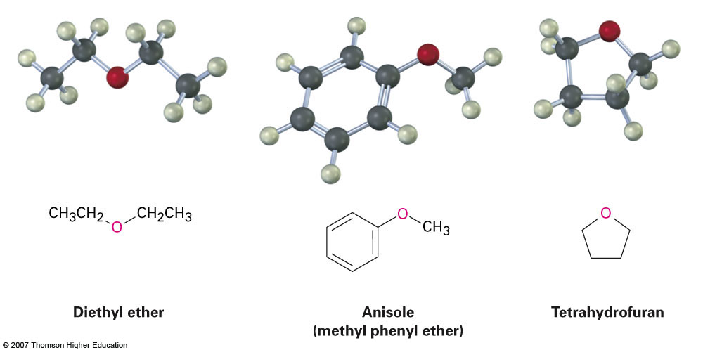
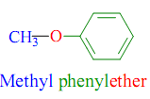
Classification of Ethers
(I) Aliphatic Ethers
(II) Aromatic Ethers

Slide 5
Common Nomenclature
The common names of ethers are derived by naming the alkyl groups bonded to the oxygen then listing them in alphabetical order followed by the word "ether".
In Symmetrical ethers write the prefix “Di” then name of group followed by the word ether.
CH₃-O-C₂H₅ CH₃-O-CH₃
Ethyl methyl ether Dimethyl ether

Slide 6
IUPAC Nomenclature
The ether functional group does not have a characteristic IUPAC nomenclature suffix, so the ethers are considered as alkoxy (RO- the smaller alkyl group) derivatives of a parent compounds (alkane, or alkene, or alkyne,or alcohol,----) .
Names of some common alkoxy groups (RO-):
CH₃O-- Methoxy
CH₃CH₂CH₂O-- n-Propoxy
CH₂CH₃O-- Ethoxy
(CH₃)₂CHO-- Isopropoxy
                (CH₃)₃CO– tert-Butoxy
C₆H₅O– Phenoxy

Slide 7

Hexyl methyl ether Diethyl ether Common
Methoxy hexane 3-Methoxy hexane Ethoxy ethane IUPAC
Ethyl vinyl ether Divinyl ether
Ethoxy ethene Vinyloxyethene 5-Ethoxy-2-heptene
Diphenyl ether Methyl Phenyl ether anisole
Propenyloxy benzene Phenoxy benzene Methoxy benzene

Slide 8
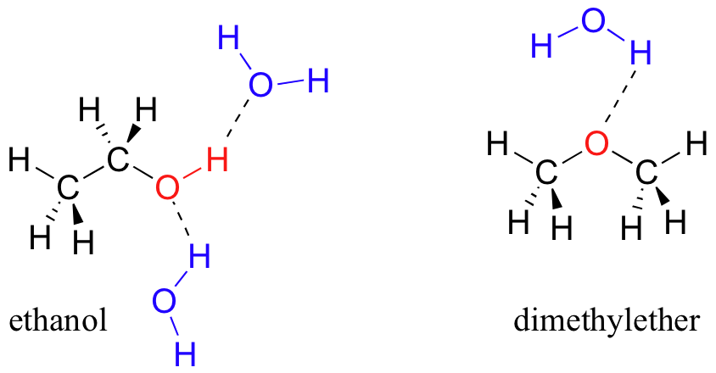
Physical Properties of Ether
ether is soluble in water, because the Oxygen atom in ether is capable of hydrogen bonding with water molecules. The solubility decreases with increase in the number of carbon atoms.
Ethers are much less soluble in water than alcohols (Because they don’t have –OH group, So they are not hydrogen bond donors).
More water-soluble than hydrocarbons of similar molecular weight (Because they are polar).
boiling points of ethers are lower than alcohols because there are no hydrogen bonding between one ether molecule and another.
Oxygen is sp³-hybridized

Slide 9
Preparation of Ethers
The Williamson synthesis
The reaction of a sodium alkoxide RONa or a sodium phenoxide ArONa with an alkyl halide to form an ether. (nucleophilic substitution reaction )
This method is used for preparation for symmetrical and unsymmetrical ethers.
The alkoxide or phenoxide is commonly made by adding Na or K to the alcohol or phenol.

Slide 10
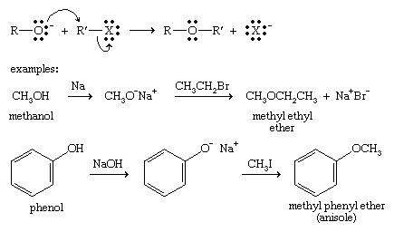
If a secondary ( 2°) or tertiary alkyl halide ( 3°) is used, an alkene is the only reaction product and no ether is formed.

Slide 11
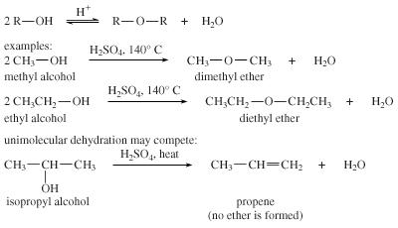
Dehydration of alcohols
The dehydration of alcohols takes place in the presence of acid catalysts (H₂SO₄, H₃PO₄) under controlled temperature. This method is used for preparation for symmetric ethers.

Slide 12
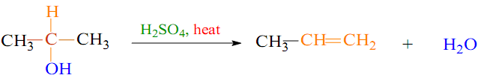
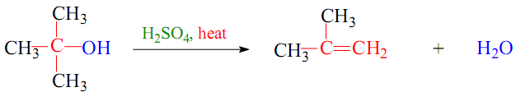
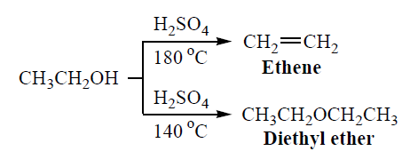
The dehydration of 2° and 3° alcohol is unsuccessful to get ethers as alkenes are formed easily.

Slide 13
Reaction of Ether
Cleavage of ethers by hot concentrated acids
R-O-R + H-X R-OH + R-X
R-O-R + 2 H-X 2R-X + H₂O
Note: the smaller alkyl group gets converted to the alkyl halide
Heat/ H₂O
concentrated
Heat/ H₂O
excess

Slide 14

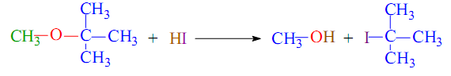


If both the alkyl groups are primary or secondary, the smaller alkyl group gets converted to the alkyl halide predominantly.
If one of the alkyl group is tertiary, the point of cleavage is such that the tertiary alkyl halide is formed as the major product
If two or more equivalents of acid are used further dehydration
can occur on formed alcohols which may react further to form a second mole of alkyl halide.

Slide 15
Epoxides
Epoxides are cyclic ethers in which the ether oxygen is part of a three-membered ring.
Epoxides are very reactive (release of ring strain), and are useful intermediates because of their chemical versatility
Common Ethylene oxide Propylene oxide Isobutylene oxide Styrene oxide
IUPAC oxirane 2-Methyl oxirane 2,2-dimethyl oxirane 2-Phenyl oxirane

Slide 16
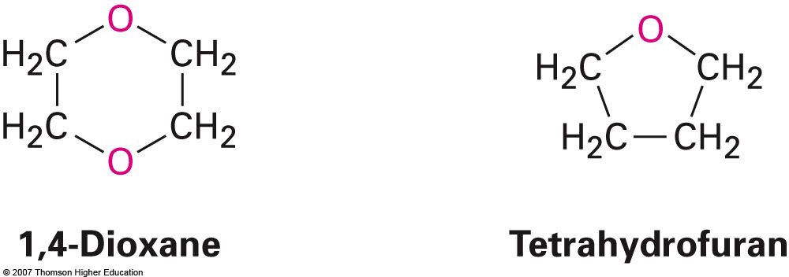
The simplest and the most important epoxide is ethylene oxide.
Dioxane and tetrahydrofuran are used as solvents

Slide 17
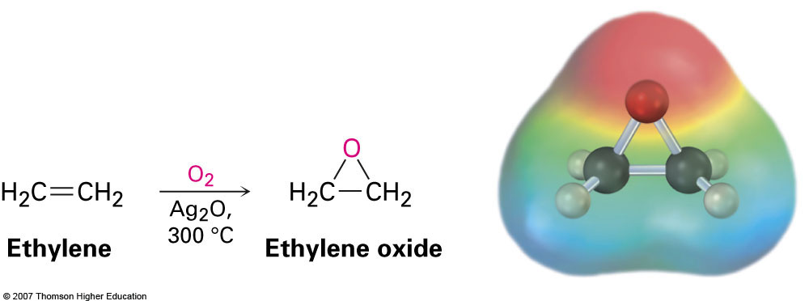
Preparation of cyclic ethers
Ethylene oxide (oxirane; 1,2-epoxyethane) is industrially important as an intermediate
Prepared by reaction of ethylene with oxygen at 300 °C and silver oxide catalyst

Slide 18
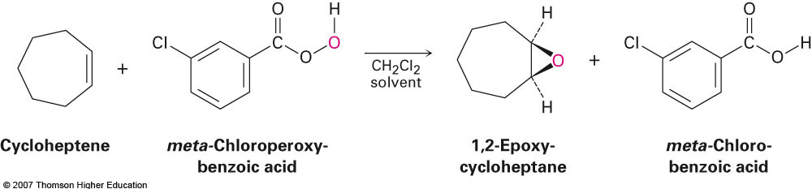
Preparation of Epoxides Using a Peroxyacid
Peroxyacids (sometimes called peracids) are used to convert alkenes to epoxides.
meta-chloroperoxybenzoic acid (MCPBA) is often used for these epoxidations.

Slide 19
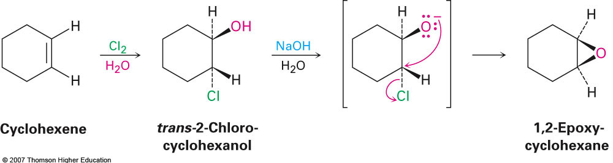
Epoxides from Halohydrins
Addition of HO-X to an alkene gives a halohydrin
Treatment of a halohydrin with base gives an epoxide
Intramolecular Williamson ether synthesis

Slide 20
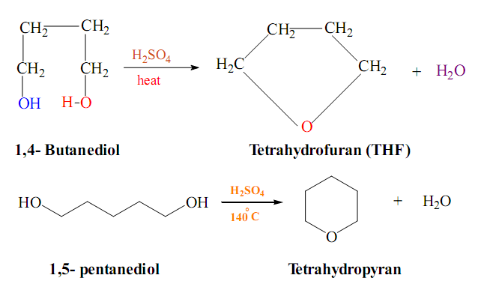
Dehydration of dialcohols

Slide 21
Reaction of Epoxides
Epoxides are easily undergo ring-opening reactions under both acidic and basic conditions.

Slide 22
Thank You for your kind
attention !
Questions?

