Slide 1
ASP.NET Part 1
Lecture 6
Sara Almudauh

Slide 2
What is ASP?
ASP is a server side scripting technology that enables scripts (embedded in web pages) to be executed by an Internet server.

Slide 3
What is ASP?
ASP stands for Active Server Pages
Also called classic ASP
ASP is a Microsoft Technology .
ASP is a program that runs inside IIS
IIS stands for Internet Information Services
ASP is a powerful tool for making dynamic and interactive Web pages.

Slide 4
ASP file
An ASP file is just the same as an HTML file
An ASP file can contain text, HTML, XML, and scripts
Scripts in an ASP file are executed on the server
An ASP file has the file extension ".asp"

Slide 5
Limitations in Classic ASP
The code block has to be placed where you want the output to appear.
With Classic ASP it is impossible to separate executable code from the HTML itself. This makes the page difficult to read, and difficult to maintain.

Slide 6
ASP.NET
ASP.NET is the latest version of Microsoft's Active Server Pages technology (ASP).

Slide 7
.NET – What Is It?
Software platform
Language neutral
In other words:
.NET is not a language (Runtime and a library for writing and executing written programs in any compliant language)

Slide 8
Framework, Languages, And Tools
VB
VC++
VC#
JScript
…
Visual Studio.NET
Common Language Specification
ASP.NET: Web Services
and Web Forms
Windows Forms
ADO.NET: Data and XML
Base Class Library
Common Language Runtime
Notes:
The .NET framework exposes numerous classes to the developer. These classes allow the development of rich client applications and Web based applications alike. In the above slide these classes have been divided into 4 areas.
ASP.NET provides the core Web infrastructure such as Web Forms for UI based development and Web Services for programmatic interface development,
User interface development on the Windows platform can be done using Windows Forms
ADO.NET and XML provide the functionality for data access.
Finally, the core base classes provide infrastructure services such as security, transaction management etc.

Slide 9
The .NET Framework .NET Framework Services
Common Language Runtime
Windows® Forms
ASP.NET
Web Forms
Web Services
ADO.NET, evolution of ADO
Visual Studio.NET
Notes:
Common Language Runtime
Common, secure execution environment.
We’ll drill into this in some detail in the first parts of the presentation.
Windows® forms
Framework for building rich clients
A demonstration will highlight some of these features, such as the delegate-based event model.
ASP.NET
Web forms
Manageable code (non spaghetti)
Logical evolution of ASP (compiled)
Again, we’ll drill into a hint at the power of Web Forms with a demonstration
Web Services
Programming the Internet to leverage the "power at the edge of the cloud".
We will cover this in detail, as this – along with the CLR – is one of the more powerful aspects of .NET Framework.
ADO.NET, evolution of ADO
New objects (e.g., DataSets, Datareader)
Visual Studio.NET
Most productive development environment gets better and fully supports the .NET Framework

Slide 10
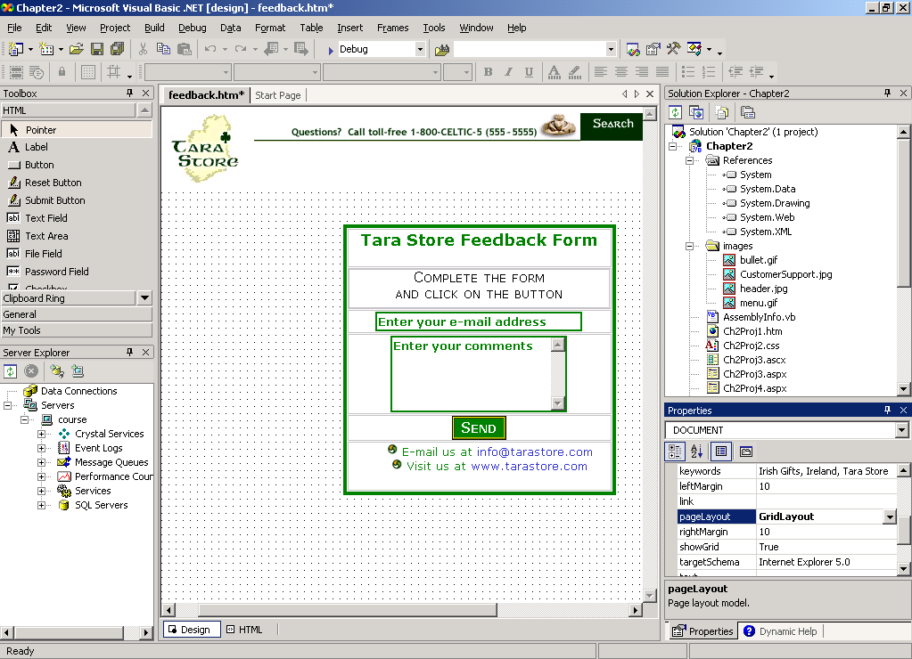
Visual Studio .NET IDE Layout

Slide 11
ASP.NET
ASP.NET is a development framework for building web pages and web sites with HTML, CSS, JavaScript and server scripting.
Web Applications are built using Web Forms
Built on .NET Framework: any .NET programming language can be used (C#, Visual Basic)

Slide 12
How ASP.NET works
Fundamentally an ASP.NET page is just the same as an HTML page.
If a browser requests an ASP.NET page, the server processes any executable code in the page, before the result is sent back to the browser.

Slide 13
ASP.Net file
ASP.NET is used to produce interactive, data-driven web applications over the internet.
It consists of a large number of controls such as text boxes, buttons, and labels for assembling, configuring, and manipulating code to create HTML pages.

Slide 14
ASP Example
<html> <body> <% response.write("My first ASP script!") %> </body> </html>
My first ASP script!

Slide 15
Web Forms
Web Forms is one of the 3 programming models for creating ASP.NET web sites and web applications.
The other two programming models are Web Pages and MVC (Model, View, Controller).
Web Forms are compiled and executed on the server, which generates the HTML that displays the web pages.

Slide 16
ASP.NET States
Now, HTTP is a stateless protocol. ASP.NET framework helps in storing the information regarding the state of the application, which consists of:
Page state
Session state

Slide 17
ASP.NET States
The page state is the state of the client, i.e., the content of various input fields in the web form. The session state is the collective information obtained from various pages the user visited and worked with, i.e., the overall session state. To clear the concept, let us take an example of a shopping cart.

Slide 18
ASP.NET States
User adds items to a shopping cart. Items are selected from a page, say the items page, and the total collected items and price are shown on a different page, say the cart page. Only HTTP cannot keep track of all the information coming from various pages. ASP.NET session state and server side infrastructure keeps track of the information collected globally over a session

Slide 19
The ASP.NET Component Model
The ASP.NET component model provides various building blocks of ASP.NET pages. Basically it is an object model, which describes:
Server side counterparts of almost all HTML elements or tags, such as <form> and <input>.
Server controls, which help in developing complex user-interface. For example, the Calendar control or the Gridview control.

Slide 20
ASP Basic Syntax Rules
An ASP file normally contains HTML tags, just like an HTML file.
any ASP server script must be surrounded by the symbols <% … %>

Slide 21
ASP Variables: Declare variables
<!DOCTYPE html> <html> <body> <% dim name name="Donald Duck" response.write("My name is: " & name) %> </body> </html>

Slide 22
Result
My name is: Donald Duck

Slide 23
ASP Variables: Declare variables
<!DOCTYPE html> <html> <body> <% response.write("<h2>You can use HTML tags to format the text!</h2>") %> <% response.write("<p style='color:#0000ff'>This text is styled with the style attribute!</p>") %> </body> </html>

Slide 24
Result
You can use HTML tags to format the text!
This text is styled with the style attribute!

Slide 25
ASP Variables This example will display a different message to the user depending on the time on the server.
<!DOCTYPE html> <html> <body> <% dim h h=hour(now()) response.write("<p>" & now()) response.write("</p>") If h<12 then response.write("Good Morning!") else response.write("Good day!") end if %> </body> </html>

Slide 26
Result
10/28/2015 12:55:44 PM
Good day!

Slide 27
ASP Variables How to loop through the six headings in HTML.
<% Dim famname(5),i famname(0) = "Jan Egil" famname(1) = "Tove" famname(2) = "Hege" famname(3) = "Stale" famname(4) = "Kai Jim" famname(5) = "Borge" For i = 0 to 5 response.write(famname(i) & "<br>") Next %>

Slide 28
Result
Jan Egil Tove Hege Stale Kai Jim Borge

Slide 29
Lifetime of Variables
A variable declared outside a procedure can be accessed and changed by any script in the ASP file.
A variable declared inside a procedure is created and destroyed every time the procedure is executed. No scripts outside the procedure can access or change the variable.
To declare variables accessible to more than one ASP file, declare them as session variables or application variables.

Slide 30
Session Variables
Session variables are used to store information about ONE single user, and are available to all pages in one application. Typically information stored in session variables are name, id, and preferences.

Slide 31
Application Variables
Application variables are also available to all pages in one application. Application variables are used to store information about ALL users in one specific application.

Slide 32
Procedures
A Sub procedure:
is a series of statements, enclosed by the Sub and End Sub statements
can perform actions, but does not return a value
can take arguments.
If you want to create a procedure in the web page where you plan to use it, include it in the head section of the web page. The creation of a procedure starts with<script> and ends with </script>

Slide 33
Procedures
<!DOCTYPE html> <html> <head> <script runat="server">
sub vbproc(byval num1 as integer, byval num2 as integer) response.write(num1*num2) end sub </script>
</head> <body> <p>Result: <%call vbproc(3,4)%></p> </body> </html>

Slide 34
Result
Result: 12

Slide 35
Function Procedure
A Function procedure:
is a series of statements, enclosed by the Function and End Function statements
can perform actions and can return a value
can take arguments that are passed to it by a calling procedure
without arguments, must include an empty set of parentheses ()
returns a value by assigning a value to its name

Slide 36
Function
<!DOCTYPE html> <html> <body> <% Function myfunction() myfunction=Date() End Function response.write("Today's date: ") response.write(myfunction()) %> <p>A Function procedure can return a result.</p> </body> </html>

Slide 37
Today's date: 10/17/2016
A Function procedure can return a result.

Slide 38
Example
<html> <body> <h2>Hello W3Schools!</h2> <p><%Response.Write(Now())%>
</p> </body> </html>
The code inside the <% --%> tags is executed on the server.
Response.Write is ASP code for writing something to the HTML output stream.
Now() is a function returning the servers current date and time.

Slide 39
ASP.NET - Event Handling
An event is an action or occurrence such as a mouse click, a key press, mouse movements, or any system-generated notification. A process communicates through events. For example, interrupts are system-generated events. When events occur, the application should be able to respond to it and manage it.

Slide 40
ASP.NET - Event Handling
Events in ASP.NET raised at the client machine, and handled at the server machine. For example, a user clicks a button displayed in the browser. A Click event is raised. The browser handles this client-side event by posting it to the server.

Slide 41
ASP.NET Objects
Session
Application
Cache
Request
Response
Server
User
Trace

Slide 42
Response
RESPONSE:
The ASP Response object is used to send output to the user from the server.
Property:
Buffer: response.Buffer[=Flag ]
False indicates no buffering. The server will send the output as it is processed.
True indicates buffering. The server will not send output until all of the scripts on the page have been processed, or until the Flush or End method has been called.

Slide 43
Example
In this example, there will be no output sent to the browser before the loop is finished. If buffer was set to False, then it would write a line to the browser every time it went through the loop.
<%response.Buffer=true%> <html> <body> <% for i=1 to 100 response.write(i & "<br>") next %> </body> </html>

Slide 44
Response
Methods:
Redirect: Redirects the user to a different URL
Write: Writes a specified string to the output
Clear: Clears any buffered HTML output
End: Stops processing a script, and returns the current result
Flush: Sends buffered HTML output immediately

Slide 45
Response.write
Write Output to a Browser:
<!DOCTYPE html> <html> <body> <% response.write("Hello World!") %> </body> </html>

Slide 46
Response.clear
<% response.Buffer=true %> <html> <body> <p>This is some text I want to send to the user.</p> <p>No, I changed my mind. I want to clear the text.</p> <% response.Clear %> </body> </html> Output: (nothing)

Slide 47
Response.End
<html> <body> <p>I am writing some text. This text will never be <% Response.End %> finished! It's too late to write more!</p> </body> </html> Output: I am writing some text. This text will never be

Slide 48
Response.Flush
Note: If response.Buffer is false, this method will cause a run-time error.
<% Response.Buffer=true %> <html> <body> <p>I write some text, but I will control when the text will be sent to the browser.</p> <p>The text is not sent yet. I hold it back!</p> <p>OK, let it go!</p> <% Response.Flush %> </body> </html> Output: I write some text, but I will control when the text will be sent to the browser. The text is not sent yet. I hold it back! OK, let it go!

Slide 49
User input
The Request object can be used to retrieve user information from forms.
User input can be retrieved with Request.QueryString or Request.Form command.

Slide 50
Request Object
The Request object is used to get information from a visitor.
Collections:
Form Contains all the form (input) values from a form that uses the post method (POST Method)
QueryString Contains all the variable values in a HTTP query string (GET Method)
ServerVariables Contains all the server variable values

Slide 51
Request.QueryString
The Request.QueryString command is used to collect values in a form with method="get".
Information sent from a form with the GET method is visible to everyone (it will be displayed in the browser's address bar) and has limits on the amount of information to send.
<form method="get" action="simpleform.asp"> First Name: <input type="text" name="fname"><br> Last Name: <input type="text" name="lname"><br><br> <input type="submit" value="Submit"> </form>

Slide 52
Request.QueryString
<body> Welcome <% response.write(request.querystring("fname")) response.write(" " & request.querystring("lname")) %> </body
If a user typed "Bill" and "Gates“,, The browser will display the following in the body of the document:
Welcome Bill Gates

Slide 53
Request.Form
The Request.Form command is used to collect values in a form with method="post".
Information sent from a form with the POST method is invisible to others and has no limits on the amount of information to send.
<form method="post" action="simpleform.asp"> First Name: <input type="text" name="fname"><br> Last Name: <input type="text" name="lname"><br><br> <input type="submit" value="Submit"> </form>

Slide 54
Request.QueryString
<body> Welcome <% response.write(request.Form("fname")) response.write(" " & request.Form("lname")) %> </body
If a user typed "Bill" and "Gates“,, The browser will display the following in the body of the document:
Welcome Bill Gates

Slide 55
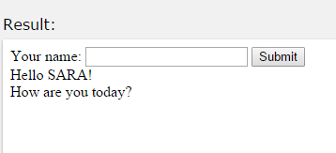
FORMS
Form with method get shows how to interact with the user, with the Request.QueryString command.
<!DOCTYPE html> <html> <body> <form action="demo_reqquery.asp" method="get"> Your name: <input type="text" name="fname" size="20" /> <input type="submit" value="Submit" /> </form> <% dim fname fname=Request.QueryString("fname") If fname<>"" Then Response.Write("Hello " & fname & "!<br>") Response.Write("How are you today?") End If %> </body> </html>

Slide 56
FORMS
Form with method post shows how to interact with the user, with the Request.Form command.
<!DOCTYPE html> <html> <body> <form action="demo_simpleform.asp" method="post"> Your name: <input type="text" name="fname" size="20" /> <input type="submit" value="Submit" /> </form> <% dim fname fname=Request.Form("fname") If fname<>"" Then Response.Write("Hello " & fname & "!<br>") Response.Write("How are you today?") End If %> </body> </html>

Slide 57
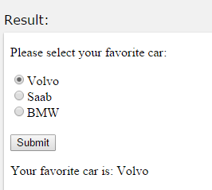
FORMS
Form with radio buttons shows how to interact with the user, with the Request.Form command.
<!DOCTYPE html> <html> <% dim cars cars=Request.Form("cars") %> <body> <form action="demo_radiob.asp" method="post"> <p>Please select your favorite car:</p> <input type="radio" name="cars" <%if cars="Volvo" then Response.Write("checked")%> value="Volvo">Volvo</input> <br> <input type="radio" name="cars" <%if cars="Saab" then Response.Write("checked")%> value="Saab">Saab</input> <br> <input type="radio" name="cars" <%if cars="BMW" then Response.Write("checked")%> value="BMW">BMW</input> <br><br> <input type="submit" value="Submit" /> </form> <% if cars<>"" then Response.Write("<p>Your favorite car is: " & cars & "</p>") end if %> </body> </html>

Slide 58
Request. ServerVariables
Contains all the server variable values
<p><b>You are browsing this site with:</b> <%Response.Write(Request.ServerVariables("http_user_agent"))%></p> <p><b>Your IP address is:</b> <%Response.Write(Request.ServerVariables("remote_addr"))%> </p> <p><b>The server's domain name:</b> <%Response.Write(Request.ServerVariables("server_name"))%> </p> <p><b>The server's port:</b> <%Response.Write(Request.ServerVariables("server_port"))%> </p> <p><b>The server's software:</b> <%Response.Write(Request.ServerVariables("server_software"))%>
http://www.w3schools.com/asp/coll_servervariables.asp

Slide 59
ASP.NET samples
Message.aspx
<html>
<head> <title>Inserting ASP.NET code Example</title> </head>
<body>
Line1: First HTML Line<br />
Line2: Second HTML Line<br />
Line3: Third HTML Line<br />
</body>
</html>
Note this has no asp code so better to use .html extension

Slide 60
Message2.aspx
<script language="VB" runat="server">
Sub Page_Load()
Response.Write ("First ASP.NET Line<br />")
Response.Write ("Second ASP.NET Line<br />")
Response.Write ("Third ASP.NET Line<br />")
End Sub
</script>
<html> <head> <title>Inserting ASP.NET code Example</TITLE> </head>
<body>
Line1: First HTML Line<br />
Line2: Second HTML Line<br />
Line3: Third HTML Line<br />
</body>
</html>

Slide 61
Questions !! ☺

