Slide 1
Alcohols and Phenols
Dr. Shatha I Alaqeel
108 Chem

Slide 2
Learning Objectives
Chapter six concerns alcohols and phenols and by the end of this chapter the student will:
know the difference in structure between alcohols and phenols
Know the different classes of alcohols
Know how to name alcohols and phenols
Know the physical properties (solubility, boiling and melting points)
Know how hydrogen bonds are formed and its effect on boiling points of alcohols
Know the acidic properties of alcohols and phenols
know the different methods that can be used to prepare alcohols and phenols.
Know the chemical reactions of these compounds ( some reactions are review, others are extensions of the chemistry that will be discussed on other chapters.
108 Chem

Slide 3
Structure Of Alcohols and Phenols
Alcohols and phenols may be viewed as organic derivatives of water
H-O-H R-O-H or PhCH₂OH Ph-O-H
Water Alcohol Phenol
Alcohols and phenols have a common functional group, the hydroxyl group, -OH.
In alcohols the hydroxyl group is attached to an alkyl group, -R.
In phenols the hydroxyl function is directly attached to benzene ring
108 Chem

Slide 4
Type of Alcohols
1- Monohydroxyls: containing one hydroxyl group
2- Dihydroxyls (glycols) : containing two hydroxyl groups
3- Polyhydroxyls : containing more than two hydroxyl groups
108 Chem

Slide 5
Classification and Nomenclature of Alcohols
The classification depends on the number of alkyl groups bonded to the carbon bearing the –OH, which called carbinol carbon.
Primary alcohols have one alkyl group attached to the carbinol carbon
secondary alcohols have two alkyl groups attached to the carbinol carbon
Tertiary alcohols have three alkyl groups attached to the carbinol carbon
108 Chem

Slide 6
Nomenclature of Alcohols
IUPAC Nomenclature Of Alcohols
Alcohols are named according to the following rules:
Select the longest continuous carbon chain that contains the -OH group. Replace the ending e of the alkane by the suffix –ol
If a molecule contains both an -OH group and a C=C or cΞc bond;
Choose the chain that include both of them even if this is not the longest chain.
The name should include suffixes indicate presence of both the OH group and the unsaturated groups provided as long as OH group takes precedence over the double or triple bonds in getting the lower number.
Cyclic alcohols are named using the prefix cyclo-, the carbon bearing the hydroxyl group is assumed to take number 1.
The suffix diol is added to the name of the parent hydrocarbon when there are two OH groups, and triol is added when there are three.
108 Chem

Slide 7
Common Nomenclature
Consist of the name of the alkyl group attached to the hydroxyl function followed by the word alcochol., if there is two OH groups on adjacent carbons are known as 1,2-glycols.
 | CH₃OH | CH₃CH₂OH | CH₂=CHCH₂OH
Common | Methyl alcohol | Ethyl alcohol | Allyl alcohol
IUPAC | Methanol | Ethanol | 2-Propen-1-ol
Common | Isopropyl alcohol | Cyclopentyl alcohol | Methylcyclohexyl alcohol
IUPAC | 2-Propanol | Cyclopentanol | 1-Methyl-1-cyclohexanol
108 Chem

Slide 8
Examples
4-Methyl-2-cyclohexen-1-ol
1-Phenylmethanol
Benzyl alcohol (common name)
2-Phenylethanol
108 Chem

Slide 9
4-Ethyl-2-hexanol
5-Chloro-3-methyl-1-heptanol
3-Methyl-1-cyclohexanol
108 Chem

Slide 10
Nomenclature of Phenols
Phenols are generally named as derivatives of the simplest member of the family, phenol.
The ortho, meta, para system is used in common names.
numbering system is employed in IUPAC names begins from the hydroxyl-substituted carbon.
Phenol
P-Aminophenol
4-Bromo-2-nitrophenol
2,4,6-Trinitrophenol
(Picric acid)
108 Chem

Slide 11
2,3,4,5,6-Pentachlorophenol
O-Cresol
m-Cresol
p-Cresol
Catecol
Resorcinol
Hydroquinone
Pyrogallol
108 Chem

Slide 12
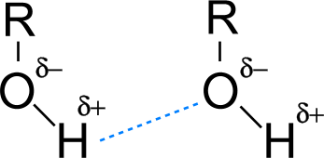
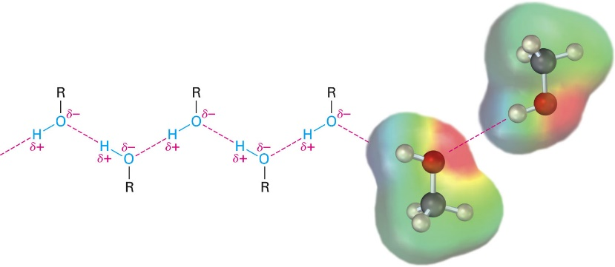
Physical Properties of Alcohols
Diols and triols are more soluble in water than monohydroxyalcohols.
The number of carbons in the alcohol increases, the solubility in water decreases and increases with branching of chain.
The boiling points (b.p.) increases with increase in molecular weights.
1º alcohol < 2º alcohol < 3º alcohol
The presence of the intermolecular hydrogen bonding between alcohol molecules exists due to which a large amount of energy is required to break these bonds as a result of the high b.p. of alcohol.
hydrogen bond
108 Chem

Slide 13
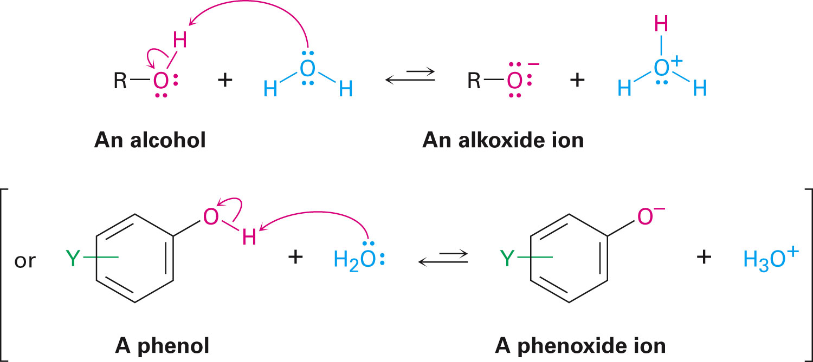
Alcohols are weak acids.
Can transfer a proton to water to a very small extent
Produces H₃O⁺ and an alkoxide ion, RO⁻, or a phenoxide ion, ArO⁻
108 Chem

Slide 14
Physical Properties of Phenols
Phenol is a liquid or crystalline solids, with a high boiling point than alcohols because they have stronger intermolecular hydrogen bonding, that is moderately soluble in water.
Phenol is a strong acid than alcohols because the negative charge in oxygen is dispersed by resonance through the benzene ring.
Introduction of electron-withdrawing groups (EWG), such as NO₂ or CN, on the ring increases the acidity of phenol and introducing electron-donating groups (EDG), such as NH2, R, OR decrease the acidity of phenols.It is due to the effective delocalization of negative charge in phenoxide ion.
108 Chem

Slide 15
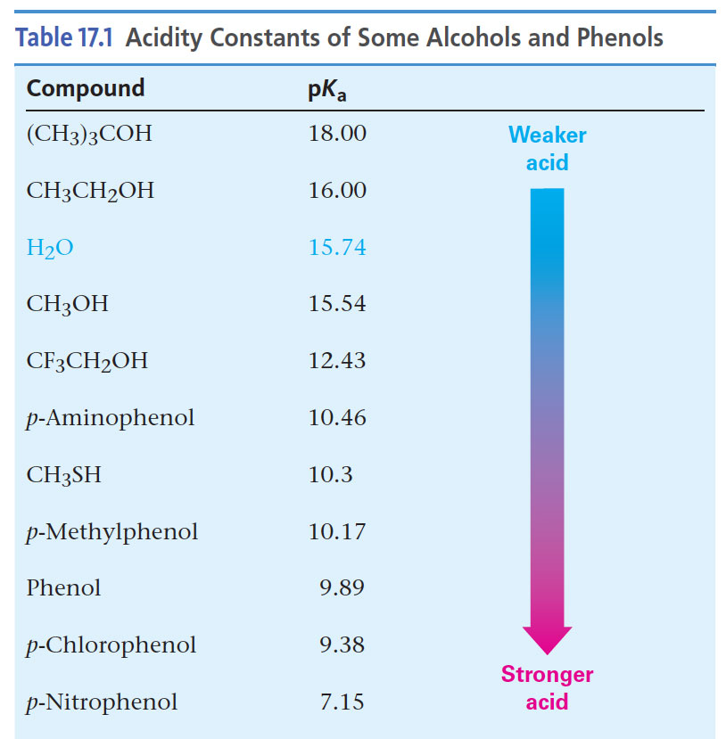
pK_{a} Values for Typical OH Compounds
108 Chem

Slide 16
108 Chem

Slide 17
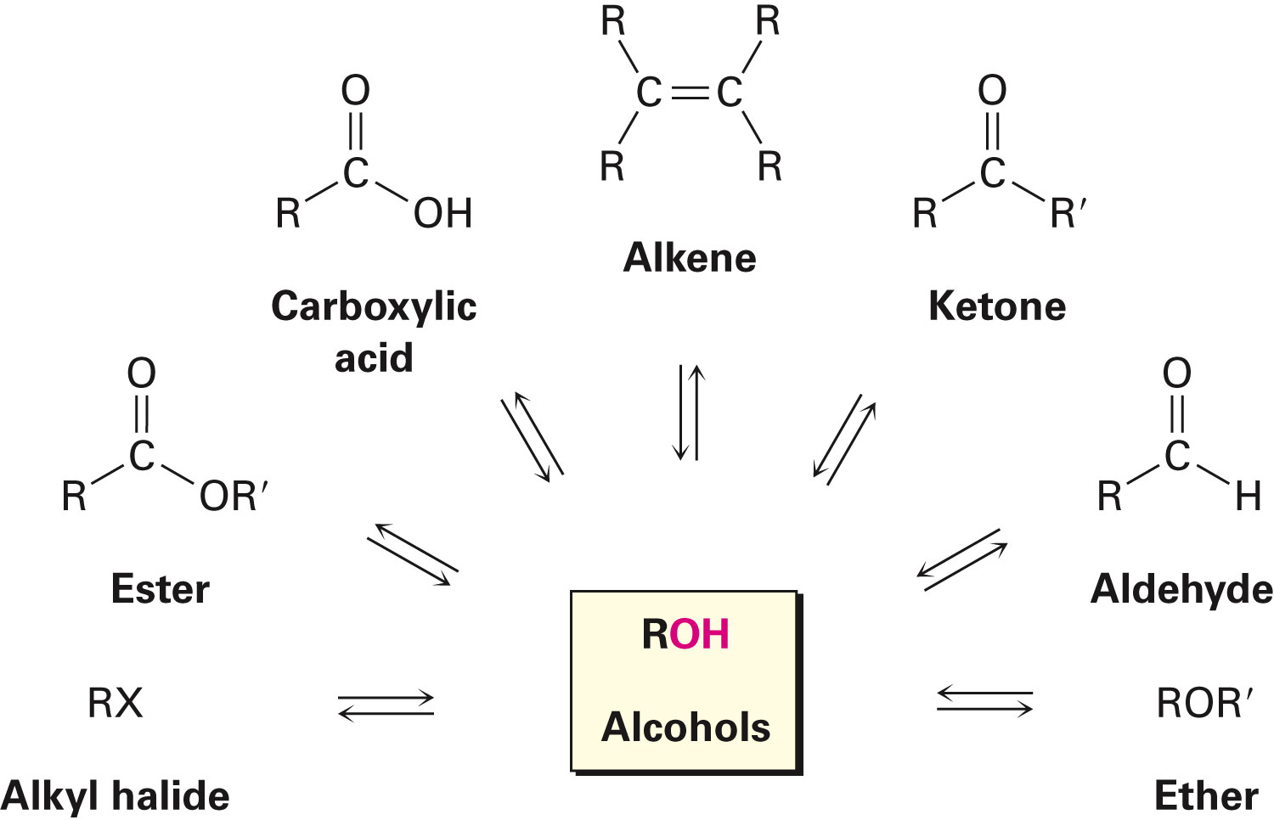
Preparation of Alcohols: A Review
Alcohols are derived from many types of compounds
The alcohol hydroxyl can be converted to many other functional groups
This makes alcohols useful in synthesis
108 Chem

Slide 18
Preparation of alcohols
1- Hydrolysis of alkyl halide
R-X + OH⁻ or H₂O R-OH + X⁻ or HX
nucleophilic substitution
(CH₃)₃C-Cl + dil KOH (CH₃)₃C-OH
A-Markonikov’s Rule
(Electrophilic addition)
2- From Alkenes
Oxidation
108 Chem

Slide 19
B- anti-Markovnikov hydration
108 Chem

Slide 20
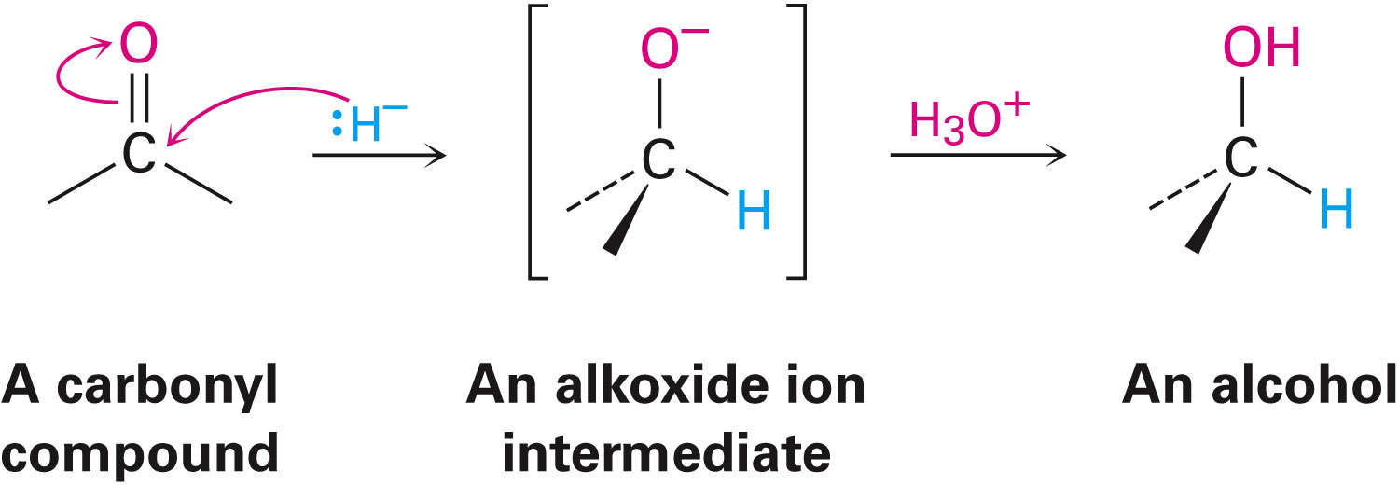
3- Reduction of aldehydes, ketones: Reduction by hydride reagents, Lithium aluminium hydride LiAlH₄or Sodium boro hydride NaBH₄
1) LiAlH₄ / dry ether or NaBH₄
2) H₃O⁺
1) LiAlH₄ / dry ether or NaBH₄
2) H₃O⁺
1) LiAlH₄ / dry ether or NaBH₄
2) H₃O⁺
108 Chem

Slide 21
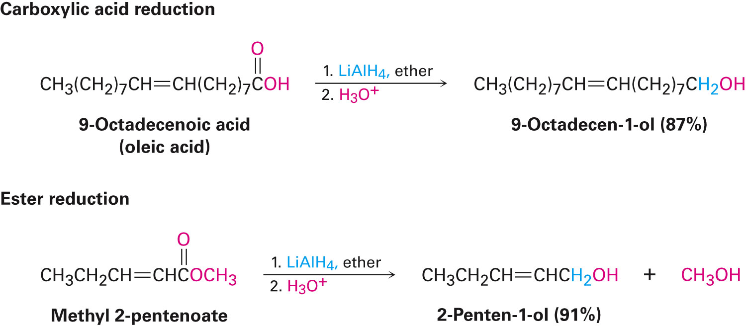
4-Reduction of carboxylic acids and esters:
Carboxylic acids and esters are reduced to give primary alcohols
LiAlH₄ is used because NaBH₄ is not effective
108 Chem

Slide 22
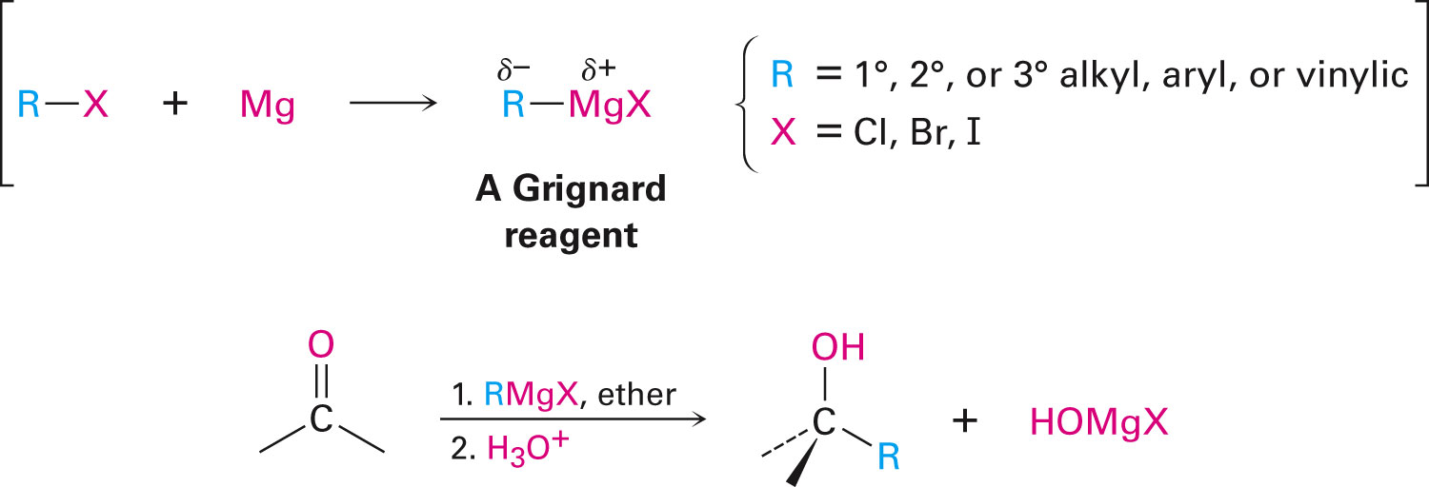
5- Addition of Grignard compounds to aldehydes & ketones
108 Chem

Slide 23
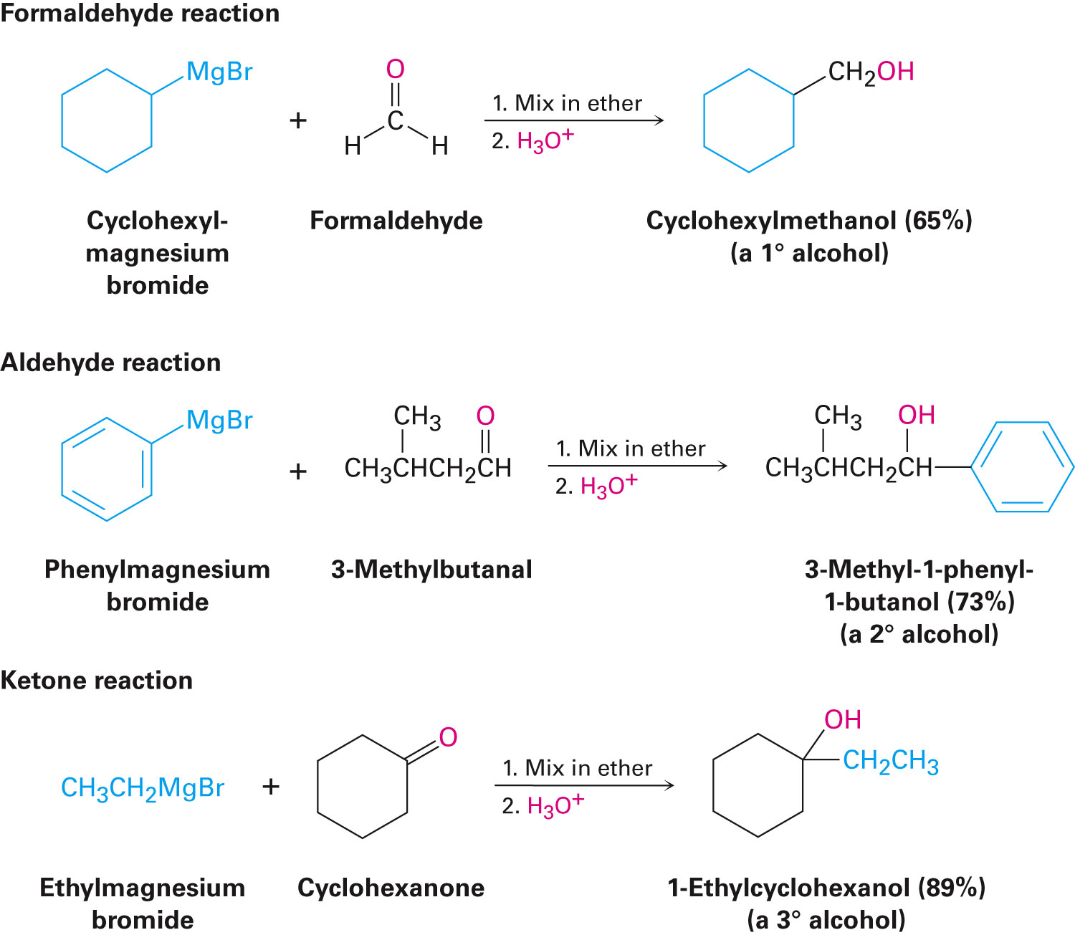
108 Chem

Slide 24
Preparation of Phenols
A- Industrial process from readily available cumene (isopropylbenzen)
Industrial process from readily available cumene
Forms cumene hydroperoxide with oxygen at high temperature
Converted into phenol and acetone by acid
108 Chem

Slide 25
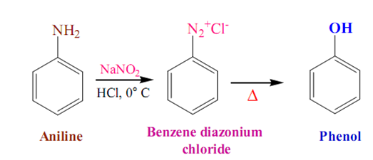
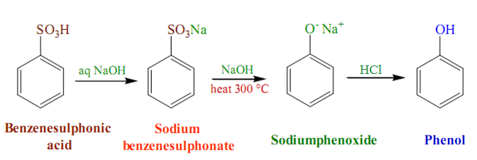
B- Hydrolysis of Diazonium salts
C- Fusion of sodium with benzene-sulfonates:
H₃O⁺
108 Chem

Slide 26
D- From Chlorobenzene:
108 Chem

Slide 27
Reaction of Alcohols and Phenols
A-Dissociation of O-H Bond
1- Salt Formation
108 Chem

Slide 28
2- Ester formation
4- Reaction with alkyl halide
108 Chem

Slide 29
B- Reactions involving carbon-oxgen bond breaking
3- Dehydration of Alcohols: Formation of Alkenes
108 Chem

Slide 30
4- Dehydrations of Alcohols: Ethers Formation
140 ⁰C
Examples:
140 ⁰C
108 Chem

Slide 31
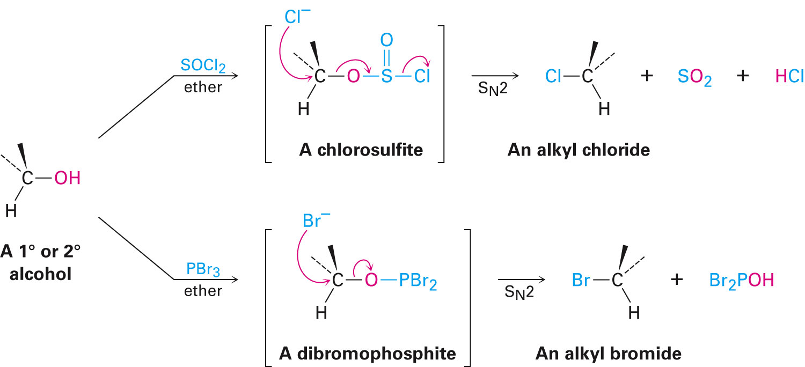
5- Reaction with alkyl halide Conversion of alcohols into alkyl halides by HCl/ZnCl2, heat; PX3; PCl5 or SOCl2.
108 Chem

Slide 32
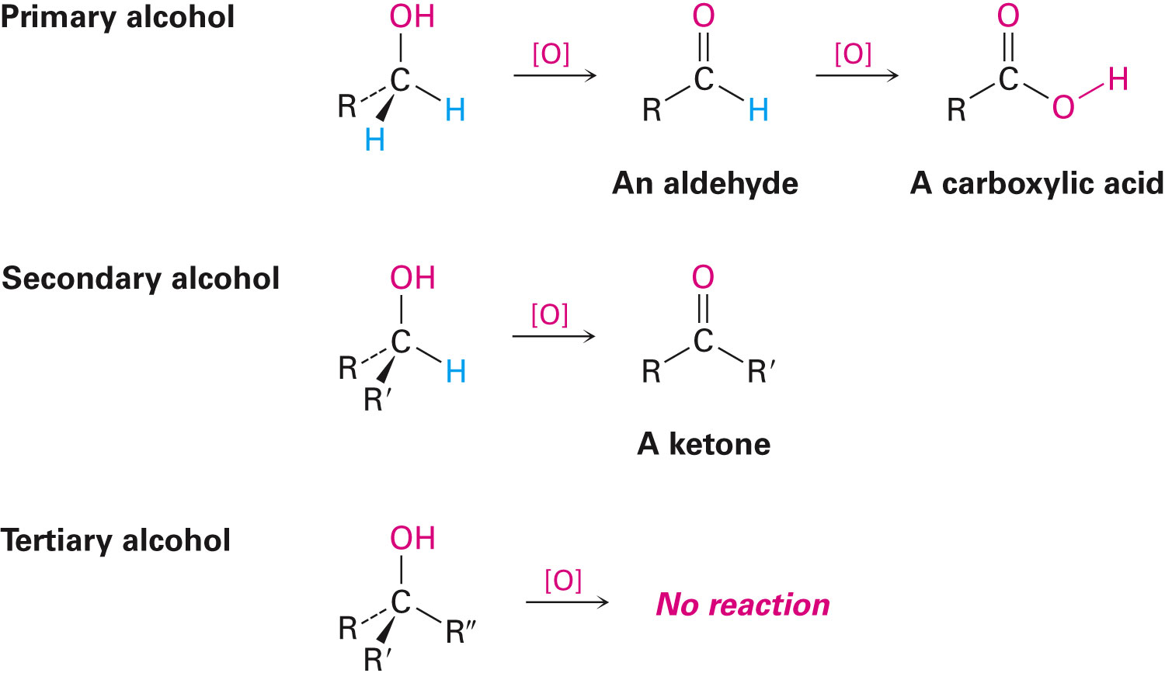
6) Oxidation Of Alcohols
For oxidation to take place easily you must have two hydrogen atoms on adjacent C and O atoms depending on their class
Can be accomplished by inorganic reagents, such as Very strong: KMnO₄ / H⁺ / Δ;
Strong: KMnO₄ / OH⁻ or H₂CrO₄ or K₂Cr₂O₄ / H⁺ or Mild: CrO₃ / pyridine or Cu / 300 °C
108 Chem

Slide 33
Benzoquinone
108 Chem

Slide 34
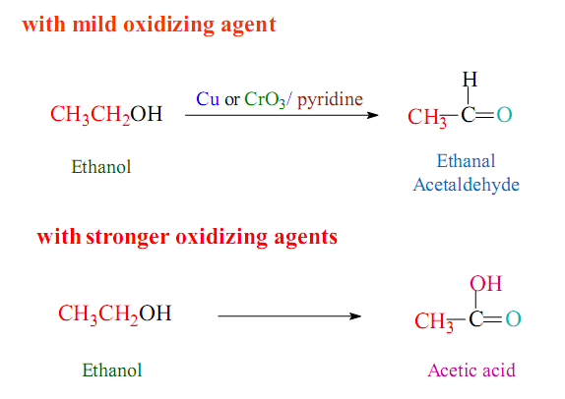
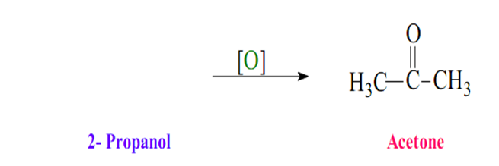
H₂CrO₇
108 Chem

Slide 35
7) Reaction of aromatic ring of phenols
108 Chem

