Slide 1
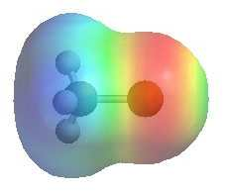
Organic Halogen Compounds
Dr. Shatha I Alaqeel
108 Chem

Slide 2
Learning Objectives
Chapter five discusses the following topics and by the end of this chapter the students will:
Recognize the structure and classes of alkyl halides
Know the common names and understand the IUPAC rules for nomenclature of
halo compounds
Understand the physical properties of halo compounds (solubility and boiling points)
Know the different methods used in preparation of halo compounds
Know the reactions of halo compounds; nucleophilic substitution, elimination, reduction reactions of Grignard reagents and know the previously disused methods of reducing alkyl halides (Chapter-1)
108 Chem

Slide 3
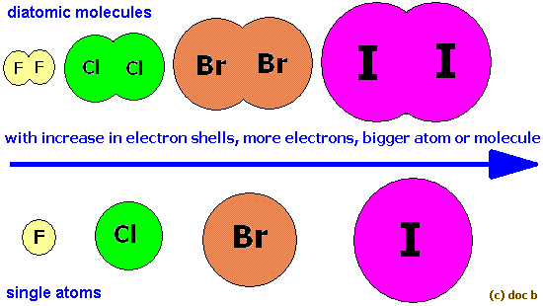
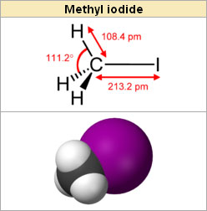
Structure Of Alkyl Halides
Alkyl halides: are compounds contain the C-X bond where X is a halogen (F,Cl,Br or I)
The chemistry of Organic halogen compounds is important because these compounds are very useful intermediates for the synthesis of wide range of other substances.
108 Chem

Slide 4
Classification
These may be classified as mono, di, or polyhalogen (tri-,tetra-, etc.) compounds depending on whether they contain one, two or more halogen atoms in their structures
Monohalocompounds
According to hydrocarbon gp.
1-Alkyl halides or haloalkanes( R-X) 2-Allylic halides
3-Vinylic halides 4-Benzylic halides
5-Aryl halides or haloarenes
1-Alkyl halides or haloalkanes( R-X)
has a halogen atom bonded to one of the sp³ hybrid atoms of an alkyl group, depending on the type of carbon to which the halogen is attached
Primary alkyl halide 1° CH₃-X and R-CH₂-X
Secondary alkyl halide 2° (R)₂-CH-X
Tertiary alkyl halide 3° (R)₃-C-X
108 Chem

Slide 5
2-Vinylic halides
has a halogen atom bonded to one of the sp² hybrid carbon atoms of an alkene (C=C)
compound | CH₃-Cl | (CH₃)₂-CH-F
Common | Methyl Chloride | Isopropyl fluoride | t.Butyl bromide
IUPAC | Chloromethane | 2-Fluoropropane | 2-Bromo-2-methylpropane
Class | 1° | 2° | 3°
CH₂=CHBr
Vinyl bromide
Bromoethene
1-Bromocyclohexene
108 Chem

Slide 6
3-Allylic halides
has a halogen atom bonded to carbon sp³ next
to a double bond carbon
CH₂=CHCH₂Cl
Allyl chloride
3-Chloro-1-propene
3-Bromocyclohexene
4-Benzylic halides
Ar-C-X ( has a halogen atom bonded to carbon sp³ hybrid next to aromatic ring)
Benzyl Chloride
Diphenylmethyl bromide
5-Aryl halides (haloarene)
Ar-X has a halogen atom bonded to one of the sp² hybrid carbon atoms of an aromatic ring (X directly attached to ∅ )
Chlorobenzene p-Bromo toluene
108 Chem

Slide 7
Polyhalogen compounds are carbon compounds containing more than one halogen atom. Many polyhalogen compounds are useful in the industry and in agriculture.
108 Chem

Slide 8
Common name OF Alkyl halides
Common names derived from the corresponding alkyl group followed by the name of halogen atom.
108 Chem

Slide 9
Nomenclature OF Alkyl halides
IUPAC names derived from the names of parent organic compound (alkane or alkene or alkyne or alcohol or aldehydes and so on) with a prefix indicating halogens and their positions. (Halo……)
CH₃-Cl CH₃-CH₂-Br (CH₃)₂-CH-F
Common Methyl Chloride Ethyl bromide Isopropyl fluoride
IUPAC Chloromethane Bromoethane 2-Fluoropropane
Class 1° 1° 2°
Common Cyclohexyl Iodide t-Butyl bromide Methylcyclopentyl chloride
IUPAC Iodocyclohexane 2-Bromo-2- methylpropane 1-Chloro-1-methyl cyclopentane
Class 2° 3 ° 3 °
108 Chem

Slide 10
Physical Properties of Organic Halides
Solubility
All organic halides are insoluble in water and soluble in common organic solvents such as CCl₄ and C₆H₆.
Boiling point
The boiling points increases with increasing in molecular weights.
Therefore, the boiling points increases in the order F < Cl < Br < I. (the size (molecular wt) of the halogen increase )
Alkyl halides have higher melting points than alkanes, alkenes, alkynes because of :
1. Polarity
2. Molecular weight
108 Chem

Slide 11
Nature of (C-X) Bond
Halogen atoms are more electronegative than carbon. C-X bond of alkyl halide is polarized: The carbon atom bears a partial positive charge whereas the halogen atom bears a partial negative charge.
108 Chem

Slide 12
Preparation Of Halocompounds
1- Direct Halogenation Of Hydrocarbons
a) Halogenation of alkanes
b) Halogenation of alkenes
108 Chem

Slide 13
c) Halogenation of alkynes
d) Halogenation of alkyl benzene
108 Chem

Slide 14
2- Conversion Of Alcohols
The hydroxyl group of an alcohol is replaced by halogen
108 Chem

Slide 15
Reactions of Organic Halides
1- Nucleophilic Subtitution Reactions S_{N}
Nu⁻ = ⁻OH, ⁻OR, ⁻OCOR, ⁻SH, ⁻SR, ⁻CN,
δ+
δ-
108 Chem

Slide 17
2- Elimination Reactions (E)
Alkyl halides can lose HX molecule to give an alkene.
If the haloalkane is unsymmetrical (e.g. 2-bromobutane or 2-bromopentane) a mixture of isomeric alkene products is obtained.
108 Chem

Slide 18
3- Reaction of Grignared reagent a- Formation of Grignard reagent
b- Reaction of Grignard reagent
108 Chem

Slide 19
4- Reduction of alkyl halides
a) By metal and acid or by metal hydrides
b) By sodium metal (Coupling reaction)(Wurtz reaction)
c) By lithium dialkyl cuprate (Symmetrical and non symmetricalalkane)
108 Chem

Slide 20
Thank You for your kind attention !
Questions
108 Chem

