Slide 1
Chapter 4:
Mathematical Expectation

Slide 2
Mean of a Random Variable:
Definition:
Let X be a random variable with a probability distribution $f(x)$. The mean (or expected value) of X is denoted by $μ_{X}$(or E(X)) and is defined by:

Slide 3
Example:
A shipment of 8 similar microcomputers to a retail outlet contains 3 that are defective and 5 are non-defective. If a school makes a random purchase of 2 of these computers, find the expected number of defective computers purchased
Solution:
Let X = the number of defective computers purchased. we found that the probability distribution of X is:

Slide 4
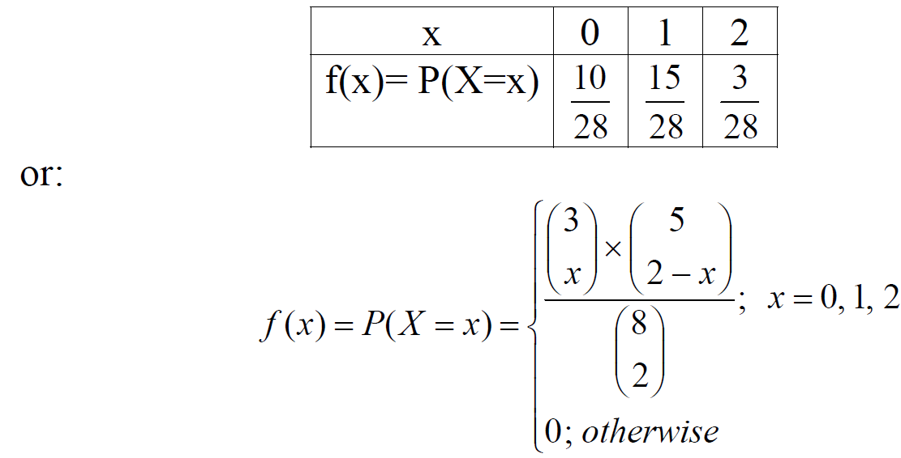

Slide 5
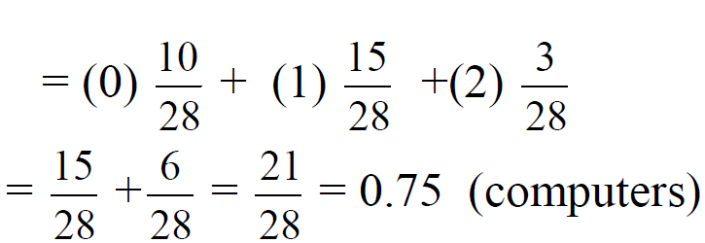
The expected value of the number of defective computers purchased is the mean (or the expected value) of X, which is:
$$E\left(X\right)=μ_{X}=\sum_{x=0}^{2}{x.f(x)}$$
$$=0.f\left(0\right)+1.f\left(1\right)+2.f\left(2\right)$$

Slide 6
Example:
A box containing 7 components is sampled by a quality inspector; the box contains 4 good components and 3 defective components. A sample of 3 is taken by the inspector. Find the expected value of the number of good components in this sample.

Slide 7
Solution:
Let X represent the number of good components in the sample. The probability distribution of X is

Slide 8
Thus, if a sample of size 3 is selected at random over and over again from a box of 4 good components and 3 defective components, it will contain, on average, 1.7 good components.

Slide 9
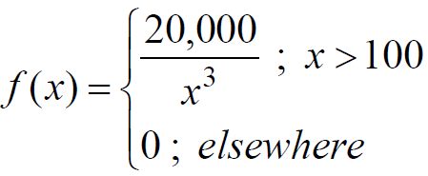
Example
Let X be a continuous random variable that represents the life (in hours) of a certain electronic device. The pdf of X is given by:
Find the expected life of this type of devices.

Slide 10
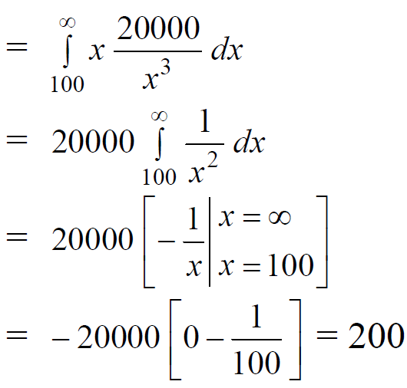
Solution:
hours
Therefore, we can expect this type of device to last, on average, 200 hours.

Slide 11
Theorem
Let X be a random variable with a probability distribution $f(x)$, and let $g(X)$ be a function of the random variable $X$. The mean (or expected value) of the random variable $g(X)$ is denoted by $μ_{g(X)}$(or $E[g(X)])$and is defined by:

Slide 12
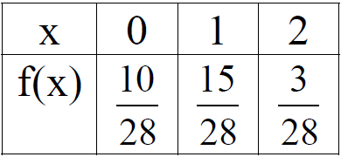
Example:
Let X be a discrete random variable with the following probability distribution
Find $E[g(X)],$where $g(X)=(X −1)2.$

Slide 13
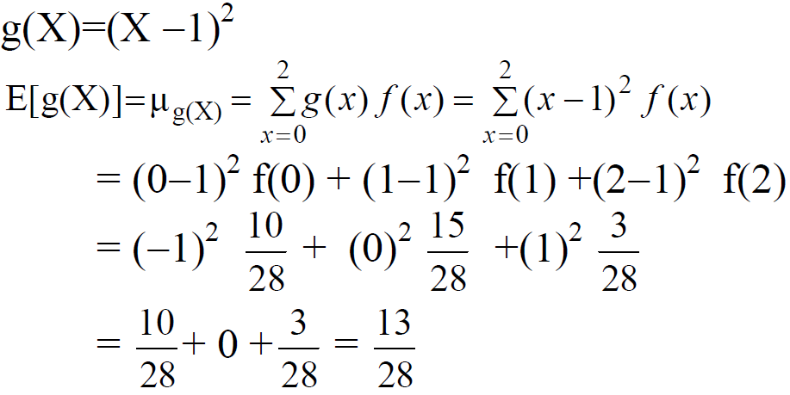
Solution:

Slide 14
Example:
Suppose that the number of cars X that pass through a car wash between 4:00 P.M. and 5:00 P.M. on any sunny Friday has the following probability distribution:
Let $g(X) = 2X−1$represent the amount of money, in dollars, paid to the attendant by the manager. Find the attendant’s expected earnings for this particular time period.

Slide 15
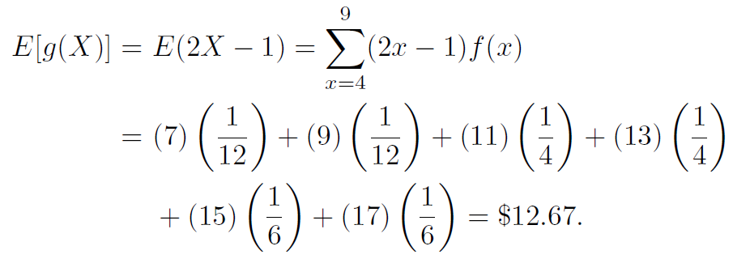
Solution:

Slide 16
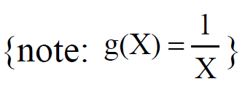
Example
Let X be a continuous random variable that represents the life (in hours) of a certain electronic device. The pdf of X is given by:
Find $E\left(\frac{1}{x}\right)$

Slide 17
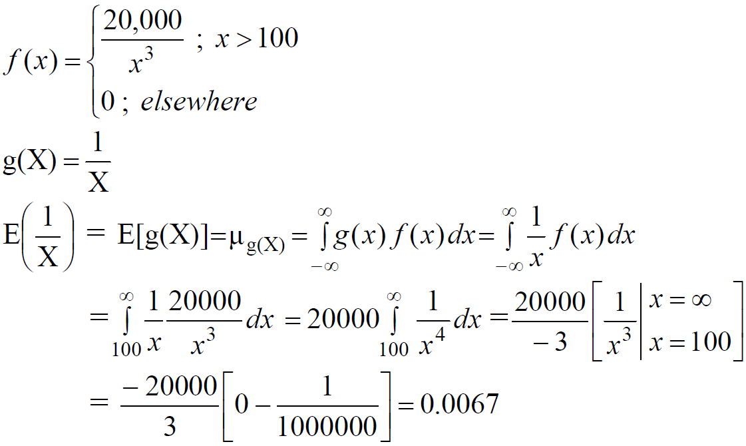
Solution:

Slide 18
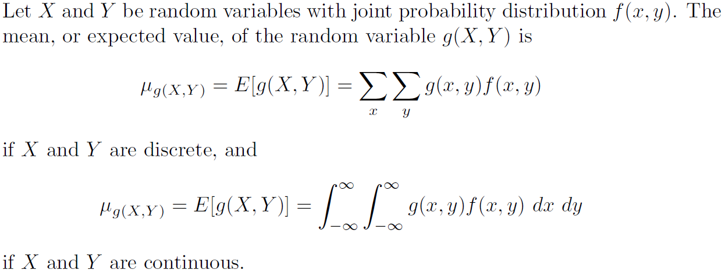
Definition

Slide 19
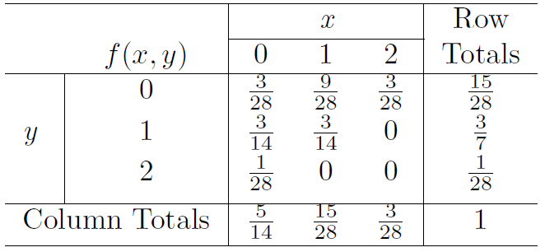
Example
Let X and Y be the random variables with joint probability distribution
Find the expected value of $g(X, Y ) = XY$.

Slide 20
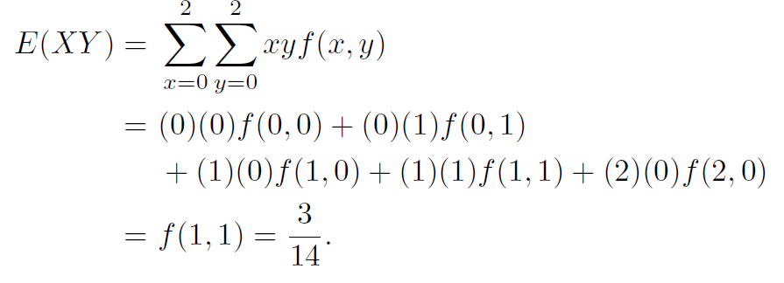
Solution:

Slide 21
Exercises
4.1 – 4.2 – 4.10 – 4.13 and 4.17 on page 117

Slide 22
Variance (of a Random Variable)
The most important measure of variability of a random variable X is called the variance of X and is denoted by $Var(X)$ or $σ^{2}$

Slide 23
Definition
Let X be a random variable with a probability distribution $f(x)$ and mean μ. The variance of X is defined by:

Slide 24
Definition: (standard deviation)

Slide 25
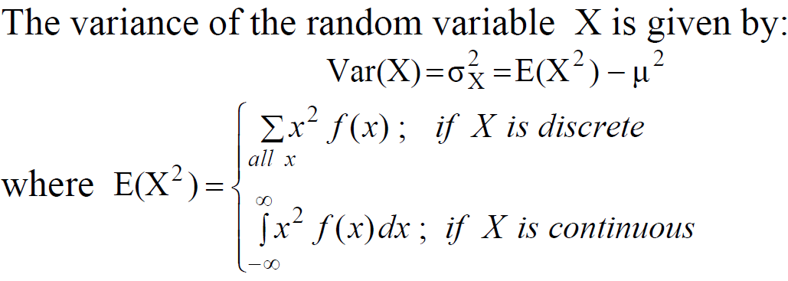
Theorem
Proof : See page 121

Slide 26
Example
Let X be a discrete random variable with the following probability distribution

Slide 27
Solution:

Slide 28
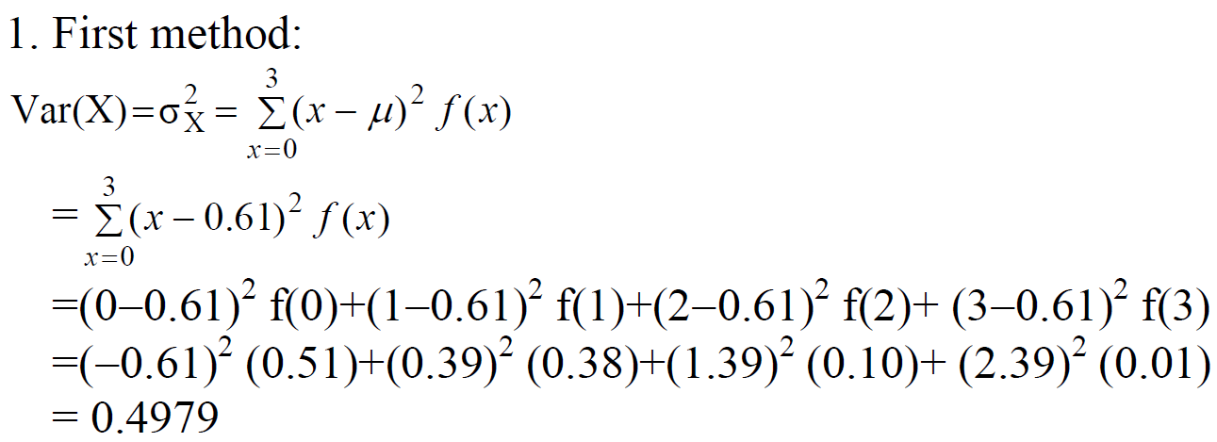

Slide 29
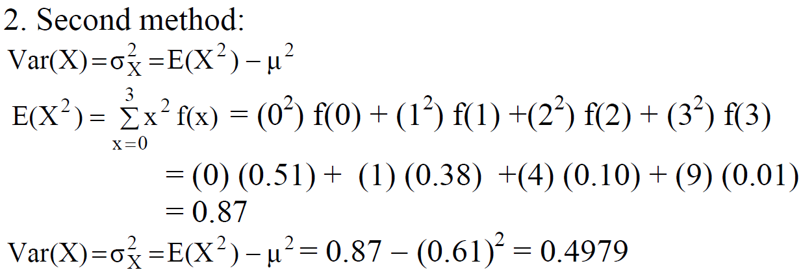

Slide 30
Example

Slide 31
Solution:

Slide 32
Means and Variances of Linear Combinations of Random Variables

Slide 33
Theorem
If X is a random variable with mean $μ=E(X)$, and if a and b are constants, then:
$$E(aX±b) = a E(X) ± b ⇔ μ_{aX±b}= aμ_{X}±b$$
Corollary 1: E(b) = b (a=0 in Theorem)
Corollary 2: E(aX) = a E(X) (b=0 in Theorem)

Slide 34
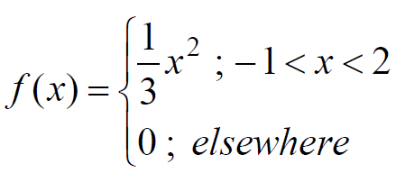
Example
Let X be a random variable with the following probability density function:
Find E(4X+3).

Slide 35
Solution:
Another solution:

Slide 36
Theorem:

Slide 37
Corollary:
If X, and Y are random variables, then:
$$E(X ± Y) = E(X) ± E(Y)$$

Slide 38
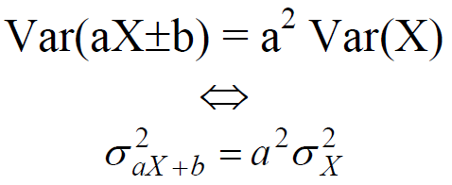
Theorem
If X is a random variable with variance
$Var\left(x\right)={σ_{x}^{2}}^{}$
and if a and b are constants, then:

Slide 39
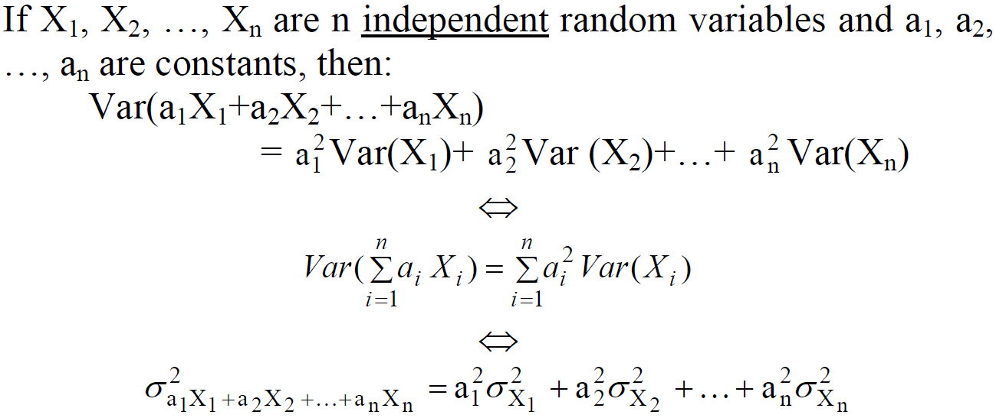
Theorem:

Slide 40
Corollary:
If X, and Y are independent random variables, then:
• Var(aX+bY) = a² Var(X) + b² Var (Y)
• Var(aX−bY) = a² Var(X) + b² Var (Y)
• Var(X ± Y) = Var(X) + Var (Y)

Slide 41
Example:
Let X, and Y be two independent random variables such that E(X)=2, Var(X)=4, E(Y)=7, and Var(Y)=1. Find:
1. E(3X+7) and Var(3X+7)
2. E(5X+2Y−2) and Var(5X+2Y−2).

Slide 42
Solution:
1. E(3X+7) = 3E(X)+7 = 3(2)+7 = 13
Var(3X+7)= (3)² Var(X)=(3)² (4) =36
2. E(5X+2Y−2)= 5E(X) + 2E(Y) −2= (5)(2) + (2)(7) − 2= 22
Var(5X+2Y−2)= Var(5X+2Y)= 5² Var(X) + 2² Var(Y) = (25)(4)+(4)(1) = 104

Slide 43
Chebyshev's Theorem
Suppose that X is any random variable with mean $E(X)=μ$and variance $Var(X)=σ^{2}$ and standard deviation $σ$.
Chebyshev's Theorem gives a conservative estimate of the probability that the random variable X assumes a value within k standard deviations ($kσ$) of its mean μ, which is
$P(μ− kσ <X< μ +kσ).$
$$P(μ− kσ <X< μ +kσ)≈ 1−\frac{1}{k^{2}}$$

Slide 44
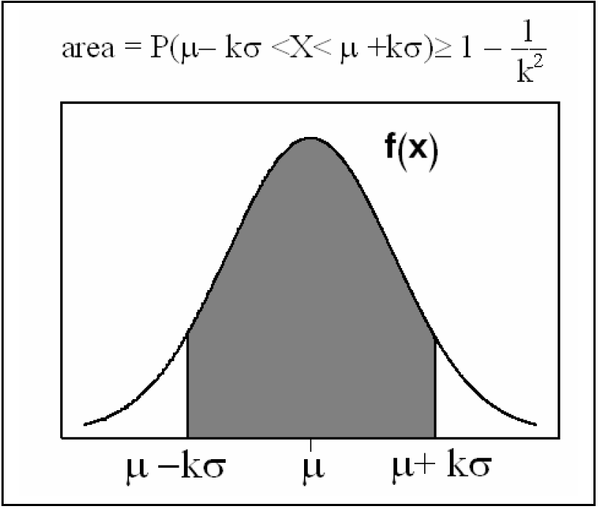

Slide 45
Theorem
Let X be a random variable with mean $E(X)=μ$and variance $Var(X)=σ2$, then for $k>1$, we have:

Slide 46
Example
Let X be a random variable having an unknown distribution with mean μ=8 and variance σ²=9 (standard deviation σ=3). Find the following probability:
(a) P(−4 <X< 20)
(b) P(|X−8| ≥ 6)

Slide 47
Solution:
(a) P(−4 <X< 20)= ??
$$(−4 <X< 20)= (μ− kσ <X< μ +kσ)$$

Slide 48
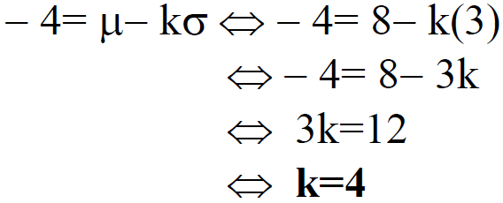
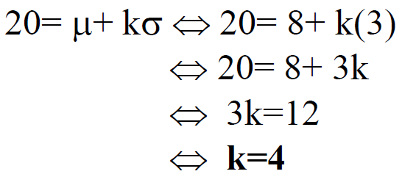
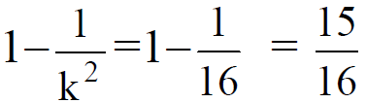
or

Slide 49
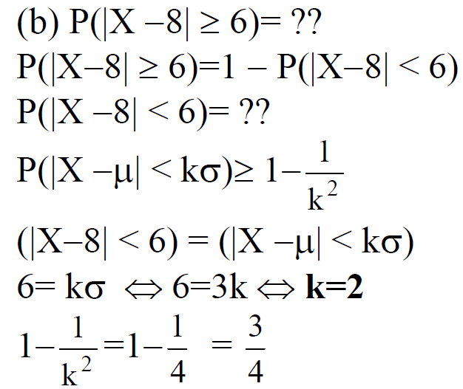

Slide 50
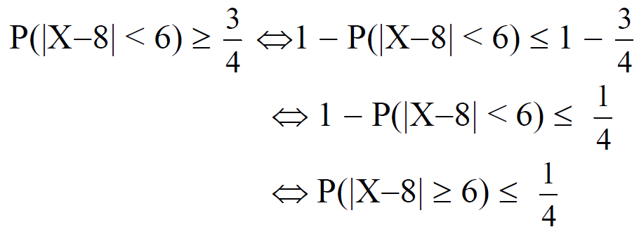

Slide 51
Another solution for part (b):
P(|X−8| < 6) = P(−6 <X−8 < 6)
= P(−6 +8<X < 6+8)
= P(2<X < 14)
(2<X <14) = (μ− kσ <X< μ +kσ)
2= μ− kσ ⇔ 2= 8− k(3) ⇔ 2= 8− 3k ⇔ 3k=6 ⇔ k=2

Slide 52
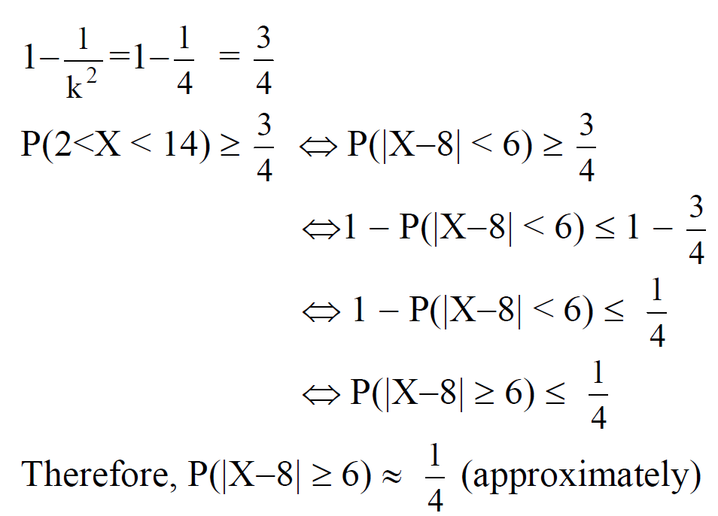

Slide 53
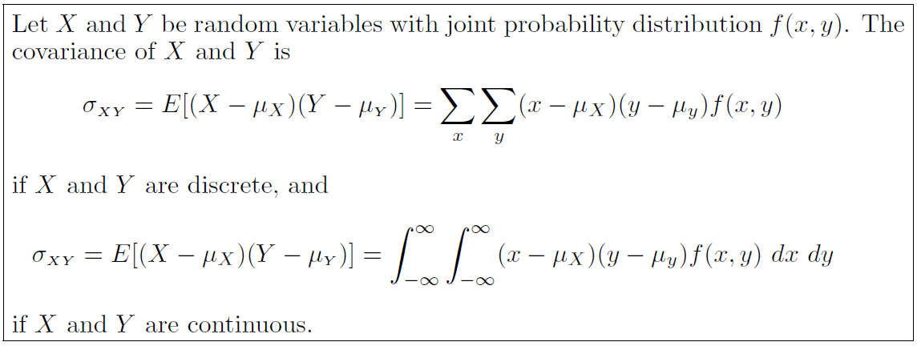
Definition:

Slide 54
Theorem:
The covariance of two random variables X and Y with means $μ_{X}$and $μ_{Y}$, respectively, is given by
$$σ_{XY} = E(XY ) − μ_{X}μ_{Y}$$
Proof: See page 124

Slide 55
Definition

Slide 56
Notes:
$ρ_{XY}$is free of the units of X and Y.
The correlation coefficient satisfies the inequality −1 ≤ $ρ_{XY}$≤ 1.
It assumes a value of zero when ${\text{σ}}_{XY}=0$

Slide 57
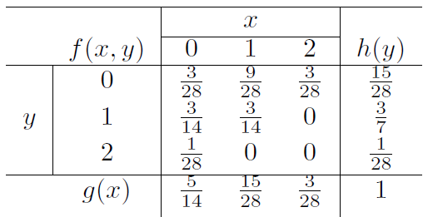
Example
Find the covariance and the correlation coefficient of X and Y for the following joint distribution

Slide 58
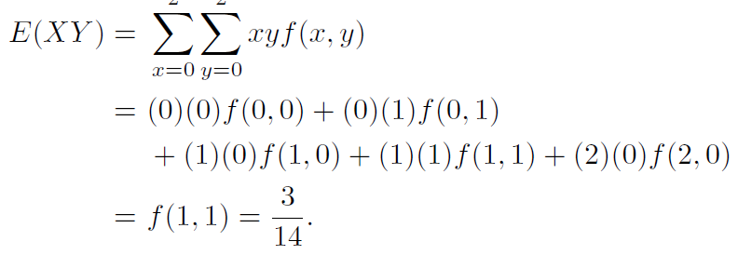
Solution:

Slide 59
Therefore,

Slide 60
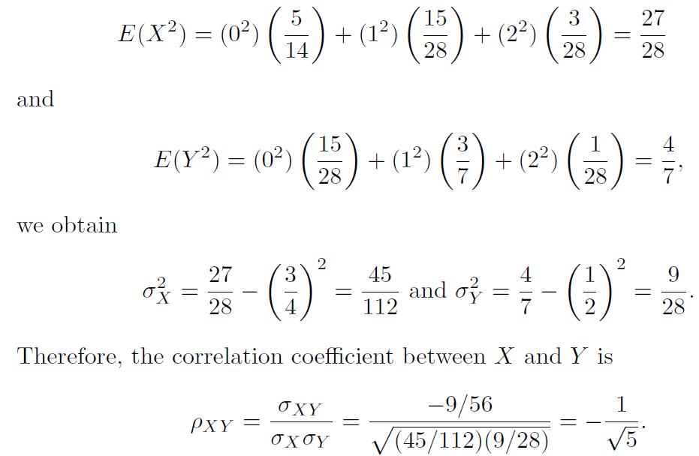
To calculate the correlation coefficient

Slide 61
Example:
The fraction X of male runners and the fraction Y of female runners who compete in marathon races are described by the joint density function
Find the covariance and the correlation coefficient
of X and Y .

Slide 62
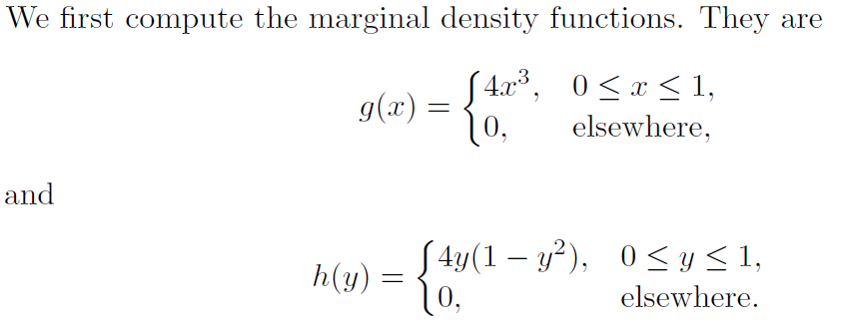
Solution:

Slide 63
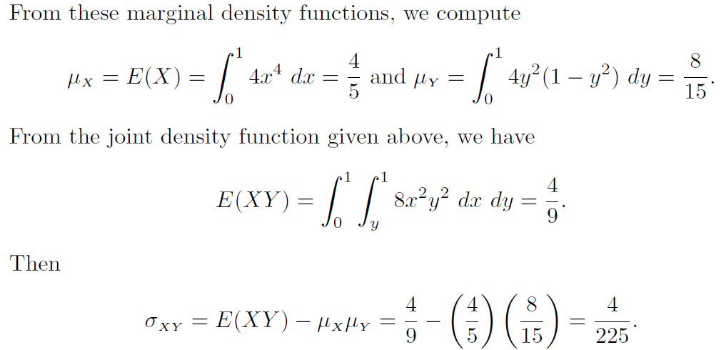

Slide 64
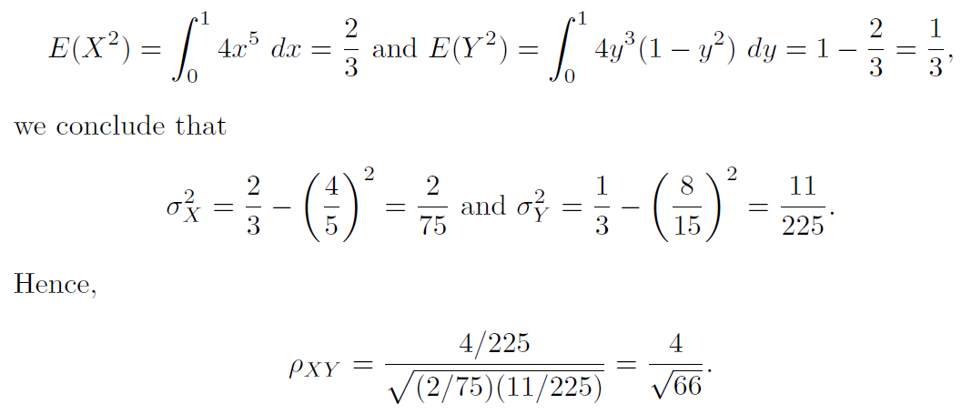
To calculate the correlation coefficient

