Slide 1

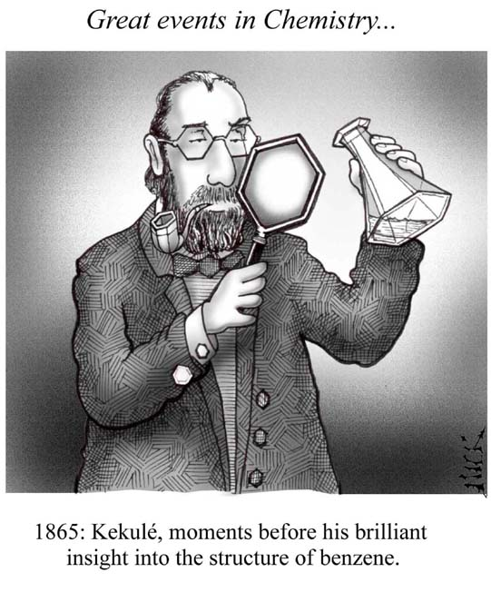
Benzene & Aromatic Compounds
Dr. Shatha I Alaqeel
108 Chem

Slide 2
Learning Objectives
By the end of chapter four the students will:
Understand the resonance description of structure of benzene
Understand the hybridization in benzene
Understand the relation between the stability of benzene and resonance energy
Know the criteria of aromaticity and Huckel rule
Understand the nomenclature rules of aromatic compounds and know the Common names of some aromatic compounds
Understand the reactivity of aromatic compounds, know what are electrophiles and know the four types of electrophilic aromatic substitution reactions (halogenation, Freidel Crafts alkylation and acylation, nitration and Sulfonation).
Know the reactions of alkyl side chains of aromatic compounds (halogenation, oxidation)
Understand the orientation and reactivity of E.A.S reactions in monosubstituted benzene derivatives.
108 Chem

Slide 3
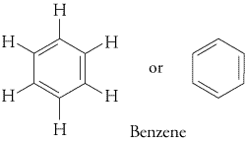
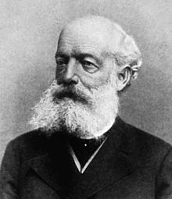
Benzene : Resonance Description
Primary analysis revealed benzene had...
a molecular mass of 78
b molecular formula of C₆H₆
_{C}
Hybridization= sp²
d Bond angles= 120º
Structure:
Kekulé suggested that benzene was...
PLANAR
CYCLIC
Had Alternating Double And Single Bonds Thus These Double Bonds Are Described As Conjugated Bonds.

Slide 4
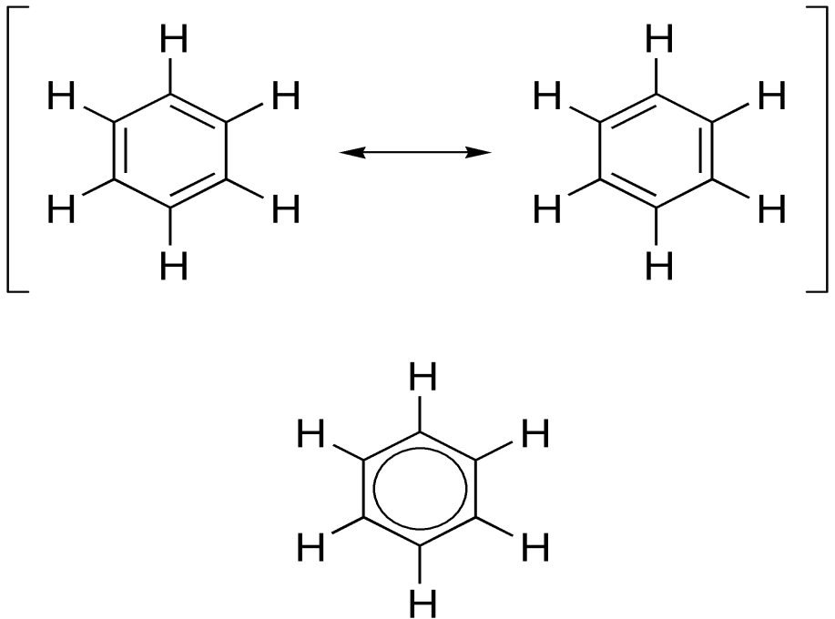
However, all bond lengths in benzene to be equal and intermediate between single bond and double bond lengths (1.39 Å) and the ring is more stable than expected.
To explain the above, it was suggested that the structure oscillated between the two Kekulé forms but was represented by neither of them. It was a RESONANCE HYBRID ( average of two structures that differ only in the placement of the valence electrons).
The energy calculated for a resonance hybrid is lower than the energies of the two alternative structure.
Contributing Structures
4
Resonance hybride

Slide 5
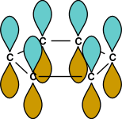
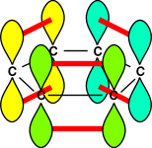
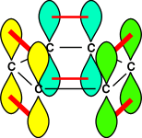
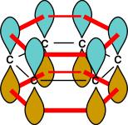
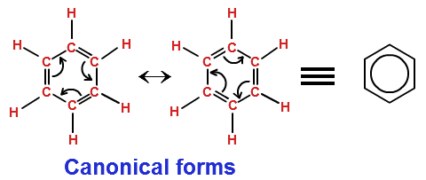
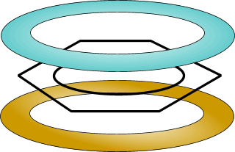

6 single bonds
one way to overlap
adjacent p orbitals
another
possibility
delocalised pi
orbital system
Hybrid
Kekule Structures
The electrons in the π-bonds are delocalized around the ring (The circle represent six π-electrons distributed over the six atoms of the ring).
108 Chem

Slide 6
Stability of Benzene
catalyst
catalyst
catalyst
heat, pressur
Cyclohexane
Benzene is more stable by 36 kcal\mol : Resonance energy
108 Chem

Slide 7
Benzene – Determination of Resonance Energy
The huge difference between the hypothetical and observed heats of hydrogenation for benzene cannot be explained solely on the basis of resonance and conjugation.
cyclohexatriene
benzene
(hypothetical)
RESONANCE
ENERGY
36 kcal/mol
cyclohexene
-49.8 kcal/mol
-85.8 kcal/mol
-28.6 kcal/mol
(calculated)
cyclohexane
108 Chem

Slide 8
Aromatic Character
Aromatic compounds are compounds that resemble benzene in chemical behavior thus they tend to react by substitution rather than by addition and fulfill the aromaticity requirements.
To be classified as aromatic, a compound must have :
Cyclic structure.
Planar structure.
Alternating Л and δ bonds
Fulfill Huckel rule i.e. the system must have 4n + 2 pi electrons : thus by calculating n value it will be an integral number i.e. n=0, 1, 2, 3…..
108 Chem

Slide 9
Examples of aromatic compounds
108 Chem

Slide 10
Heterocyclic Aromatic compounds
108 Chem

Slide 11
Examples of non aromatic compounds
108 Chem

Slide 12
Nomenclature of Aromatic Compounds
1. Monosubstituted Benzenes
a. IUPAC Names
They are named as derivatives of benzene.
No number is needed for mono-substituted benzene.
108 Chem

Slide 13
Benzene ring has priority over :side chains with alkyl, alkoxy groups, halogens, double and triple bonds
In some cases the side chains on aromatic ring contain functional groups of higher priorities (NH₂, OH, CHO,C=O, COOH, COOR) thus in this case the aromatic ring will be considered as a substituent and the side chain will be used to give the root name. Two aromatic radials are known
108 Chem

Slide 14
b. Common Names Of Monosubstituted Benzenes
108 Chem

Slide 15
2. Nomenclature of Disubstituted and polysubstituted Benzenes
All disubstituted benzenes (two groups are attached to benzene), can give rise to three possible positional isomers. The relative positions of the substituents are designated by numbers or, more commonly, by the prefixes ortho (o-: 1,2), meta (m-:1,3) or para (p-:1,4).
When the substituents are different, they are of equal priorities they will should be listed in alphabetical order.
108 Chem

Slide 16
If one of the substituents is part of a parent compound, then the disubstituted or polysubstituted benzene is named as a derivative of that parent compound i.e. priorities determine the root name and substituents.
108 Chem

Slide 17
The physical properties of Benzene
Benzene is toxic, volatile, and flammable.
Benzene is a colorless liquid.
Benzene is non polar.
Benzene is soluble in organic solvents but immiscible in water.
several aromatic hydrocarbons are toxic. Benzene itself is implicated as a cancer causing chemical.
108 Chem

Slide 18
Polynuclear Aromatic Hydrocarbons
108 Chem

Slide 19
Electrophilic Aromatic Substitution Reactions
108 Chem

Slide 20
Halogenation
Friedel-Crafts
Alkylation
Friedel-Crafts
Acylation
Nitration
Sulfonation
108 Chem

Slide 21
Side-Chain Reactions of Aromatic Compounds
a. Halogenation of an Alkyl Side Chain
b. Oxidation of an Alkyl Side Chain
108 Chem

Slide 22
Orientation effects of substituents in electrophilic aromatic substitution reactions of monosubstituted Benzenes
Alkyl groups and groups with lone pairs (electron donating groups) direct new groups to ortho-, para-positions and speed-up the reaction (i.e. o & p directors and activating groups).
Halogens direct new groups to ortho-, para- positions but they slow down the
reaction (i.e. halogens are o & p directors and deactivating groups).
Electron withdrawing groups such as nitro, nitrile, and carbonyl direct new
groups to the meta-position and slow the reaction down (i.e. i.e. m directors and deactivating groups).

Slide 23
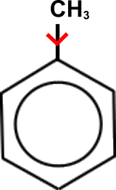
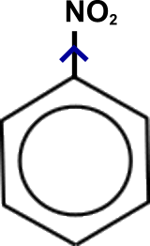
Orientation effects of substituents in electrophilic aromatic substitution reactions of monosubstituted Benzenes
Meta directors | Ortho , para directors
-NO2 -SO3H -COOH, -COOR -CHO, -COR -CN | -OH, -OR -NH2, -NHR, -NR2 -C6H5 -CH3, -R (alkyl) -F, -Cl, -Br, -I

Slide 24
108 Chem

Slide 25
Thank You for your kind attention !
Questions
108 Chem

