Slide 1
Chapter 4+17
The Relational Model
Pearson Education © 2014

Slide 2
Objectives
Terminology of relational model.
How tables are used to represent data.
Properties of database relations.
How to identify CK, PK, and FKs.
Purpose and advantages of views.
How to derive a set of relations from a conceptual data model.
Pearson Education © 2014
2

Slide 3
Database design
Steps in building a database for an application:
Understanding real-world domain being captured
Specify it using a database conceptual model (ER/OO)
Translate specification to model of DBMS (relational)
Create schema using DBMS commands (DDL)
Load data(DML)
Real World Domain
Conceptual model (ERD)
Relational Data Model
Create schema
(DDL)
Load Data
(DML)

Slide 4
Relational Model Terminology
A relation is a table with columns and rows. Holds information about entities.
Only applies to logical structure of the database, not the physical structure.
Attribute is a named column of a relation.
Domain is the set of allowable values for one or more attributes.
Every attribute in a relation is defined on a domain.
Pearson Education © 2014
4

Slide 5
Relational Model Terminology
Tuple is a row of a relation.
Degree is the number of attributes in a relation.
Cardinality is the number of tuples in a relation.
Relational Database is a collection of normalized relations with distinct relation names.
Pearson Education © 2014
5

Slide 6
Instances of Branch and Staff Relations
Pearson Education © 2014
6

Slide 7
Examples of Attribute Domains
Pearson Education © 2014
7

Slide 8
Alternative Terminology for Relational Model
Pearson Education © 2014
8

Slide 9
Properties of Relations
Relation name is distinct from all other relation names in relational schema.
Each cell of relation contains exactly one atomic (single) value.
Each attribute has a distinct name.
Values of an attribute are all from the same domain.
Pearson Education © 2014
9

Slide 10
Properties of Relations
Each tuple is distinct; there are no duplicate tuples.
Order of attributes has no significance.
Order of tuples has no significance, theoretically.
Pearson Education © 2014
10

Slide 11
Relational Keys
Candidate Key
An attribute, or set of attributes, that uniquely identifies a tuple, and no proper subset of CK within a relation.
Primary Key
Candidate key selected to identify tuples uniquely within relation.
Foreign Key
Attribute, or set of attributes, within one relation that matches candidate key of some (possibly same) relation. Used to represent relationship between tuples of two relations.
Pearson Education © 2014
11

Slide 12
Integrity Constraints
Null
Represents value for an attribute that is currently unknown or not applicable for tuple.
Deals with incomplete or exceptional data.
Represents the absence of a value and is not the same as zero or spaces, which are values.
Pearson Education © 2014
12

Slide 13
RELATIONAL INTEGRITY =integrity rules =integrity constraint
Data model: An integrated collection of concepts for describing and manipulating data, relationships between data, and constraints on the data in an organization. CH2
A data model has three components:
A structural part, consisting of a set of rules according to which databases can be constructed;
A manipulative part, defining the types of operation that are allowed on the data;
A set of integrity constraints, which ensures that the data is accurate.

Slide 14
RELATIONAL INTEGRITY
There are many important integrity rules:
domain constraints
entity integrity
referential integrity
Multiplicity
General constraints

Slide 15
RELATIONAL INTEGRITY
Entity Integrity: In a base relation, no attribute of a primary key can be null.
Referential integrity if a foreign key exists in a relation, either the foreign key value must match a candidate key value of some tuple in its home relation or the foreign key value must be wholly null.

Slide 16
Database Relations
Relation schema
Named relation defined by a set of attribute and domain name pairs.
If A₁, A₂, A₃,…,A_{n} are a set of attributes, then relation schema R is:
R=(A₁,A₂,A₃,…..,A_{n})
Pearson Education © 2014
16

Slide 17
Database Relations
Relational database schema
Set of relation schemas, each with a distinct name.
If R₁, R₂, R₃,…,R_{n} are a set of attributes, then relation schema R is:
R=(R₁,R₂,R₃,…..,R_{n})
Pearson Education © 2014
17

Slide 18
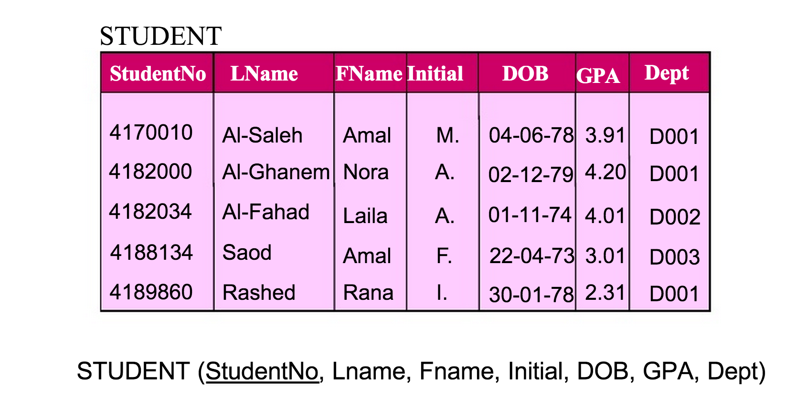
Database Relations
Pearson Education © 2014
18

Slide 19
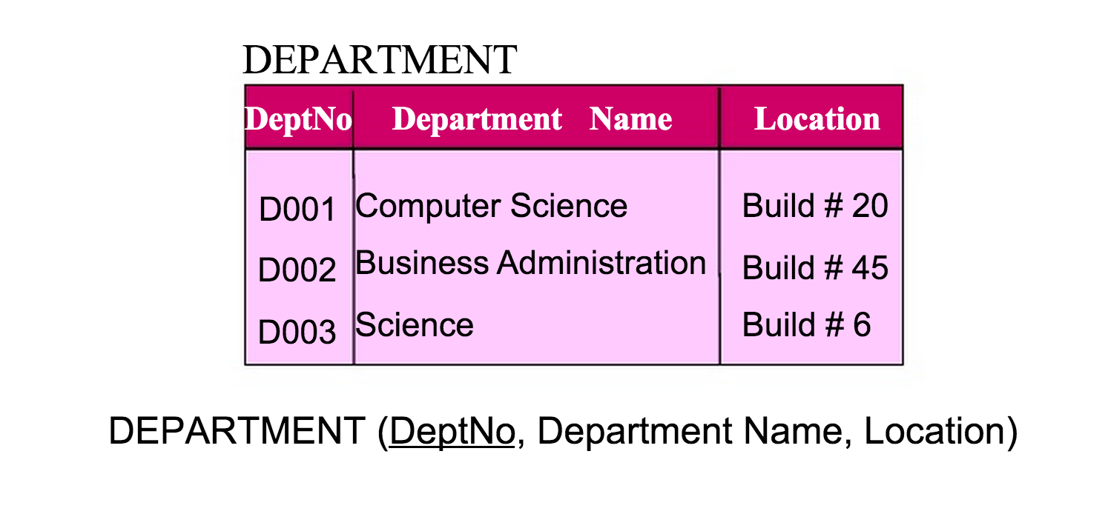
Database Relations
Pearson Education © 2014
19

Slide 20
Views
Base Relation
Named relation corresponding to an entity in conceptual schema, whose tuples are physically stored in database.
View
Dynamic result of one or more relational operations operating on base relations to produce another relation.
Pearson Education © 2014
20

Slide 21
Views
A virtual relation that does not necessarily actually exist in the database but is produced upon request, at time of request.
Contents of a view are defined as a query on one or more base relations.
Views are dynamic, meaning that changes made to base relations that affect view attributes are immediately reflected in the view.
Pearson Education © 2014
21

Slide 22
Purpose of Views
Provides powerful and flexible security mechanism by hiding parts of database from certain users.
Permits users to access data in a customized way, so that same data can be seen by different users in different ways, at same time.
Can simplify complex operations on base relations.
Pearson Education © 2014
22

Slide 23
Updating Views
All updates to a base relation should be immediately reflected in all views that reference that base relation.
If view is updated, underlying base relation should reflect change under the following rules:
Updates are allowed if query involves a single base relation and contains a PK of base relation.
Updates are not allowed involving multiple base relations.
Updates are not allowed involving aggregation or grouping operations.
Pearson Education © 2014
23

Slide 24
Build and Validate Logical Data Model
Derive relations for logical data model
To create relations for the logical data model to represent the entities, relationships, and attributes that have been identified.

Slide 25
Derive relations for logical data model
(1) Strong entity types
For each strong entity in the data model, create a relation that includes all the simple attributes of that entity.
For composite attributes, include only the constituent simple attributes.
Derived attributes are usually omitted.
FName
Initial
LName
Name
Age
EmpNo
EMPLOYEE
Employee ( EmpNo, Fname, Initial, Lname )

Slide 26
Derive relations for logical data model
Multi Value Attribute
Suppose A is a relation that contains the multivalued attribute.
Create a relation R to represent the attribute.
Include the PK of A as FK in R.
The PK of R is the combination of the PK of A (FK) & the multivalued attribute.
BranchNo
street
city
telNo
Branch
Branch( brachNo, street, city, postCode)
BrachTel (telNo, brachNo)
postCode

Slide 27
Derive relations for logical data model
Weak entity types
For each weak entity in the data model, create a relation that includes all the simple attributes of that entity.
The primary key of a weak entity is the partial key and its strong entity type PK. The FK will be the strong entity PK.
Lname
Fname
DepNo
Fname
EmpNo
DOB
EMPLOYEE
has
DEPENDENT
Employee ( EmpNo, Lname,Fname, DOB)
Dependents(DepNo, EmpNo, Fname)

Slide 28
Derive relations for logical data model
(3) One-to-many (1:*) binary relationship types
The entity on the ‘one side’ of the relationship is designated as the parent entity and the entity on the ‘many side’ is designated as the child entity.
Include the PK of the one side as a FK in the many side.
Add attributes that describes the relationship to the many side.
1
M
DEPARTMENT
Has
STAFF
DeptNo
year
StaffNO
DeptName
sName
Department (DeptNo, DeptName)
Staff (StaffNO, sName , DeptNo , year)

Slide 29
Derive relations for logical data model
(4) One-to-one (1:1) binary relationship types
Mandatory participation on both sides of 1:1 relationship.
Mandatory participation on one side of 1:1 relationship.
Optional participation on both sides of 1:1 relationship.

Slide 30
Derive relations for logical data model
Mandatory participation on both sides of 1:1 relationship
we should combine the entities involved into one relation and choose one of the primary keys of the original entities to be the primary key of the new relation, while the other (if one exists) is used as an alternate key
(1,1)
(1,1)
EMPLOYEE
has
OFFICE
Year
OfficeNo
EmpName
EmpID
OfficeLoc
Employee( EmpID, EmpName,OfficeNo, OfficeLoc, Year)

Slide 31
Derive relations for logical data model
Mandatory participation on one side of a 1:1 relationship
Add the PK attributes of the optional side as a FK to the mandatory side.
Add attributes of the relationship to the mandatory side.
(1,1)
(0,1)
EMPLOYEE
has
SPOUSE
EmpName
EmpID
Year
SpouseID
SpoudeName
Employee(EmpID, EmpName)
Spouse(SpouseID, SpouseName, EmpID, Year)

Slide 32
Derive relations for logical data model
Optional participation on both sides of a 1:1 relationship
Choose one side and add its PK as a FK to the other side.
Add attributes of the relationship to the other side.
(0,1)
(0,1)
EMPLOYEE
use
CAR
Year
CarNo
EmpName
EmpID
CarName
Employee(EmpID, EmpName)
Car (CarNo, CarName, EmpID, Year)

Slide 33
Derive relations for logical data model
(5) Many-to-many (*:*) binary relationship types
Create a new relation with columns for the PKs of the two participating entity sets, and attributes of the relationship.
The PK of the new relation consists of the PKs of the two entities.
The PKs of the two entities also serve as foreign keys referencing the entities.
M
N
STUDENT
enroll
SUBJECT
stNo
date
sCode
stName
sName
Student (stNo, stName)
Subject (sCode, sName)
Enroll (stNo, sCode, date)

Slide 34
One-to-one (1:1) recursive relationships
with mandatory participation on both sides: represent the recursive relationship as a single relation with two copies of the primary key. (one copy of the primary key represents a foreign key
and should be renamed to indicate the relationship it represents.)
with mandatory participation on only one side, we have the
Option: to create a single relation with two copies of the primary key as described above, OR to create a new relation to represent the relationship. The new relation would only have two attributes, both copies of the primary key. As before, the copies of the primary keys act as foreign keys and have to be renamed to indicate the purpose of each in the relation.
with optional participation on both sides, again create a
new relation as described above

Slide 35
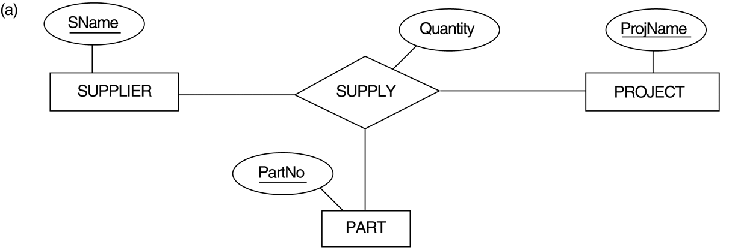
Derive relations for logical data model
(6) N-ary relationship
Create a relation R to represent the relationship
Include the PK of the participating entities E1,E2.. En as FKs in R.
The combination of all FKs form the PK of R.
Add the relationship attributes to R
Supplier (Sname)
Project (Projname)
Part (PartNo)
Supply (Sname, PartNo, ProjName, Quantity)

Slide 36
Mapping EER
Mandatory/NonDisjoint
Suppose specialization with subclasses (S₁, S₂, .., S_{m}) & a superclass C.
Create a relation L to represent C with PK & attributes.
Include the unshared attributes for each subclass S_{i}, 1≤ i ≤ m.
Add discriminator in L to distinguish the type of each tuple.

Slide 37
Mapping EER
Mandatory/NonDisjoint
Salary
EmpNo
LName
EMPLOYEE
Fname
DOB
o
Typing
Speed
SECRETARY
TECHNICIAN
EngType
ENGINEER
TGrade
EMPLOYEE( EmpNo, Fname, Lname, DOB, Salary,TypingSpeed,TGrade,
EngType, Secretary Flag, Technician Flag, Engineer Flag )

Slide 38
Mapping EER
Mandatory/Disjoint
Suppose specialization with subclasses (S₁, S₂, .., S_{m}) & a superclass C.
Create a relation Li, 1< i < m, to represent each combination of super/subclass.
Add the PK and attributes of C to Li, 1< i < m.

Slide 39
Mapping EER
Mandatory/Disjoint
Salary
EmpNo
LName
EMPLOYEE
Fname
DOB
d
Typing
Speed
SECRETARY
TECHNICIAN
EngType
ENGINEER
TGrade
SECRETARY(EmpNo, Fname, Lname, DOB, Salary,TypingSpeed)
TECHNICIAN(EmpNo, Fname, Lname, DOB, Salary,Tgrade)
ENGINEER(EmpNo, Fname, Lname, DOB, Salary, EngType)

Slide 40
Mapping EER
Optional/Disjoint
Suppose specialization with subclasses (S₁, S₂, .., S_{m}) & a superclass C.
Create a relation L to represent C with PK & attributes.
Create a relation Li to represent all subclasses Si, 1< i < m.

Slide 41
Mapping EER
Optional/Disjoint
Salary
EmpNo
LName
Fname
EMPLOYEE
DOB
d
Typing
Speed
SECRETARY
TECHNICIAN
ENGINEER
EngType
TGrade
EMPLOYEE(EmpNo, Fname, Lname, DOB, Salary)
SECRETARY(EmpNo, TypingSpeed)
TECHNICIAN(EmpNo, Tgrade)
ENGINEER(EmoNo, EngType)

Slide 42
Mapping EER
Optional/NonDisjoint
Suppose specialization with subclasses (S₁, S₂, .., S_{m}) & a superclass C.
Create a relation L to represent C with PK & attributes.
Create a relation Li to represent all subclasses Si, 1< i < m.
Add discriminator in Li to distinguish the type of each tuple.

Slide 43
Mapping EER
Optional/NonDisjoint
Salary
EmpNo
LName
EMPLOYEE
Fname
DOB
o
Typing
Speed
SECRETARY
TECHNICIAN
EngType
ENGINEER
TGrade
EMPLOYEE(EmpNo, Fname, Lname, DOB, Salary)
SUB-EMP(EmpNo, TypingSpeed,TGrade, EngType, Secretary Flag, Technician Flag, Engineer Flag)

Slide 44
Guidelines for representation of superclass / subclass relationship

Slide 45
Summary of how to map entities and relationships to relations

Slide 46
Summary
Relational database.
Relation, attribute, tuple, degree, cardinality.
Primary key, Foreign key.
Relational schema, Relational database schema.
Views.

