Slide 1
Crystal Imperfection
Crystals: Basis with infinite space lattice. Infinite periodicity.
Real crystals: are finite in extent. Therefore, they have surface at boundary where some atomic bonds are broken. Surface itself is an imperfection.
In addition, there are other occasional disruption in periodicity within a crystal. Volume wise disruption may be 0.01%.

Slide 2
Why we bother for imperfection
The study of imperfections has a two fold purpose, namely,
A better understanding of crystals and how they affect the
properties of metals.
Exploration of possibilities of minimizing or eliminating these
defects.
The term “defect” or “imperfection” is generally used to
describe any deviation from the perfect periodic array of
atoms in the crystal.

Slide 3
Why we bother for imperfection
PROPERTIES
Structure sensitive
Structure Insensitive
E.g. Yield stress, Fracture toughness
E.g. Density, elastic modulus

Slide 4
Classification of Imperfection
On the basis of geometry
POINT IMPERFECTIONS
LINE IMPERFECTIONS
SURFACE IMPERFECTIONS
VOLUME IMPERFECTIONS

Slide 5
POINT IMPERFECTIONS
They are imperfect point- like regions, one or two
atomic diameters in size and hence referred to as
‘zero dimensional imperfections’.
There are different kinds of point imperfections.
VACANCIES
If an atom is missing from its normal site in the
matrix, the defect is called a vacancy defect.
It may be a single vacancy, divacancy or a trivacancy.

Slide 6
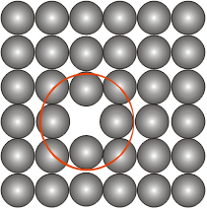
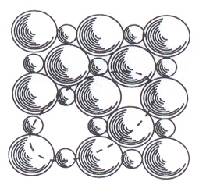
Vacancy
Missing atom from an atomic site
Atoms around the vacancy displaced
Tensile stress field produced in the vicinity
A pair of one cation and one anion can be missed from an ionic crystal. Such a pair of vacant ion sites is called Schottky imperfection.
Tensile Stress
Fields ?
SCHOTTKY IMPERFECTIONS

Slide 7
Relative
size
Interstitial
Compressive
Stress
Fields
Impurity
Substitutional
Compressive stress fields
SUBSTITUTIONAL IMPURITY
• Foreign atom replacing the parent atom in the crystal
• E.g. Cu sitting in the lattice site of FCC-Ni
INTERSTITIAL IMPURITY
• Foreign atom sitting in the void of a crystal
• E.g. C sitting in the octahedral void in HT FCC-Fe
Tensile Stress
Fields

Slide 8
Interstitial C sitting in the octahedral void in HT FCC-Fe
r_{Octahedral void} / r_{FCC atom} = 0.414
r_{Fe-FCC} = 1.29 Å ⇒ r_{Octahedral void} = 0.414 x 1.29 = 0.53 Å
r_{C} = 0.71 Å
⇒ Compressive strains around the C atom
Solubility limited to 2 wt% (9.3 at%)
Interstitial C sitting in the octahedral void in LT BCC-Fe
r_{Tetrahedral void} / r_{BCC atom} = 0.29 • r_{C} = 0.71 Å
r_{Fe-BCC} = 1.258 Å ⇒ r_{Tetrahedral void} = 0.29 x 1.258 = 0.364 Å
► But C sits in smaller octahedral void- displaces fewer atoms
⇒ Severe compressive strains around the C atom
Solubility limited to 0.008 wt% (0.037 at%)

Slide 9
ENTHALPY OF FORMATION OF VACANCIES
Formation of a vacancy leads to missing bonds and distortion of the
lattice
The potential energy (Enthalpy) of the system increases
Work required for the formaion of a point defect →
Enthalpy of formation (ΔH_{f}) [kJ/mol or eV / defect]
Though it costs energy to form a vacancy its formation leads to
increase in configurational entropy
⇒ above zero Kelvin there is an equilibrium number of vacancies
Crystal | Kr | Cd | Pb | Zn | Mg | Al | Ag | Cu | Ni
kJ / mol | 7.7 | 38 | 48 | 49 | 56 | 68 | 106 | 120 | 168
eV / vacancy | 0.08 | 0.39 | 0.5 | 0.51 | 0.58 | 0.70 | 1.1 | 1.24 | 1.74

Slide 10
Let n be the number of vacancies, N the number of sites in the lattice
Assume that concentration of vacancies is small i.e. n/N << 1
⇒ the interaction between vacancies can be ignored
⇒ ΔH_{formation} (n vacancies) = n . ΔH_{formation} (1 vacancy)
Let ΔH_{f} be the enthalpy of formation of 1 mole of vacancies
ΔG = ΔH − T ΔS
ΔS = ΔS_{thermal} + ΔS_{configurational}
ΔG (putting n vacancies) = nΔH_{f} − T ΔS_{config}
Larger contribution
zero
For minimum

Slide 11
⇒
Assuming n << N
Considering only configurational entropy
User R instead of k if ΔH_{f} is in J/mole
?
Using
ΔS = ΔS_{thermal} + ΔS_{configurational}
Independent of temperature, value of ~3

Slide 12
G (perfect crystal)
T (ºC) | n/N
500 | 1 x 10⁻¹⁰
1000 | 1 x 10⁻⁵
1500 | 5 x 10⁻⁴
2000 | 3 x 10⁻³
ΔH_{f} = 1 eV/vacancy = 0.16 x 10⁻¹⁸ J/vacancy
At a given T
Certain equilibrium number of vacancies are preferred at T > 0K

Slide 13
Estimate number of vacancies in Cu at room T
k_{B} = 1.38 × 10⁻²³ J/atom-K = 8.62 × 10⁻⁵ eV/atom-K
T = 27º C + 273 = 300 K.
k_{B}T = 300 K × 8.62 × 10⁻⁵ eV/K = 0.026 eV
Q_{v} = 0.9 eV/atom
N_{s} = N_{A}ρ/A_{cu}
N_{A} = 6.023 × 10²³ atoms/mol
ρ = 8.4 g/cm³
A_{cu} = 63.5 g/mol

Slide 14
Ionic Crystals
Overall electrical neutrality has to be maintained
Frenkel defect
Cation (being smaller get displaced to interstitial voids
E.g. AgI, CaF₂

Slide 15
ELECTRONIC DEFECTS
Errors in charge distribution in solids are called
‘electronic defects’.
These defects are produced when the composition of
an ionic crystal does not correspond to the exact
stoichiometric formula.
These defects are free to move in the crystal under
the influence of an electric field.

Slide 16
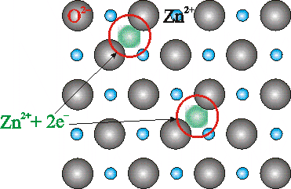
Other defects due to charge balance
If Cd²⁺ replaces Na⁺ → one cation vacancy is created
Defects due to off stiochiometry
ZnO heated in Zn vapour → Zn_{y}O (y >1)
The excess cations occupy interstitial voids
The electrons (2e⁻) released stay associated to the interstitial cation

Slide 17
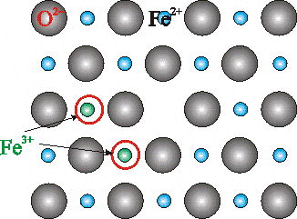
FeO heated in oxygen atmosphere → Fe_{x}O (x <1)
Vacant cation sites are present
Charge is compensated by conversion of ferrous to ferric ion:
Fe²⁺ → Fe³⁺ + e⁻
For every vacancy (of Fe cation) two ferrous ions are converted to
ferric ions → provides the 2 electrons required by excess oxygen

Slide 18
LINE IMPERFECTIONS
The defects, which take place due to dislocation or distortion of atoms along a line, in some direction are called as ‘line defects’.
Line defects are also called dislocations. In the geometic sense, they may be called as ‘one dimensional defects’.
A dislocation may be defined as a disturbed region between two substantially perfect parts of a crystal.
It is responsible for the phenomenon of slip by which most metals deform plastically.

Slide 19
EDGE DISLOCATION
What is the edge dislocation?
Edge dislocations. An edge dislocation is a defect where an extra half-plane of atoms is introduced mid way through the crystal, distorting nearby planes of atoms.
In perfect crystal, atoms are arranged in both vertical and horizontal planes parallel to the side faces.
If one of these vertical planes does not extend to the full length, but ends in between within the crystal it is called ‘edge dislocation’.
In the perfect crystal, just above the edge of the incomplete plane the atoms are squeezed and are in a state of compression.
Just below the edge of the incomplete plane, the atoms are pulled apart and are in a state of tension.

Slide 20
EDGE DISLOCATION
The distorted configuration extends all along the edge into the crystal.
Thus as the region of maximum distortion is centered around the edge of the incomplete plane, this distortion represents a line imperfection and is called an edge dislocation.
Edge dislocations are represented by ‘⊥’ or ‘Τ‘ depending on whether the incomplete plane starts from the top or from the bottom of the crystal.
These two configurations are referred to as positive and negative edge dislocations respectively.

Slide 21

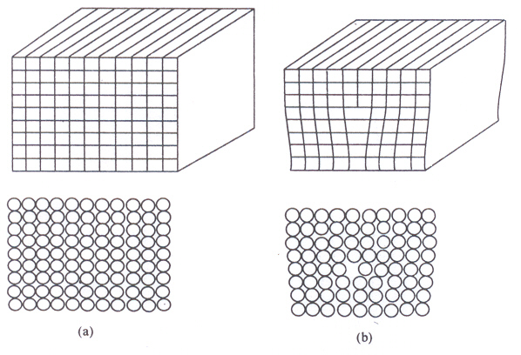

Slide 22
BURGERS VECTOR
The magnitude and the direction of the displacement are defined by a vector, called the Burgers Vector.
In figure (a), starting from the point P, we go up by 6 steps, then move towards right by 5 steps, move down by 6 steps and finally move towards left by 5 steps to reach the starting point P.Now the Burgers circuit gets closed.
When the same operation is performed on the defect crystal (figure (b)) we end up at Q instead of the starting point.

Slide 23
BURGERS VECTOR
So, we have to move an extra step to return to P, in order to close the Burgers circuit.
The magnitude and the direction of the step defines the Burgers Vector (BV).
BV = = b
The Burgers Vector is perpendicular to the edge dislocation line.

Slide 24

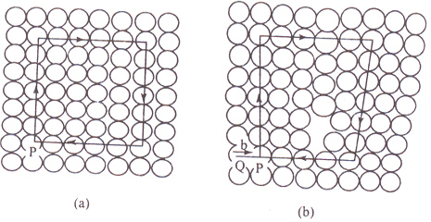
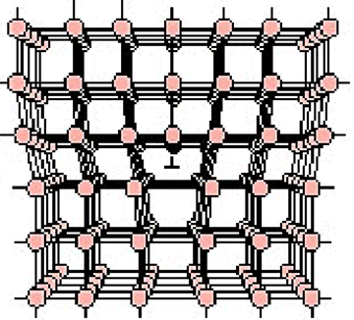

Slide 25
Video of Edge Dislocation
https://www.youtube.com/watch?v=-t6btGjGKYU

Slide 26
SCREW DISLOCATION
In this dislocation, the atoms are displaced in two separate planes perpendicular to each other.
It forms a spiral ramp around the dislocation.
The Burgers Vector is parallel to the screw dislocation line.
Speed of movement of a screw dislocation is lesser compared to edge dislocation. Normally, the real dislocations in the crystals are the mixtures of edge and screw dislocation.

Slide 27
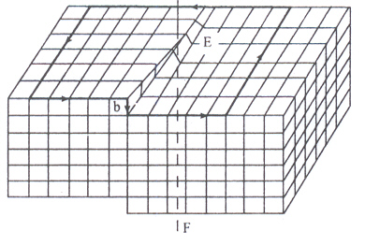
SCREW DISLOCATION

Slide 28
Video address for screw dislocation
https://www.youtube.com/watch?v=TxJOP3hA6To

Slide 29
SURFACE IMPERFECTIONS
Surface imperfections arise from a change in the stacking of atomic planes on or across a boundary.
The change may be one of the orientations or of the stacking sequence of atomic planes.
In geometric concept, surface imperfections are two- dimensional. They are of two types external and internal surface imperfections.

Slide 30
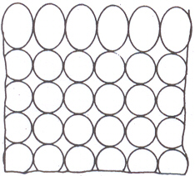
EXTERNAL SURFACE IMPERFECTIONS

Slide 31
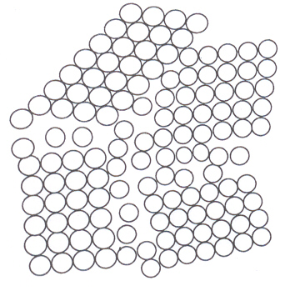
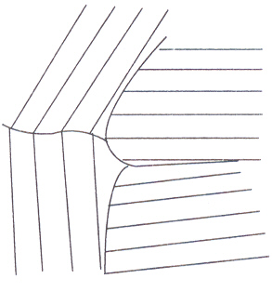
GRAIN BOUNDARIES

Slide 32
TILT BOUNDARIES
This is called low-angle boundary as the orientation difference between two neighbouring crystals is less than 10°.
The disruption in the boundary is not so severe as in the high-angle boundary. In general low-angle boundaries can be described by suitable arrays of dislocation.
Actually a low-angle tilt boundary is composed of edge dislocation lying one above the other
The angle or tilt will be
where b = Burgers vector and
D = the average vertical distance between dislocations.

Slide 33
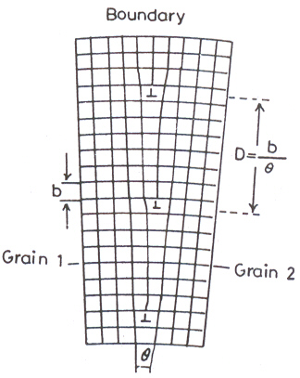
TILT BOUNDARIES

Slide 34
TWIN BOUNDARIES
If the atomic arrangement on one side of a boundary is a mirror reflection of the arrangement on the other side, then it is called as twin boundary.
As they occur in pair, they are called twin boundaries. At one boundary, orientation of atomic arrangement changes.
At another boundary, it is restored back. The region between the pair of boundaries is called the twinned region.
These boundaries are easily identified under an optical microscope.

Slide 35

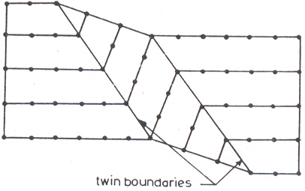

Slide 36
STACKING FAULTS
Whenever the stacking of atomic planes is not in a proper sequence throughout the crystal, the fault caused is known as stacking fault.
For example, the stacking sequence in an ideal FCC crystal may be described as A-B-C-A-B-C- A-B-C-……. But the stacking fault may change the sequence to A-B-C-A-B-A-B-A-B-C. The region in which the stacking fault occurs (A-B-A-B) forms a thin region and it becomes HCP.
This thin region is a surface imperfection and is called a stacking fault.

Slide 37

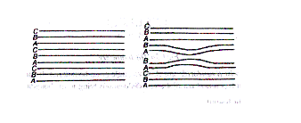

Slide 38
VOLUME IMPERFECTIONS
Volume defects such as cracks may arise in crystals when there is only small electrostatic dissimilarity between the stacking sequences of close packed planes in metals. Presence of a large vacancy or void space, when cluster of atoms are missed is also considered as a volume imperfection.
Foreign particle inclusions and non crystalline regions which have the dimensions of the order of 0.20 nm are also called as volume imperfections.

Slide 39
Physics is hopefully simple but Physicists are not

