Slide 1
Bayes' Rule
Definition:
The events $A_{1}$, $A_{2}$,…, and $A_{n}$constitute a partition of the sample space $S$if:
$$\bigcup_{i=1}^{n}{A_{i}=A_{1}∪A_{2}∪…∪A_{n}=S}$$
$$A_{i}∩A_{j}=∅, ∀ i≠j$$

Slide 2
Theorem: (Total Probability)
If the events $A_{1}$, $A_{2}$,…, and $A_{n}$constitute a partition of the sample space $S$such that
$P(A_{k})≠0$ for $k=1,2,…,n,$
then for any event B:
$$P\left(B\right)=\sum_{k=1}^{n}{P\left(A_{k}∩B\right)=\sum_{k=1}^{n}{P\left(A_{k}\right).P(B/{A_{k}})}}$$

Slide 3
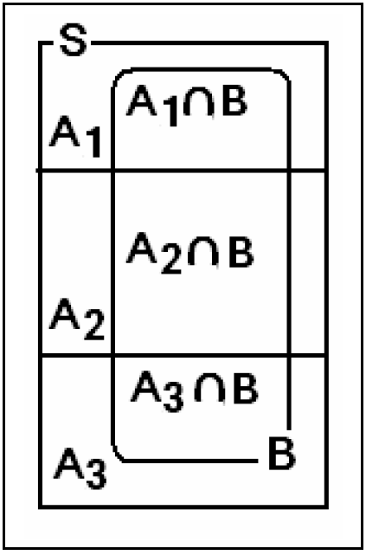

Slide 4
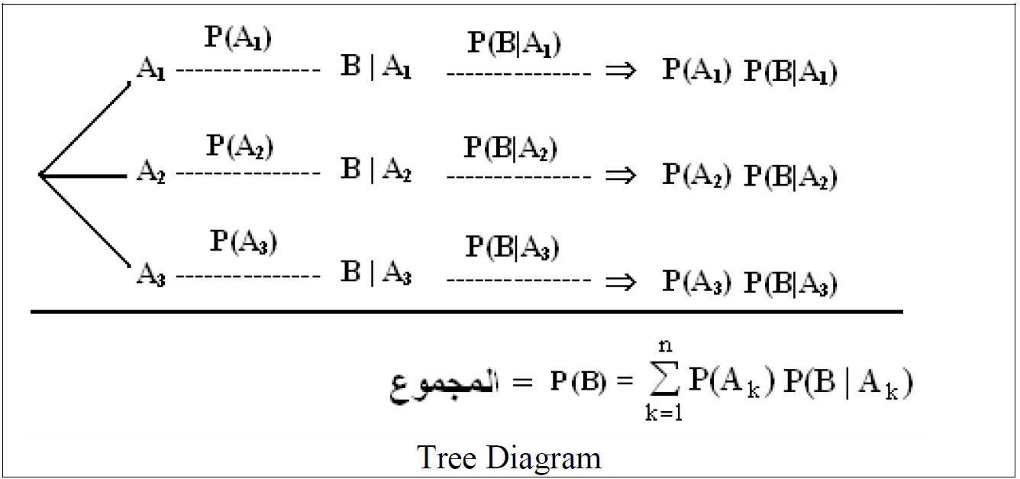

Slide 5
Example
Three machines $A_{1}$, $A_{2}$and $A_{3}$make 20%, 30%, and 50%, respectively, of the products. It is known that 1%, 4%, and 7% of the products made by each machine, respectively, are defective. If a finished product is randomly selected, what is the probability that it is defective?

Slide 6
Solution:
Define the following events:
B = {the selected product is defective}
$A_{1}$= {the selected product is made by machine $A_{1}$}
$A_{2}$= {the selected product is made by machine $A_{2}$}
$A_{3}$= {the selected product is made by machine $A_{3}$}

Slide 7
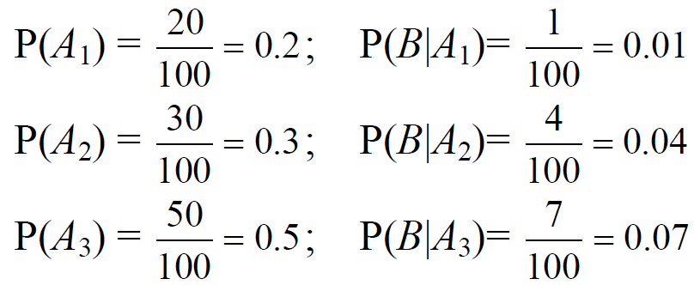

Slide 8
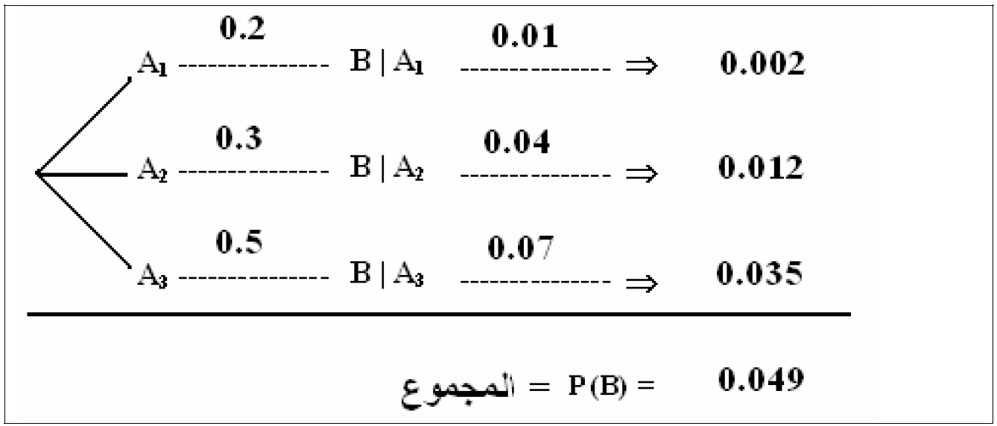

Slide 9
Another Example: see Example 2.41 page 74

Slide 10
Question:
If it is known that the selected product is defective, what is the probability that it is made by machine $A_{1}$?
Answer:
This rule is called Bayes' rule.

Slide 11
Theorem: (Bayes' rule)

Slide 12
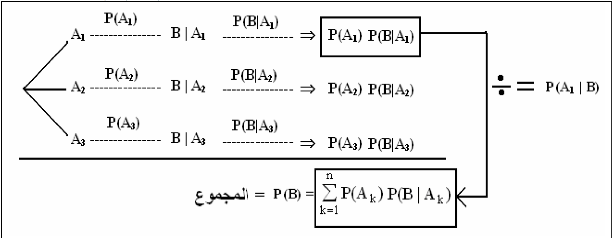

Slide 13
Example
In the previous example, if it is known that the selected product is defective, what is the probability that it is made by:
(a) machine $A_{2}$?
(b) machine $A_{3}$?

Slide 14
Solution:

Slide 15
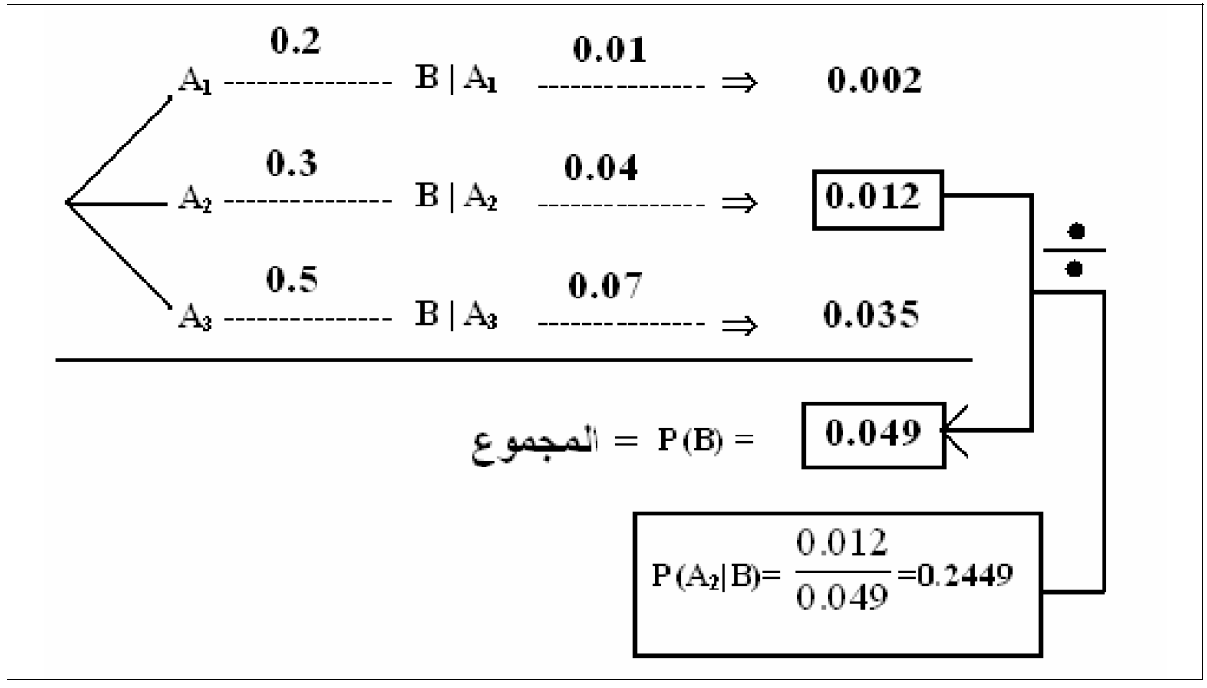

Slide 16
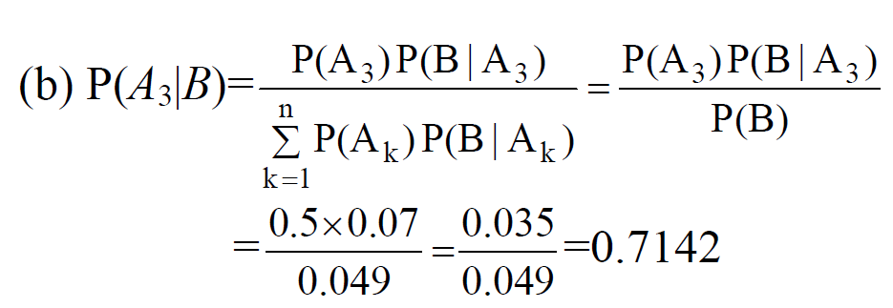

Slide 17
Note:
P($A_{1}$|B) = 0.0408, P($A_{2}$|B) = 0.2449, P($A_{3}$|B) = 0.7142
$$\sum_{k=1}^{3}{P\left({A_{k}}/B\right)=1}$$
If the selected product was found defective, we should check machine $A_{3}$first, if it is ok, we should check machine $A_{2}$, if it is ok, we should check machine $A_{1}$.

Slide 18
Another Example: see Example 2.42 page 75

Slide 19
Chapter 3: Random Variables and Probability Distributions

Slide 20
3.1 Concept of a Random Variable:
In a statistical experiment, it is often very important to allocate numerical values to the outcomes.

Slide 21
Example:
• Experiment: testing two components.
D=defective (معيب),
N=non-defective(غير معيب)
• Sample space: S={DD,DN,ND,NN}
• Let X = number of defective components when two components are tested.

Slide 22
Assigned numerical values to the outcomes are:
Sample point (Outcome) | Assigned Numerical Value (x)
DD | 2
DN | 1
ND | 1
NN | 0
Notice that, the set of all possible values of the random variable X is {0, 1, 2}.

Slide 23
Definition 3.1:
A random variable X is a function that associates each element in the sample space with a real number (i.e., X : S → R.)
Notation:
"X" denotes the random variable .
"x" denotes a value of the random variable X.

Slide 24
Types of Random Variables:
• A random variable X is called a discreterandom variable if its set of possible values is countable, i.e.,
$x$ ∈ {$x_{1}$, $x_{2}$, …, $x_{n}$} or $x$ ∈ {$x_{1}$, $x_{2}$, …}
• A random variable X is called a continuousrandom variable if it can take values on a continuous scale, i.e.,
.x ∈ {x: a < x < b; a, b ∈R}

Slide 25
3.2 Discrete Probability Distributions
A discrete random variable X assumes each of its values with a certain probability.

Slide 26
Example:
Experiment: tossing a non-balance coin 2 times independently.
• H= head , T=tail
• Sample space: S={HH, HT, TH, TT}
• Suppose P(H)=1/3 and P(T)=2/3

Slide 27
Let X= number of heads

Slide 28
• The possible values of X are: 0, 1, and 2.
• X is a discrete random variable.
• Define the following events:

Slide 29
The possible values of X with their probabilities are:
$$x$$ | $$P\left(X=x\right)=f(x)$$
0 | $$4/9$$
1 | $$4/9$$
2 | $$1/9$$
Total | 1
The function f(x)=P(X=x) is called the probability function (probability distribution) of the discrete random variable X.

Slide 30
Definition
The function f(x) is a probability function of a discrete random variable X if, for each possible values x, we have:
$f\left(x\right)≥0$
$\sum_{all x}{f\left(x\right)=1}$
$f\left(x\right)=P(X=x)$

Slide 31
Example:
For the previous example, we have:
$$x$$ | $$P\left(X=x\right)=f(x)$$
0 | $$4/9$$
1 | $$4/9$$
2 | $$1/9$$
Total | 1

Slide 32
Note
If X is a discrete random variable then
$$P(X<a)≠P(X≤a)$$

Slide 33
Example
A shipment of 8 similar microcomputers to a retail outlet contains 3 that are defective and 5 are non-defective. If a school makes a random purchase of 2 of these computers, find the probability distribution of the number of defectives.

Slide 34
Answer
2 Computers
8 Computers
D
N
3
5

Slide 35
Solution:
We need to find the probability distribution of the random variable: X = the number of defective computers purchased.
Experiment: selecting 2 computers at random out of 8

Slide 36
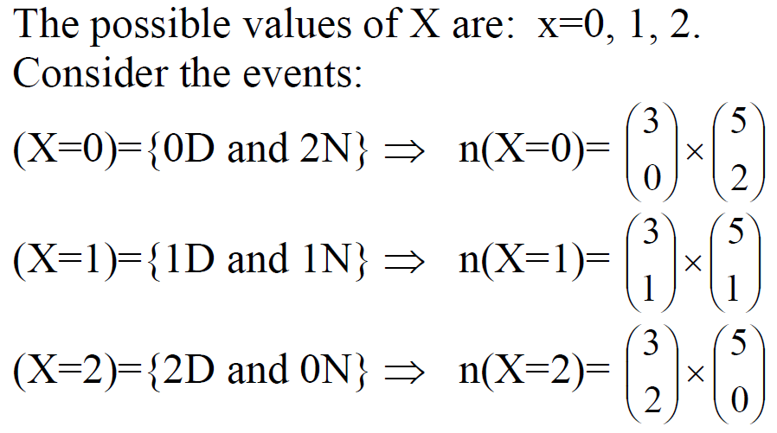

Slide 37
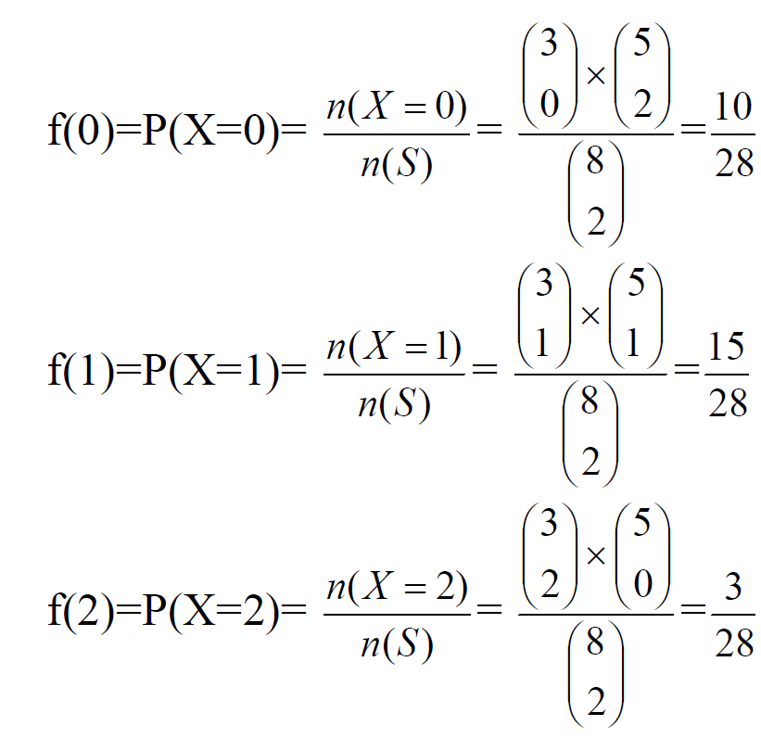

Slide 38
In general, for x=0,1, 2, we have:

Slide 39
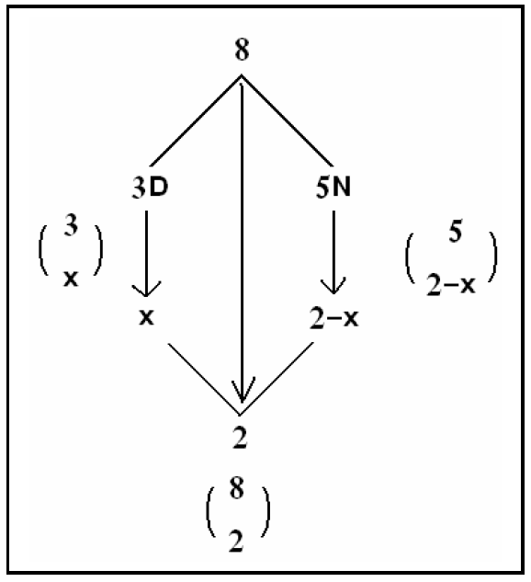

Slide 40
The probability distribution of X can be given in the following table

Slide 41
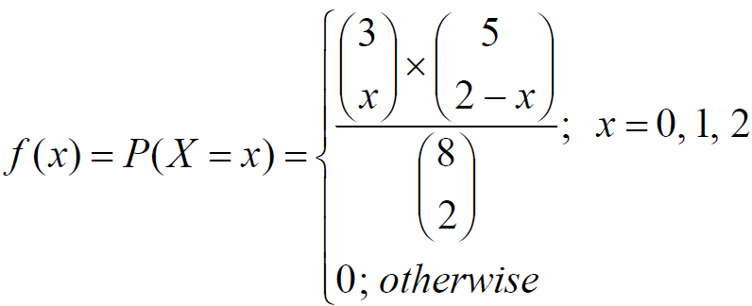
The probability distribution of X can be written as a formula as follows:
Hypergeometric Distribution

Slide 42
Another Example: see Example 3.8 page 84

Slide 43
Definition 3.5:
The cumulative distribution function (CDF), F(x), of a discrete random variable X with the probability function f(x) is given by:
$$F\left(x\right)=P\left(X≤x\right)=\sum_{t≤x}{f(t)}, −∞<x<∞$$

Slide 44
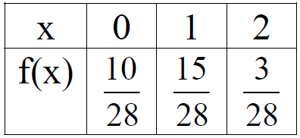
Example:
Find the CDF of the random variable X with the probability function:

Slide 45
Solution:
$$F\left(x\right)=P\left(X≤x\right) for −∞<x<∞$$
$$for x<0: F\left(x\right)=0$$
$$for 0≤x<1: F\left(x\right)=P\left(X=0\right)=\frac{10}{28}$$
$$for 1≤x<2: F\left(x\right)=P\left(X=0\right)+P\left(X=1\right)=\frac{10}{28}+\frac{15}{28}=\frac{25}{28}$$
$$for x≥2: F\left(x\right)=P\left(X=0\right)+P\left(X=1\right)+P\left(X=2\right)=\frac{10}{28}+\frac{15}{28}+\frac{3}{28}=1$$

Slide 46
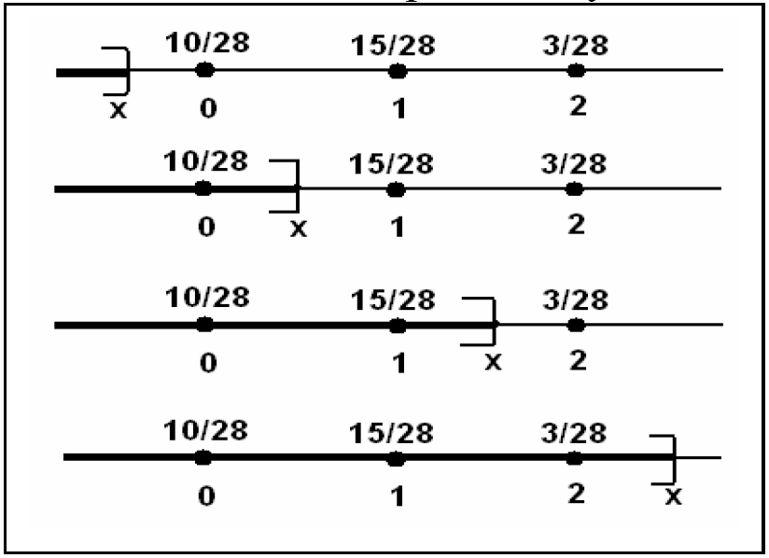

Slide 47
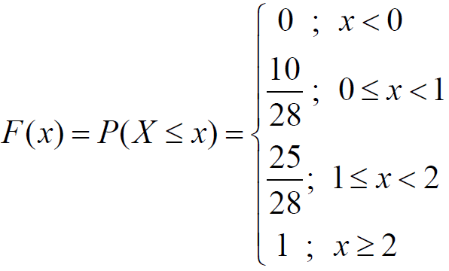
The CDF of the random variable X is:

Slide 48
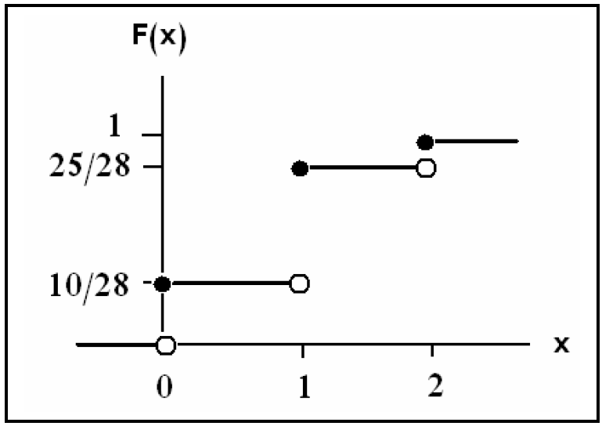

Slide 49
Note:
F(−0.5) = P(X≤−0.5)=0
F(1.5)=P(X≤1.5)=F(1) =25/28
F(3.8) =P(X≤3.8)=F(2)= 1

Slide 50
Result:

Slide 51
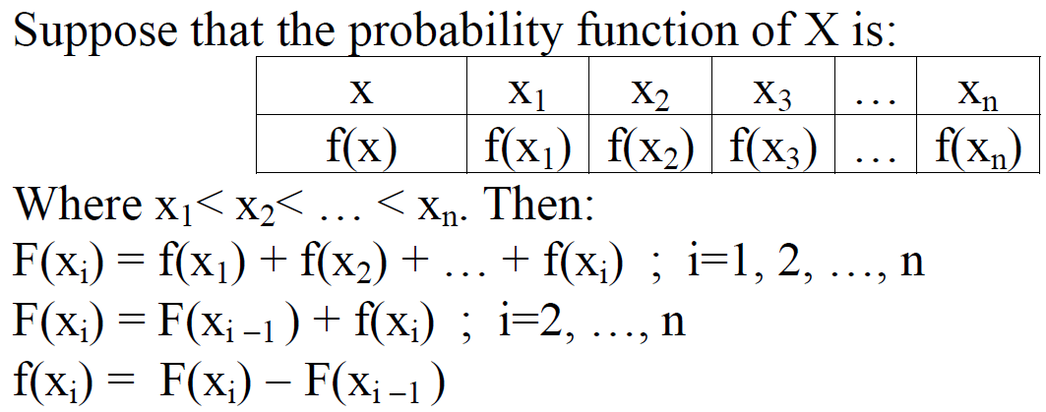
Result:

Slide 52
Example:
In the previous example,

Slide 53
Continuous Probability Distributions
For any continuous random variable, X, there exists a non-negative function f(x), called the probability density function (p.d.f) through which we can find probabilities of events expressed in term of X.

Slide 54
For any continuous r. v. X, there exists a function $f(x)$, called the density function of X , for which:
(i) The total area under the curve of $f(x)$=1.
$$f: ℝ⟶\left[0,∞)\right.$$
$$f(x)$$
a
$$x$$
b

Slide 55
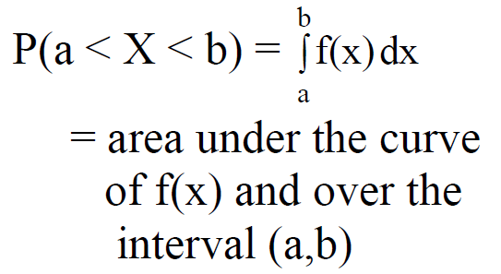

Slide 56
Definition

Slide 57
Note:

Slide 58
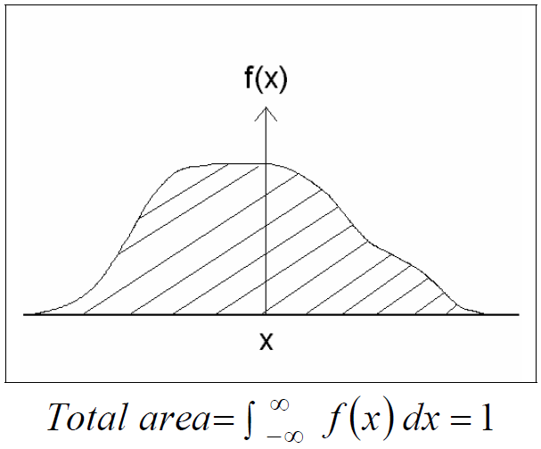

Slide 59
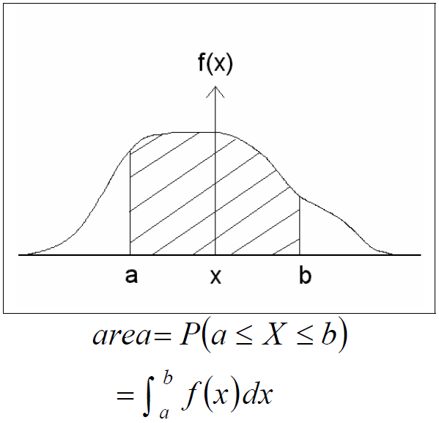

Slide 60
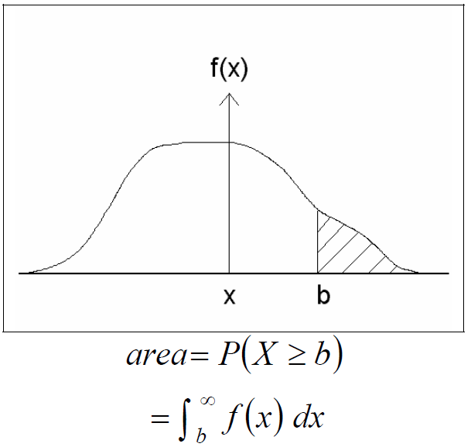

Slide 61
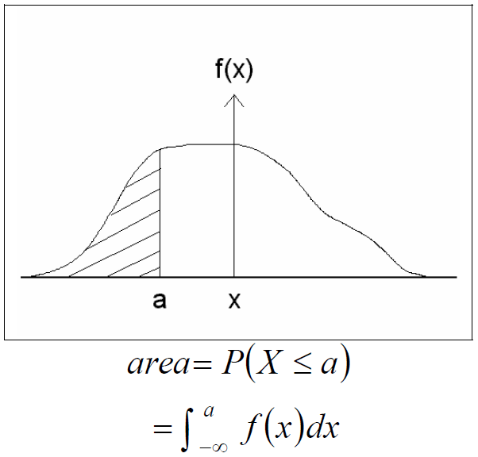

Slide 62
Example

Slide 63
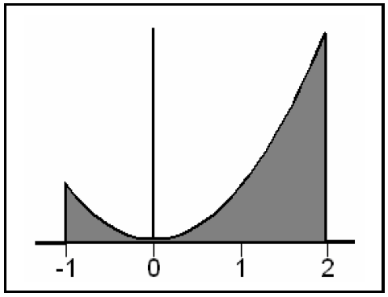
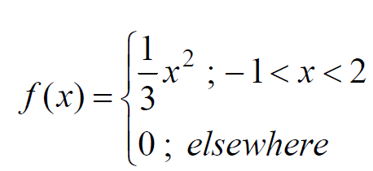
Solution:
X = the error in the reaction temperature in ºC.
X is continuous r. v.

Slide 64
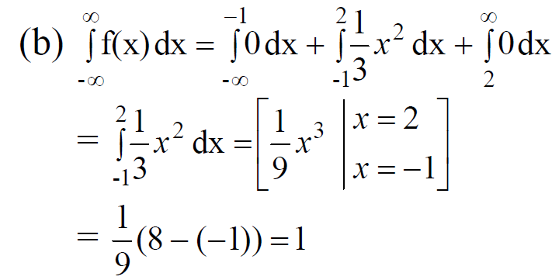
1. (a) f(x) ≥ 0 because f(x) is a quadratic function.

Slide 65
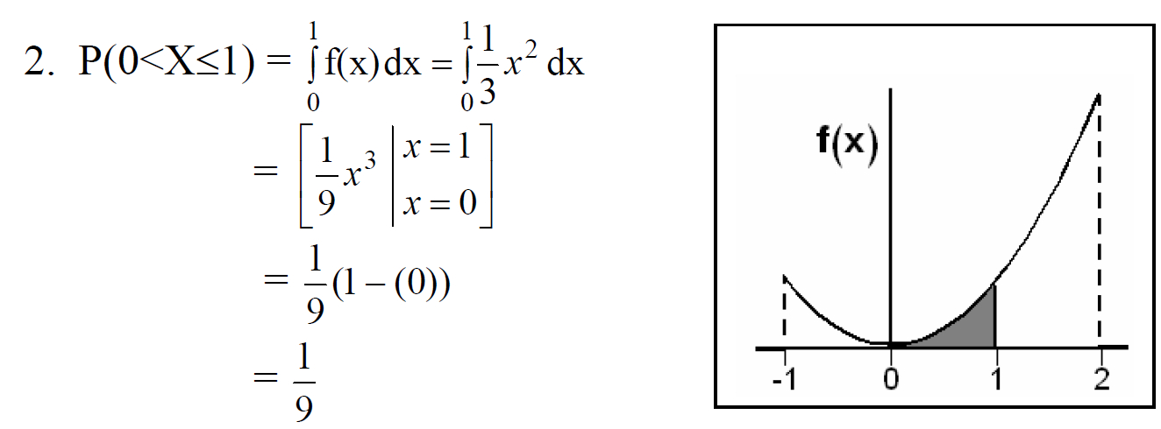

Slide 66
Definition
The cumulative distribution function (CDF), F(x), of a continuous random variable X with probability density function f(x) is given by:

Slide 67
Result:

Slide 68
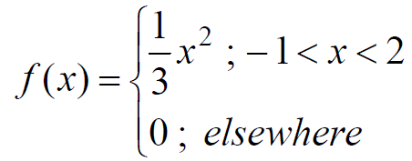
Example:
In the previous example
1. Find the CDF
2. Using the CDF, find P(0<X≤1).

Slide 69
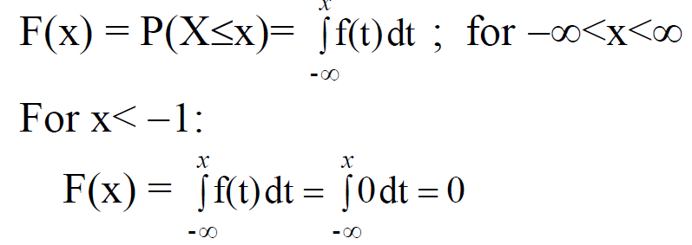
Solution:
(1) Finding F(x):

Slide 70
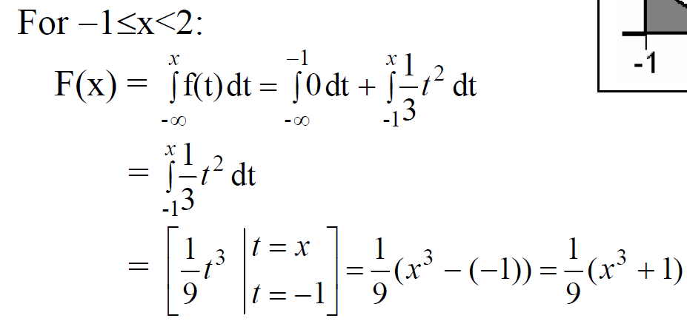

Slide 71
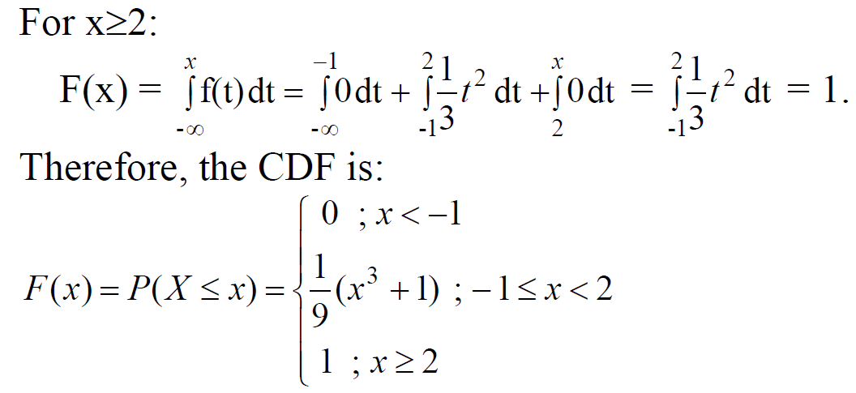

Slide 72
2. Using the CDF,

Slide 73
Exercises
3.6 – 3.9 page 92
(2) 3.18 – 3.20 page 93
(3) On a laboratory assignment, if the equipment is working, the density function of the observed outcome,X, is
$$f\left(x\right)=k\left(1−x\right), 0<x<1$$
Determine $k$that renders $f\left(x\right)$ a valid density function.
Calculate $P(X ≤ 1/3).$
What is the probability that $X$will exceed 0.5?

