Slide 1
1.2 Propositional Equivalences
DEFINITION 1
A compound proposition that is always true, no matter what the truth values of the propositions that occur in it, is called a tautology.
A compound proposition that is always false is called
a contradiction.
A compound proposition that is neither a tautology nor a contradiction is called a contingency.

Slide 2
EXAMPLE 1 We can construct examples of tautologies and contradictions using just one
propositional variable.
Consider the truth tables of p v -p and
p ˄ -p, shown in Table 1 . Because p v -p is
always true, it is a tautology. Because p ˄-p is always false, it is a contradiction.

Slide 3
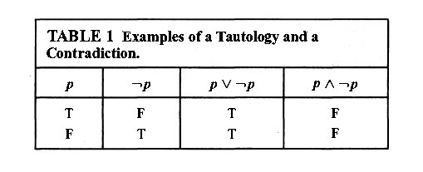

Slide 4
Logical Equivalences
DEFINITION 2
The compound propositions p and q are called logically equivalent if p ↔q is a tautology.
The notation p ≡ q denotes that p and q are logically equivalent.

Slide 5
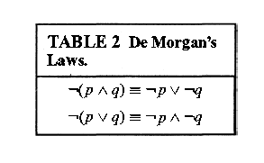

Slide 6
EXAMPLE 2
Show that - (p v q ) and -p ˄ -q are logically equivalent.

Slide 7
EXAMPLE 3
Show that p → q and -p v q are logically equivalent.

Slide 8
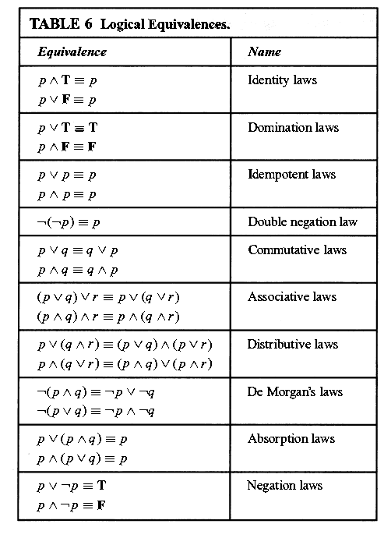

Slide 9
Homework
Page 28
1(b,c)
2
9 (a,e)
16

