Slide 1

Unsaturated Hydrocarbons
Alkenes
Dr. Shatha I Alaqeel
108 Chem

Slide 2
Learning Objectives
Chapter two discusses the following topics and the student by the end of this chapter will:
Know the structure, hybridization and bonding of alkenes
Know the common and IUPAC naming of alkenes
Know the geometry of the double bond i.e. cis/trans isomerization
Know the physical properties of alkenes
Know the different methods used for preparation of alkenes (elimination reactions ; dehydrogenation, dehydration and alkenes stability (Zaitsev’s rule) play an important role in understanding these reactions
Know the addition reactions of alkenes and the effect of Markovnikov’s rule in determining the regioselectivity of this reaction.

Slide 3
Structure Of Alkenes (Olefines)
They are unsaturated hydrocarbons – made up of C and H atoms and contain one or more C=C double bond somewhere in their structures.
Their general formula is C_{n}H_{2n} - for non-cyclic alkenes
Their general formula is CnH₂n-2 - for cyclic alkenes

Slide 4
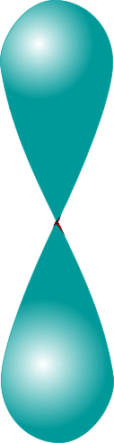

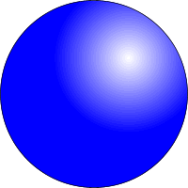

Alkenes
sp² Hybridization Of Orbitals In Alkenes
The electronic configuration of a carbon atom is 1s²2s²2p²
Thus
2s²
2s¹
2p³
3 x sp²
2p
2p²
promotion
hybridization
Trigonal planar

Slide 5
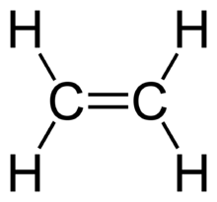
Alkenes
Orbital Overlap In Ethene
In ethylene (ethene), each carbon atom use an sp² orbital to form a single
C-C bond. Because of the two sp² orbitals overlap by end- to- end the resulting bond is called σ bond. The pi (π) bond between the two carbon atoms is formed by side- by-side overlap of the two unhybridized p- orbitals (2p–2p ) for maximum overlap and hence the strongest bond, the 2p orbitals are in line and perpendicular to the molecular plane.
This gives rise to the planar arrangement around C=C bonds. Also s orbitals of hydrogen atoms overlap with the sp² orbitals in carbon atoms to form two
C-H bonds with each carbon atom.
The resulting shape of ethene molecule is planar with bond angles of 120º and C=C bond length is 1.34 Å
5

Slide 6
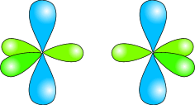
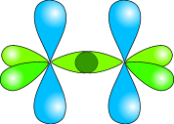
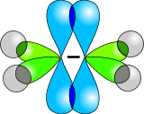
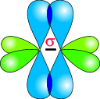
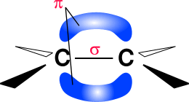
Alkenes
Orbital Overlap In Ethene
sp² hybridized carbon atoms
two sp² orbitals overlap to form a sigma bond between the two carbon atoms
two 2p orbitals overlap to form a pi bond between the two carbon atoms
s orbitals in hydrogen atoms overlap with the sp² orbitals in carbon atoms to form C-H bonds
the resulting shape is planar with bond angles of 120º and C=C (1.34 Å)
6

Slide 7
Nomenclature Of Alkenes and Cycloalkenes
1. Alkene common names:
Substituent groups containing double bonds are:
H₂C=CH– Vinyl group
H₂C=CH–CH₂– Allyl group
The substituent is named in a similar way to the parent alkene. It is named based on the number of carbon atoms in the branch plus the suffix -yl. i.e. alkenyl. Vinyl group (=Ethenyl group)

Slide 8
IUPAC RULES
Select the longest continuous Carbon chain containing the double bond , the ending of the name is changed from alkane to alkene .
The C- chain is numbered starting from the end closet to the double bond. Indicate the location of the double bond by using the number of the first atom of the double bond just before the suffix ene or as a prefix.
Indicate the positions of the substituents using numbers of carbon atoms to which they are bonded and write their names in alphabetical order (N.B. discard the suffixes tert-, di, tri,---when alphabetize the substituents) and if more than one substituent of the same type are present use the prefixes di- or tri or tetra or penta,--- to indicate their numbers.

Slide 10
In cycloalkenes, the double bond carbons are assigned ring locations #1 and #2. Which of the two is #1 may be determined by the nearest substituent rule.

Slide 11
If the substituents on both sides of the = bond are at the same distance, the numbering should start from the side that gives the substituents with lower alphabet the lower number.
When the longer chain cannot include the C=C bond, a substituent name is used

Slide 12
Geometrical Isomerism (G.I) In Alkenes
G. I. found in some, but not all, alkenes
It occurs in alkenes having two different groups / atoms attached to each carbon atom of the = bond
G. I. x G. I. X G. I.  G. I. 
A≠C B≠D
A = B or C = D Cis or Z
A =D or C = B trans or E
G. I. 
A = C or B = D
No Cis or trans
(G. I. X)

Slide 13

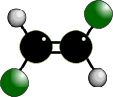
Alkenes
Geometrical Isomerism In Alkenes
It occurs due to the Restricted Rotation of C=C bonds so the groups on either end of the bond are ‘fixed’ in one position in space; to flip between the two groups a bond must be broken.
Geometrical isomers can not convert to each at room temperature.

Slide 14
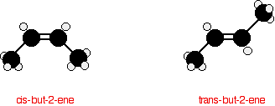

Geometric (cis-trans) isomerism
The restricted rotation about C=C and the planer geometry give rise to a type of isomerism.
The prefix cis- is used when the two similar atoms or groups are on the same side of the double bond.
The prefix trans- is used when they are on opposite sides of the double bond.

Slide 15
E-Z NOTATION FOR GEOMETRIC ISOMERISM
If the groups attached to the C=C are different, we distinguish the two isomers
If the two first-priority atoms are together on the same side of the double bond, you have Z isomer.
If the two first-priority atoms are on opposite sides of the double bond, you have E isomer.
The priorities of the substituents are determined by the atomic number with atoms of higher atomic number having higher priority.
I> Br > Cl > F > O > N > C > H

Slide 16
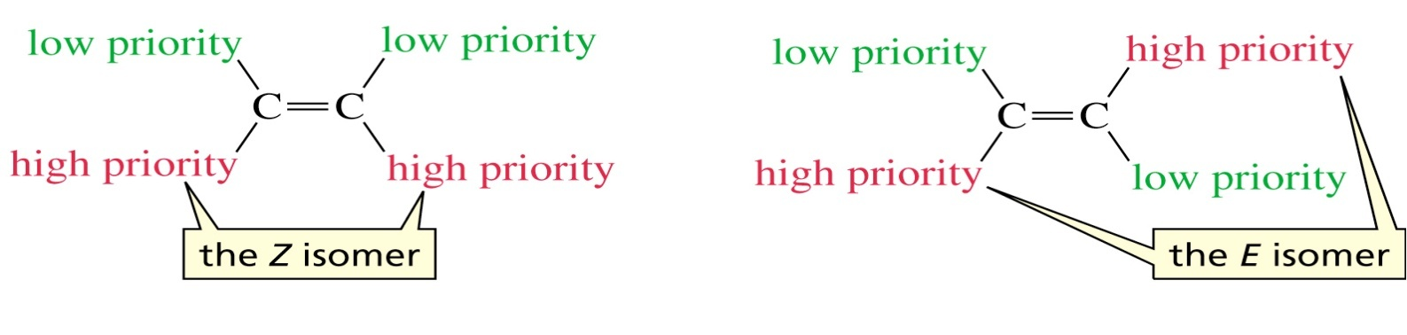
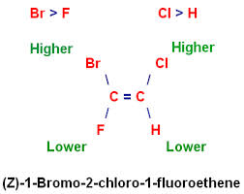
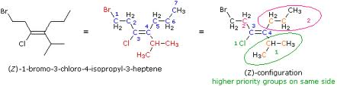
Examples
E-3-Methyl-2-pentene

Slide 17
Exercise
Alkenes
Q1-Which of the following compounds can exhibit cis / trans isomerism
2-Methylpropene
1-Butene
2-Methyl-2-pentene
2-Butene
3-Methyl-2-hexene
Q2- Name the following compounds according to IUPAC system
17

Slide 18
Physical Properties of Alkenes
physical states
C1-C4 are gases
C5-C17 are liquids
more than 18 carbon atoms are solids.
Solubility
Alkenes are non polar compounds. Insoluble in water. Soluble in non polar organic solvents ( hexane, benzene,…).
They are less dense than water.
Boiling point
The alkenes has a boiling point which is a small number of degrees lower than the corresponding alkanes. The boiling point of alkenes increase as the number of carbons increase.

Slide 19
Preparation Of Alkenes
Elimination
1- Dehydration of alcohols: ( removal of OH group and a proton from two adjacent carbon atoms ) using mineral acids such as H₂SO₄ or H₃PO₄ (H⁺).

Slide 20
Zaitsev’sRule
If there are different protons can be eliminated with the hydroxyl group or with halogen atom, in this case more than one alkene can be formed, the major product will be the alkene with the most alkyl substituents attached to the double bonded carbon.
Zaitsev rule: an elimination occurs to give the most stable, more highly substituted alkene

Slide 21
2- Dehydrohalogenation of alkyl halides using a base:
(removal halogen atom with hydrogen atom ) Heating an alkyl halide with a solution of KOH, in alcohol, yields an alkenes.

Slide 22
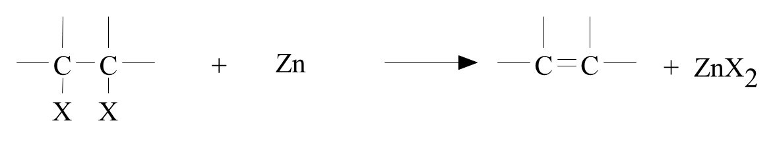
3- Dehalogenation of vicinal dihalides
alcohol
Example:

Slide 23
Reactions Of Alkenes

Slide 24
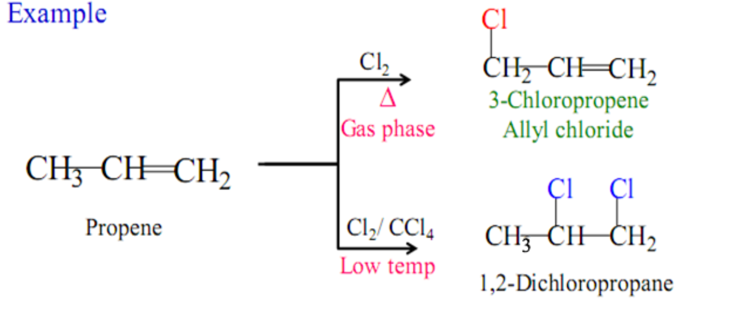
1-Substitution reactions
Halogenation at High Temperature
Involve the saturated alkyl chain at High temperature or UV light
CH₂=CH-CH₃
Addition reaction:
low temperature
Absence of light
Substitution reaction:
High temperature
or Ultraviolet light

Slide 25
Electrophilic Addition Reaction
2- Additions To The Carbon-Carbon Double Bond
2.1 Addition Of Hydrogen: Hydrogenation
Cis-1,2-Dimethyl cyclohexane

Slide 26
2.2.Addition of Halogens( Halogenation)
CCl4

Slide 27
2.3. Addition of Hydrogen Halides (Hydrohalogenation)
when HX is added to symmetrical alkenes, there is only one possible product from this addition by strong acids such as ethene, 2-butene and cyclohexene.
However, if the double bond carbon atoms are not structurally equivalent, i.e. unsymmetrical alkenes as in molecules of 1- propene, 1-butene, 2-methyl-2-butene and 1-methylcyclohexene, the reagent may add in two different ways to give two isomeric products. This is shown for 1-propene in the following equation.

Slide 28
Stability of carbocation
28

Slide 29
Markovnikov’s rule
In addition of unsymmetrical reagent to unsymmetrical alkenes the positive ion adds to the carbon of the alkene that bears the greater number of hydrogen atoms and the negative ion adds to the other carbon of the alkene.

Slide 30
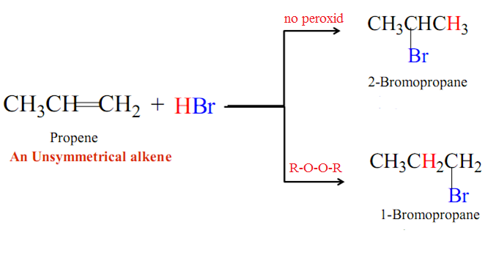
Anti Markovnikov’s Rule
In the addition of an acid to an alkene the hydrogen will go to the vinyl carbon that already has the lowest number of hydrogens.

Slide 31
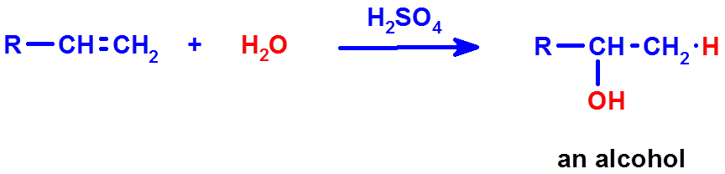
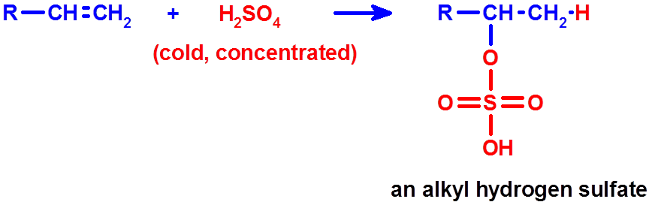
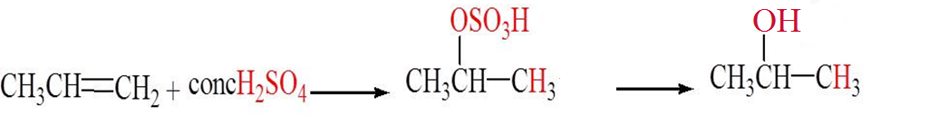
2.4- Addition of Sulfuric acid
heat
(H-OSO₃H)
Addition of Sulfuric acid to alkenes also follows Markovnikov’s rule,
as the example
H₂O
heat
Propene
Isopropyl hydrogen sulfate
2-Propanol

Slide 32
2.5. Addition of HOX ( ⁻OH, X⁺): Halohydrin formation
Only one product is possible from the addition of HOX acids (formed from mixture of H2O and X2) to symmetrical alkenes such as ethene and cyclohexene.
However, addition reactions to unsymmetrical alkenes will result in the formation of Markovonikov’s product preferentially.

Slide 33
2.6. Addition of H₂O: Hydration
Only one product is possible from the addition of H₂O in presence of acids as catalysts to symmetrical alkenes such as ethene and cyclohexene.
However, addition reactions to unsymmetrical alkenes will result in the formation of Markovonikov’s product preferentially.

Slide 34
3-Oxidation of alkenes
3.1- Ozonolysis ( Oxidation of alkenes by ozone O₃ )
This reaction involves rupture of the C=C to give aldehydes or ketones according to the structure of the original alkene.

Slide 35
3.2- Oxidation of alkenes with Permanganate (Baeyer test)
3.3- Oxidation of alkenes with peroxy acid
Epoxide
anti hydroxylation

Slide 36

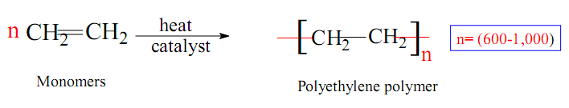
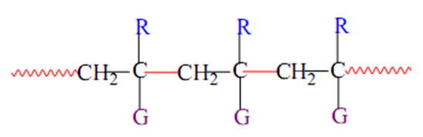
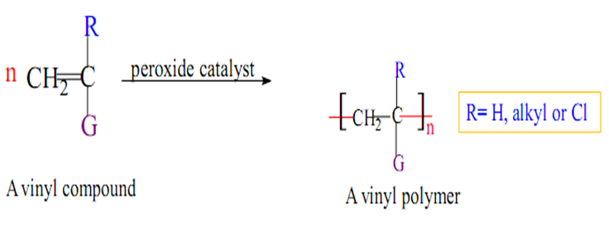
Polymerization (Free radical)
A)
B)

Slide 37
Thank You for your kind attention !
Questions?

