Slide 1
Chapter 2: Probability

Slide 2
Random Experiment:
Random experiment is an experiment we do not know its exact outcome in advance but we know the set of all possible outcomes.

Slide 3
Examples:
The following situations are random experiments:
Tossing a coin has two possibilities, head (H) or Tail (T).
Tossing a die and observe the number appears on top.
A football team plays two games and in each game either he wins (W) or be equal (D) or losses (L).

Slide 4
The Sample Space
The set of all possible outcomes of a statistical experiment is called the sample space and is denoted by S or$Ω$.
Each outcome (element or member) of the sample space S is called a sample point.
If we are interested only in whether the number is even or odd, the sample space is simply
S={even,odd}

Slide 5
Events
An event A is a subset of the sample space S. That is A⊆S.
φ⊆S is an event (φ is called the impossible event)
S⊆S is an event (S is called the sure event)

Slide 6
Example
Experiment: Selecting a ball from a box containing 6 balls numbered 1,2,3,4,5 and 6.
This experiment has 6 possible outcomes
$S$={1,2,3,4,5,6}.

Slide 7
Consider the following events:
$E_{1}$=getting an event number
$E_{2}$=getting a number less than 4
$E_{3}$=getting 1 or 3
$E_{4}$=getting an odd number
$E_{5}$=getting a negative number
$E_{6}$=getting a number less than 10

Slide 8
Notation

Slide 9
Example:
Experiment: Selecting 3 items from manufacturing process; each item is inspected and classified as defective (D) or non-defective (N).

Slide 10
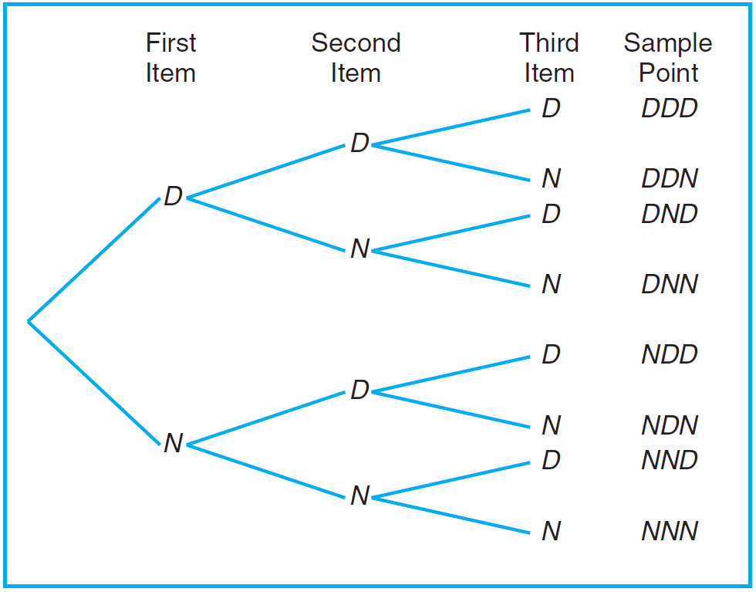

Slide 11
This experiment has 8 possible outcomes
S={DDD,DDN,DND,DNN,NDD,NDN,NND,NNN}

Slide 12
Consider the following events:
A={at least 2 defectives}= {DDD,DDN,DND,NDD}⊆S
B={at most one defective}= {DNN,NDN,NND,NNN}⊆S
C={3 defectives}= {DDD}⊆S

Slide 13
Rule (1)
If an operation can be performed in $n_{1}$ ways, and if for each of these ways a second operation can be performed in $n_{2}$ ways, then the two operations can be performed together in $n_{1×}n_{2}$ ways.

Slide 14
Example
How many sample points are there in the sample space when a pair of dice is thrown once?
Solution:
The first die can land face-up in any one of $n_{1}$ = 6 ways. For each of these 6 ways, the second die can also land face-up in $n_{2}$ = 6 ways.
Therefore, the pair of dice can land in
$n_{1}×n_{2}=\left(6\right)\left(6\right)=36$possible ways.

Slide 15
Rule (2)
If an operation can be performed in $n_{1}$ ways, and if for each of these ways a second operation can be performed in $n_{2}$ ways and for each of the first two a third operation can be performed in $n_{3}$ ways, and so forth, then the sequence of $k$operations can be performed in $n_{1}.n_{2}…n_{k }$ways.

Slide 16
Example:
Sam is going to assemble a computer by himself. He has the choice of chips from two brands, a hard drive from four, memory from three, and an accessory bundle from five local stores. How many different ways can Sam order the parts?
Solution:

Slide 17
Some Operations on Events
Let A and B be two events defined on the sample space . $S$
Union: $A∪B$
$A∪B$Consists of all outcomes in A or in B or in both A and B.
A∪B = {x ∈S: x∈Aor x∈B}
$S$
A
B

Slide 18
A∪B Occurs if A occurs, or B occurs, or both A and B occur.
That is A∪B Occurs if at least one of A and B occurs.

Slide 19
Example:
Let A = {a, b, c} and B = {b, c, d, e};
then A ∪ B = {a, b, c, d, e}.

Slide 20
Intersection $A∩B$
$A∩B$Consists of all outcomes in both A and B.
$$S$$
A
B
A∩B =AB={x ∈S: x∈A and x∈B}
A∩B Occurs if both A and B occur together.

Slide 21
Example:
Let V = {a, e, i, o, u} and C = {l, r, s, t};
then V ∩ C = φ.

Slide 22
Complement $A^{c}$
A^{c} is the complement of A.
A^{c} consists of all outcomes of $S$ but are not in A.
A^{c} occurs if A does not.
$$S$$
A
$$A^{c}$$

Slide 23
Example:
Let S = {1, 2, 3, 4, 5, 6}, A={1,2,4}
Then

Slide 25
Exercises
2.3 – 2.4(a) – 2.7 and 2.14 on page 42

Slide 26
Mutually Exclusive (Disjoint) Events
Two events A and B are mutually exclusive (or disjoint) if and only if A∩B=φ; that is, A and B have no common elements (they do not occur together).

Slide 27
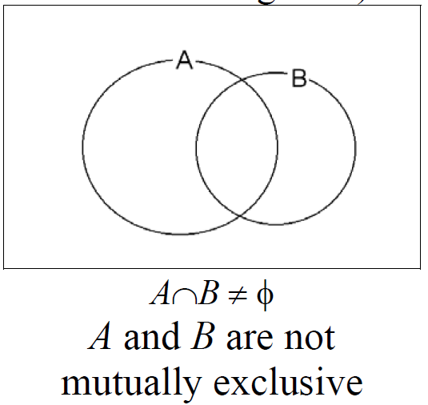
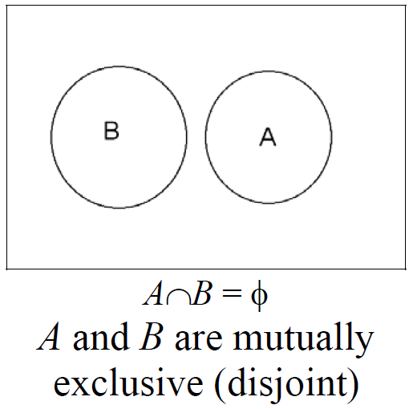

Slide 28
Combinations:
In many problems, we are interested in the number of ways of selecting r objects from n objects without regard to order. These selections are called combinations.

Slide 29
Combinations:

Slide 30
Theorem:

Slide 31
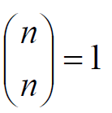
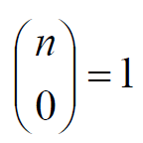
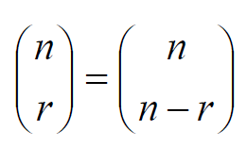
Notes:

Slide 32
Example
If we have 10 equal–priority operations and only 4 operating rooms, in how many ways can we choose the 4 patients to be operated on first?
Answer:

Slide 33
Probability of an Event
To every point (outcome) in the sample space of an experiment S, we assign a weight (or probability), ranging from 0 to 1, such that the sum of all weights (probabilities) equals 1.
The weight (or probability) of an outcome measures its likelihood (chance) of occurrence.
To find the probability of an event A, we sum all probabilities of the sample points in A. This sum is called the probability of the event A and is denoted by P(A).

Slide 34
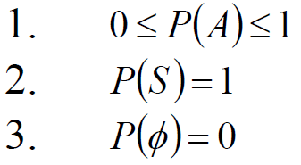
Definition
The probability of an event A is the sum of the weights (probabilities) of all sample points in A. Therefore,

Slide 35
Example
A balanced coin is tossed twice. What is the probability that at least one head occurs?
Solution:
S = {HH, HT, TH, TT}
A = {at least one head occurs}= {HH, HT, TH}
Since the coin is balanced, the outcomes are equally likely; i.e., all outcomes have the same weight or probability.

Slide 36
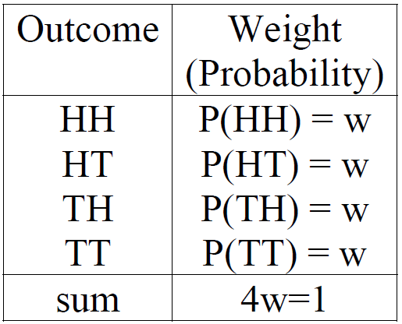

Slide 37
Theorem
If an experiment has $n(S)=N$equally likely different outcomes, then the probability of the event A is:

Slide 38
Example
A mixture of candies consists of 6 mints, 4 toffees, and 3 chocolates. If a person makes a random selection of one of these candies, find the probability of getting:
(a) a mint
(b) a toffee or chocolate.
M
6
T
4
C
3
13

Slide 39
Solution
Define the following events:
M = {getting a mint}
T = {getting a toffee}
C = {getting a chocolate}
Experiment: selecting a candy at random from 13 candies
$n\left(S\right)=$no. of outcomes of the experiment of selecting a candy=13.

Slide 40
The outcomes of the experiment are equally likely because the selection is made at random.
(a) M = {getting a mint}
$n(M)=$6

Slide 41
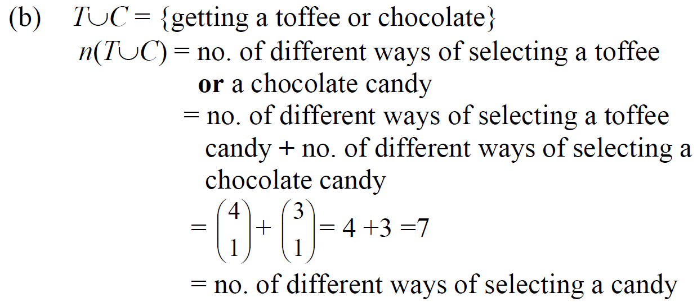
= 4+3=7

Slide 42
Additive Rules:
Theorem:
If A and B are any two events, then:
P(A∪B)= P(A) + P(B) − P(A∩B)

Slide 43
Corollary 1:
If A and B are mutually exclusive (disjoint) events, then:
P(A∪B)= P(A) + P(B)

Slide 44
Corollary 2:

Slide 45
Notes
$P\left(A\right)=P\left(A∩B\right)+P\left(A{∩B}^{c}\right)$
$P\left(B\right)=P\left(A∩B\right)+P\left(A^{c}∩B\right)$
$P\left(A∩B^{c}\right)=P\left(A\right)−P\left(A∩B\right)$
$P\left(A^{c}∩B\right)=P\left(B\right)−P\left(A∩B\right)$
$P\left(A^{c}∩B^{c}\right)=1−P\left(A∪B\right)$
$P\left(A∪B\right)$=$P\left(A\right)$+$P\left(A^{c}∩B\right)$

Slide 46
Example
The probability that Ahmad passes Mathematics is 2/3, and the probability that he passes English is 4/9. If the probability that he passes both courses is 1/4, what is the probability that he will:
(a) pass at least one course?
(b) pass Mathematics and fail English?
(c) fail both courses?

Slide 47
Solution:
Define the events:
M={Ahmed passes Mathematics}
E={Ahmed passes English}
We know that $P(M)=2/3, P(E)=4/9$, and $P(M∩E)=1/4.$
(a) Probability of passing at least one course is:
$$P(M∪E)= P(M) + P(E) − P(M∩E)$$
$$\frac{2}{3}+\frac{4}{9}−\frac{1}{4}=\frac{31}{36}$$

Slide 48
(b) Probability of passing Mathematics and failing English is:
$$P(M∩E^{c})= P(M) − P(M∩E)$$
$$\frac{2}{3}−\frac{1}{4}=\frac{5}{12}$$
(c) Probability of failing both courses is:
$$P(M^{c}∩E^{c})= 1 − P(M∪E)$$
$$1−\frac{31}{36}=\frac{5}{36}$$

Slide 49
Theorem
If A and$A^{c}$are complementary events, then:
$$P\left(A\right)+ P\left(A^{c}\right)= 1$$
$$⇔ P(A^{c}) = 1 − P(A)$$

Slide 50
Conditional Probability:
The probability of occurring an event A when it is known that some event B has occurred is called the conditional probability of A given B and is denoted $P(A|B).$

Slide 51
Definition
The conditional probability of the event A given the event B is defined by

Slide 52
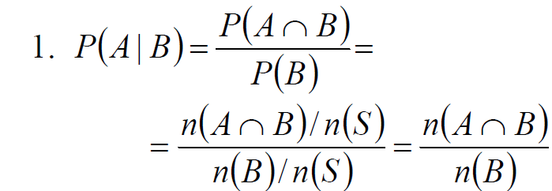
Notes:

Slide 53
Example:
339 physicians are classified as given in the table below. A physician is to be selected at random.
(1) Find the probability that:
(a) the selected physician is aged 40 – 49
(b) the selected physician smokes occasionally
(c) the selected physician is aged 40 – 49 and smokes
occasionally
(2) Find the probability that the selected physician is aged
40 – 49 given that the physician smokes occasionally.

Slide 54
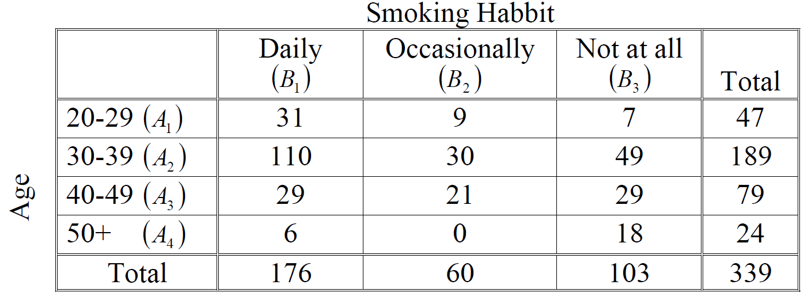

Slide 55
Solution:

Slide 58
Note:

Slide 59
Note:
$P(A|B)=P(A)$means that knowing B has no effect on the probability of occurrence of A. In this case A is independent of B.
$P(A|B)>P(A)$means that knowing B increases the probability of occurrence of A.
$P(A|B)<P(A)$means that knowing B decreases the probability of occurrence of A.

Slide 60
Independent Events
Definition:
Two events A and B are independent if and only if $P(A|B)=P(A)$and $P(B|A)=P(B).$Otherwise A and B are dependent.
Example:
In the previous example, we found that
$$P\left({A_{3}}/{B_{2}}\right)≠P\left(A_{3}\right)$$
Therefore, the events $A_{3}$ and $B_{2}$are dependent, i.e., they are not independent. Also, we can verify that
$P\left({B_{2}}/{A_{3}}\right)≠P\left(B_{2}\right)$

Slide 61
Multiplicative Rule
Theorem:
If $P(A) ≠ 0$and $P(B) ≠ 0$, then:
$$P(A∩B) = P(A) P(B|A)$$
$$= P(B) P(A|B)$$

Slide 62
Example
Suppose we have a fuse box containing 20 fuses of which 5 are defective (D) and 15 are non-defective (N). If 2 fuses are selected at random and removed from the box in succession without replacing the first, what is the probability that both fuses are defective?

Slide 63
Solution:
Define the following events:
A = {the first fuse is defective}
B = {the second fuse is defective}
$A∩B=${the first fuse is defective and the second fuse is defective} = {both fuses are defective}
We need to calculate $P(A∩B)$.

Slide 64
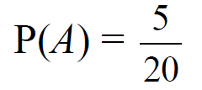
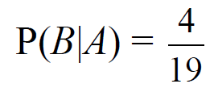
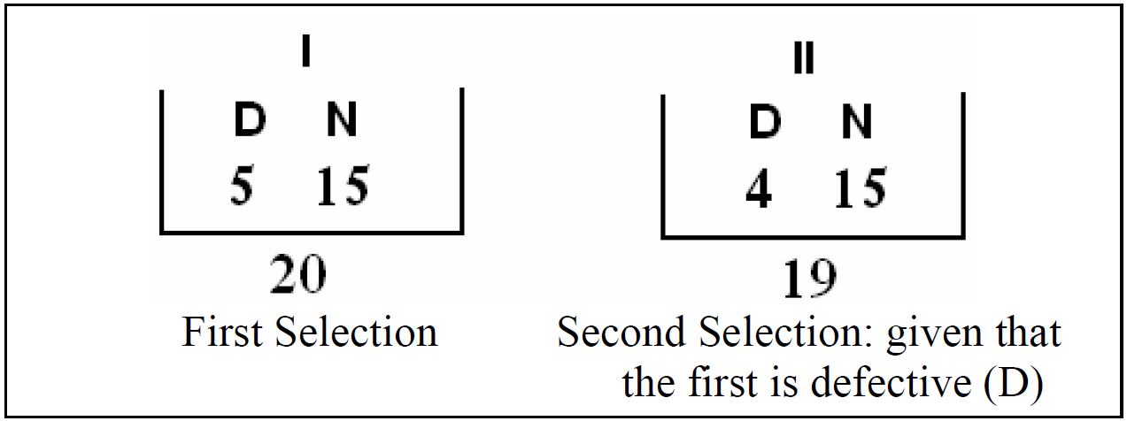

Slide 65
Theorem
Two events A and B are independent if and only if
$$P(A∩B)= P(A) P(B)$$
(Multiplicative Rule for independent events)

Slide 66
Note:
Two events A and B are independent if one of the following conditions is satisfied:
(i) $P(A|B)=P(A)$
⇔ (ii) $P(B|A)=P(B)$
⇔ (iii) $P(A∩B)= P(A) P(B)$

Slide 67
Theorem $(k=3)$

