Slide 1


Slide 2



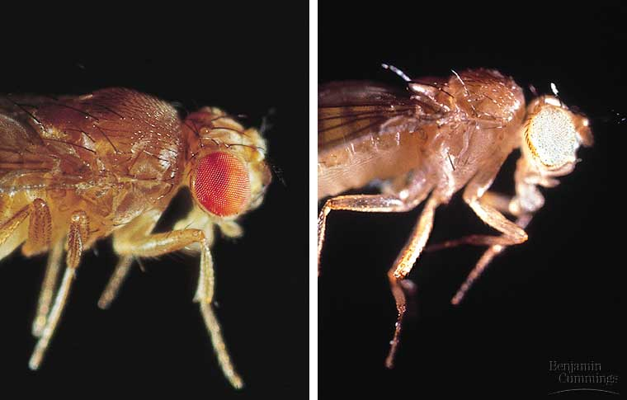
THE CHROMOSOMAL BASIS OF INHERITANCE
The chromosomal basis of sex varies with the organism
Sex-linked genes have unique patterns of inheritance
Copyright © 2002 Pearson Education, Inc., publishing as Benjamin Cummings

Slide 3
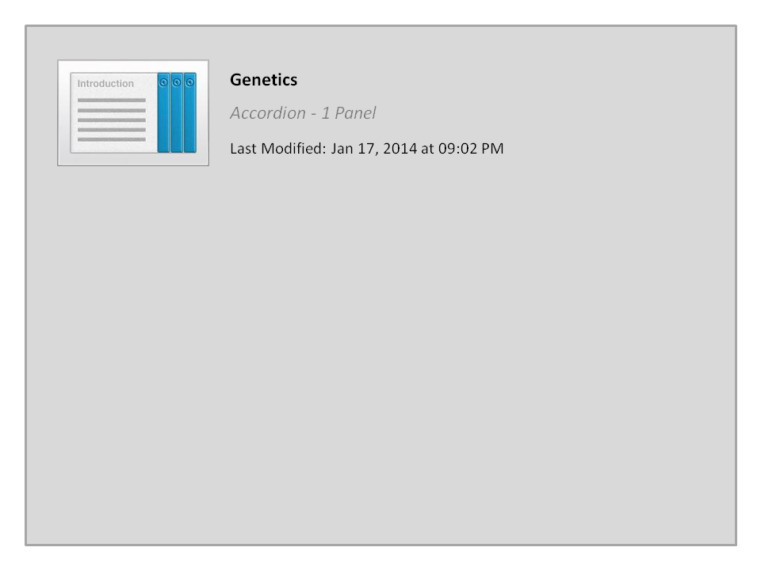



Genetics

Slide 4


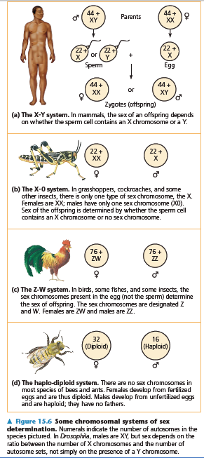
1. The chromosomal basis of sex varies with the organism
In human and other mammals, there are two varieties of sex chromosomes, X & Y.
  An individual who inherits two X chromosomes usually develops as a female.
  An individual who inherits an X and a Y chromosome usually develops as a male.
This X-Y system of mammals is not the only chromosomal mechanism of determining sex.
Other options include the X-0 (in locust) system, the Z-W system (in birds), and the haplo-diploid system (in bees).
In Human, the SRY gene (Sex-determining Region of the Y chromosome) modifies embryonic gonads into testes.
Females lack the SRY gene, thus, the embryonic gonads develop into ovaries.

Slide 5
The chromosomal basis of sex varies with the organism
In the X-Y system, Y and X chromosomes behave as homologous chromosomes during meiosis.
  In reality, they are only partially homologous and rarely undergo crossing over
In both testes (XY) and ovaries (XX), the two sex chromosomes segregate during meiosis and each gamete receives one.
  Each egg receives an X chromosome.
  Half the sperm receive an X chromosome and half receive a Y chromosome.
Because of this, each conception has about a fifty-fifty chance of producing a particular sex.
Copyright © 2002 Pearson Education, Inc., publishing as Benjamin Cummings

Slide 6
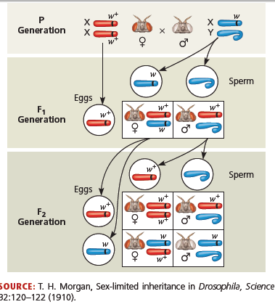
2. Sex-linked genes have unique patterns of inheritance
The sex chromosomes, especially the X chromosome, have genes for many characters unrelated to sex.
These sex-linked genes جينات مرتبطة بالجنس follow the same pattern of inheritance as the white-eye locus in Drosophila.
If a sex-linked trait is due to a recessive allele, a female have this phenotype only if homozygous.
  Heterozygous females will be carriers.

Slide 7
Sex-linked disorders الأمراض المرتبطة بالجنس in human.
Duchenne muscular dystrophy: وَهَن العضلات affects one in 3,500 males born in the United States.
  Affected individuals rarely live past their early 20s.
  This disorder is due to the absence of an X-linked gene for a key muscle protein, called dystrophin.
  The disease is characterized by a weakening ضعف of the muscles and loss of coordination فـقـْد التوازن.
Hemophilia: النزيف الدمويis a sex-linked recessive trait defined by the absence of one or more clotting factors عوامل تجلط.
  These proteins normally slow and then stop bleeding.
  Individuals with hemophilia have prolonged bleeding نزيف مستمر because a firm clot تجلط forms slowly.
  Individuals can be treated with intravenous injections of the missing protein.
  This gene is transmitted to offspring via the mothers.
  Thus, Sons borne from hemophilic woman should be exempted يُستثنى from circumcision الختان.

Slide 8
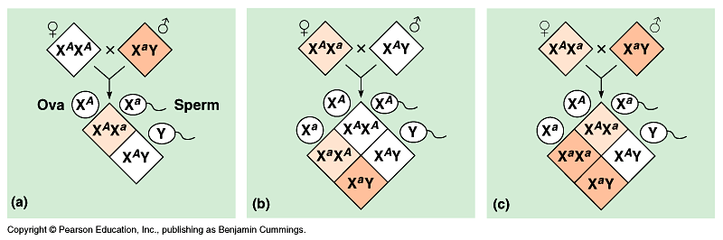
Sex-linked disorders
Color blindness: عمى الألوان is a disorder inherited as a recessive sex-linked character and affect both males and females.
  A color blind female (XªXª) may be born to a color blind father (XªY) and a carrier mother (X^{A}Xª)

Slide 9
Sex-linked genes
Because males have only one X chromosome (hemizygous), any male receiving the recessive allele from his mother will express the trait.
Therefore, males are far more likely to inherit sex-linked recessive disorders مرض than are females.
الصفات المرتبطة بالجنس تورث للأبناء الذكور من الأم فقط لأنهم يرثون منها الكروموسوم X الحامل لهذا النوع من الـﭼـينات، حيث إن Y لا يحمل شىء

Slide 10
Chromosomal aberration الشذوذ الكروموسومي.
It is common شائع in meiosis and includes:
    Chromosomal deletions/translocations نقص أو فقد جزء من الكروموسوم
      Homologous chromatids may break تـَنكسر and rejoin و تلتحم مرة أخرى at incorrect places, thus, one chromatid will loose more genes than it receives.
    Chromosomal duplications تضاعُف (Polyploidy تعدد الكروموسومات).
      result from nondisjunction عدم الإنفصال الكامل للكروموسومات أثناء الإنقسام الميوزي during gamete production in one parent.
A diploid embryo that is homozygous for a large deletion or male with a large deletion to its single X chromosome is usually missing يفتقد many essential genes and this leads to a lethal مُمِيت outcome.
  Duplications and translocations تغيير أماكن الأجزاء المقطوعة are very harmful.
Translocation or inversion can alter phenotype because a gene’s expression is influenced by its location.

Slide 11
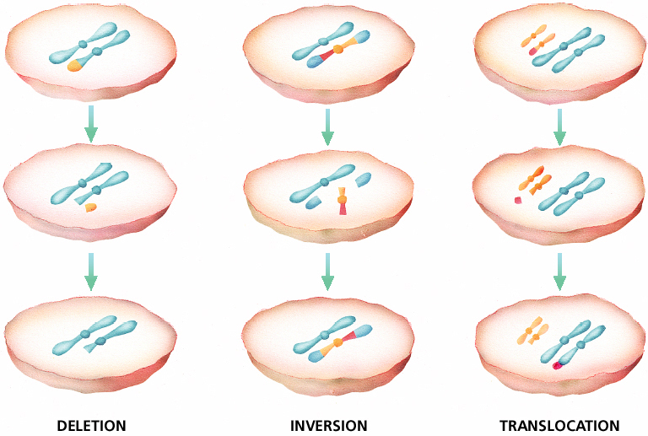
Chromosomal Mutations
Chapter 12

Slide 12
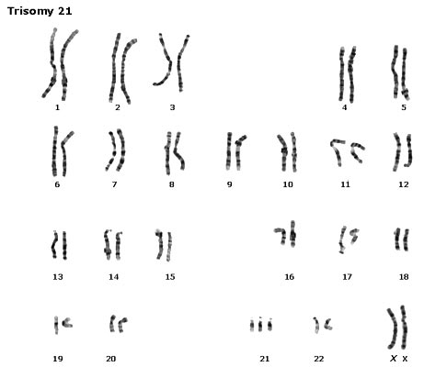
A)- Aneuploidy (Chromosomal duplication)
التعدد الكروموسومي غير التام
1- Down syndrome [Polyploidy (2n + 1), trisomy in autosomes]:
Is due to three copies of chromosome 21 (Trisomies مجموعات كروموسومية ثلاثية).
Although chromosome 21 is the smallest human chromosome, it severely alters يُغير an individual’s phenotype in specific ways.

Slide 13
Symptoms of Down Syndrome
Aneuploidy
Upward slant to eyes.
Small ears that fold over at the top.
Small, flattened nose.
Small mouth, making tongue appear large.
Short neck.
Small hands with short fingers.
In addition, down syndrome always involves some degree of mental retardation, from mild to severe. In most cases, the mental retardation is mild to moderate.

Slide 14
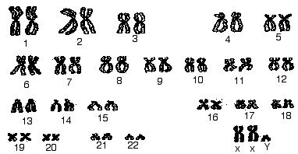
2- Klinefelter’s syndrome [Polyploidy (2n + 1), trisomy in sex chromosomes ],
Disorder occurring due to nondisjunction of the X chromosome.
The Sperm containing both X and Y combines with an egg containing the X, results in a male child.
The egg may contribute the extra X chromosome.
(a)- An XXY male, occurs once in every 2000 live births.
These individuals have male sex organs, but are sterile.
There may be feminine characteristics له صفات أنثوية, but their intelligence is normal.
Males with some development of breast tissue normally seen in females.
Little body hair is present, and such person are typically tall, have small testes.
Infertility results from absent sperm.
Evidence of mental retardation may or may not be present.
(b)- An XYY male, tend to somewhat taller than average
(c)- A trisomy female (XXX), which occurs once in every 2000 live births, produces healthy females.

Slide 15
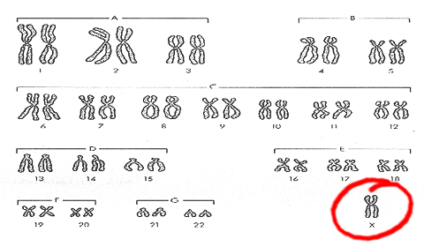
Aneuploidy
3- Turner’s syndrome, a monosomy female (X0),
Occurs once in every 5000 births, produces phenotypic, but immature females غير ناضجة جنسيا.
Turner syndrome is associated with underdeveloped ovaries, short stature.
Bull neck, and broad chest. Individuals are sterile, and lack expected secondary sexual characteristics.
Mental retardation typically not evident.
Chromosomal or monogenic?

Slide 16
B)- Chromosomal structure-alterations
It can also cause human disorders.
Deletions حزف, even in a heterozygous state, cause severe physical and mental problems.
Cri-du-chat عارض مواء القط, results from a specific deletion in chromosome 5.
- Is due to a missing part of chromosome 5
  These individuals are mentally retarded, have a small head with unusual facial features, and a cry like the mewing of a distressed cat.
  This syndrome is fatal in infancy الطفوية or early childhood.

Slide 17
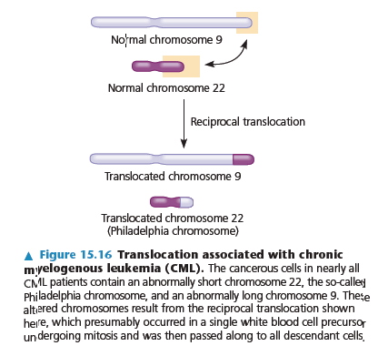
Chromosomal structure-alterations
Myelogenous, [leukemia (CML)]. Caused by chromosomal translocations since a fragment of chromosome 22 switches places with a small fragment from the tip of chromosome 9.

Slide 18



Quiz1

Slide 19




College of Science,
Zoology Department
General Animal Biology
(Zoo-145)
Prof. Ashraf M. Ahmed
aalii@ksu.edu.sa

