Slide 1


Slide 2



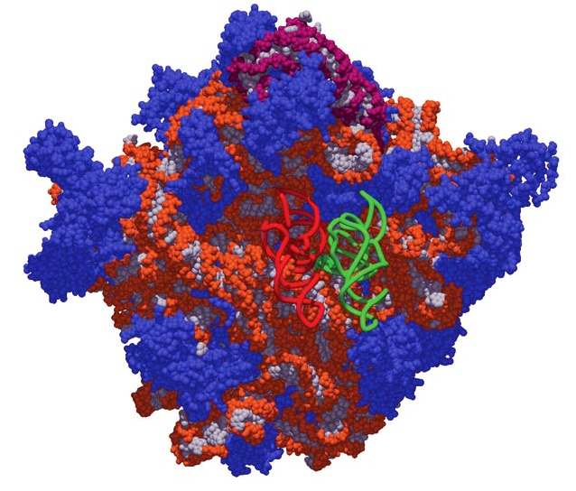
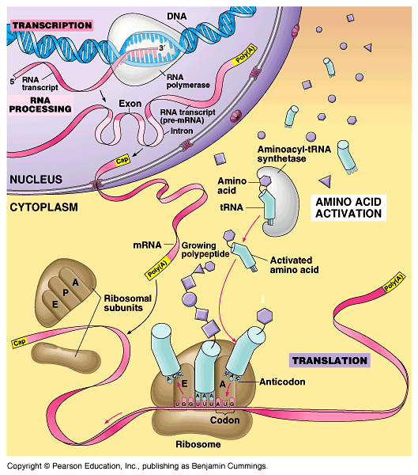
FROM GENE TO PROTEIN
Copyright © 2002 Pearson Education, Inc., publishing as Benjamin Cummings

Slide 3
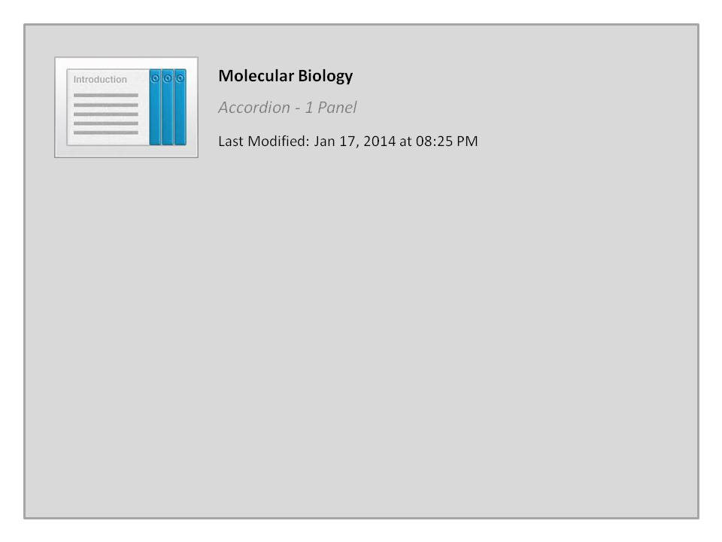
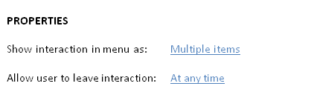


Molecular Biology

Slide 4


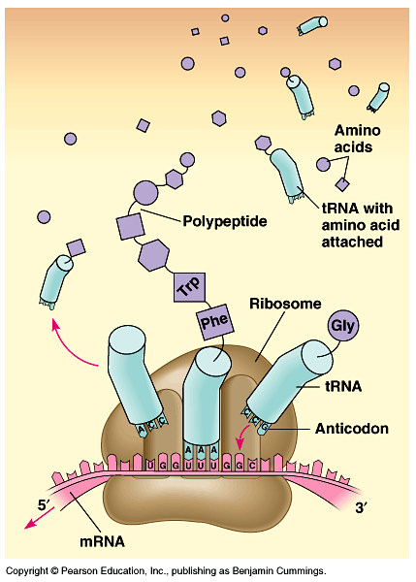
Translations is the RNA-directed synthesis of a polypeptide
In the process of translation, a cell sends a series of codons along a mRNA molecule.
Transfer RNA (tRNA)(الناقل)
transfers amino acids from the cytoplasm to a ribosome.
The ribosome adds each
amino acid carried by tRNA to the growing end of the polypeptide chain.

Slide 5
During translation, each type of tRNA links a mRNA codon with the appropriate amino acid.
Each tRNA arriving at the ribosome carries a specific amino acid at one end and has a specific nucleotide triplet, an anticodon, at the other end.
The anticodon base-pairs with a complementary codon on mRNA.
  If the codon on mRNA is UUU, a tRNA with an AAA anticodon and carrying phenyalanine will bind to it.
Codon by codon, tRNAs deposit amino acids in the prescribed order and the ribosome joins them into a polypeptide chain.

Slide 6
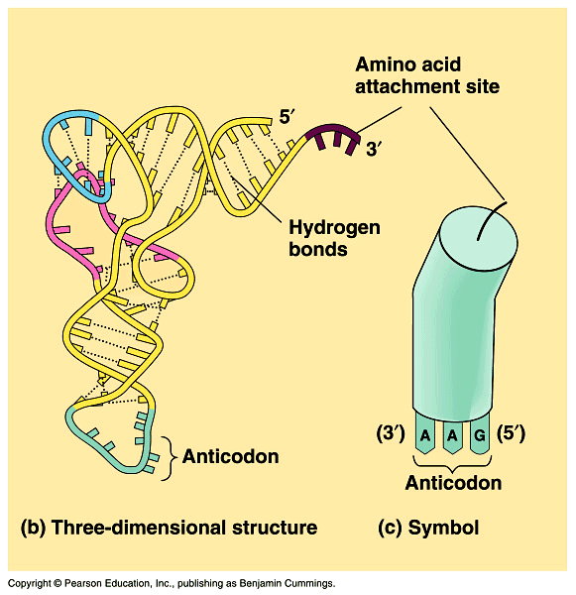
tRNA
tRNA molecules: are transcribed from DNA in the nucleus.
Once it reaches the cytoplasm, each tRNA is used repeatedly for the following functions:-
  to pick up يحمل its relevant amino acid in the cytosol,
  to deposit يضع the amino acid at the ribosome
  to return to the cytosol to pick up another copy of that amino acid.
The anticodons الشفرة المُعاكسة of some tRNAs recognize more than one codon.
Copyright © 2002 Pearson Education, Inc., publishing as Benjamin Cummings

Slide 7
Synthesis of a polypeptide
Ribosomes: the protein making machine
facilitate the coupling of the tRNA anticodons with mRNA codons.
  Each ribosome has a large and a small subunit formed in the nucleolus.
  Ribosome is composed of proteins and ribosomal RNA (rRNA), the most abundant RNA in the cell.
rRNA is transcribed in the nucleus, then bind to special proteins to form the ribosomal subunits in the nucleolus.
The subunits exit the nucleus via nuclear pores.
The large and small subunits join to form a functional ribosome only when they attach to an mRNA molecule.

Slide 8
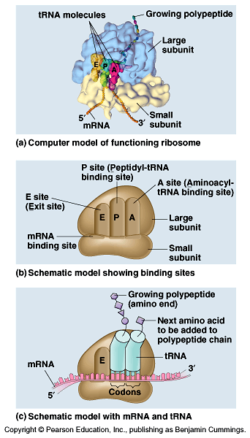
Synthesis of a polypeptide
Each ribosome has a binding site for mRNA and three binding sites for tRNA molecules.
  The Peptidyle (P) site holds the tRNA carrying the growing polypeptide chain.
  The Acceptor (A) site carries the tRNA with the next amino acid.
  The Exit (E) site at which the discharged tRNA leave the ribosome.

Slide 9
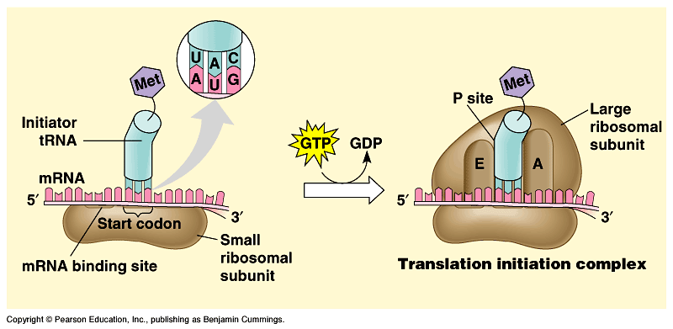
Synthesis of a polypeptide
Translation occurs in three stages:
1- initiation البدء of translation
2- elongation الاستطالة البنائية of polypeptide chain
3- termination الإيقاف of translation
Initiation: brings together mRNA, a tRNA (with the first amino acid) and the two ribosomal subunits (large & small).
  First, a small ribosomal subunit binds with mRNA and a special initiator tRNA, which carries methionine and attaches to the start codon.
  Initiation factors bring in the large subunit such that the initiator tRNA occupies the P site.
Methionine
Guanosine triphosphate

Slide 10
Synthesis of a polypeptide
Elongation:
Consists of a series of three step cycles as each amino acid is added to the proceeding one in 3 steps:-
Codon recognition التعرف على الشفرات, an elongation factor assists hydrogen bonding between the mRNA codon under the A site with the corresponding anticodon of tRNA carrying the appropriate المناسب amino acid [This step requires the hydrolysis of two guanosine triphosphate (GTP)].
Peptide bond formation: an rRNA molecule catalyzes the formation of a peptide bond between the polypeptide in the P site with the new amino acid in the A site. This step separates the tRNA at the P site from the growing polypeptide chain and transfers the chain, now one amino acid longer, to the tRNA at the A site.
Translocation تغيير المكان of tRNA: the ribosome moves the tRNA with the attached polypeptide from the A site to the P site.

Slide 11
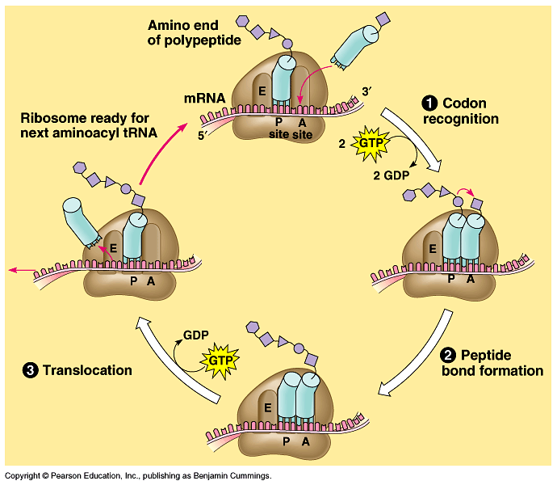
The three steps of elongation continue codon by codon to add amino acids until the polypeptide chain is completed.

Slide 12
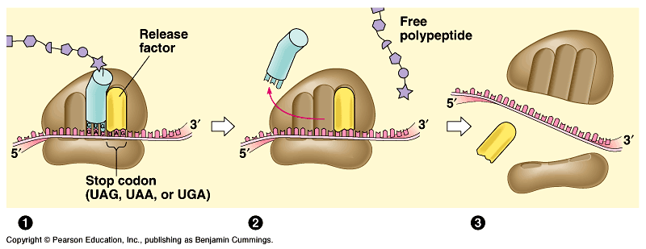
Synthesis of a polypeptide
Termination: Occurs when one of the three stop codons reaches the A site.
A release factor عامل مُحرر binds to the stop codon and hydrolyzes the bond between the polypeptide and its tRNA in the P site.
This frees the polypeptide and the translation complex disassembles يتفكك.
Fig. 17.19
The free and bound ribosomes are both active participants in protein synthesis.

Slide 13
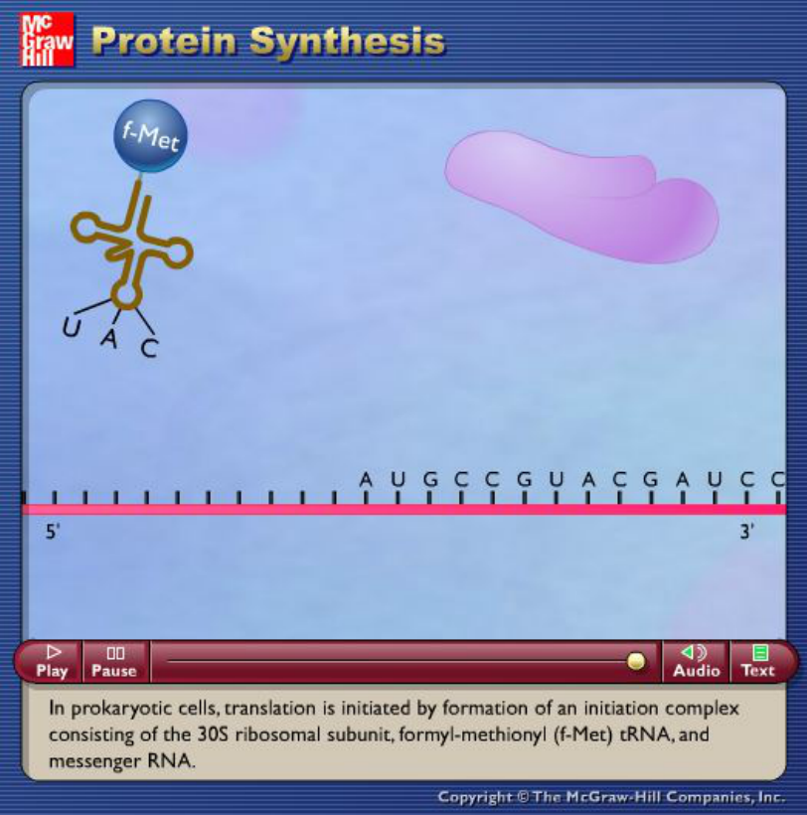
Source: http://highered.mcgraw-hill.com/sites/dl/free/0072437316/120060/ravenanimation.html

Slide 14
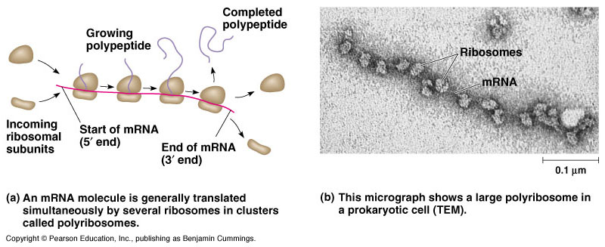
Polyribosomes ريبوسومات متعددة
A ribosome requires less than a minute to translate an average-sized mRNA into a polypeptide.
Multiple ribosomes, polyribosomes, may trail along the same mRNA.
Thus, a single mRNA is used to make many copies of a polypeptide simultaneously.

Slide 15
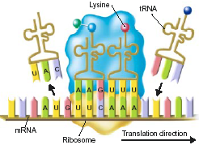
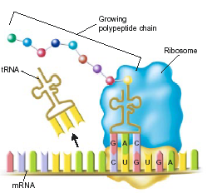
Summary of mRNA Translation Mechanism
1
1) mRNA attaches to a ribosome at the AUG, which is the start codon. This begins translation.
2) The transfer RNA (tRNA) bonds with the correct amino acid and becomes “charged.” (in the cytoplasm)
3) The tRNA carries the amino acid to the ribosome. Each tRNA has an anticodon whose bases are complementary to a codon on the mRNA strand. The tRNA brings the correct amino acid to the ribosome.
4) The ribosome moves along the mRNA and adds more amino acids to the growing polypeptide or protein
2
5) The process continues until the ribosome reaches one of the three stop codons on the mRNA, and then the ribosome falls off the mRNA.
6) The result is a polypeptide chain or protein that is ready for use in the cell.
3
Notes:
15

Slide 16
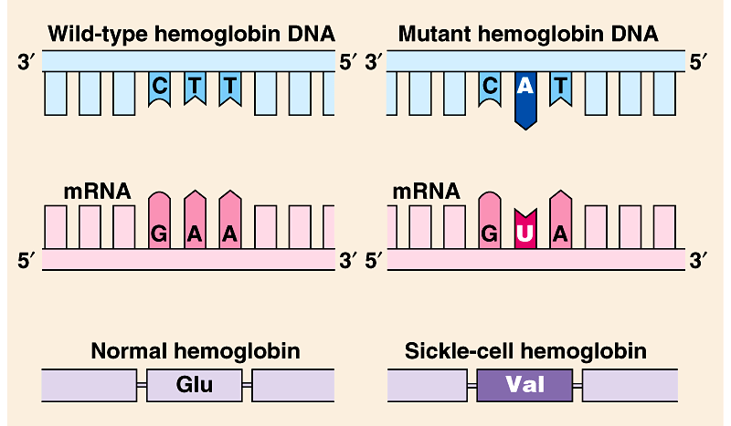
Mutations: الطفرات They affect protein structure and function
Mutation is a change in the genetic material of a cell (or virus).
These include large-scale mutations in which long segments of DNA are affected (e.g., translocations, duplications, and inversions).
Point mutation طفرة موضعية: is a chemical change in just one base pair of a gene.
If these occur in cells producing gametes, they may be transmitted to future generations (offspring).
For e.g., sickle-cell disease is caused by a mutation of a single base pair in the gene that codes for one of the polypeptides of hemoglobin.
  A change in a single nucleotide from T to A in the DNA template leads to an abnormal protein.

Slide 17
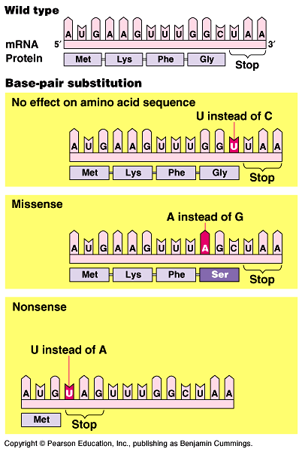
A)- Base-pair substitution إستبدال زوج من القواعد
It is a point mutation that results in replacement of a pair of complimentary nucleotides with another nucleotide pair.
Silent mutation: some base-pair substitutions (point mutation) have little or no impact تأثير واضح on protein function which lead to switches from one amino acid to another with similar properties.
Other base-pair substitutions cause a detectable change تغيير ملحوظ in a protein which impactيؤثر على function.
Missense mutations: a point mutation that still code for an amino acid but change the resulting protein.
Nonsense mutations: change an amino acid codon into a stop codon, nearly always leading to a nonfunctional protein بروتين غير وظيفي.

Slide 18
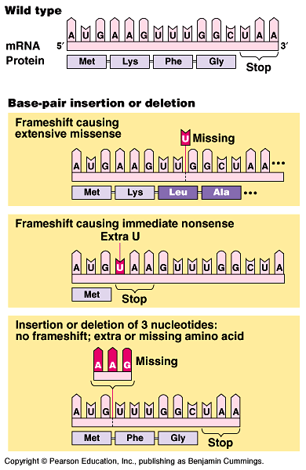
B)- Insertions and deletions إضافة أو حزف قواعد
Frame-shift إزاحة mutation.
It is a mutation in which additions or losses of nucleotide pairs occurs and causes Frame-shift إزاحة mutation.
  These have a disastrous كارثي effect on the resulting protein
When frame-shift occurs, all the nucleotides downstream of the deletion or insertion will be improperly grouped into new codons.
  The result will be extensive missense, ending sooner or later in nonsense - premature termination وقف مبكر للترجمة.

Slide 19
Mutagens المطفرات
Mutations can occur in a number of ways.
  Errors can occur during DNA replication, DNA repair, or DNA recombination.
  These can lead to base-pair substitutions, insertions, or deletions, as well as mutations affecting longer stretches of DNA.
  These are called spontaneous mutations.
Mutagens مُسـببات الطفرات: are chemical or physical agents that interact with تتفاعل مع DNA to cause mutations.
Physical agents include high-energy radiation like X-rays and ultraviolet light الأشعة فوق البنفسجية.
Chemical agents may operate in several ways.
  Some chemicals are base analogues that may be substituted into DNA, but that pair incorrectly during DNA replication.
  Other mutagens interfere with DNA replication by inserting into DNA and distorting the double helix.
  Still others cause chemical changes in bases that change their pairing properties.

Slide 20

Human Genome & protein synthesis

Slide 21
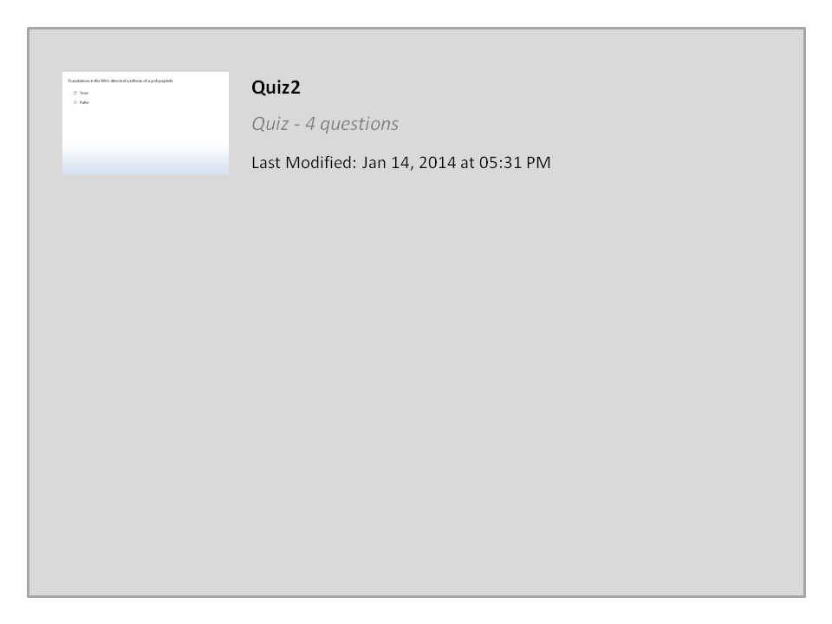
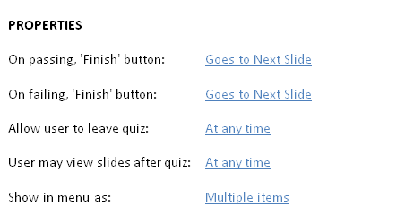

Quiz2

Slide 22




College of Science,
Zoology Department
General Animal Biology
(Zoo-145)
Prof. Ashraf M. Ahmed
aalii@ksu.edu.sa

