Slide 1



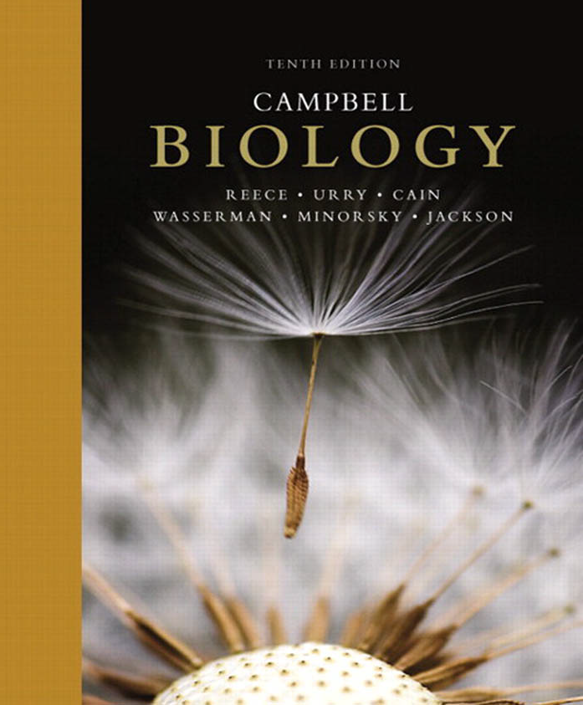
College of Science,
Zoology Department

Slide 2


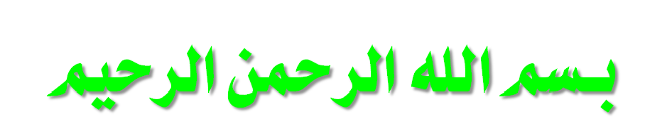
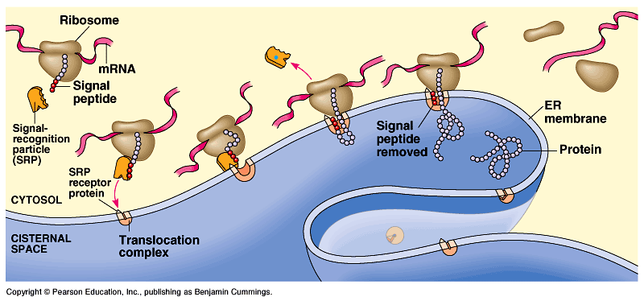
RNA: The Connection Between Gene and Protein
Copyright © 2002 Pearson Education, Inc., publishing as Benjamin Cummings

Slide 3


Objectives
Types of RNAs.
mRNA transcription and translation are the two main processes that link gene to protein.
Transcription is the DNA-directed synthesis of mRNA:
  Synthesis of mRNA Transcript.
    RNA Polymerase Binding and Initiation of Transcription.
    Elongation of the mRNA Strand.
    Termination of Transcription
The genetic codes (nucleotide triplets) specify the amino acids.
Eukaryotic cells modify mRNA after transcription.

Slide 4
Types of RNAs
mRNA: is the carrier of the genetic “message” from the DNA to the cytosol.
rRNA: is the major component of ribosomes.
tRNA: is the carrier of a specific amino acid from the cytosol to ribosimes thus help to form polypeptides.
Copyright © 2002 Pearson Education, Inc., publishing as Benjamin Cummings

Slide 5
RNA transcription إنسلاخ and translation ترجمة are the two main processes that link gene to protein
The information content of DNA is in the form of specific sequences of nucleotides along the DNA strands.
The DNA inherited by an organism leads to specific traits by dictating the synthesis of proteins.
Proteins are the links between genotype and phenotype.
  For example, Mendel’s dwarf pea plants lack a functioning copy of the gene that specifies the synthesis of gibberellins (which stimulate the normal elongation of stems).
Genes provide the instructions for making specific proteins.
The bridge between DNA and protein synthesis is RNA.
The specific sequence of hundreds or thousands of nucleotides in each gene carries the information for the primary structure of a protein, the linear order of the 20 possible amino acids.

Slide 6
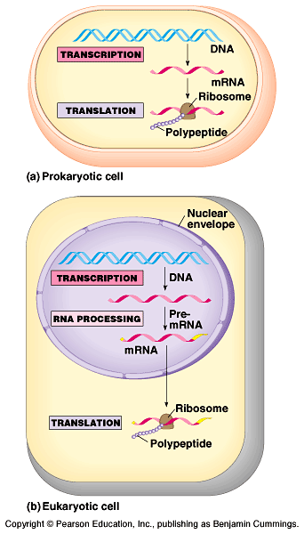
From gene to protein
During RNA transcription الإنسلاخ, a DNA strand provides a template for the synthesis of a complementary RNA strand.
Transcription of a gene produces a messenger RNA (mRNA) molecule.
During mRNA translation الترجمة (at ribosomes), the information contained in the order of nucleotides in mRNA is used to determine تـُحدد the amino acid sequence ترتيب of a polypeptide.
The basic mechanisms of RNA transcription and translation are similar in eukaryotes and prokaryotes, while the process of RNA transcription and translation are not similar as following:
In prokaryotes:
They lack nuclei, thus transcription and translation are coupled مـُتلازمان.
Translation of mRNA by the ribosome starts while the transcription is still in progress.

Slide 7
From gene to protein
While In a eukaryotes:
All mRNA transcription occurs within the nucleus, while the translation occurs mainly by ribosomes in the cytoplasm.
In addition, the primary mRNA is modified in various ways during mRNA processing تجهيز before it leaves to the cytoplasm.
In conclusion: genes program (control) protein synthesis via genetic mRNA.
Transcription
Translation
DNA
mRNA
Protein

Slide 8
Video: plays in LMS

Slide 9
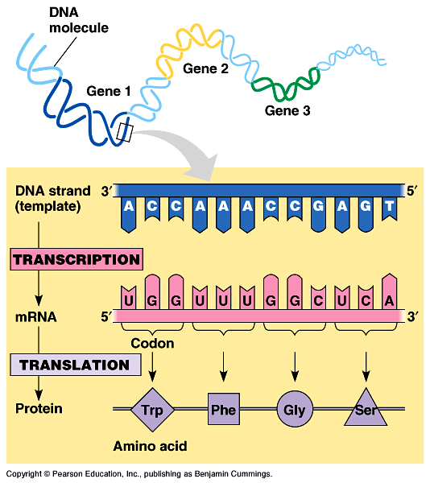
In the genetic code الشفرة الـﭽينية, “nucleotide triplets الشفرة الثلاثية” specify amino acids
Triplets مجموعات ثلاثية of nucleotide bases are the smallest units that can code for all amino acids.
In the triplet code three consecutive متتالي bases specify تحدد an amino acid.
The genetic instructions for a polypeptide chain are written in DNA as a series of three-nucleotidewords (triplets).
During transcription, one DNA strand (the template strand) provides an mRNA template.
The complementary mRNA molecule is synthesized according to base-pairing rules, except that uracil is the complementary base
to adenine.
During translation, blocks
of three nucleotide bases (codons شفرة), (الشفرة عبارة عن مجموعة ثلاثية من القواعد) are decoded فك الشفرة into a sequence تتابع of amino acids.

Slide 10
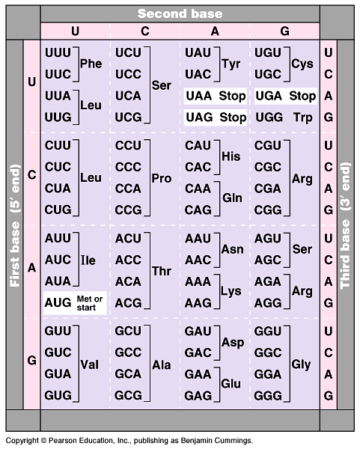
During translation, the codons are read in the 5’->3’ direction along the mRNA.
The codon UUU coded for the amino acid phenylalanine.
The codon AUG not only codes for the amino acid methionine but also indicates the start of translation.
A specific codon indicates a specific corresponding amino acid, but the amino acid may be the translation of several possible codons.
The reading frame and subsequent codons are read in groups of three nucleotide bases (codon).
In summary, genetic information is encoded as a sequence of base triplets (codons) which is translated into a specific amino acid during protein synthesis.

Slide 11
A)- The Transcription of mRNA
mRNA is transcribed ينسخ from the template strand of a gene.
RNA polymerase separates the DNA strands at the suitable point and bonds يربط the RNA nucleotides as they base-pair along the DNA template.
Like DNA polymerases, RNA polymerases can add nucleotides only to the 3’ end of the growing polymer.
Specific sequences of nucleotides along the DNA mark where gene transcription begins and ends.
  RNA polymerase attaches and initiates transcription at the promotor المُحَفـز, at the beginning of the transcription unit (gene) on the DNA.
  The terminator منطقة النهاية ends the transcription.
Bacteria have a single type of RNA polymerase that synthesizes all RNA molecules.
In contrast, eukaryotes have three RNA polymerases (I, II, and III) in their nuclei.
  RNA polymerase II is used for mRNA synthesis.

Slide 12
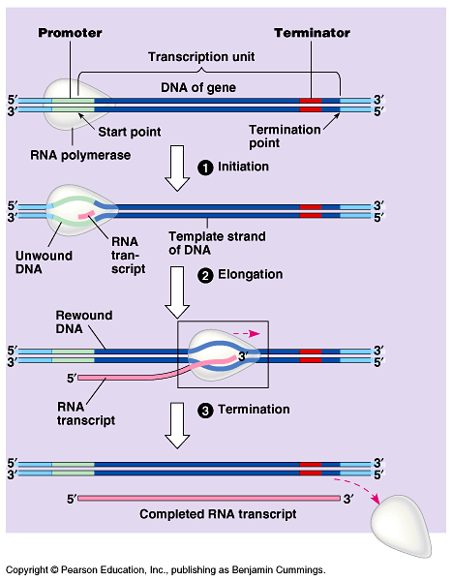
Transcription
can be separated
into three stages:
1- initiation البدء
2- elongation الإستطالة,
3- termination الإنتهاء.
The promotor contains the starting point for the transcription of a gene.
The promotor also includes a binding site for RNA polymerase.
Thus, RNA- polymerase can recognize and bind directly to the promotor region.

Slide 13
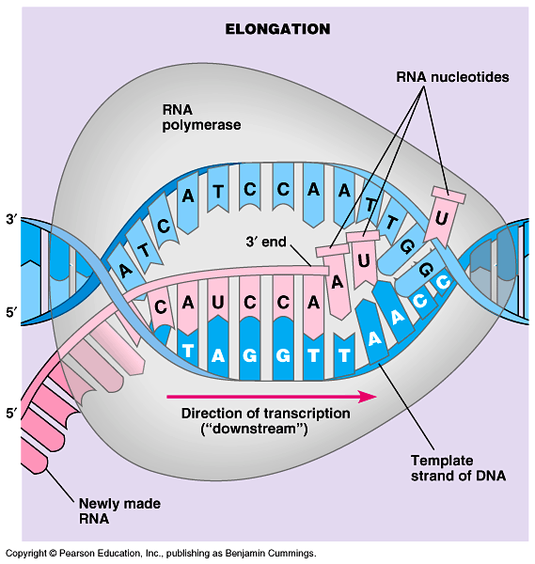
As RNA polymerase moves along the DNA, it untwists the double helix, 10 to 20 bases at a time.
The enzyme adds
nucleotides to the
3’ end of the
growing strand.
Behind the point
of RNA synthesis,
the double helix
re-forms and the
RNA molecule
moves away.
Transcription proceeds until after the RNA polymerase transcribes a terminator sequence in the DNA.

Slide 14
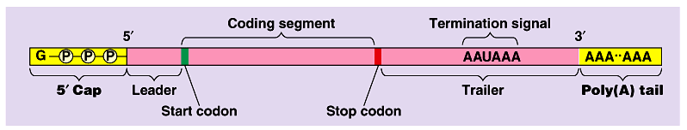
B)- The Processing of mRNA:
Eukaryotic cells modify RNA after transcription
Enzymes in the eukaryotic nucleus modify pre-mRNA before the genetic messages are dispatched to the cytoplasm.
At the 5’ end of the pre-mRNA molecule, a modified form of guanine is added, the 5’ cap which function as:
  protect mRNA from hydrolytic مُحلل enzymes.
  a translation start point for ribosomes.
At the 3’ end, an enzyme adds 50 to 250 adenine nucleotides, the poly(A) tail.
The poly(A) tail facilitates the export of mRNA from the nucleus.

Slide 15
Summary of RNA Transcription Mechanism
1) Transcription begins when the enzyme RNA polymerase binds to DNA at a promoter region.
2) The enzyme separates the DNA strands by breaking the hydrogen bonds, and then uses one strand of DNA as a template from which nucleotides are assembled into a strand of mRNA.
3) RNA polymerase pairs up free floating mRNA nucleotides with DNA template and joins the nucleotides together to form the backbone of the new mRNA strand.
4) When mRNA hits a termination sequence, it separates from the DNA.
5) mRNA editing occurs in the nucleus: before the mRNA leaves the nucleus, it is called pre-mRNA and it gets “edited.” Parts of the pre-mRNA that are not involved in coding for proteins are called introns and are cut out. The remaining mRNA pieces are called exons (because they are expressed) and are spliced (combine) back together to form the mRNA.
6) Then the final mRNA leaves the nucleus through the nuclear pores and enters the cytoplasm headed to the ribosomes.
Notes:
15

Slide 16
Video: plays in LMS

Slide 17
RNA transcription & translation
Bubble
5
3
T
A
C
T
G
A
C
RNA
polumerase
T
A
G
A
G
T
C
T
A
T
G
A
C
A
T
C
C
U
C
U
C
G
A
G
A
A
T
G
A
C
T
G
T
G
A
A
T
G
A
C
T
G
Promoter
Ribosome
Protein

Slide 18
Definitions
Codons (الـشفرة الـﭽينية) or triplet code: it is a block of three consecutive متتالى nucleotide bases that specify تحدد a particular amino acid.
Start codon: a codon that specifies the start of mRNA translation.
Stop codon: a codon that specifies the end of mRNA translation.
RNA polymerases: RNA transcription enzyme that first separates the DNA strands at the suitable point then start to add nucleotides to the 3’ end of the growing RNA polymer until completed.
Transcription unit (the gene): a specific sequences of nucleotides along the DNA that marks where mRNA transcription begins and ends.
Promotor المُحَفـز: a specific short sequence on DNA at which RNA polymerase attaches and initiates transcription at the beginning of the transcription unit.
Terminator منطقة النهاية: a specific short sequence on DNA at which mRNA transcription ends (the end of the gene).

Slide 19


College of Science,
Zoology Department
General Animal Biology
(Zoo-109)
Zoology Department

