Slide 1
Media Translation
Lecture 1

Slide 2
Media
Media (a plural of medium) refers to any kind of format used to convey information.

Slide 3
Mass Media
Mass Media refers to those types of media that are designed to reach large numbers of people. A means of public communication reaching a large audience.

Slide 4
Types of Mass Media
Television
Radio
Film & video
Print Media: newspapers, magazines
Photography
Electronic

Slide 5
Mass Media Genres
Informative media—such as news shows, newspapers, informative websites, etc
Educational media—such as books, educational video, or educational software programs
Persuasive media—such as all types of advertising, television infomercials, newspaper editorials, or web sites that attempt to persuade
Entertainment media—such as entertainment magazines, movies, novels or entertainment related websites

Slide 6
Understanding Newspaper Headlines

Slide 7
What is a Headline?
The headline of a news story is the short summary which introduces the story at the beginning of a TV or radio news broadcast, or which appears above articles in a newspaper or on a website.
Headlines are not full sentences but short summaries designed to attract attention.

Slide 8
8 grammar rules for writing newspaper headlines

Slide 9
1. Use present simple tense for past events
Parliament confirms new stray dog policy
Lion escapes zoo

Slide 10
2. Leave out auxiliary verbs
New policy decided by Parliament (New policy has been decided by Parliament)
Lion escapes zoo – ten killed (ten people have been killed / were killed)
Four stranded in sudden flood (four people have been stranded / were stranded)
Temperatures rising as climate changes (temperatures are rising)

Slide 11
3. Use infinitives for future events
Parliament to decide new policy tomorrow
President to visit France for further talks

Slide 12
4. Leave out articles (a, an, the)
Prime Minister hikes Alps for charity (The Prime Minister hiked the Alps)
Man releases rabid dog in park (A man released a rabid dog in a park)

Slide 13
5. Leave out “to be”
Residents unhappy about new road (residents are unhappy)
Family of murder victim satisfied with court decision (family of murder victim is satisfied.)

Slide 14
6. Leave out “to say”
Mr Jones: “They’re not taking my house!”
Bush on Iraqi invasion: “This aggression will not stand.”
Reported speech is usually represented by a colon, or a hyphen, with the subject introduced with ‘on…’. This includes leaving out other verbs such as comment, tell, argue, announce, shout – unless the act of speaking needs emphasizing, for instance to demonstrate a promise or official policy.

Slide 15
7. Replace conjunctions with punctuation
Police arrest serial killer – close case on abductions
Fire in bakery: hundreds dead
As with reporting speech, commas, colons, semi-colons, hyphens and so on can replace all conjunctions, or some joining verbs, to join clauses. Commas may also be used to join nouns (more common in American English).
Man kills 5, self

Slide 16
8. Use figures for numbers
9 dead in glue catastrophe
7 days to Christmas – shoppers go mad

Slide 17
Tips and Reminders
No headline may start with a verb.
Headlines are complete sentences or imply complete sentences.
A linking verb can be implied rather than spelled out.
If a story is about past or present events, write present tense verbs.

Slide 18
If a story is about future events, use the infinitive verb (to leave, to work).
To be verbs, such as is, are, was and were should be omitted.
Don't use the articles a, an and the. They waste space unnecessarily.
A new fire engine helps make the houses safer New fire engine helps make houses safer

Slide 19
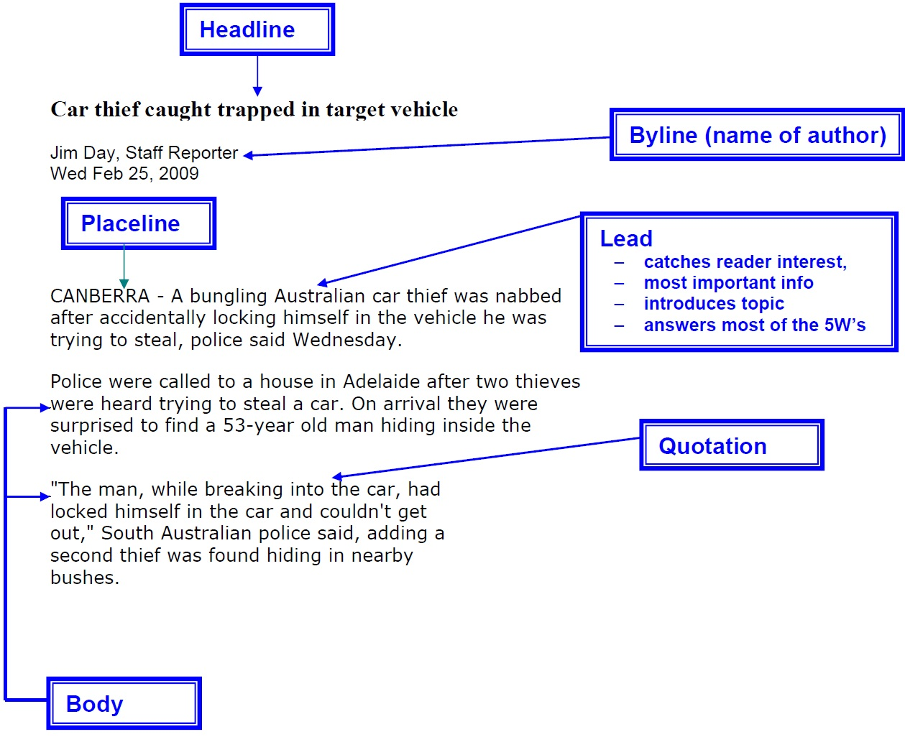

Slide 20
A lead, or lede, paragraph in literature is the opening paragraph of an article, essay, news story or book chapter. Often called the lead, it usually occurs together with the headline or title. It precedes the main body of the article, and it gives the reader the main idea of the story.

