Slide 1
Materials Science
Phys 574
Syllabus
Crystalline and amorphous solids –
Metallic, semiconducting and insulating materials –
Crystal growth –
Thin films –
Nanoproperties –
Phase change in solids and phase diagrams –
X-ray diffraction – Elemental analysis –
Preparation of alloys and ceramics –
Types of defects – Elasticity and hardness – Polymers and plastics -
Ultraviolet and infrared properties of materials.

Slide 2
Our Text Book:
Material Science and Engineering :An Introduction by William D. Callister, Jr Seventh Edition, John Wiley & Sons, Inc.
Material Science and Engineering A first Course: Fifth Edition by V Raghavan PHI

Slide 3
Exam and Grading:
Homework: 20%
Two one and half hour tests: 40 %
The final exam: 40%

Slide 4
Historical Perspective
Beginning of the Material Science - People began to make tools from stone – Start of the Stone Age about two million years ago.
Natural materials: stone, wood, clay, skins, etc.
The Stone Age ended about 5000 years ago with introduction of Bronze in the Far East. Bronze is an alloy (a metal made up of more than one element), copper + < 25% of tin + other elements.
Bronze: can be hammered or cast into a variety of shapes, can be made harder by alloying, corrode only slowly after a surface oxide film forms.
The Iron Age began about 3000 years ago and continues today. Use of iron and steel, a stronger and cheaper material changed drastically daily life of a common person.
Age of Advanced materials: throughout the Iron Age many new types of materials have been introduced (ceramic, semiconductors, polymers, composites…). Understanding of the relationship among structure, properties, processing, and performance of materials. Intelligent design of new materials.
Notes:
Materials are so important in the development of civilization that we associate Ages with them.
Pottery and metals. It was found that the properties of a material could be altered by heat treatments and by the addition of other substances (alloying in case of metals).
The next big step was the discovery of a cheap process to make steel around 1850, which enabled the railroads and the building of the modern infrastructure of the industrial world.
Empirical vs theoretical/analytical methods of materials design. Give example with grades (one can find relationship between the amount of efforts and grade empirically and analytically). Some of the empirical solutions/recipes are amusingly advanced and complex and look supernatural or magic but we have to keep in mind that they resulted from experimenting for generations of “material scientists”. In the modern world we have to be more efficient – the reason for taking this class…

Slide 5
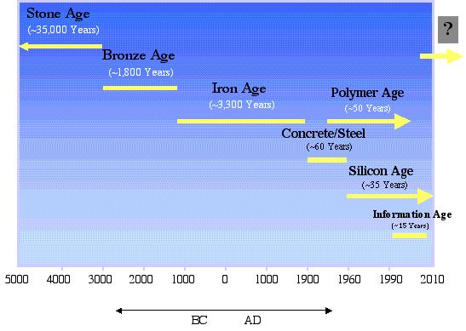
History of Materials Science & Engineering
materials closely connected our culture
the development and advancement of societies are dependent on the available materials and their use
early civilizations designated by level of materials development
initially natural materials
develop techniques to produce materials with superior qualities (heat treatments and addition of other substances)
Notes:
Needs some pictures. Too many words.

Slide 6
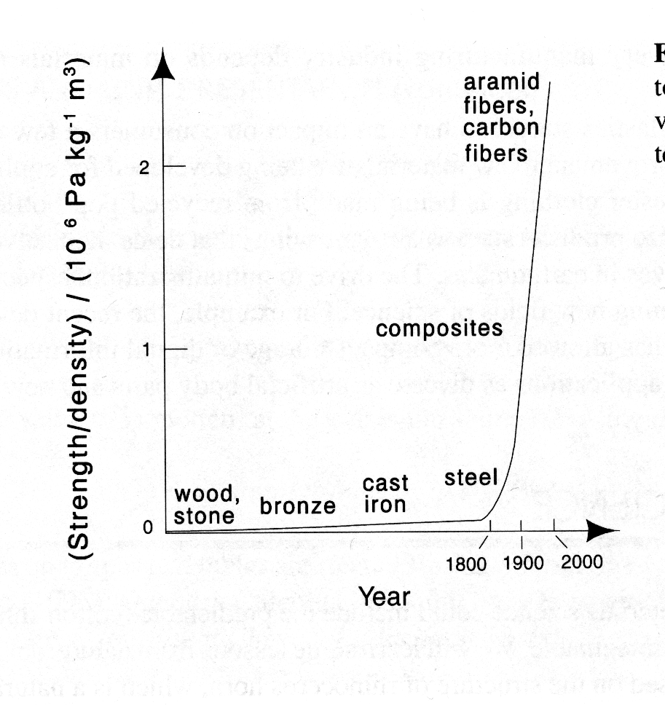
A better understanding of structure-composition-properties relations has lead to a remarkable progress in properties of materials. Example is the dramatic progress in the strength to density ratio of materials, that resulted in a wide variety of new products, from dental materials to tennis racquets.

Slide 7
Materials Science
  The discipline of investigating the relationships that exist between the structures and properties of materials.
Materials Engineering
  The discipline of designing or engineering the structure of a material to produce a predetermined set of properties based on established structure-property correlation.

Slide 8
Four Major Components of Material Science and Engineering:
  Structure of Materials
  Properties of Materials
  Processing of Materials
  Performance of Materials

Slide 9

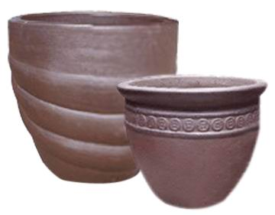


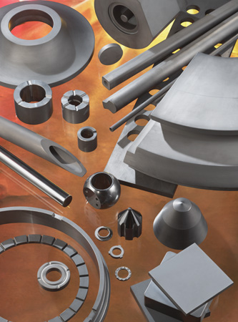

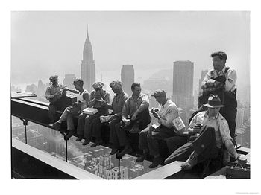
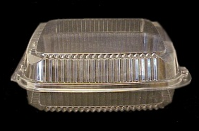
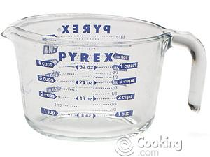
Classification of Materials
Metals
good conductors of electricity and heat
lustrous appearance
susceptible to corrosion
strong, but deformable
Ceramics & Glasses
thermally and electrically insulating
resistant to high temperatures and harsh environments
hard, but brittle
Polymers
very large molecules
low density, low weight
maybe extremely flexible
Notes:
interactive

Slide 10
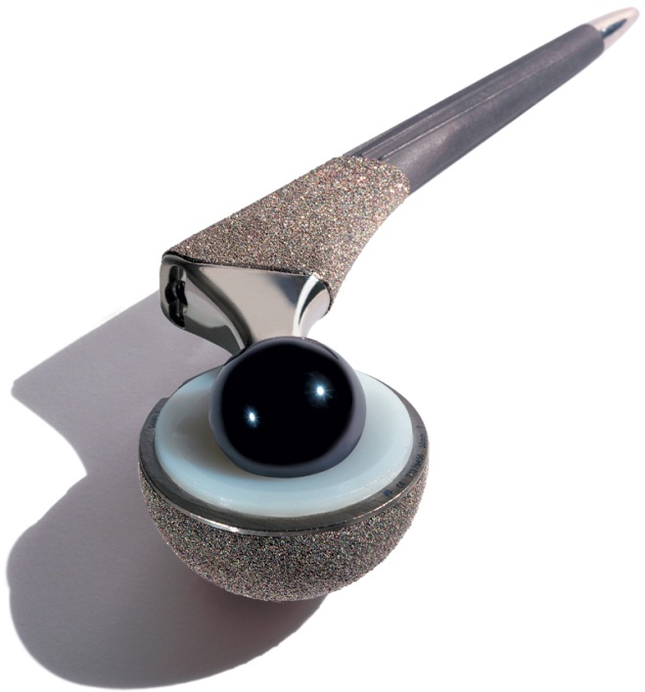

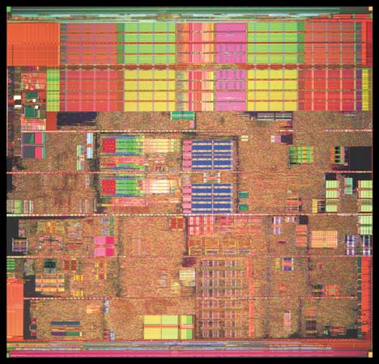
Classification of Materials: A Few Additional Catagories
Biomaterials
implanted in human body
compatible with body tissues
Semiconductors
electrical properties between conductors and insulators
electrical properties can be precisely controlled
Composites
consist of more than one material type
designed to display a combination of properties of each component
hip replacement
Intel Pentium 4
fiberglass surfboards

Slide 11
Doing Materials!
Engineered Materials are a function of:
  Raw Materials Elemental Control
  Processing History
Our Role in Engineering Materials then is to understand the application and specify the appropriate material to do the job as a function of:
  Strength: yield and ultimate
  Ductility, flexibility
  Weight/density
  Working Environment
  Cost: Lifecycle expenses, Environmental impact*
* Economic and Environmental Factors often are the most important when making the final decision!

Slide 12
Overview: Amorphous and crystalline solid states.
States of matter.
General description.
A vapor (or gas) needs a completely enclosed container to have a definite volume; it will readily take on any shape imposed.
Liquids have definite volume but will change shape under an arbitrarily small force (e.g. their own weight).
Solids have a definite volume and change shape especially irreversibly) only under considerable force.

Slide 13
Engineering considerations.
Certain kinds of materials do not lend themselves to such a simple classification.
􀀩 Window glass flows like a liquid over extended periods of time even at room temperature.
􀀩 Polymer melts which are treated very much like liquids in ordinary processing operations in fact have many of the properties of solids when deformed at high rates.
The explanation for the different behavior of these materials lies in a more detailed analysis of the structures involved.

Slide 14
Materials that really behave as solids (i.e., do not change shape under arbitrarily small forces over even infinitely long times) have a perfect crystalline structure in which no defects or non-crystalline regions are present.
􀀩 Materials that behave like solids, but only over the short term, can undergo structural rearrangements that occur very slowly.
Example: in the case of polymers, motions of very large segments are required to change molecular conformations to achieve shape changes. Often molecular rearrangement is slow because the temperature is too low

Slide 15
Many of these types of substances are amorphous or have significant amorphous content within them.
However, liquids are amorphous and structural rearrangements can take place on a scale very fast compared to most experimental time scales.
Therefore the essence of solid and liquid like character is more easily distinguished on the basis of structure.

Slide 16
True solids are crystalline, i.e., they have regular arrangements of atoms or groupings of atoms in a lattice.
True liquids are amorphous, i.e. the relative positions of the atoms or molecules are not correlated except perhaps for nearest neighbors.
However, their density is quite high often only 10-20% lower than that of the solid formed from the same atoms or molecules.
In addition, the thermal energy is high enough to continuously shuffle the arrangement of the atoms or molecules.

Slide 17
Amorphous “solids” have the structure of liquids, but this is frozen in” at low temperatures so that structural changes cannot occur quickly enough on ordinary time scales to produce liquid behavior.
Liquid crystalline materials behave very much like a liquid in their flow behavior but have some elements or ordering associated with their structure. These materials do not possess 3-dimensional order but (probably) only rotational order associated with asymmetric molecules.
In the gas state, molecules are almost entirely free of the influence of other molecules; there is virtually no structure and the densities are very low.

Slide 18
On the basis of the above discussion, a reasonable classification can be made as follows:
􀀩 A solid is a material that conforms to the "everyday" concept of a solid; it should always be stated whether we are dealing with a crystalline or an amorphous material.
This will correspond closely with the stricter definition involving a solid as a material that has been cooled to below its crystallization temperature (crystallizable materials) or its glass formation temperature (for glass forming solids)
􀀩 Similarly, a liquid material corresponds to the “everyday” concept of a liquid
whereby the material changes shape readily under very small forces. This is in reasonable agreement with the stricter definition of a liquid as a material that is above its crystallization or glass formation temperature.
􀀩 The gas or vapor state is the simplest to comprehend and treat scientifically; however, it plays the least role in materials science.
For many materials, e.g. all polymers, the gas state cannot be reached because the substance decomposes before temperatures high enough for the vapor state can be achieved.
Liquid crystalline materials must be considered as a separate entity

Slide 19
Solid Materials: basic concepts of crystallization, glass formation and melting.
Assumptions.
One-component systems (therefore alloys, blends, etc.) are excluded for the present.
Materials can exist at sufficiently high enough temperatures as liquids (melts)
without any long-range order. There are important classes of materials that never involve an equilibrium melt during their formation process.
An important example is epoxy resins that are synthesized directly into a (glassy) solid state during the curing or hardening reaction.
The melt is the only state of matter (other than the gas) in which materials exist in a state of thermodynamic equilibrium.
Whenever a material is reheated into the melt region, it reaches the same state depending upon only temperature, pressure and possibly other state variables (if no chemical changes have occurred).
As the material is cooled, a number of changes may occur which allow classification of the material at the lower temperature.
Additional information can be obtained by re-heating the material into the melt state.

Slide 20
Techniques for studying the solid – liquid transition. Dilatometry.
The volume is measured as a function of temperature.
Measuring the linear dimensions is not suitable if liquids are involved since the linear dimension can change without a change in the volume.
Differential Thermal Analysis (DTA) and Differential Scanning Calorimetry
(DSC).
A sample and an inert reference material are placed symmetrically inside a furnace in which the temperature is changed linearly with time.
In one method (DTA) the temperature difference between the sample and reference is measured and recorded directly as a function of the sample temperature.
If both the reference and sample have the same specific heat, the temperature difference will be zero between sample and reference.
If both the reference and sample have different specific heat values, a temperature difference (representative of the specific heat) will be measured.
When a sample undergoes any kind of transformation that uses or emits energy (heat), the temperature difference between the sample and reference will change further.

Slide 21
Differential Scanning calorimetry (DSC)
In the other method Differential Scanning calorimetry (DSC) special circuitry keeps the temperature difference at a value of zero by means of small heaters under the sample and reference material.
The thermal analysis signal in this case is the power required to maintain a zero temperature difference.
It reflects the specific heat of the sample and any heats of transformation just as in the DTA method.
In the discussion that follows, the thermal analysis signal is either the temperature difference (DTA) or the power required for a zero difference (DSC).

Slide 22
DTA

Slide 23
DSC

Slide 24
With suitable calibration, the area under a signal peak is proportional to the enthalpy change involved.
Except for the aforementioned differences, the signals appear very similar and both have the same capability of being interpreted quantitatively.

Slide 25
Transitional behavior.
Crystallization temperature (T_{C})
The most common behavior observed is that the material will crystallize at a particular temperature (T_{c}) when cooled from the melt. The value of T_{c} will depend significantly upon the cooling rate (decreasing as cooling rate increases) as well as external factors including the presence of nucleating agents or other crystallization promoters.

Slide 26
Melting Point Tm
When a sample is reheated from the crystalline state, it will lose the Crystalline order at the melting point Tm. Tm is always higher than Tc; the difference is identified as the super-cooling interval.

Slide 27
There is a volume discontinuity (usually a decrease) during the crystallization transition.

Slide 28
The thermal analysis signal indicates the presence of a heat of crystallization (exothermic).
On melting there is an endothermic heat of fusion.

Slide 29
Tm is more fundamental and reproducible than Tc.
The magnitude of the supercooling effect is (T_{m} – T_{c}).
Hg 77 C
Au 230 C
Co 330 C
H₂O 39 C
Ga 29 C
Semi – crystalline polymers 50 C
Some melts will not crystallize even though they are cooled very slowly. These are intrinsically glass-forming materials.

Slide 30
Generally, they will not crystallize because they are very irregular from a structural point of view, i.e. it is impossible to fit their molecules into a lattice.
Many polymers fall into this category.
Other materials have melts that could potentially crystallize.
These will do so only if the cooling rate is slow enough to give them time to rearrange their structure.
If the cooling rate is too high, they will form glasses.

Slide 31
Glass transition
Representative dilatometric and thermal analysis results for these materials would have the following characteristics:
The volume has no discontinuity at the glass formation temperature but a change in slope.
Similarly, the thermal analysis signal shows a step change in specific heat.
This behavior for the primary (V) and secondary (Cp) thermodynamic quantities defines the transition as a second order thermodynamic transition.

Slide 32
The glassy state is not a thermodynamic equilibrium state: it is very dependent upon formation history including cooling rate, pressure, etc.
The exact nature of the glass transition is somewhat controversial: although it is not a 2nd order transition in the sense of Ehrenfest*, phenomenologically it appears
as a 2nd order transition

