Slide 1


Slide 2


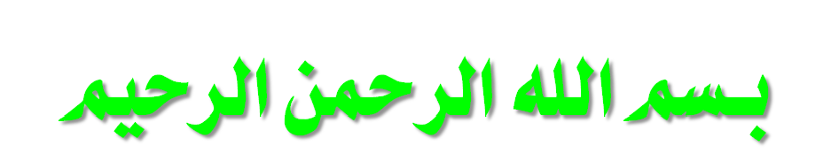
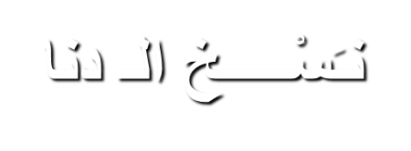
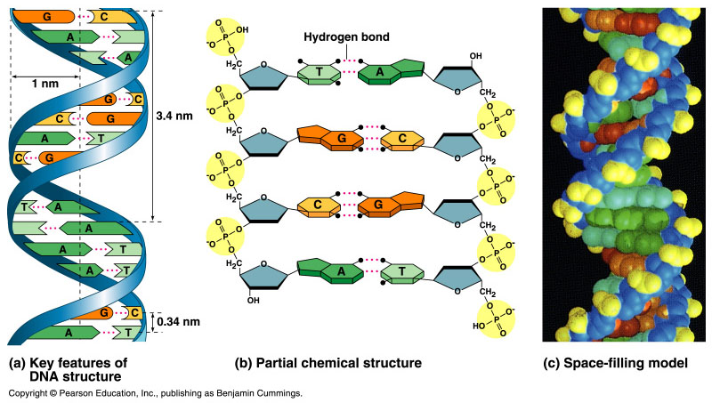
DNA Replication
Copyright © 2002 Pearson Education, Inc., publishing as Benjamin Cummings

Slide 3
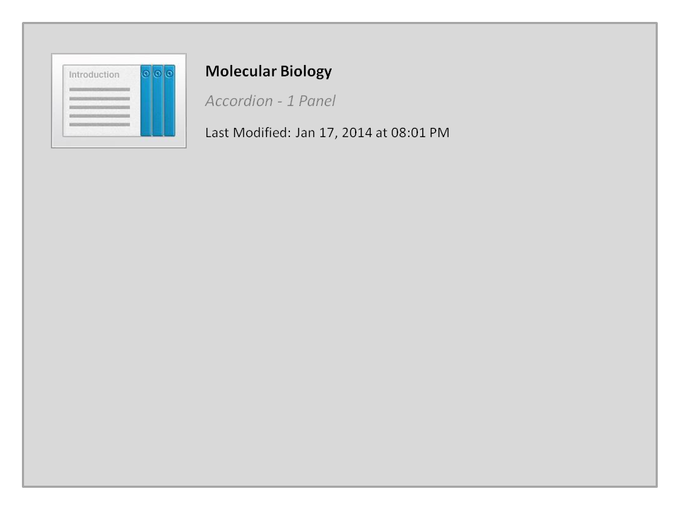
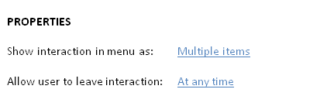


Molecular Biology

Slide 4


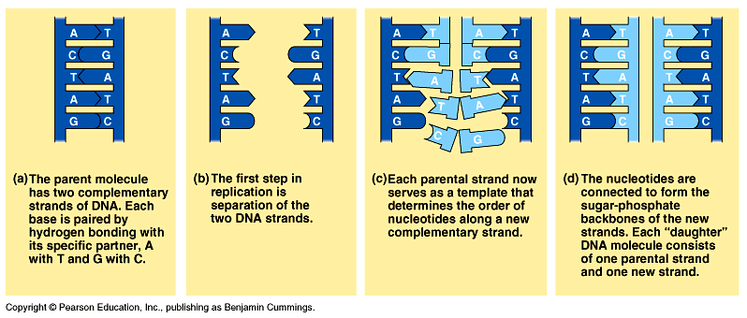
DNA replication
When a cell copies a DNA molecule, each strand serves as a template نموذج for ordering nucleotides into a new complimentary strand الجانب المُكمِّل.
  Nucleotides line up تـَتـَراص along the template strand according to the base-pairing rules.
  The nucleotides are linked to form new strands (complementary).
Copyright © 2002 Pearson Education, Inc., publishing as Benjamin Cummings

Slide 5
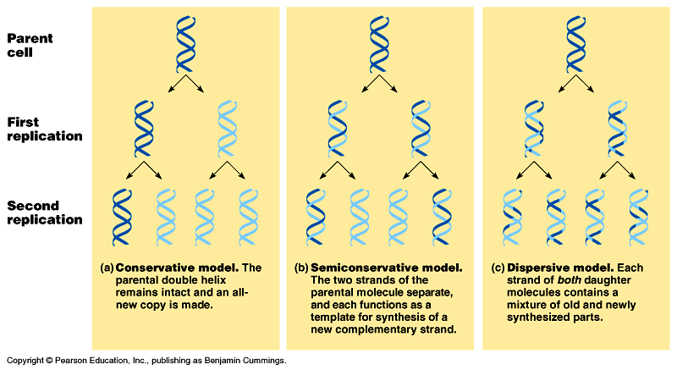
Types of DNA replication
Semiconservative replication (the most common and accepted by Watson and Crick). The double helix replicates each of the daughter molecules and will have one old strand and one newly made strand.
The other two models are the conservative and the dispersive models

Slide 6
Semiconservative DNA Replication نـَسْـــــخ
During DNA replication, base pairing إزدواج القواعد enables existing DNA strands to serve as templates نموذج/قالب for new complimentary strands الجانب المُكمِّل
Several enzymes and other proteins carry out DNA replication:
Helicase,
Primase,
Polymerase,
Ligase.
The ends of DNA molecules are replicated by a special mechanism.

Slide 7
A large team of enzymes and other proteins carries out DNA replication: The Replication Mechanism
It takes E. coli less than an hour to copy each of the 5 million base pairs in its single chromosome and divide to form two identical daughter cells.
A human cell can copy its 6 billion base pairs and divide into daughter cells in only a few hours.
This process is remarkably accurate, with only one error per billion nucleotides.
A helicase; untwists يَلغي الإلتفاف and separates the template DNA strands at the replication fork.
Single-strand binding proteins; keep the unpaired template strands apart منفصلين during replication.

Slide 8
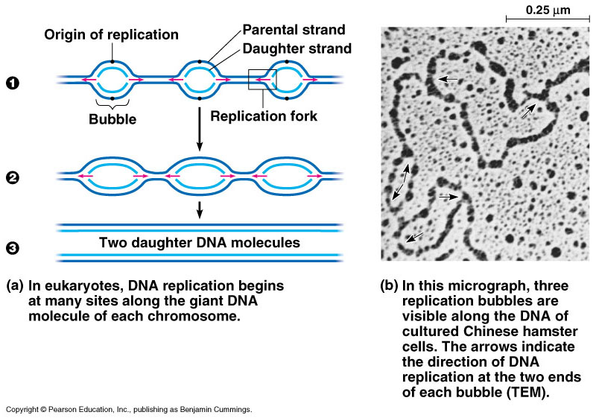
The Replication Mechanism
The replication of a DNA molecule begins at special site called origin of replication مـنشأ التضاعف which is a single specific sequence of nucleotides that is recognized by the replication enzymes.
Replication enzymes separate the strands, forming a replication “bubble” فقعة التضاعف.
  Replication proceeds in both directions until the entire molecule is copied.
In eukaryotes, there may be hundreds or thousands of bubbles (each has origin sites for replication) per chromosome.
  At the origin sites, the DNA strands separate forming a replication “bubble” with replication forks شوكة النسخ at each end.
  The replication bubbles elongate تستطيل as the DNA is replicated and eventually fuse تندمج مع بعضها.

Slide 9
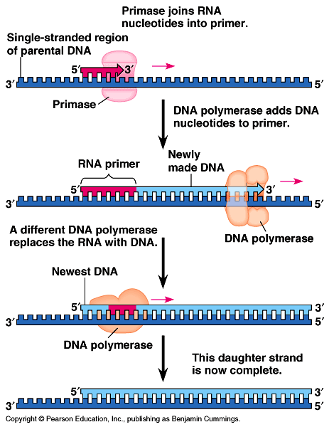
Primer: مُبديء (a short segment of RNA, 10 nucleotides long) is required to start a new chain.
Primase: (an RNA polymerase) links ribonucleotides that are complementary to the DNA template into the primer.
DNA polymerases: catalyze the elongation of new DNA at a replication fork. After formation of the primer, DNA polymerases can add deoxyribonucleotides to the 3’ end of the ribonucleotide chain.
Another DNA polymerase later replaces the primer ribonucleotides with
deoxyribonucleotides
complimentary to the template.

Slide 10
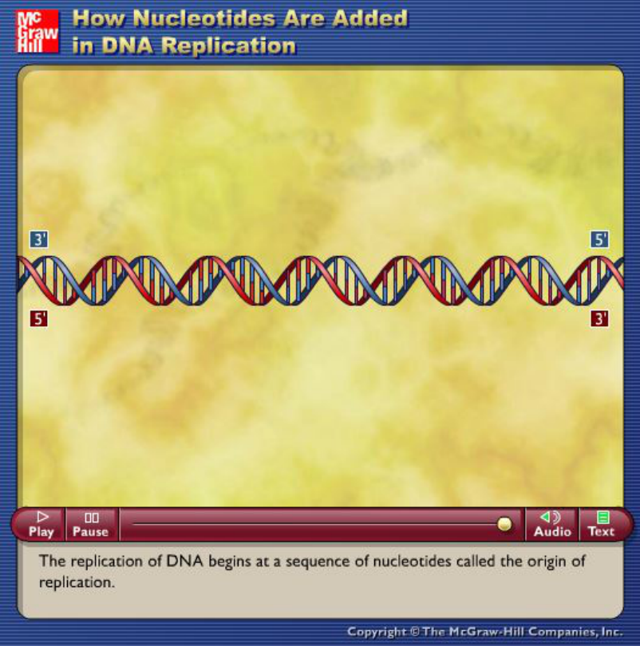
Source: http://highered.mcgraw-hill.com/sites/dl/free/0072437316/120060/ravenanimation.html

Slide 11
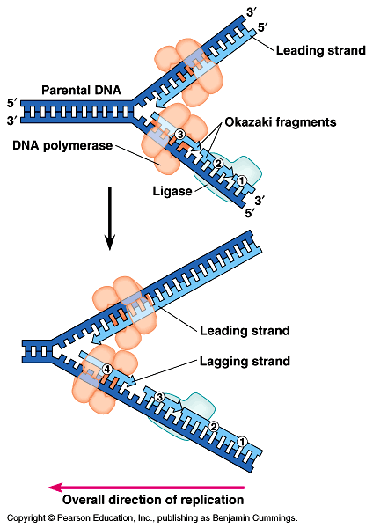
The Replication Mechanism
DNA polymerases can only add nucleotides to the free 3’ end of a growing DNA strand.
A new DNA strand can only elongate in the 5’->3’ direction.
At the replication fork, one parental strand (3’-> 5’ into the fork), the leading strand, can be used by polymerases as a template for a continuous complimentary strand.
The other parental strand (5’->3’ into the fork), the lagging strand, is copied away from the fork in short segments
(Okazaki fragments قـِطـَع صغيرة).
Okazaki fragments (each about 100-200 nucleotides) are joined by DNA ligase الإنزيم الرابط to form the sugar-phosphate backbone of a single DNA strand.

Slide 12
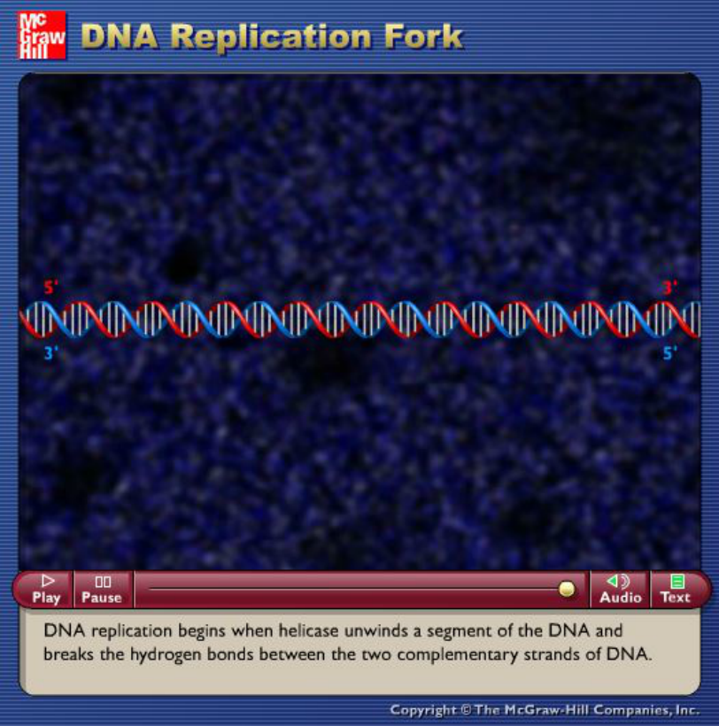
Source: http://highered.mcgraw-hill.com/sites/dl/free/0072437316/120060/ravenanimation.html

Slide 13
Summary of DNA replication mechanism
Step 1
Helicases: Enzymes that separate the DNA strands
Helicase move along the strands and breaks the hydrogen bonds between the complimentary nitrogen bases
Replication Fork: the Y shaped region that results from the separation of the strands
Step 2
DNA Polymerase: enzymes that add complimentary nucleotides.
Nucleotides are found floating freely inside the nucleus
Covalent bonds form between the phosphate group of one nucleotide and the deoxyribose of another
Hydrogen bonds form between the complimentary nitrogen bases
Step 3
DNA polymerases finish replicating the DNA and fall off.
The result is two identical DNA molecules that are ready to move to new cells in cell division.
Semi-Conservative Replication: this type of replication where one strand is from the original molecule and the other strand is new
Notes:
13

Slide 14
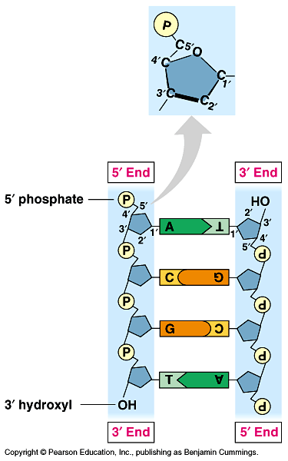
Summary of DNA replication mechanism
Each strand is making its own new strand.
DNA synthesis is occurring in two different directions
One strand is being made towards the replication fork and the other is being made away from the fork. The strand being made away from the fork has gaps.
Gaps are later joined by another enzyme, DNA ligase
The strands in the double helix are antiparallel متوازيين و متضادين فى الإتجاه.
The sugar-phosphate backbones run in opposite directions.
  Each DNA strand has a 3’ end with a free OH group attached to deoxyribose and a 5’ end with a free phosphate group attached to
  deoxyribose.
  The 5’ -> 3’ direction of one strand runs counter to مُعاكس لـ the 3’ -> 5’ direction of the other strand.
Notes:
14

Slide 15
Summary of DNA replication mechanism
The two DNA-strands separate forming replication bubbles.
Each strand functions as a template for synthesizing new complementary & lagging strands via primers, polymerase and ligase.
5
3
T
A
C
T
G
A
C
A
G
A
G
G
G
A
T
A
C
T
Primer
T
C
T
3
5
Complementary (leading) strand
Templates
Polymerase
Ligase
T
A
C
T
G
A
C
3
5
Lagging strand (complementary)
Okazaki fragments

Slide 16
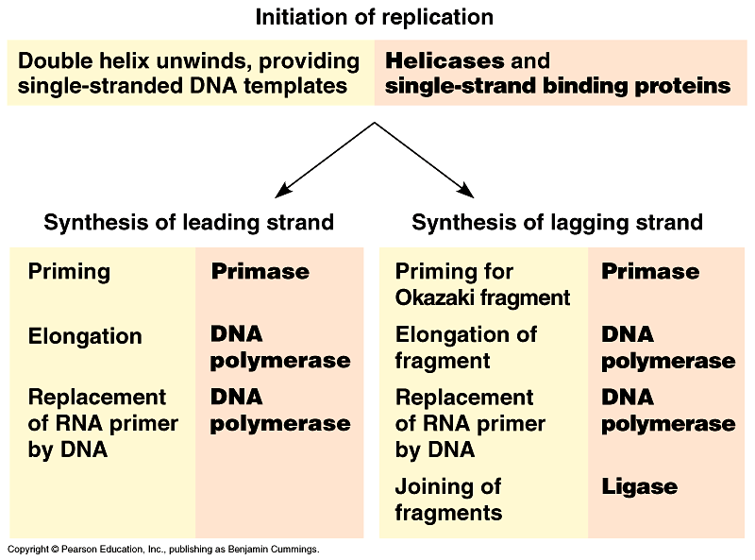
1
2
البـَـــدْء
3
الإستطالة
4
Fig. 16.15, Page 298

Slide 17
Definitions
Helicase: untwists the double helix to separate the DNA strands by forming
replication bubbles.
Replication enzymes: separates DNA strands, forming a replication “bubble”.
Replication bubble: formed at the origin sites of replication as DNA strands
separate, and hence, replication forks formed at each end.
Replication site: it is also called origin of replication which is a single specific
sequence of nucleotides that is recognized by the replication enzymes
and at which replication starts.
Primer: is a short piece of RNA (10 nucleotide long) which is synthesised
by primase and used to initiate the leading strands of the new DNA.
DNA-polymerase: builds up the new DNA strand by adding nucleotides to
the primer (from 5’ to 3’ end).
Leading strand: the elongation strand (5’ 3’ into the fork) that initiate the
new DNA after recognizing the sequence of the primer by special proteins.
Lagging strand: Is the other parental strand (5’ 3’ into the fork), is copied
away from the fork in short segments (Okazaki fragments).
Okazaki fragments: the newly formed segments (5’ 3’, away from the fork)
then, form the lagging strand when connected by ligase towards the fork.
DNA-ligase: joins the Okazaki fragments of the newly formed bases to form
the new lagging DNA strand.

Slide 18
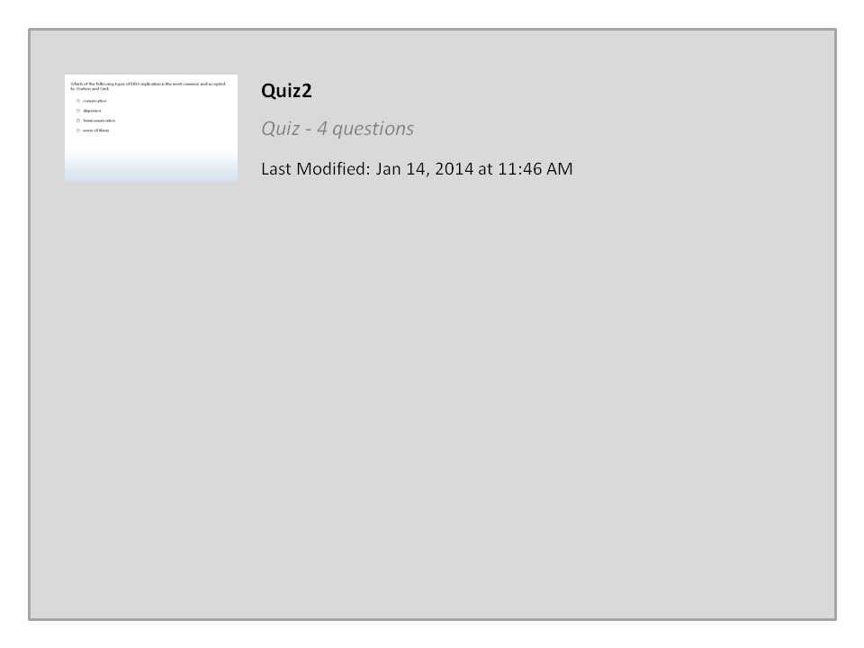
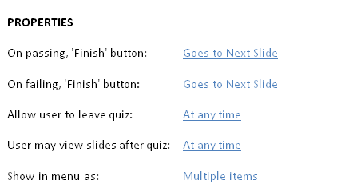

Quiz2

Slide 19


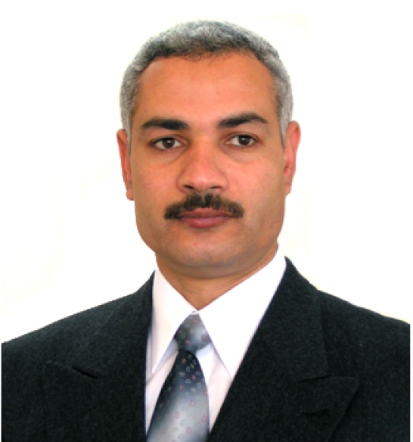

College of Science,
Zoology Department
General Animal Biology
(Zoo-145)
Prof. Ashraf M. Ahmed
aalii@ksu.edu.sa

