Slide 1


Slide 2
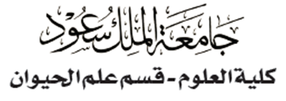

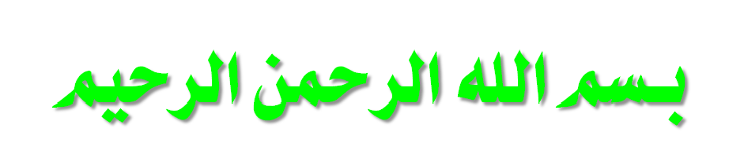
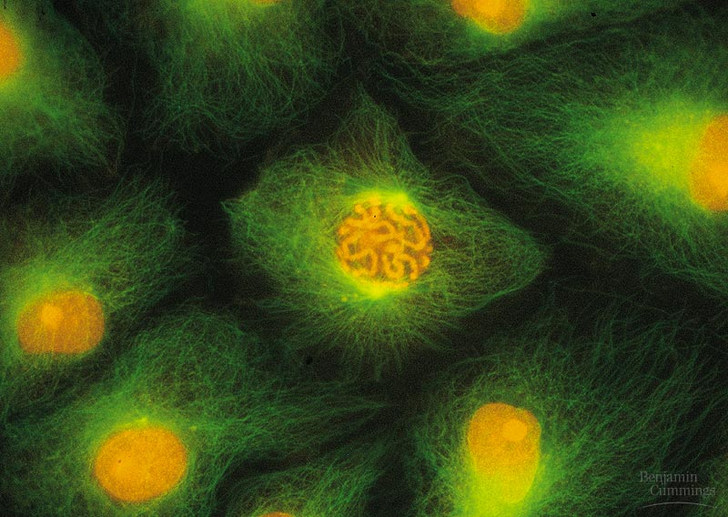
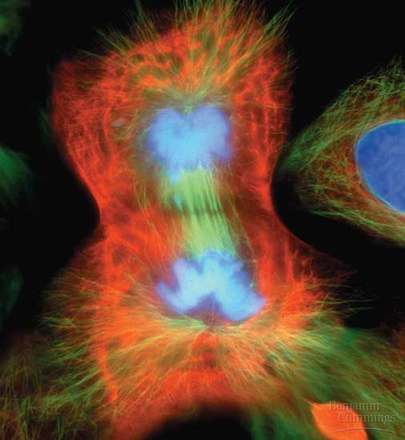
THE CELL CYCLE: The Key Roles of Cell Division
Copyright © 2002 Pearson Education, Inc., publishing as Benjamin Cummings

Slide 3
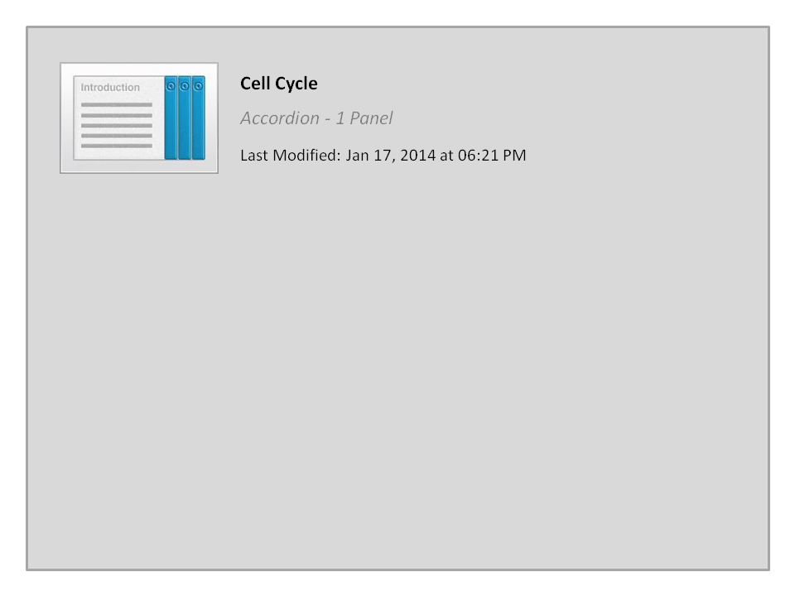
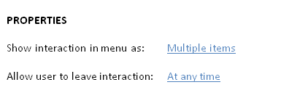


Cell Cycle

Slide 4

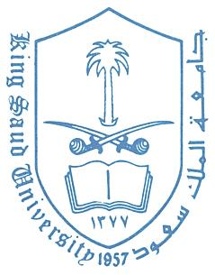
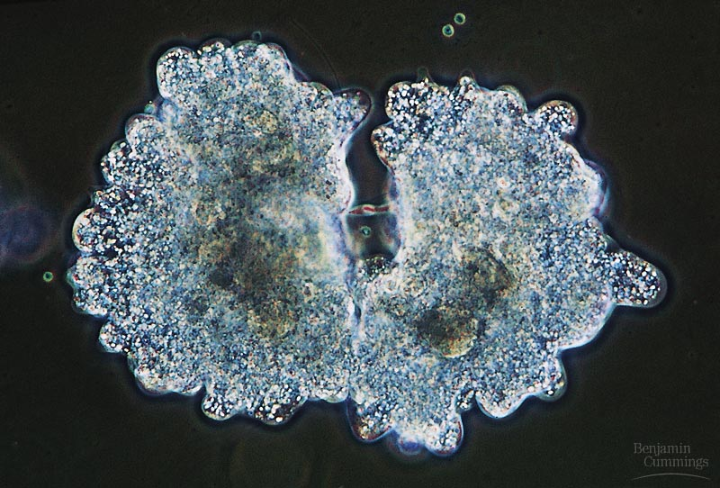
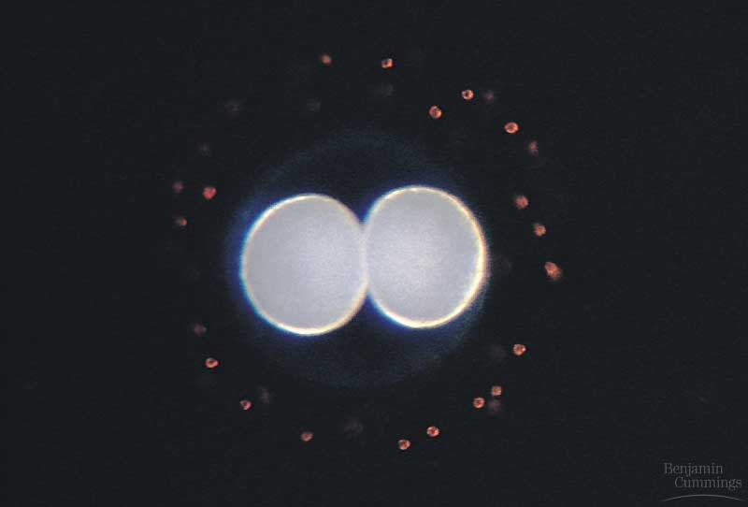
Introduction
The continuity of life from one cell to another is based on the reproduction of cells via cell division.
This division process occurs as part of the cell cycle (the life of a cell from its origin in the division of a parent cell until its own division into two).
The division of a unicellular وحيد الخلية organism (e.g. Amoeba) reproduces an entire organism, increasing the population.
Cell division is also central to the development of a multicellular عديد الخلايا organism that begins as a fertilized egg or zygote.
Copyright © 2002 Pearson Education, Inc., publishing as Benjamin Cummings

Slide 5
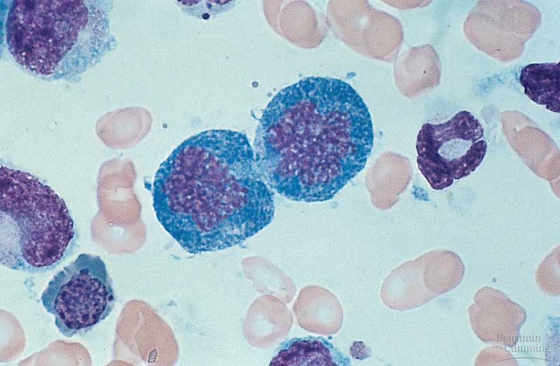
Introduction
Multicellular organisms also use cell division to repair and renew cells that die normally or by accidents (blood cells from bone marrow).
Cell division distributes the genetic material (DNA) to two daughter cells.
Division is different among cells:.
Skin cells divide frequently.
Liver cells divide when needed (damage repair).
Nerve cells and muscle cells never divide.

Slide 6
Cell division distributes identical sets of chromosomes to daughter cells
A cell’s genetic information (genome البنك الـﭽيني) is packaged as DNA.
In prokaryotes, the genome is often a single long DNA molecule.
  In eukaryotes, the genome consists of several DNA molecules.
A human cell must duplicate about 3m of DNA and separate the two copies such that each daughter cell ends up with a complete genome.
DNA molecules are packaged into chromosomes.
  Every eukaryotic species has a characteristic number of chromosomes in the nucleus.
  Human somatic cells (body cells) have 46 chromosomes.
  Human gametes أمشاج (sperm or eggs) have 23 chromosomes, half the number in
  a somatic cell الخلية الجسدية.
Each eukaryotic chromosome consists mainly of a long, linear DNA molecule.

Slide 7
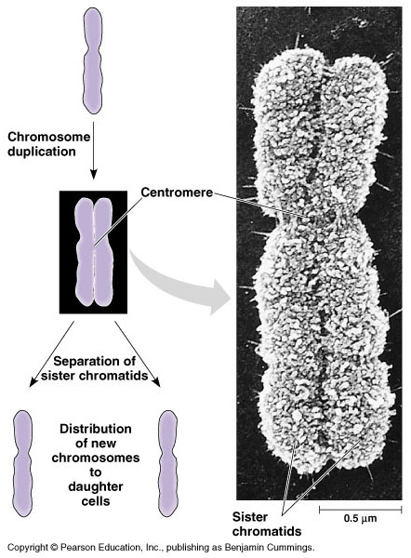
Chromosome
Each chromosome has hundreds or thousands of genes (the units that specify an organism’s inherited characters الصفات الوراثية).
This DNA-protein complex (chromatin) is organized into a long thin fiber.
After the DNA duplication, chromatin condenses to form (chromosome).
Each duplicated chromosome consists of two sister chromatids which contain identical copies of the chromosome’s DNA.
The narrow region where the chromosomal strands connect is the called centromere.
Later, the sister chromatids are pulled apart and repackaged into two new nuclei at opposite ends of the parent cell during cell division.
The process of the formation of the two daughter nuclei is called (mitosis) and is usually followed by division of the cytoplasm (cytokinesis الإنشطار الخلوي ). It occurs in somatic cells الخلايا الجسدية.

Slide 8
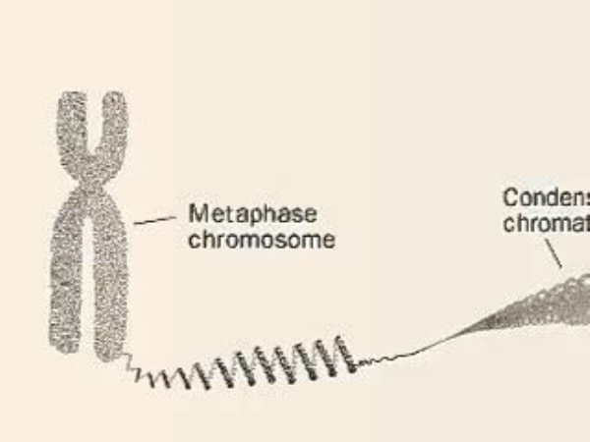
Chromosome

Slide 9
Chromosome
Chromatid
Chromatin (DNA + Protein )
Sister chromatids
Centromere
صبغيات متماثلة
Homologous Chromosomes
Chromosome الصبغ

Slide 10
Chromosome
In the gonads المناسل, cells undergo a meiotic division, which yields four daughter cells, each with half the chromosomes’ number of the parent cell.
  In humans, meiosis reduces the number of chromosomes from 46 to 23.
Each of us inherited 23 chromosomes from each parent: one set in an egg and one set in a sperm during meiosis.
Gametes الأمشاج(eggs or sperm) are produced only in gonads المناسل (ovaries or testes).
The fertilized egg undergoes trillions of cycles of mitosis and cytokinesis to produce a fully developed multicellular human.
These processes continue every day to replace dead and damaged cell.
Fertilization fuses two gametes together and doubles the number of chromosomes to 46 again.

Slide 11
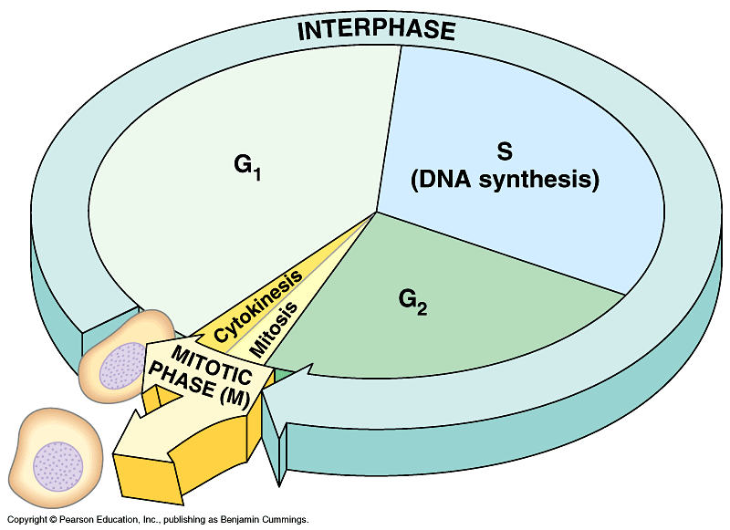
The Mitotic Cell Cycle (division)
The mitotic (M) phase of the cell cycle alternates تتبادل with the much longer interphase المرحلة البينية.
  The M phase includes mitosis and cytokinesis الإنشطار الخلوي .
  Interphase accounts for 90% of the cell cycle.
During interphase the cell prepares for division by producing cytoplasmic organelles and copying its chromosomes.
Interphase has three sub-phases:
  The G₁ phase (“first gap”): cell is carrying out its everyday activities.
  The S phase (“synthesis”): genetic material replicates itself, which allows the cell to contain enough material for 2 cells upon division
  The G₂ phase (“second gap”): cellular organelles are produced to allow for an adequate amount for the new cell being produced.
Division phase (M). The cell starts the division process.
The resulting daughter cells may then repeat the cycle again.

Slide 12
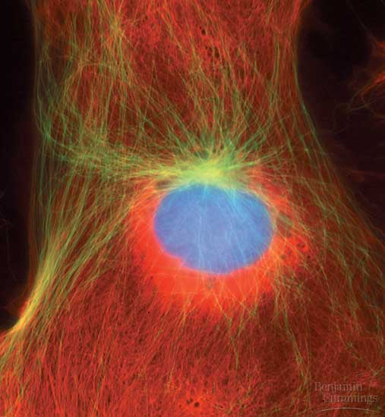
A) Mitosis:
Usually includes five sub-phases مراحل فرعية:
  Prophase, التمهيدية
  Prometaphase, قبل الإستوائية
  Metaphase, الإستوائية
  Anaphase, الإنفصالية
  Telophase. الإنتهائية
By late interphase (G2), the chromosomes have been duplicated تضاعفت but are loosely packed.
The centrosomes have been duplicated and begin to organize microtubules into an aster (“star”).

Slide 13
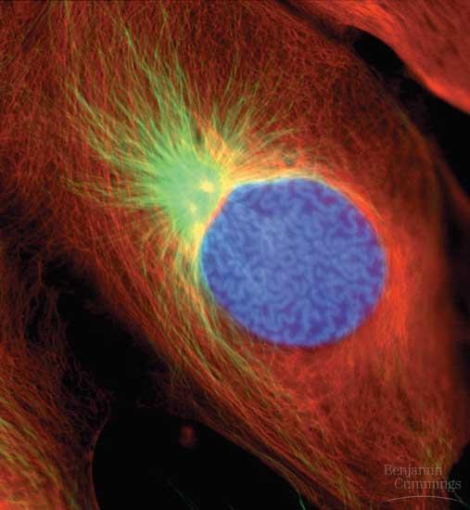
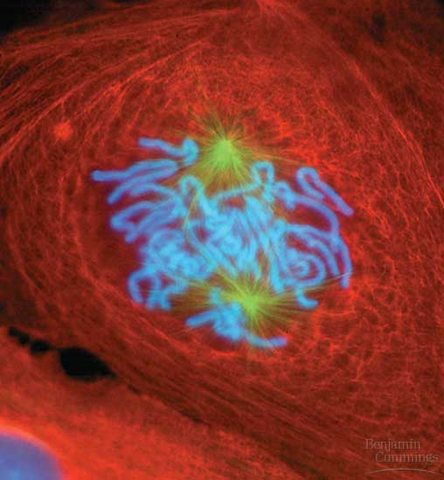
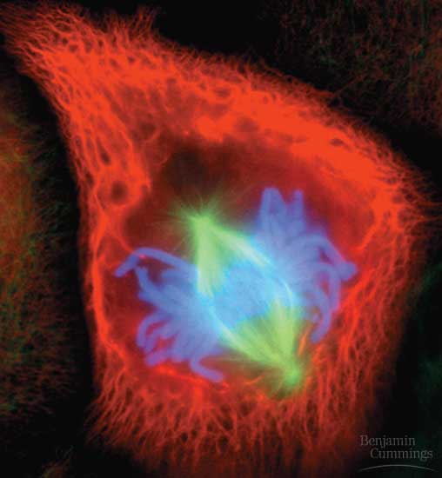
Prophase, التمهيدية the chromosomes are tightly coiled, with sister chromatids joined together, The nucleoli disappear. The mitotic spindle begins to form and appears to push the centrosomes away from each other towards opposite ends (poles) of the cell.
Prometaphase, قبل الإستوائية the nuclear envelope fragments and microtubules from one pole attach to one of two kinetochores (special regions of the centromere) while microtubules from the other pole attach to the other kinetochore.
Metaphase, الإستوائية the spindle fibers push the sister chromatids until they are all arranged at the imaginary plane equidistant between the poles, defining metaphase.

Slide 14
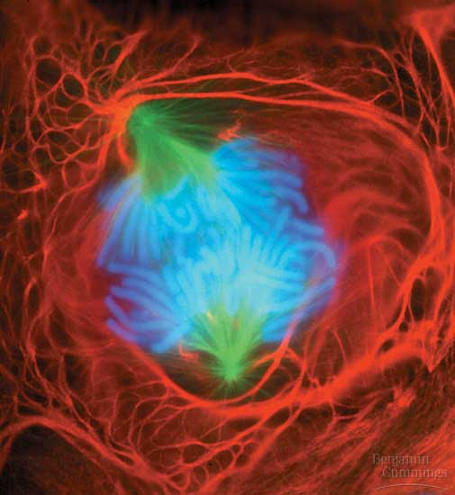
Anaphase, الإنفصالية the centromeres divide, result in separating the sister chromatids. Each is then pulled toward the pole to which it is attached by spindle fibers. By the end, the two poles have equivalent collections of chromosomes.
Telophase, الإنتهائية the cell continues to elongate as free spindle fibers from each centrosome push off each other.
  Two nuclei begin to form, surrounded by the fragments of the parent’s nuclear envelope.
  Chromatin becomes less tightly coiled.
  Cytokinesis, begins as the division of the cytoplasm occurs.

Slide 15
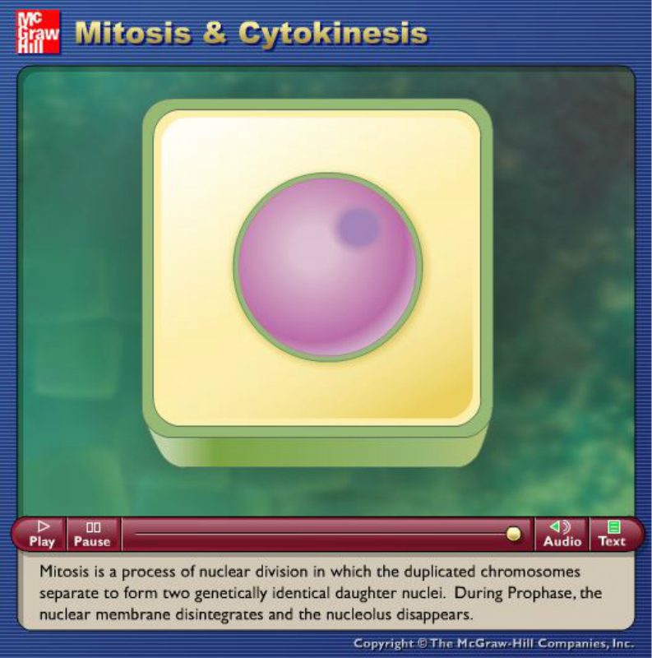
Source: http://highered.mcgraw-hill.com/sites/dl/free/0072437316/120060/ravenanimation.html

Slide 16
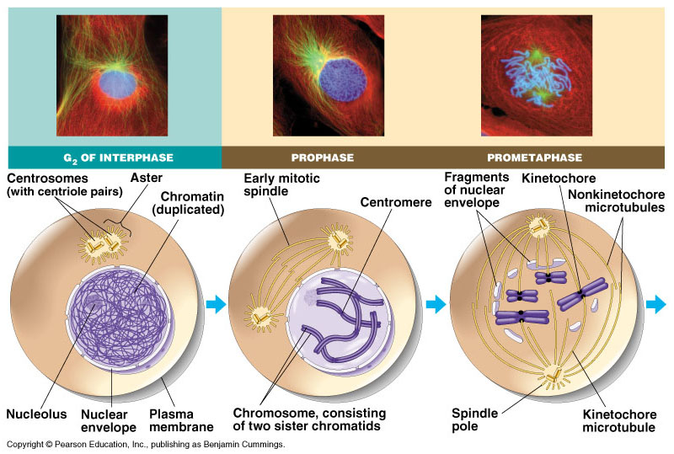

Slide 17
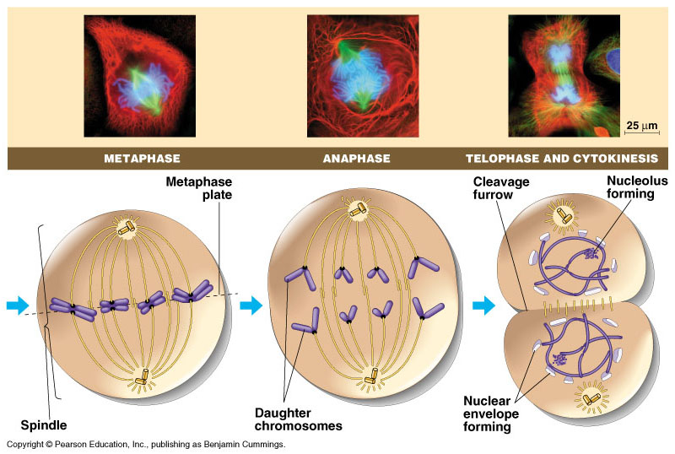

Slide 18
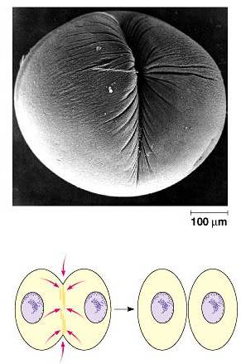
B. The cytokinesis: الإنشطار الخلوي
It is the division of the cytoplasm
Cytokinesis typically follows mitosis.
Contraction إنقباض of the cell pinches the cell into two new cells

Slide 19
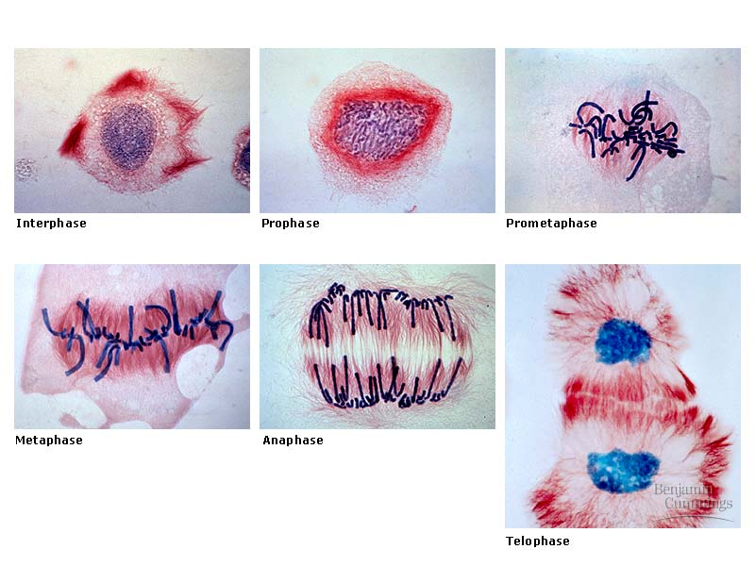

Slide 20
Summary of the cell cycle
Cell Cycle
Interphase
Division process (M)
Mitosis
Cytokinesis
G1
S
G2
Prophase التمهيدية
Prometaphase قبل الإستوائية
Metaphase الإستوائية
Anaphase الإنفصالية
Telophase الإنتهائية

Slide 21
Mitosis: hints
What are type of cells that divide?
  They are somatic cells (body cells)
How many cells are produced and are they similar?
  Produces 2 genetically identical cells
What abbreviation and name describes the fact that they contain 2 sets of chromosomes?
  form diploid (2n) cell
Does the division reduce the number of chromosomes or maintain the same number?
  Maintains the same number of chromosomes in each daughter cell
How many cell divisions are there?
  1 cell division
How many steps are there in mitosis?
  4 steps

Slide 22
Definitions
Genes: The units that specify an organism’s inherited characters.
Chromatin: A DNA-protein complex which is organized into a long
thin fiber
Chromosome: The package that is formed from a condensed, coiled
and folded chromatin.
Chromatids: Two sister arms (chromatids) formed from each duplicated
chromosome. They contain identical copies of the chromosome’s DNA
Centromere: The narrow region at which the chromosomal strands
(Chromatids) are connected together.
Mitosis: Is the division process which forms two daughter nuclei
Cytokinesis: الإنشطار الخلوي Is the division stage of the cytoplasm which
usually follows mitosis.
Meiosis: A division process that occurs In the gonads المناسل, and yields
four daughter cells, each with half the chromosomes of the parent.

Slide 23
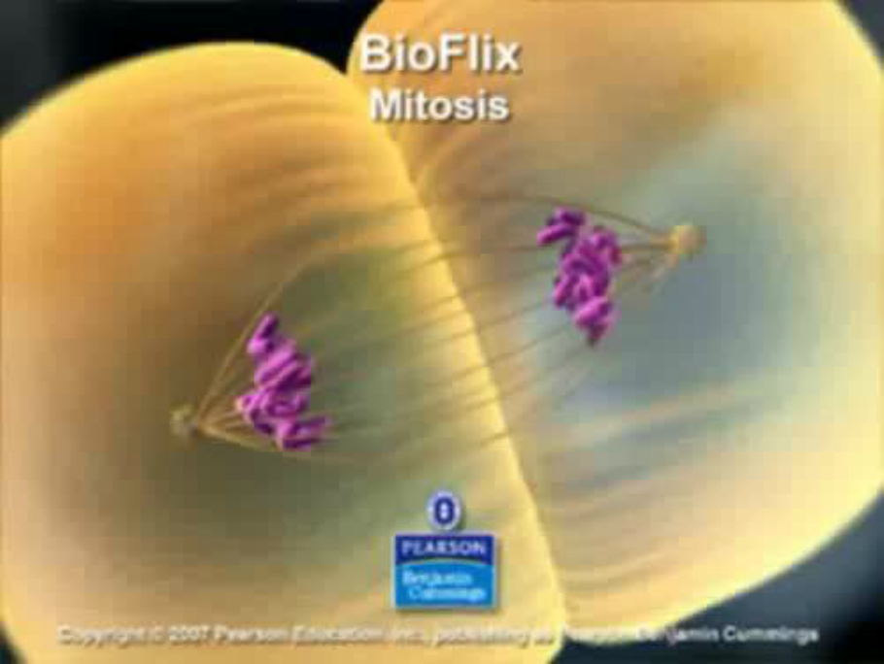
Mitosis

Slide 24
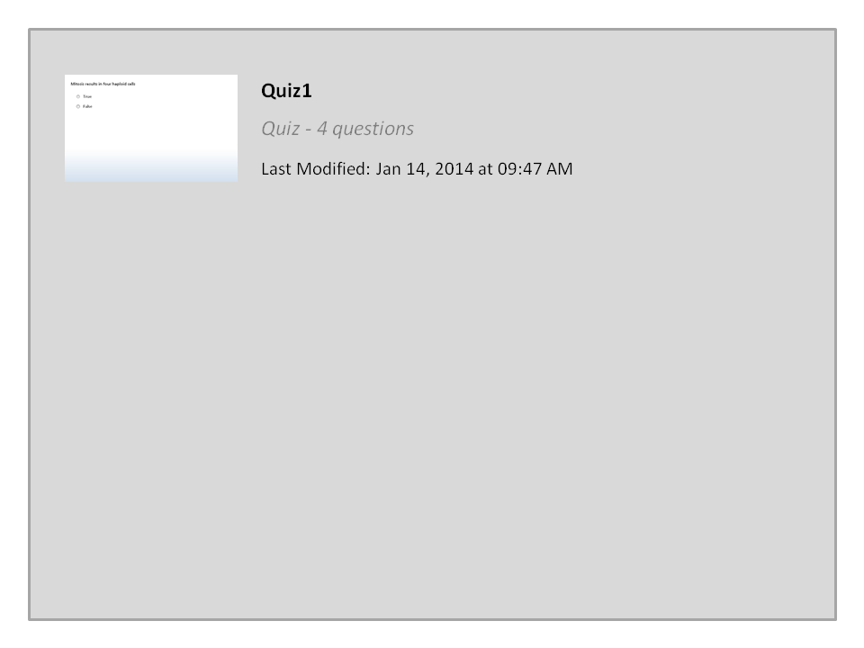
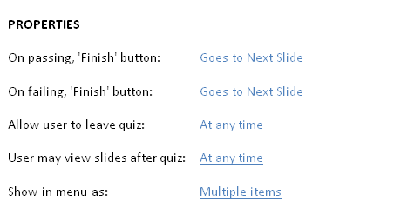

Quiz1

Slide 25

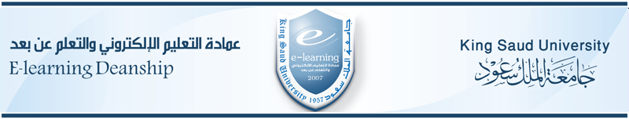
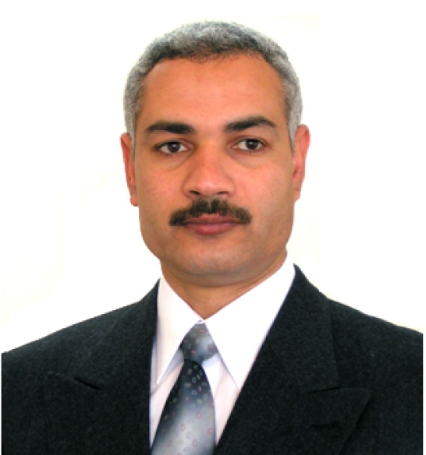

College of Science,
Zoology Department
General Animal Biology
(Zoo-145)
Prof. Ashraf M. Ahmed
aalii@ksu.edu.sa

