Slide 1


Slide 2
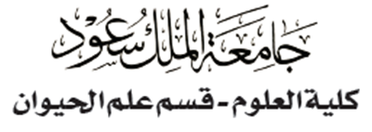


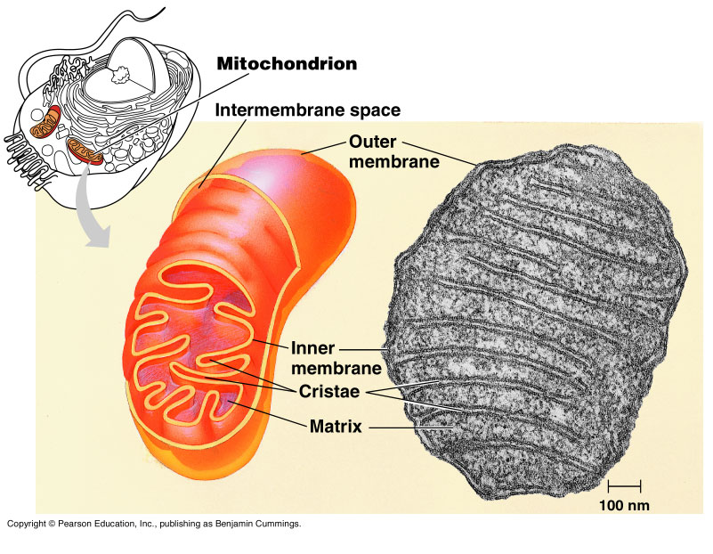
CELLULAR RESPIRATION: Harvesting chemical energy
Copyright © 2002 Pearson Education, Inc., publishing as Benjamin Cummings

Slide 3
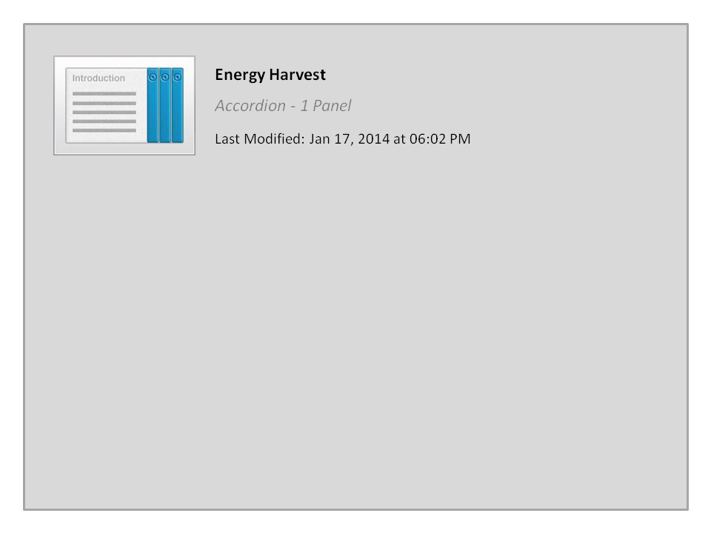
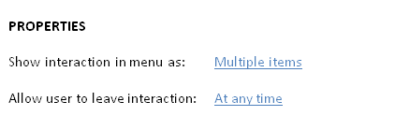
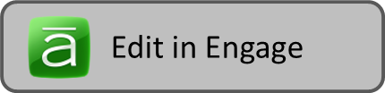
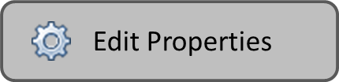
Energy Harvest

Slide 4


Processes of Cellular Respiration
Respiration involves three stages:
Glycolysis harvests chemical energy by oxidizing glucose to pyruvate and produces about 5% of ATP (in cytoplasm).
2. Krebs cycle completes the energy-yielding oxidation of organic molecules and produces about 5% of ATP (in mitochondrial matrix).
Electron transport chain to synthesis ATP and produces about 90% of ATP (inner mitochondrial membrane).
Cellular respiration generates many ATP molecules. For each sugar molecule it oxidizes (38 ATP molecule).
Copyright © 2002 Pearson Education, Inc., publishing as Benjamin Cummings

Slide 5
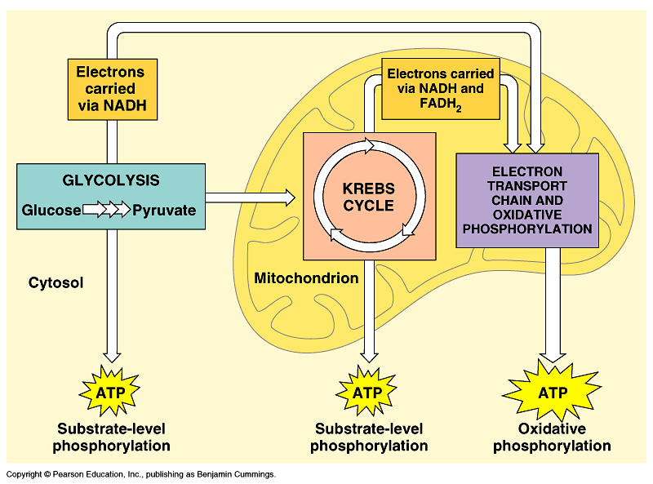
Respiration involves glycolysis, the Krebs cycle, and electron transport
Respiration occurs in three metabolic stages: glycolysis, the Krebs cycle, and the electron transport chain & oxidative phosphorylation.
Glycolysis occurs in the cytoplasm.
  It begins catabolism by breaking glucose into two molecules of pyruvate.
The Krebs cycle occurs in the mitochondrial matrix.
  It degrades pyruvate to carbon dioxide.
Several steps in glycolysis and the Krebs cycle transfer electrons from substrates to NAD⁺, forming NADH.
NADH passes these electrons to the electron transport chain.

Slide 6
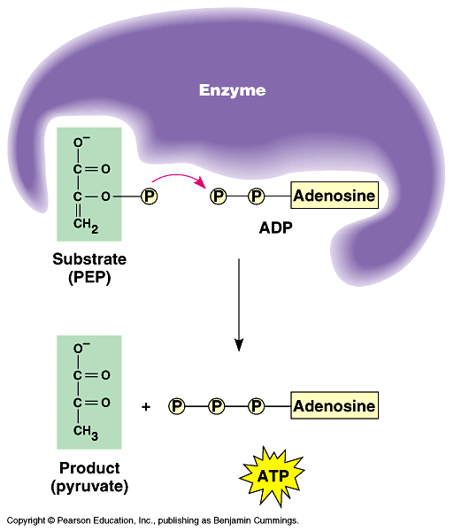
Phosphorylation
I- Substrate-level phosphorylation:
Some ATP is generated in glycolysis and in Krebs cycle by Substrate-level phosphorylation. Phosphate group is transferred from an organic molecule (the substrate) to ADP, forming 10% ATP (4 ATP).
II- Oxidative phosphorylation:
As electrons passed along the chain, their energy stored in the mitochondrion in a form that can be used to synthesize the rest 90% of the ATP (34 ATP).
via Oxidative phosphorylation.
Ultimately 38 ATP are produced per mole of glucose that is degraded to carbon CO₂ and H₂O by respiration.

Slide 7
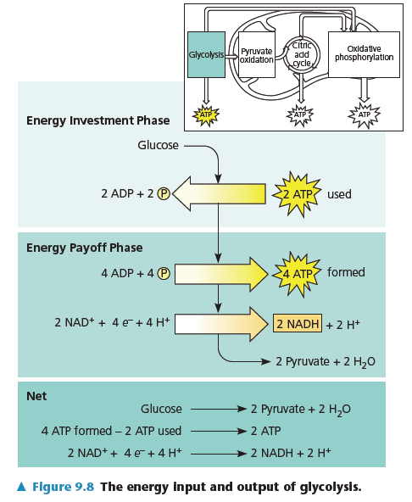
1- Glycolysis (splitting glucose): harvests chemical energy by oxidizing glucose to 2-pyruvate
During glycolysis, glucose (a six carbon-sugar) is split into two molecules (each is three-carbon sugar).
These smaller sugars are oxidized and rearranged to form two molecules of pyruvate.
Each of the 10 steps in glycolysis is catalyzed by a specific enzyme.
These steps can be divided into two phases:
1)- Energy investment phase: إستهلاك طاقة
ATP is consumed to provide activation energy by phosphorylating glucose (this requires 2 ATP per glucose).
2)- Energy payoff phase: إنتاج طاقة
ATP is produced by substrate-level phosphorylation and NAD⁺ is reduced to NADH.
4 ATP and 2NADH are produced per glucose.
Thus, the net yield from glycolysis is 2 ATP and 2 NADH per glucose.
Oxygen is not required for glycolysis

Slide 8
Summary of Glycolysis (Splitting of glucose)
It is the process of breaking a glucose into 2 Pyruvates.
It is a source for some ATP & NADH and occurs in the
CYTOSOL (cytoplasm).
It has two phases
A)- Energy investment phase
1)- Glucose is phosphorylated twice by adding 2 P
coming from 2 ATP (substrate-level-phosphorylation).
2)- Thus, Glucose (6-C) splits into two small sugar molecules (each with 3-C).
B)- Energy pay-off phase
4ATP are formed by adding 4P to 4ADP molecules.
The net yield of this process is the formation of 2 NADH,
2 ATP and 2 pyruvate molecules.

Slide 9
2. The Krebs cycle completes the energy-yielding oxidation of organic molecules (in mitochondrial matrix)
It is the process of producing some of the remaining energy (ATP) from the Pyruvate molecules. It occurs mainly in mitochondrial matrix if oxygen is present.
It is the main source for preparing most of the cellular NADH (storing energy molecule), and for producing some more of the cellular ATP.
It includes two cycles :
Pre-Krebs cycle المرحلة التحضيرية
Krebs cycle

Slide 10
A)- Pre-Krebs cycle
Pyruvate is converted into acetyle-CoA in the presence of O₂ through 3 steps.
a)- C=O⁻ group of pyruvate is released as CO₂.
b)- The remaining two-C fragments are oxidized (releasing e⁻) into
acetate and the resulting e⁻ transform NAD⁺ into NADH.
c)- The coenzyme-A (CoA) transform acetate compound into
acetyle-CoA, which will be ready for Krebs Cycle for further
oxidation.
2 NAD⁺
2 NADH + H⁺
2Pyruvate
2Acetyle-CoA
+ CO₂ + H₂O
CoA
Krebs Cycle

Slide 11
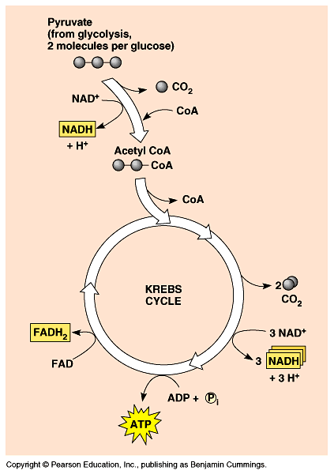
B)- Krebs cycle
It has eight steps starting with 2 acetyle-CoA compounds. They are summarized as in the shown figure:
Pre-Krebs Cycle
This cycle begins when acetate from each acetyl-CoA combines with oxaloacetate (4 C atoms) to form citrate (citric acid).
Ultimately, the oxaloacetate is recycled and the acetate is broken down to CO₂.
Each cycle produces one ATP by substrate-level phosphorylation, three NADH, and one FADH₂ (another electron carrier) per acetyl CoA.
Thus, the outcome of the two cycles is (for the 2 Acetyle-CoA molecules):
2 ATP
6 NADH
2 FADH₂
Output
Flavin Adenine Dinucleotide

Slide 12
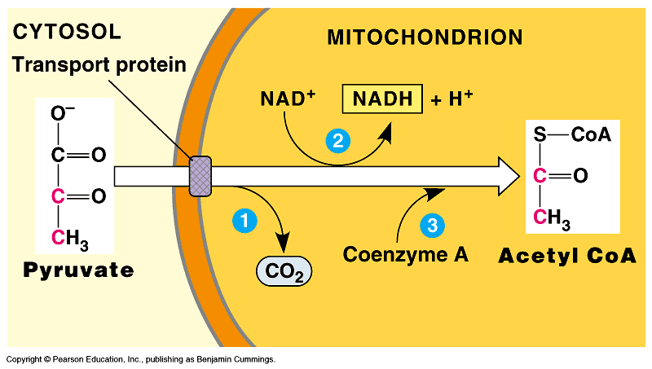
The Krebs cycle
If O₂ is present, pyruvate enters the mitochondrion where enzymes of the Krebs cycle complete the oxidation of this organic fuel to CO₂.
As pyruvate enters the mitochondrion which modifies pyruvate to acetyl-CoA which enters the Krebs cycle in the matrix.
  A carboxyl group is removed as CO₂.
  A pair of electrons is transferred from the remaining two-carbon fragments to NAD⁺ to form NADH.
  The oxidized fragment, acetate, combines with coenzyme A to form acetyl-CoA.

Slide 13
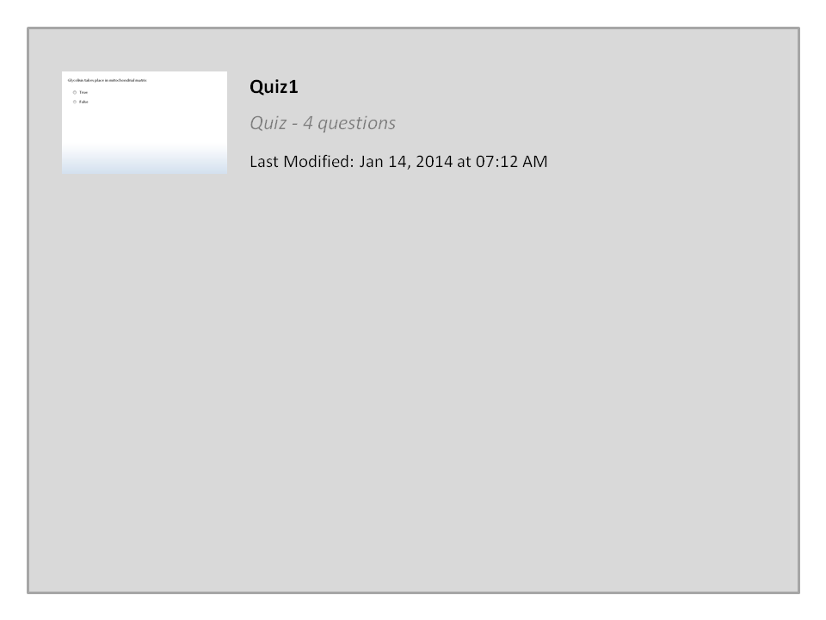
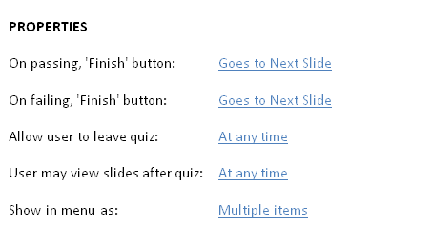
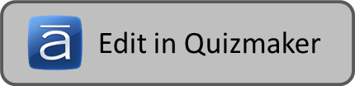
Quiz1

Slide 14


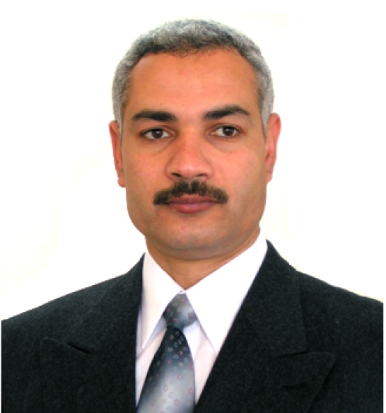

College of Science,
Zoology Department
General Animal Biology
(Zoo-145)
Prof. Ashraf M. Ahmed
aalii@ksu.edu.sa

