Slide 1
Menu

Slide 2
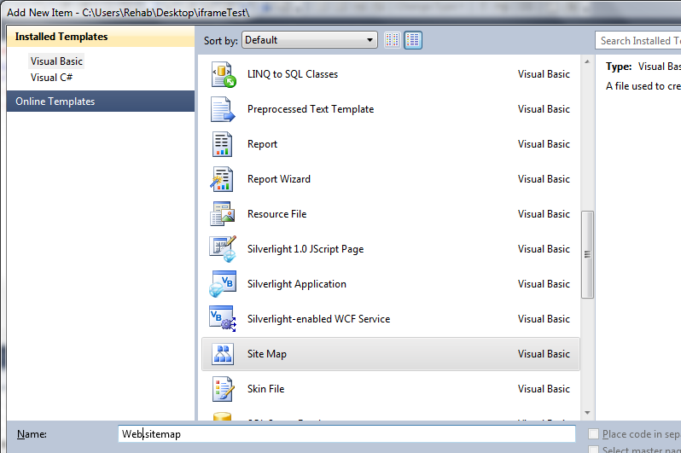
Add New Item > Site Map

Slide 3
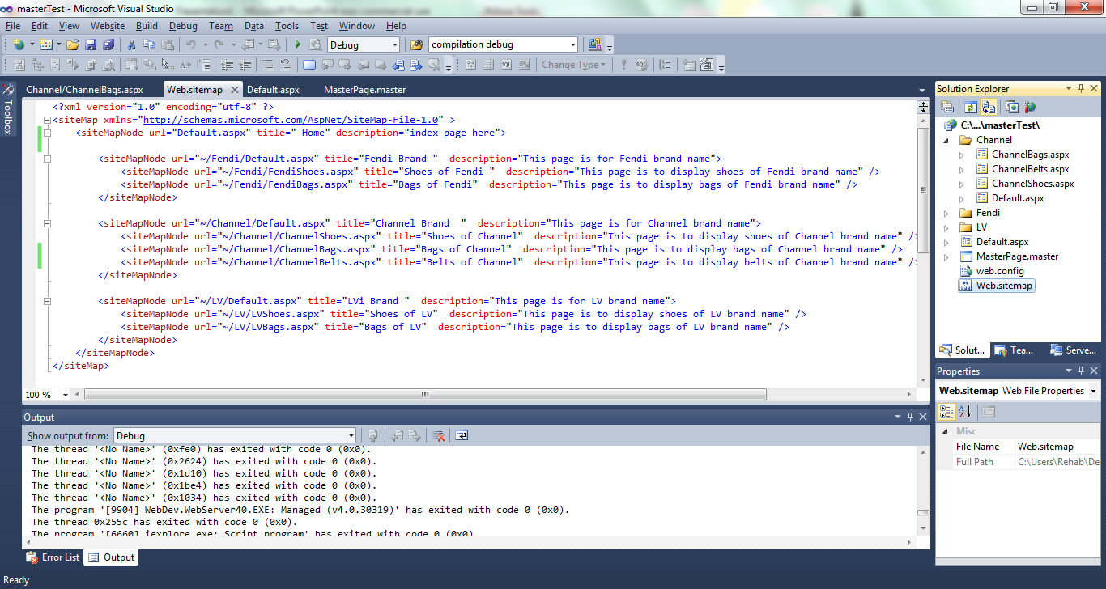
List all your pages in a tree format

Slide 4
In the MasterPage add from the Toolbar> Data> SiteMapDataSource

Slide 5
You will use this ID later for Menu/SiteMapPath/TreeView

Slide 6
In the MasterPage Add From Toolbar > Navigation > Menu

Slide 7
Add the SiteMapDataSourceID in the Menu tag in SourceCode of MasterPage

Slide 8
SiteMap Menu

Slide 9
In the MasterPage Add From Toolbar > Navigation > SiteMapPath

Slide 10
Add the DataSourceID in the SiteMapPath tag in sourceCode of the MasterPage

Slide 11
SiteMapPath

Slide 12
In any aspx page ex: ChannelBags.aspx You can add a TreeView
Add DataSourceID

Slide 13
Don’t forget: TreeView control and any content will be inside the Content tag where It’s linked with the contentPlaceHolder from MasterPage
Don’t forget DataSourceID

Slide 14
TreeView

Slide 15
Iframe

Slide 16
Manualy type the following code for iframe tag in the aspx source code

Slide 17
Put the iframe tag inside <div> tag
src attribute defines the target aspx page you want to display in the iframe
You can modify height and width based on the space you want to show as an iframe in the page
Don’t use runat=“server” in the iframe tag if you wish to embed a page from your own website.

Slide 18
index.aspx
Content of
Page1.aspx

Slide 19
In this example: the Button Sign in will go to page1.aspx

Slide 20
index.aspx
Content of
Page2.aspx

Slide 21
Questions !! ☺

