Slide 1
Amines
Dr. Shatha I Alaqeel
108 Chem

Slide 2
Learning Objectives
Chapter ten discusses the amines and by the end of this chapter the students will:
Know the structure and classification of amines
Know the naming rules for amines.
Know the physical properties of amines
Know the effect of lone pair of electrons of N atom on basic properties of amines
Know the different methods used in synthesis of amines
Know the reactions of amines; in addition to behaving as bases amines can be nucleophiles.
108 Chem

Slide 3
Structure and classification of amines
Amines: is a class of organic compounds that contain the NH₂ group, Amines are derivatives of ammonia
Nitrogen atom with a lone pair of electrons, making amines both basic and nucleophilic
Classification Of Amines
primary (1°) amines secondary (2°) amines
tertiary (3°) amines quaternary (4°) ammonium salts
H
H
R N:
R N:
H
R
R
R
+
R N:
R N R
R
R
108 Chem

Slide 4
Common Nomenclature Of Amines
The common names of amines by listing the names of the groups surrounding the nitrogen (in alphabetical order) and adding the suffix amine.
IUPAC Names Of Primary Amines :
If the compound does not contain a functional group except amino group, then the compound is named by finding the longest alkane chain containing the amino group and replacing the e in the IUPAC name by the suffix amine
However if the compound contain other functional groups then the order of precedence determines which group are named with prefix or suffix. (see the precedence table on slide 7)
108 Chem

Slide 5
The highest precedence group takes the appropriate suffix with all other groups taking the prefix (es), however = or Ξ bonds only take suffix form (ene, yne respectively.
In secondary and tertiary amines: use the italic capital letter “N ” to show the location of an alkyl group that is attached to the nitrogen atom (The smaller alkyl groups on the amine nitrogen are designated as substituents and given the locate N).
Methyl amine Benzyl methyl amine Trimethyl amine Tetramethyl ammonium bromide
N-Methyl phenyl methanamine
N,N-Dimethylmethanamine

Slide 6
5-Methyl-3-hexanamine 5-Aminoheptanoic acid 3-Amino-2-butanol
Aniline o-Nitroaniline p-Toluidine p-aminophenol p-nitro-N-ethylaniline
108 Chem

Slide 7
Precedence Order of Functional Groups
Class | Functional group | Prefix | suffix
Carboxylic acids Cyclic alkanes or alkenes with COOH group | COOH |  | oic acid carboxylic acid
Aldehydes Cyclic alkanes or alkenes with CHO group | -CHO | Formyl | al Carbaldehyde
ketone | -C=O | oxo | one
Alcohols | -OH | hydroxy | ol
Amines | -NH₂ | amino | amine
Aromatic ring with R,C=C, C=C, OR, X Aromatic ring with OH, NH₂, CHO, CO,COOH, COOR | C₆H₅-CH₂ | - Phenyl Benzyl | Benzene -
Ethers | -OR | alkoxy | -
Alkenes and aAlkynes | = & Ξ bonds | - | ene & yne
108 Chem

Slide 8
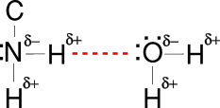
Physical properties of Amines
Polarity :
Because they possess a polar N-H bond, because N is more electronegative than H or C.
Solubility :
All amines are capable of forming
hydrogen bonds with water so they soluble in water. But aromatic amines are insoluble in water
108 Chem

Slide 9
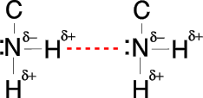
Boiling point
Because they possess a polar N-H bond, primary and secondary amines are capable of forming intermolecular hydrogen bonds among their molecules; therefore they have:
higher boiling points than alkanes but lower than alcohols (alcohols form stronger H-bonds than amines). because N is less electronegative than O, so N-H bond is less polar than O-H bond.
Tertiary amines can not form H-bonds among their molecules and their molecules are more branched thus they have the lowest boiling points among amines.
108 Chem

Slide 10
Basicity of Amines
Amines basic because N has non bonded pair of electrons which can be donated to an acid to form ammonium salt.
base strength depend on the degree of availability of the non bonded electron pair (electron density on N is lowered effectively) on N: CH₃-NH-CH₃ > NH₂-CH₃ > NH₃
Aliphatic amines are considerably more basic than aromatics amines.
due to lone pair of electrons on N is involved in aromaticity
108 Chem

Slide 11
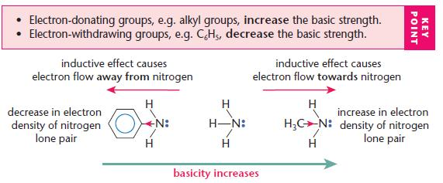
108 Chem

Slide 12
Preparation of amines
Reduction of nitro compounds, nitriles, amides, and oximes
Nitrile
Amides
108 Chem

Slide 13
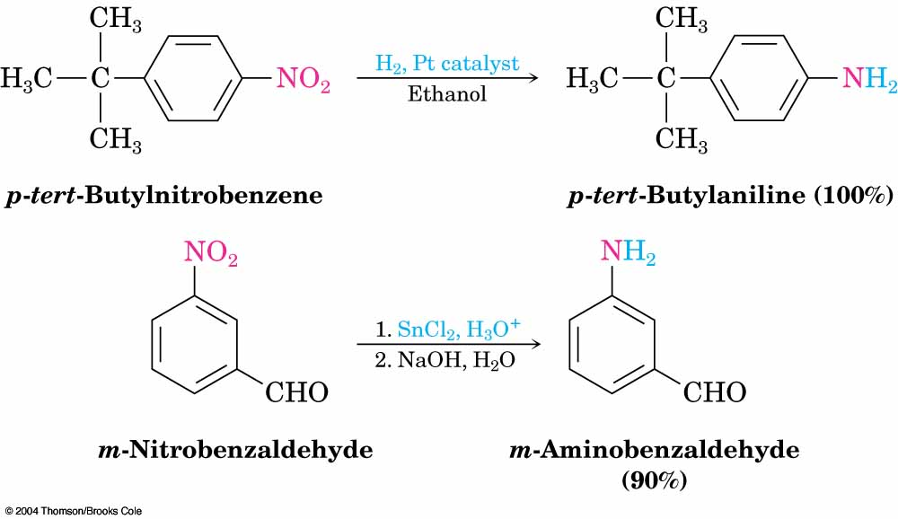
Nitro compounds
or
1. LiALH₄ / dry ether
2. H₂O
Oxime
108 Chem

Slide 14
2- Alkylation of ammonia
108 Chem

Slide 15
3- Hoffman degradation of Amides
Convert Amide to Primary amine by reduce 1 carbon atom.
108 Chem

Slide 16
Reaction of Amines with Nitrous Acid (diazotization)
Diazonium Salt
Azo Compound
108 Chem

Slide 17
Reactions Of Amines
N-nitrosamines
p-nitroso aromatic compounds
108 Chem

Slide 18
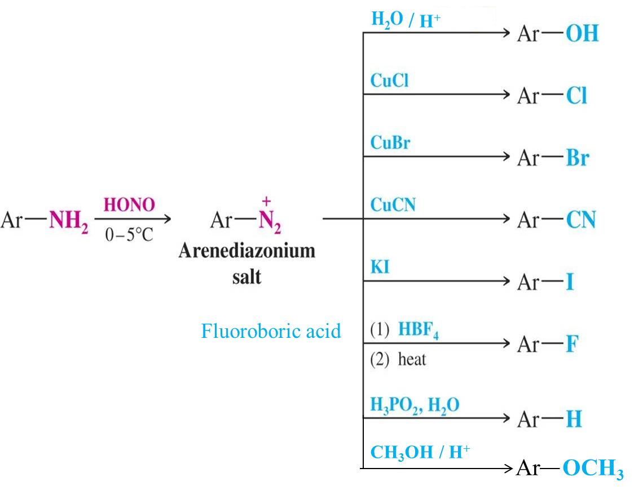
H₃PO₄ , H₂O
108 Chem

Slide 19
3
108 Chem

Slide 20
Thank you for attentions
Questions
108 Chem

