Slide 1

GE105
Introduction to Engineering Design College of Engineering
King Saud University
Lecture 10.
Concept Generation and Evaluation
FALL 2017

Slide 2
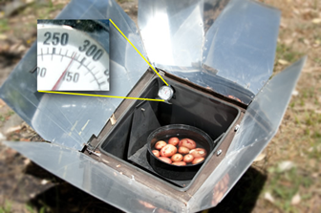
Introduction
So far you should know how to:
  Interpret the needs and analyze them
  Specify the objectives (primary and secondary)
  Determine the human factors
  Formulate the constraints and criteria
  Conduct a morphological analysis and generate concepts.
Today you will learn how to:
  Evaluate alternatives through the
  weight-and-rate technique
This will be covered through a “solar oven” design example

Slide 3

The Design Cycle
1 Customer Need
10
Evaluate
2
Define Problem
9
Implement
3
Search
Implementation
Problem
Formulation
8
Plan
4
Criteria and Constraints
Problem
solving
7
Decision
5
Alternative Solutions
6
Analysis

Slide 4

The Solar Oven Example
It is required to design a solar oven. The oven should be simple, easy to manufacture, inexpensive and
highly effective
Needs
-Learn about heat
transfer
-Learn about solar
ovens
A well Understood problem
The first step is not about finding solutions; It is about understanding the problem

Slide 5
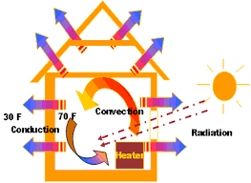
Heat Transfer
It occurs through one of three modes when a ΔT exists
Conduction: Heat travels from atom to atom of a solid
    Example: Doorknob is hot if fire is on other side
Convection: With a gas or liquid, the heat propagates as molecules move
Example: When you open the door of an oven, the temperature in the kitchen increases
Radiation: A heated surface emits electromagnetic waves which carry energy away from the emitting object
Example: Heat felt from a brick wall that has been in the sun all day

Slide 6

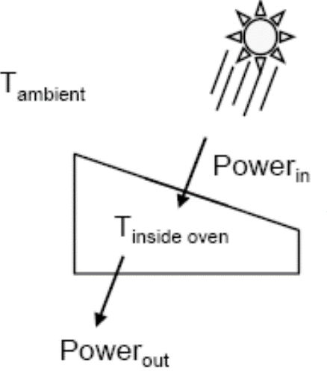


Understanding the Problem
$$∆T=T_{inside oven}−T_{ambient}$$
Criteria:
Maximize $∆T$
Minimize Cost

Slide 7
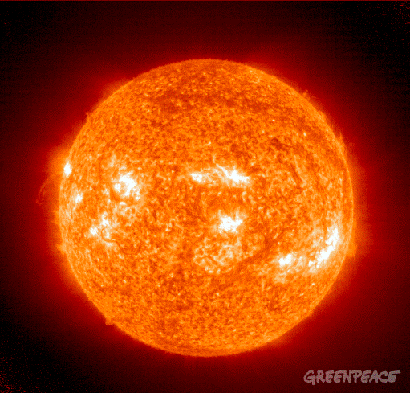
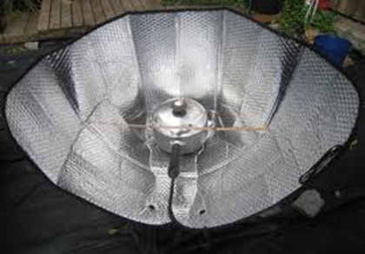
Key Ideas
  Sunlight contains energy
  You want a solar oven that gets as hot as possible (highest temperature in oven chamber)
  You want your oven to receive solar energy easily
  You also want your oven not to lose the solar energy it has captured

Slide 8
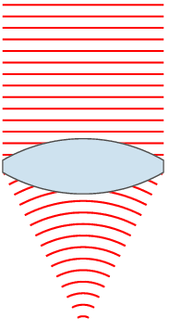
Needs
Low Cost
Maximum Temperature
No lenses
Size of chamber (partition)
No preheating
Presence of a thermometer
High simplicity
…

Slide 9

Solar Oven Heat Transfer
$$∆T=T_{inside oven}−T_{ambient}$$

Slide 10

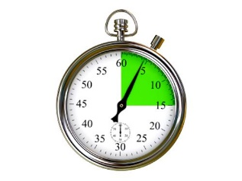
Time = 0
Cover
Time = Shortly after
Cover is Removed

Slide 11

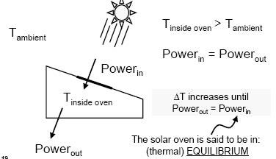
Time = a long time after “0"

Slide 12
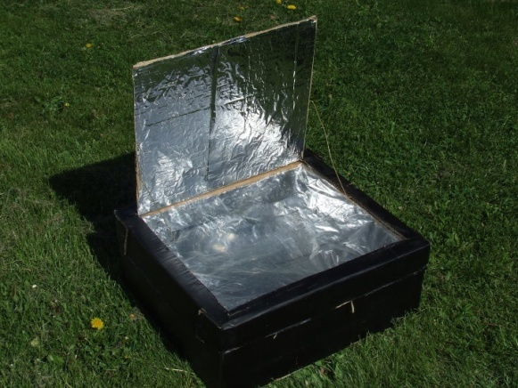


Summarizing what we know
We want the largest ΔT we can get for a given cost
To get a larger ΔT, we need either to:
  Increase Power in (get more sun into the oven)
  Decrease Power out for a given ΔT (reduce the rate at which energy is leaving the oven)
$∆T={T}_{2}$-$T_{1}$
$∆T=T_{2}$-${T}_{1}$
Notes:
* We are trying to come up with a proper problem definition here

Slide 13
Increasing Power_{in}
Solar Intensity = 1,000 W/m²
What determines Power_{in}:
Window Size
Sun Intensity
Window Thickness
Angle light hits window
Color of oven Wall*
To increase Power_{in} :
Bigger window
Thinner window*
Increase the area
Notes:
* We are determining our criteria in this step

Slide 14
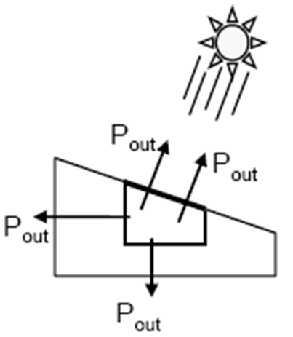
Decreasing Power_{out} for a given ΔT?
Energy leaves the oven through:
Radiation
(back out window)
Conduction and Convection
  back out window
  sides of oven
  bottom of oven

Slide 15

Decreasing Power_{out} for a given ΔT?
Heat Transfer Via Window
  About 25 W /(m² °C) when T inside oven = 150°C
  About 12 W/(m² °C) for a thicker window
Heat Transfer Via Sides and Bottom
  About 1.5 W/(m² °C)
More heat is lost through window
  Therefore, you want a smaller, thicker window to
  keep heat in!
  Some good insulation on sides and bottom

Slide 16
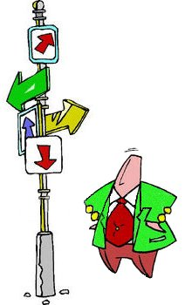

Putting it all Together
To increase Power_{in}
Increase window size
Decrease window thickness
To decrease Power_{out}
  Decrease window size
  Increase window thickness
Conflicting objectives? well, this is Engineering Design; you must make tradeoffs (compromise)

Slide 17
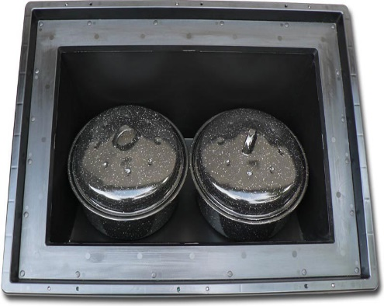
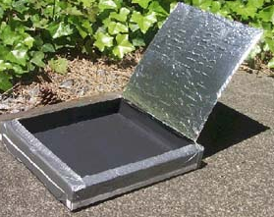
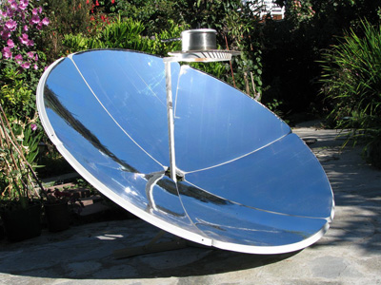
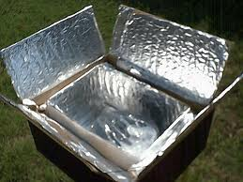
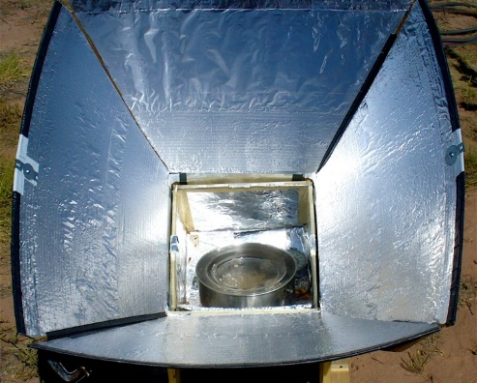
Solar Oven Concept Generation (Brainstorming)
Single Flat Reflector
No Reflector
Parabolic
4 Flat Reflectors
Open Corners
4 Flat Reflectors
Closed Corners

Slide 18
Concept Evaluation
Characteristics of Engineering Decisions
    Multiple criteria
    Criteria are of different importance
    Criteria are conflicting
    Multiple interested parties
1 Customer Need
10
Evaluate
2
Define Problem
9
Implement
3
Search
Implementation
Problem
Formulation
Use a Decision Matrix:
A simple decision approach to weigh pros and cons applying weight and rate concept (multiply and sum)
8
Plan
4
Criteria and Constraints
Problem
solving
7
Decision
5
Alternative Solutions
6
Analysis
Notes:
* i.e. we are here at the very important “analysis” design step (step 6)

Slide 19
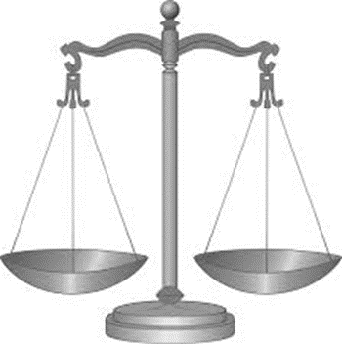
Applying weight-and-rate
Features/attributes of the solar viewed important:
    Direct Energy into Oven
    Easy to Manufacture
    Room for Error in Aim
    Hold Energy in Oven
    Durable
    …
Keep attributes as independent as possible!*
Notes:
* i.e. try not to repeat any attributes/criteria

Slide 20
Weights
To determine the importance of each attribute,
we use a simple approach based on weights that sum to 100
 | Direct Energy | Manufacturability | Flexibility | Holding Energy in Oven | Total Weight
Scenario 1: Compromise | 25 | 25 | 25 | 25 | 100%
Scenario 2: Most light in | 40 | 5 | 15 | 40 | 100%
Scenario 3: Easy to make | 20 | 40 | 20 | 20 | 100%

Slide 21
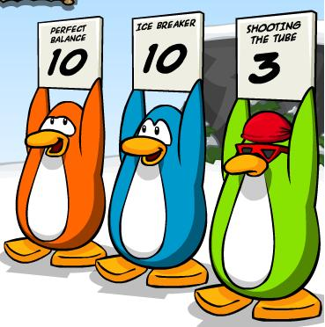
Rates
Once alternative concepts are determined, rate each attribute for each alternative concept on a scale from 1 (worst) to 10 (best)
For the solar oven example, we will only use three alternative concepts* and four attributes
Normally, you would have more concepts and more attributes
Notes:
* Some important terminology here: attributes = criteria; concepts = alternative solutions; scenario = division of weights (e.g. compromise = equal weights); rates = score for each attribute (1-10)

Slide 22
Rating the Concepts
Let us use the “most light in” Scenario
This scenario uses weights (40,5,15,40)
 | Direct Energy | Manufacturability | Flexibility | Holding Energy in Oven | Score
Weights➔ | 40 | 5 | 15 | 40
Concept 1: No reflector Big window | 1 | 10 | 5 | 3 | 285
 | 40 | 50 | 75 | 120
Concept 2: 1 reflector Small window | 4 | 8 | 7 | 6 | 545
 | 160 | 40 | 105 | 240
Concept 3: Parabolic | 9 | 2 | 4 | 4 | 590
 | 360 | 10 | 60 | 160
⊗
⊗
⊕

Slide 23
Rating the Concepts
Let us use the “compromise” Scenario*
This scenario uses weights (25, 25 , 25, 25)
 | Direct Energy | Manufacturability | Flexibility | Holding Energy in Oven | Score
Weights➔ | 25 | 25 | 25 | 25
Concept 1: No reflector Big window | 1 | 10 | 5 | 3 | 475
 | 25 | 250 | 125 | 75
Concept 2: 1 reflector Small window | 4 | 8 | 7 | 6 | 625
 | 100 | 200 | 175 | 150
Concept 3: Parabolic | 9 | 2 | 4 | 4 | 475
 | 225 | 50 | 100 | 100
Notes:
* Now repeat for scenario 3; Q: which highest score to take? A: usually best to take –globally- highest scenario (read next slide for more tips)

Slide 24

Final Remarks
Decision matrices (weight-and-rate) are helpful tools for exploring trade-offs
Use more than one scenario and do not be driven by a single-objective mentality
You do not necessarily have to use the one with the highest score

