Slide 1
GE105
Introduction to Engineering Design College of Engineering
King Saud University
Lecture 7.
Problem Formulation Case Studies
FALL 2016

Slide 2
Remember!
Need Analysis
Literature
Interview/Survey
Market Studies
Focus Groups
Interpret and Summarize
Specifications
Objectives
Constraints
Criteria
Customer Statement
Problem Formulation
Before solving a problem, answer:
Why (very few know this)
How (some know this)
What (everyone knows this)

Slide 3
Example 1:
What
Machine
Why
Wash clothes
How
Automatic
Dry clothes
Capacity up to 5 kg
Can use voltage 110 V / 220 V
Low power consumption/wattage less than 100 Watts
Portable washing machine
Noise level must not exceed 65 dB
Must be safe
Filter for the water
Water inlet and outlet
Cost must not exceed 500 SR
Weight must be less than 100 N
Statement:
Needs:
Device to wash clothes
Can be easily operated
Can be started by operating the timer manually
Variation of rotating speed for different types of clothes
Notes:
While you are reading each of these needs, write next to each one if you think it is: objective (O) or specification (S), constraint (CT), or criteria (CR)

Slide 4
Constraints
Capacity: up to 5 kg
Noise level less than 65 dB
Size: 1 m x 0.9 m x 0.5 m
Weight not more than 100 N (10 kg mass)
Cost less than 500 SR
After drying no water drop from the clothes
110 / 220 volts
Portable
Life more than 5 Years
Electric consumption less than 100 W.h (Watt-hours)
Criteria
High effectiveness of cleaning the clothes
High durability
Easy to use (simple)
High number of cloth types

Slide 5
Safety Specifications
If overloaded, the machine shouldn’t start
Maximum water level to prevent water waist and dangerous current short-cuts.
Electrical grounding
Stop spinner if the door is opened
Kids protection by motor isolation

Slide 6
Problem Formulation [paragraph(s)]
Design a simple washing machine that can wash different types of clothes and dry them by various spinning speeds. The machine should be 5 kg capacity and easily manipulated. Its size should be limited to 1 m / 0.9 m / 0.5m and its weight is not to exceed 100 N. The washing machine must be portable and able to function using 110 V or 220 V voltage. The machine consumption and cost should be respectively limited to 100 watt-hours and to 500 SR. The minimum life duration of the machine should be 5 years.
The machine should have a water level to prevent water waist and be grounded to avoid electrical shortcuts. Besides, it shouldn’t start If overloaded and must stop spinning if its door is open. A motor isolation for kids protection is also a must.
Notes:
Note how the formulation contains all elements of problem definition in textual format (combination of objectives, specifications, constraints, criteria)
Also note how need analysis spreads out all details required from problem/client statement, which are classified into categories, then unified once again into problem formulation

Slide 7
Needed Information to be gathered :
Motor power to be used
Speed for various types of clothes
Timing needed to clean common types of clothes and dry them
Common types of clothes to be washed
Characteristics of each type of clothes (spinning speed, adequate washing temperature…etc.)

Slide 8
Example 2
Statement: Need a simple device to crash cans
Needs Analysis:
Design a simple device to crash cans (soft drinks)
The final product is recyclable (green design)
Does not occupy large space
High strength material
It costs 80 – 100 SR
High safety
Design for kids
Light weight (portable)
Easy to use
Easy to maintain
Heavy and large base (does not tip over)
Will be operated by human power* (foot, hands, or both)
Using available materials/components
Notes:
* i.e. manual use

Slide 9
Primary objective:
To design a simple, easy to use device to crash cans
Secondary objective:
The device should be easy to construct, easy to maintain, marketable and portable
Constraints:
The cost should not exceed 100 SR
The weight should not exceed 5 kg
Applied Force should be less than 30 N*
Does not tip over
Notes:
Note how this is an enigneering interpretation of the statement from the client stating: “human power”

Slide 10
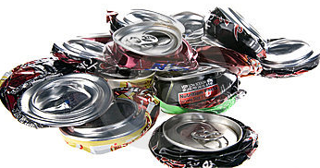
Criteria*:
Low cost
Light weight
Low force
High safety
Simple to manufacture
Needed Information* *:
Type of materials used
Typical existing devices in the market
Different can sizes
Mechanism for applying force
Notes:
* i.e. what you should focus on (even if listed in constraints precisely) or what should be the highlight/emphasis of the design
* * Also note how specifications not listed here; what should they be? Needed info. Will help you determine this

Slide 11
Need Analysis*
Example # 3
Statement: Need a device for securing a coffee cup near the driver's seat of an automobile
Coffee cup holder for car (near the driver seat)
Locking system to prevent the cup from spilling
It does not interfere with the proper operation of the car
Adaptable to a wide variety of vehicles
Detachable (designed to be unfastened or disconnected without damage)
Easy to use
Durable material for various temperatures
No need to modify car interior
Cost not exceed 50 SR
Flexibility of coffee cup size
Notes:
* At this point, you are deciding what is: O (P and S); CR, CT, S (if necessary)

Slide 12
Primary Objectives
A device for securing a coffee cup near the driver’s seat of an automobile
Secondary Objectives:
The device should be detachable
No modification of car interior is needed

Slide 13
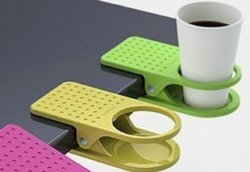
Constraints
Spilling free
Does not interfere with the driver
Size max: 200 x 150 x 150 mm (H x W x L)
Weight not to exceed 0.5 kg
Cost less than SR 50
2 years lifetime
Criteria
Simple
Easy to install and dispatch
Durable
Strong attachment to the car
High adaptability to car types
High adaptability to cup sizes

Slide 14
Problem Formulation
Design a simple device for securing a coffee cup near the driver’s seat of an automobile that prevents the cup from spilling. The device should not interfere with the proper operation of the driver and should be adaptable to a wide variety of vehicles and coffee cup size. The device should be easy to install and detach and no interior modification of the car should be needed. The maximum size and weight if the device are respectively 200 x 150 x 150 mm³ and 2 kg. It should also be durable, offering a minimum of two years lifetime and a cost of less than 50 SR.
Notes:
Again, note how the formulation consists usually of 4 to 5 sentences, and combines in a simple, clear methods various elements of the O, CR, CT, and Specs (is available).

Slide 15
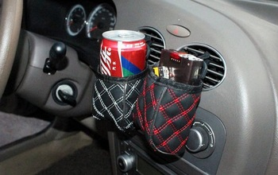
Needed Information*
Average amount of coffee in cup
Average coffee cup size and weight
Coffee cup material
General car interior layout/design
Temperature inside the car (max/min)
Available relevant holder designs in the market
Notes:
* i.e. what info you need to gather to start the project (as part of the need analysis)

