Slide 1
GE105
Introduction to Engineering Design College of Engineering
King Saud University
Lecture 4.
Engineering Functional Jobs
fall 2016
Notes:
Q: what do you want to do as soon as you graduate?

Slide 2
The Path to a Professional Engineer
BS/MS
Functional (job) Classification
Company Levels
Major
Specialization

Slide 3
Research
Experimental
Analytical
Design
Development
Testing
Operations
Sales/Marketing
Manufacturing
Management
Consulting
Construction
Production
The Path (contn’d)
Functional (Job)
Classification
BS/MS
For all Majors
Notes:
A given job title can be held by engineers of various disciplines.
A given Co. Level can be held by engineer of various Functional jobs

Slide 4
Engineering Functional Jobs
Title | Function | Skill/Knowledge
Research Eng. | Solves new problems. Obtains new data. Devises new methods of calculation Gains new knowledge | Perceptiveness Patience Self-Confidence
Analytical Eng. | Models physical problems using math to predict performance. Performs failure analysis | Math, physics, engineering science, software
Develop. Eng. | Develops products, processes, or systems Uses well-known principles and employs existing processes or machines to perform a new function Concerned only with a prototype or model | Ingenuity Creativity Judgment
Notes:
Failure analysis: تحليل الاخفاق

Slide 5
Engineering Functional Jobs (contn’d)
Title | Function | Skill/Knowledge
Design Eng. | Converts concepts and information into detailed plans and specs from which the finished product can be Manufactured Restricted by the state of the art | Creativity Innovation Knowledge of many disciplines Understanding of economics and people
Production Eng. | Devises a schedule to efficiently coordinate materials and personnel Orders raw materials at the optimum times Sets up the assembly line Handles and ships the finished product | Knowledge of design, economics, and psychology. Ability to visualize the overall operation of a project Knowledge of each step of the production effort

Slide 6
Engineering Functional Jobs (contn’d)
Title | Function | SKILLS/Knowledge
Test Eng. | Develops and conducts tests to verify that a new product meets design specs Products are tested for structural integrity, performance, and reliability Testing is performed under all expected environmental conditions | Knowledge of statistics, product and process specifications. Measurement techniques Fundamental engineering Aspects of the design
Operations or Plant Eng. | Selects sites for facilities Specifies the layout for all facets of the operation Selects the fixed equipment for climate control, lighting, and communication Responsible for maintenance and modifications | Industrial engineering Economics and law

Slide 7
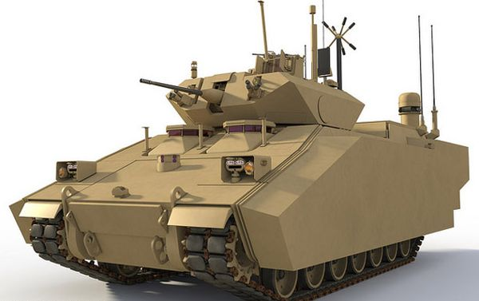
Engineering Career Path
There are at least seven career options for graduating engineering students:
Corporate ladder
Independent entrepreneur
Military or government
Engineering and social service board
Professor/engineer
Graduate work outside engineering
A mix of first six options
Notes:
Q: which do you want to take and why?
Entrepreneur: رجل الأعمال

Slide 8
Corporate Management
COB Chair of the Board of Directors
CEO=Chief Executive Officer
V.P. of …
Director of …
Officer
Company Levels (Publicly owned)
Management
Plant Mgt.
Functional Mgt.*
Project Mgt.
Line Mgt.
Engineering
Fellow*
Senior E.
Project E.
Advisory*
Staff*
Sr. Associate E.*
Engineer
“Entry Level”
*: Large companies
Notes:
Board of directors: مجلس الاداره
CEO: المدير التنفيذي

Slide 9
(Group A) Good Understanding of:
Group C A minimum of:
(Group B) Basic understanding of:
Golden Set of Skills for a Professional Engineer
Engineering science fundamentals: a. Physical and life sciences b. Information technology c. Math (including statistics)
The design and manufacturing process
Good communication skills:
Written
Verbal
Graphic
Listening
The context in which engineering is practiced, including:
Economics/business practice
History
The environment
Customer and social needs
A multidisciplinary systems perspective.
The importance of teamwork.
Ethical standards
Curiosity and a lifelong desire to learn (LLL)
Ability to think critically and creatively as well as independently and cooperatively
Flexibility, the ability, and the self-confidence to Adopt/Adapt
Notes:
Q: how do Group C engineers differ (you think) from Group B engineers?
A: usually, these are the ones that will move up the ladder more quickly, will contribute more to the company/institution, will better salaries, etc.

Slide 10
Other Directions
Advanced Degrees-Academic Institutions (Teaching, researching, publishing, community involvement)
Engineering Management (MSE/MBA)
Law (Patent law, Corporate Law)
Medicine (bioengineering)
Government, Defense
Engineering Consultant
Your Own Business
Notes:
CAN YOU THINK of any other directions?
Which of the above are the most risky (you think)? Most will say 6 and 7?

Slide 11
End Notes …
Understand that Engineering is a Profession
Become familiar with Code of Ethics of your Discipline
Join Student Engineering Societies
Join other Professional Organizations
There’s more to being an engineer than technical competence
Notes:
What does that last statement mean? Join student institutions, do extra curricular activities, attend/ participate in conferences (if you can), etc.
Code of Ethics: قواعد السلوك المهني

