Slide 1
Lecture 1. Course Introduction
GE105
Introduction to Engineering Design College of Engineering
King Saud University
Fall 2016

Slide 2
This course

Slide 3
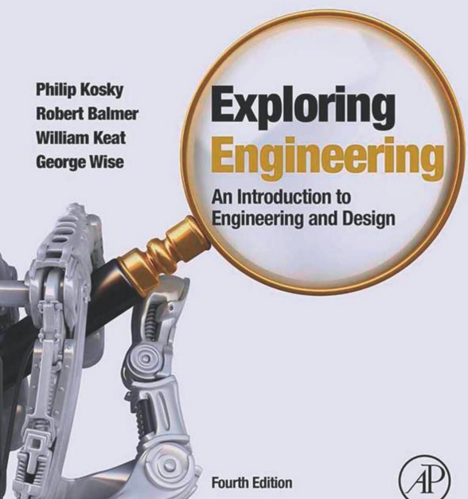
Information
Suggested Book
Exploring Engineering:
An Introduction to Engineering and Design (Fourth Edition)
By:
Philip Kosky , Robert T. Balmer , William D. Keat , George Wise
Credits: 2(1,1,2)
Prerequisites: GE104
Number of Sections: 12
Given By: 10 Professors
Your Instructor: Dr. Ahmed M. El-Sherbeeny
Meetings
Lecture : Sundays 8:00-8:50 am
Tutorial : Tuesdays 8:00-8:50 am
Studio : Sundays 1:00-2:50 pm,

Slide 4
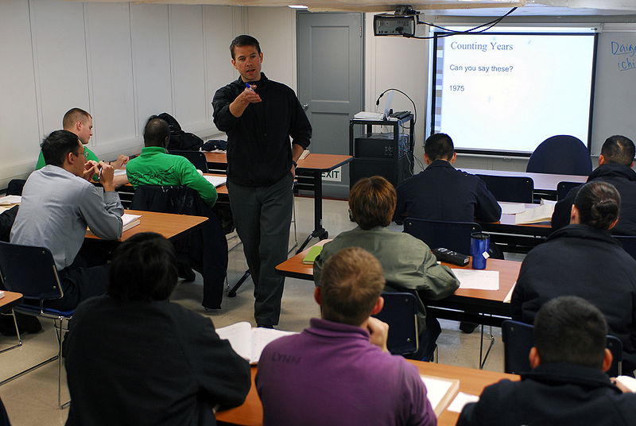
Lecturing Styles Used
Lecture : “Normal” Classes
Studios: Design project classroom activities practicing various skills intensive discussions group dynamics
Tutorials: Help with homework assignments and exams Solving problems

Slide 5
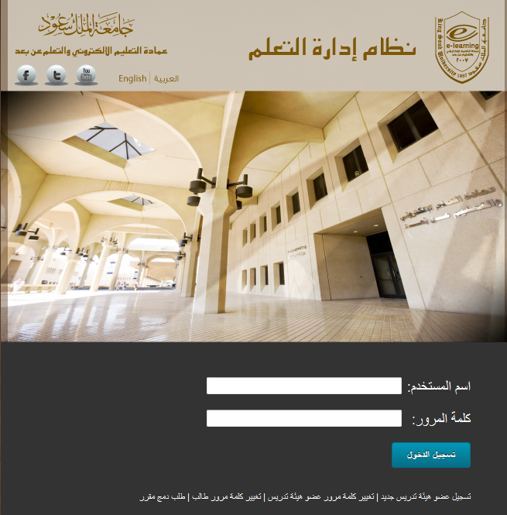
Sources of Assistance
Your Instructor
Office number 2A128/1
Office hours posted
Email: aelsherbeeny@ksu.edu.sa
Your Teaching Assistant
Lectures slides
Studios slides
Course materials on website (http://fac.ksu.edu.sa/aelsherbeeny)
Your Textbook
Prince Salman Library
Internet

Slide 6
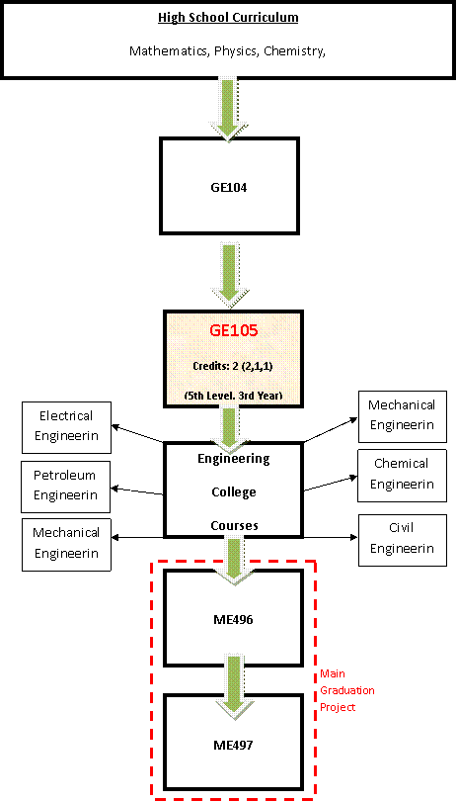
Relation to Other Courses
Engineering Specializations requiring GE105:
Mechanical Engineering
Electrical Engineering
Petroleum and Gas Engineering
Civil Engineering
Chemical Engineering
Industrial Engineering (currently under consideration)
g
g
g
g
GE105 provides the basics for the final year project and gives the necessary skills for an engineering student
g
g
EE496/ME496
EE497/ME497

Slide 7
Course Objectives
Formally Expose students to the engineering field
Grasp the values of professionalism, ethics, safety, intellectual property, environment, and human factors.
Introduce the design process, problem-solving skills, and practices dealing with open-ended problems
Enforce the skills in teamwork, group dynamics, critical thinking, planning, scheduling, and written/oral communications through the design project

Slide 8
Course Outline (Topics)
An Overview of Engineering Design
The Engineering Profession
Engineering Need Analysis
Problem Formulation
Creativity in Design : Thinking Outside the box
Concept Generation and Evaluation
Human Factors Engineering
Intellectual Property – Legal Factors
Engineering Ethics

Slide 9
Learning Outcomes (1. Knowledge)
Ability to use the engineering design process to carry out a project.
Ability to prepare a need-assessment, define and formulate the problem, consider the problem constraints, and specify a deliverable for a project.
Ability to solve open-ended design problems, cope with decision making and satisfy competing objectives.
Ability to synthesize gathered information to solve open-ended problems.
Ability to conceptualize alternative concepts, evaluate and select preferred alternative, and implement the preferred design using engineering tools.
Understand the importance of professional and ethical responsibility.
Understand ethics, environmental and legal issues.

Slide 10
Learning Outcomes (2. Cognitive Skills)
Ability to apply design heuristic of recognition of the problem, problem definition, design criteria, and design constraints
Ability to apply creative techniques to generate alternative solutions (concepts)
Ability to apply procedures to evaluate the solutions and select the "best" solution, decide on a course of action and implement the selected solution
Ability to synthesize and critically judge the relevant gathered information to solve open-ended problems
Ability to exercise professional and ethical responsibility in carrying out the design project
Ability to consider human factors and legal factors in the design problems

Slide 11
Learning Outcomes (3. Interpersonal Skills)
Ability to take the responsibility to solve given assignments on your own and submit the solution on time.
Ability to engage and work effectively in teams with full group interaction during the work on the design project, exercise full responsibility in holding team meetings, distributing tasks, leadership and team dynamics.
Ability to manage the time between self study, solving assignments, carrying out the design project activities, and submitting project reports.
Ability to find out the proper action when confronted with engineering ethical problems.

Slide 12
Grading
Classwork: 15%
Tutorial : 10%
Design Project: 35%
Presentation 15%
Report 10%
Poster 5%
Logbook 5%
Final Exam: 40%
Total 100%
Required From Students
Attendance ON TIME!!!
Assignments submitted on time
Contributing to all open classroom discussions
Quizzes
Design Project
Studios
Teamwork
Meeting Logs Retention (logbook)
Project Report
Joint Presentation
Final Exam
Produce Results Not Excuses!
Work Hard and
Enjoy the Course

