Slide 1
Authentication
CT1405 Lecture 6

Slide 2
Objectives
Describe the three types of authentication credentials
Explain what single sign-on can do
List the account management procedures for securing passwords
Define trusted operating systems

Slide 3
Introduction
Authentication
Process of ensuring a person desiring to access resources is authentic
Chapter topics
Authentication and secure management of user accounts
Different types of authentication credentials
Single sign-on
Techniques and technology to manage user accounts securely
Trusted operating systems

Slide 4
Authentication Credentials
Types of authentication credentials
What you have
Example: key fob to lock your car
What you are
Example: facial characteristics recognized by health club attendant
What you know
Example: combination to health club locker

Slide 5
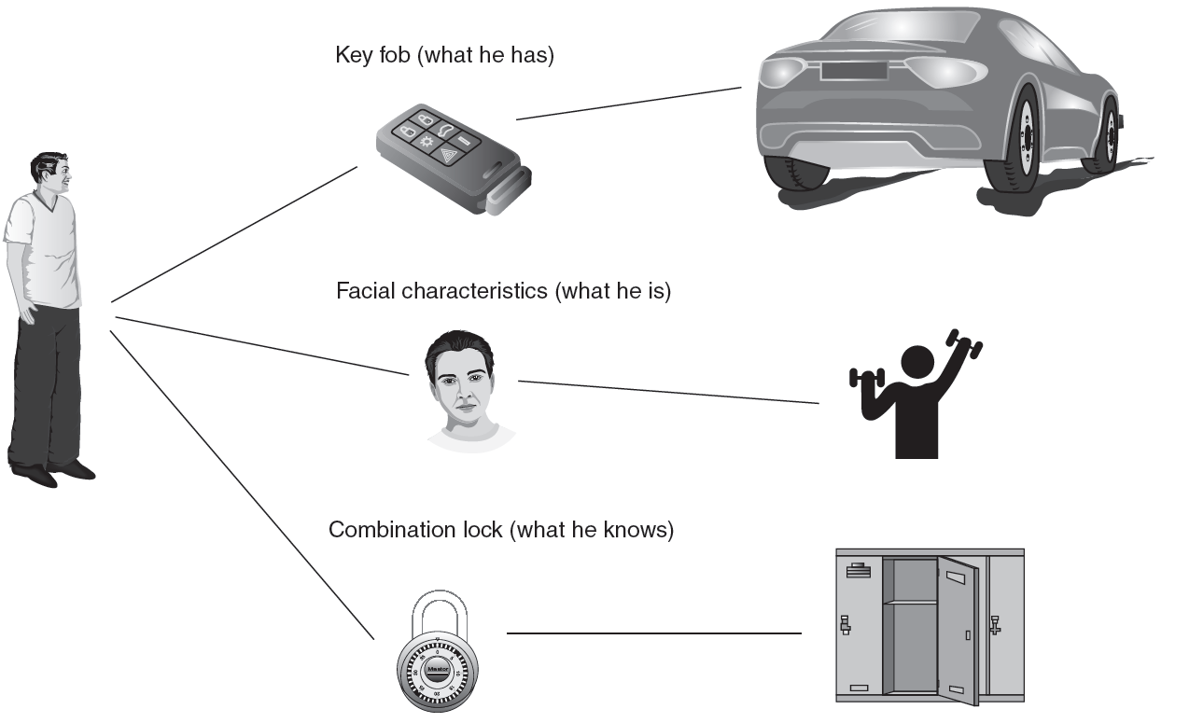
Figure 10-1 Authentication credentials
© Cengage Learning 2012

Slide 6
What You Know: Passwords
User logging in to a system
Asked to identify himself
User enters username
User asked to authenticate
User enters password
Passwords are most common type of authentication today
Passwords provide only weak protection

Slide 7
Password Weaknesses
Weakness of passwords is linked to human memory
Humans can only memorize a limited number of items
Long, complex passwords are most effective
Most difficult to memorize
Users must remember passwords for many different accounts
Security policies mandate passwords must expire
Users must repeatedly memorize passwords

Slide 8
Password Weaknesses (cont’d.)
Users often take shortcuts
Using a weak password
Examples: common words, short password, or personal information
Reuse the same password for multiple accounts
Easier for attacker who compromises one account to access others

Slide 9
Attacks on Passwords
Social engineering
Phishing, shoulder surfing, dumpster diving
Capturing
Keylogger, protocol analyzer
Man-in-the-middle and replay attacks
Resetting
Attacker gains physical access to computer and resets password
Online guessing
Not really practical

Slide 10
Attacks on Passwords (cont’d.)
Offline cracking
Method used by most password attacks today
Attackers steal file with encrypted password
Compare with encrypted passwords they have created
Offline cracking types
Brute force
Every possible combination of letters, numbers, and characters used to create encrypted passwords and matched against stolen file
Slowest, most thorough method

Slide 11
Attacks on Passwords (cont’d.)
Automated brute force attack program parameters
Password length
Character set
Language
Pattern
Skips
Dictionary attack
Attacker creates encrypted versions of common dictionary words
Compares against stolen password file

Slide 12
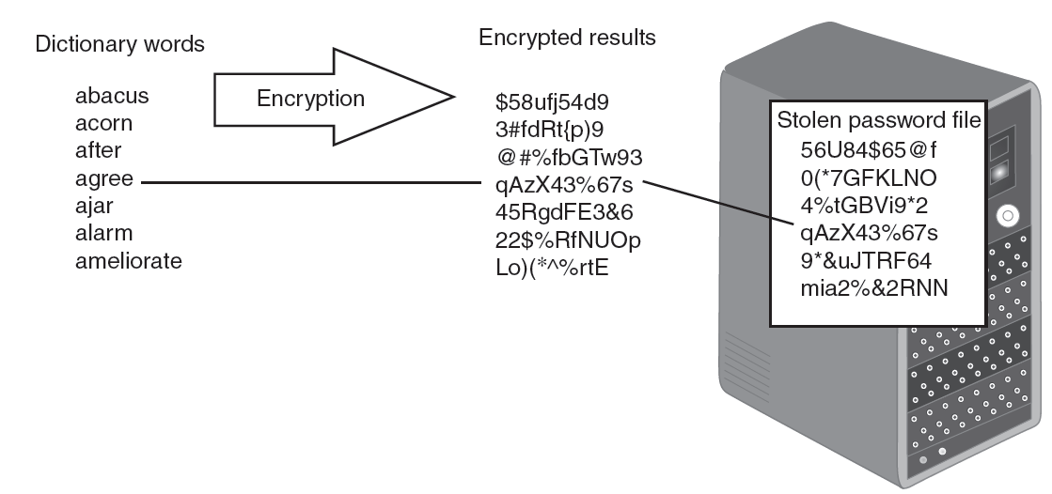
Figure 10-2 Dictionary attack
© Cengage Learning 2012

Slide 13
Attacks on Passwords (cont’d.)
Hybrid attack
Slightly alter dictionary words
Adding numbers to the end of the password
Spelling words backward
Slightly misspelling words
Including special characters
Rainbow tables
Large pregenerated data set of encrypted passwords

Slide 14
Attacks on Passwords (cont’d.)
Steps for using a rainbow table
Creating the table
Chain of plaintext passwords
Encrypt initial password
Feed into a function that produces different plaintext passwords
Repeat for a set number of rounds
Using the table to crack a password
Run encrypted password though same procedure used to create initial table
Results in initial chain password

Slide 15
Attacks on Passwords (cont’d.)
Using the table to crack a password (cont’d.)
Repeat, starting with this initial password until original encryption is found
Password used at last iteration is the cracked password
Rainbow table advantages over other attack methods
Can be used repeatedly
Faster than dictionary attacks
Less machine memory needed

Slide 16
Password Defenses
Creating strong passwords
Insight into how to create strong passwords gained by examining attack methods
Most passwords consist of:
Root
Attachment
Prefix or suffix
Attack program method
Tests password against 1000 common passwords

Slide 17
Password Defenses (cont’d.)
Attack program method (cont’d.)
Combines common passwords with common suffixes
Uses 5000 common dictionary words, 10,000 names, 100,000 comprehensive dictionary words
Uses lowercase, initial uppercase, all uppercase, and final character uppercase
Makes common substitutions for letters in the dictionary words
Examples: $ for s, @ for a

Slide 18
Password Defenses (cont’d.)
General observations to create strong passwords
Do not use dictionary words or phonetic words
Do not use birthdays, family member or pet names, addresses or any personal information
Do not repeat characters or use sequences
Do not use short passwords
Managing passwords
One important defense: prevent attacker from obtaining encrypted password file

Slide 19
Password Defenses (cont’d.)
Managing passwords (cont’d.)
Defenses against password file theft
Do not leave computer unattended
Screensavers should be set to resume with a password
Password protect the ROM BIOS
Physically lock the computer case so it cannot be opened
Good password management practices
Change passwords frequently
Do not reuse old passwords

Slide 20
Password Defenses (cont’d.)
Good password management practices (cont’d.)
Never write password down
Use unique passwords for each account
Set up temporary password for another user’s access
Do not allow computer to automatically sign in to an account
Do not enter passwords on public access computers
Never enter a password while connected to an unencrypted wireless network

Slide 21
Password Defenses (cont’d.)
Other guidelines
Use non-keyboard characters
Created by holding down ALT key while typing a number on the numeric keypad
Password supplements
Problem: managing numerous strong passwords is burdensome for users
One solution: rely on technology to store and manage passwords

Slide 22
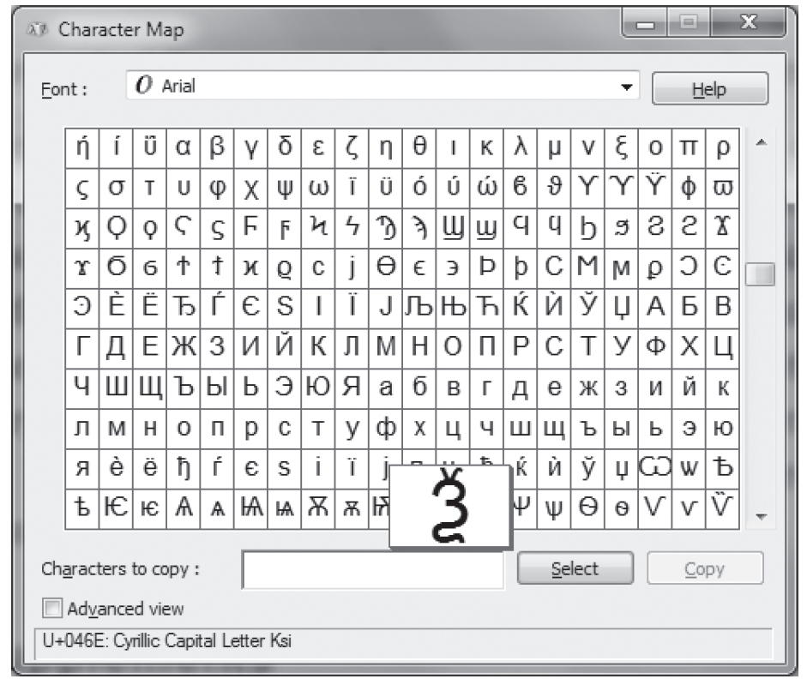
Figure 10-3 Windows character map
© Cengage Learning 2012

Slide 23
Password Defenses (cont’d.)
Password supplements (cont’d.)
Internet Explorer (IE) and Firefox Web browsers contain function that allows user to save passwords
AutoComplete Password in IE
Encrypted and stored in Windows registry
Disadvantages of password supplements
Password information specific to one computer
Passwords vulnerable if another user allowed access to the computer

Slide 24
Password Defenses (cont’d.)
Password management applications
User creates and stores passwords in single user “vault” file protected by one strong master password
Password management application features
Drag and drop capability
Enhanced encryption
In-memory protection prevents OS cache from being exposed
Timed clipboard clearing

Slide 25
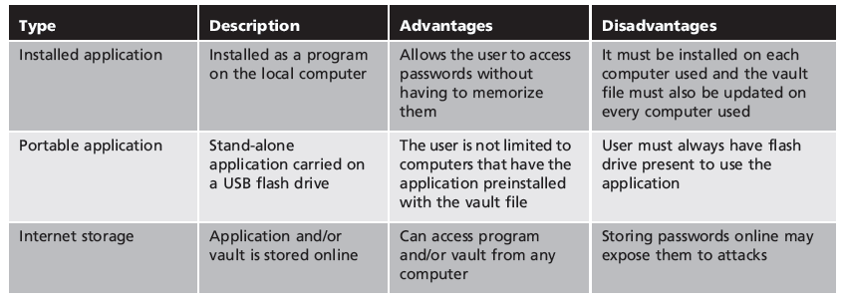
Table 10-1 Password management applications

Slide 26
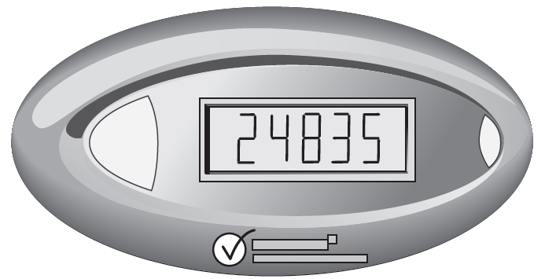
What You Have: Tokens and Cards
Tokens
Small devices with a window display
Synched with an authentication server
Code is generated from an algorithm
Code changes every 30 to 60 seconds
Figure 10-4 Token
© Cengage Learning 2012

Slide 27
What You Have: Tokens and Cards (cont’d.)
User login steps with a token
User enters username and code from token
Authentication server looks up algorithm associated with that user, generates its own code, and compares it to user’s code
If a match, user is authenticated
Advantages over passwords
Token code changes frequently
Attacker would have to crack code within time limit

Slide 28
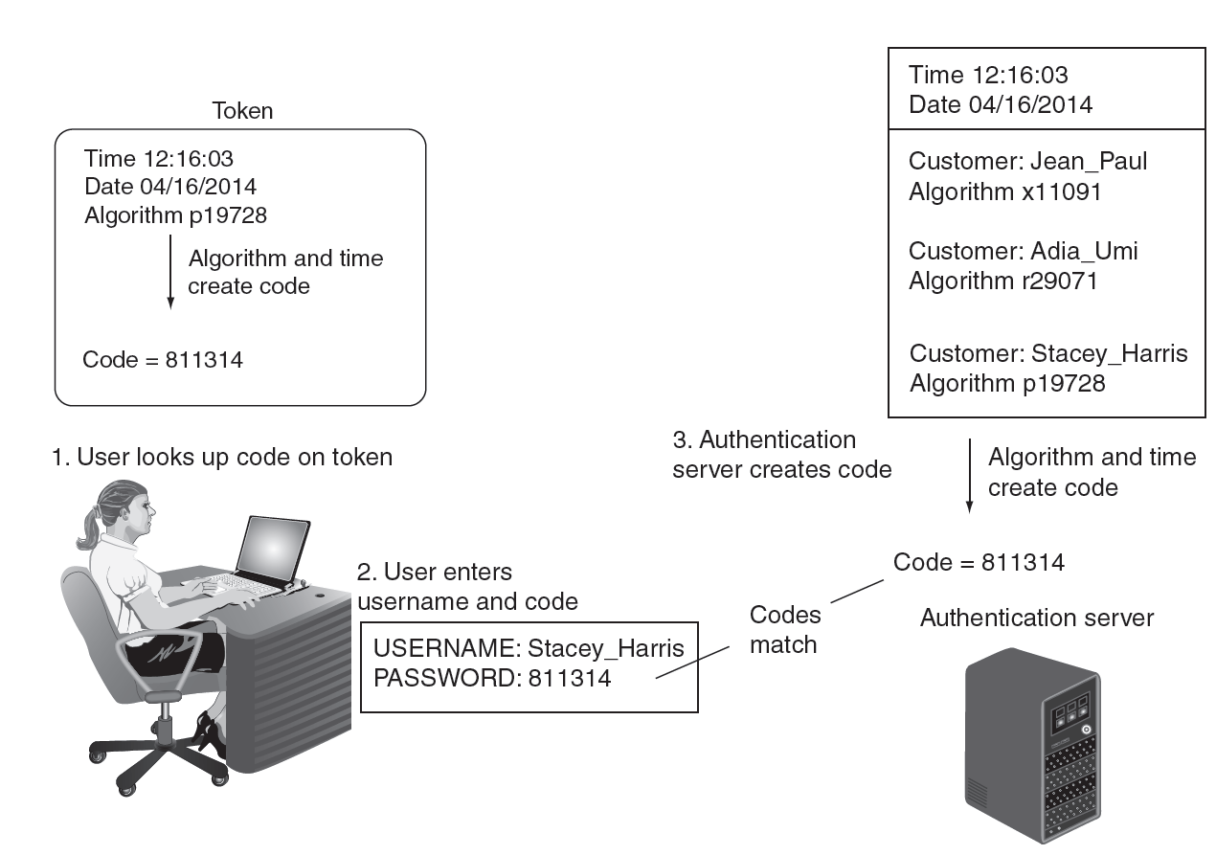
Figure 10-5 Code generation and comparison
© Cengage Learning 2012

Slide 29
What You Have: Tokens and Cards (cont’d.)
Advantages over passwords (cont’d.)
User may not know if password has been stolen
If token is stolen, it becomes obvious
Steps could be taken to disable account
Token system variations
Some systems use token code only
Others use code in conjunction with password
Some combine PIN with token code

Slide 30
What You Have: Tokens and Cards (cont’d.)
Cards
Smart card contains integrated circuit chip that holds information
Contact pad allows electronic access to chip contents
Contactless cards
Require no physical access to the card
Common access card (CAC)
Issued by US Department of Defense
Bar code, magnetic strip, and bearer’s picture

Slide 31
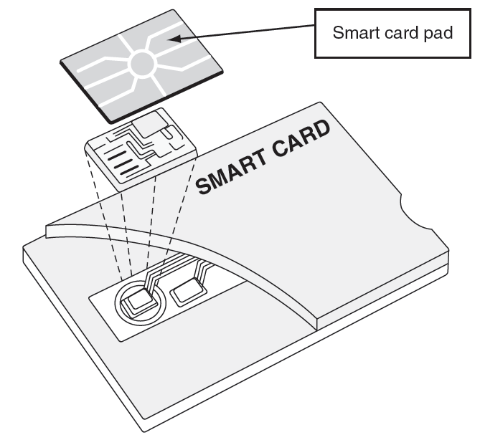
Figure 10-6 Smart card
© Cengage Learning 2012

Slide 32
What You Are: Biometrics
Standard biometrics
Uses person’s unique physical characteristics for authentication
Fingerprint scanners most common type
Face, hand, or eye characteristics also used
Fingerprint scanner types
Static fingerprint scanner
Takes picture and compares with image on file
Dynamic fingerprint scanner
Uses small slit or opening

Slide 33
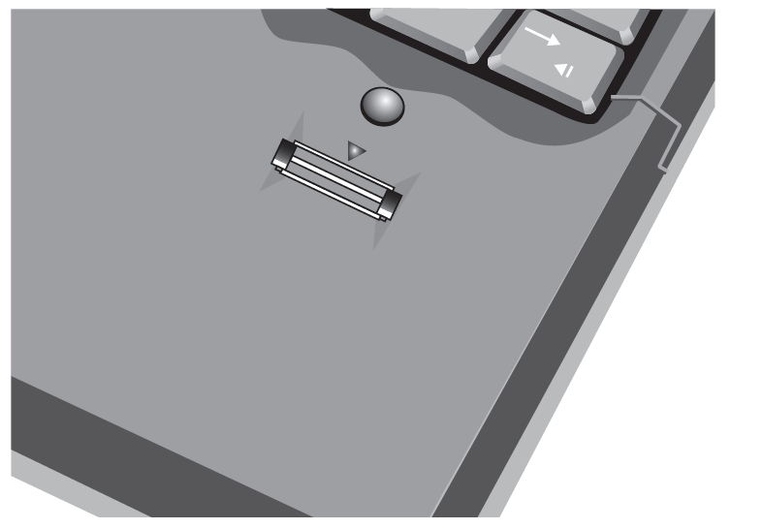
Figure 10-7 Dynamic fingerprint scanner
© Cengage Learning 2012

Slide 34
What You Are: Biometrics (cont’d.)
Disadvantages of standard biometrics
Cost of hardware scanning devices
Readers have some amount of error
Reject authorized users – false positive
Accept unauthorized users – false negative
Privacy Concerns:
http://www.reuters.com/article/2011/07/20/us-crime-identification-iris-idUSTRE76J4A120110720
Behavioral biometrics
Authenticates by normal actions the user performs
Keystroke dynamics
Voice recognition
Computer footprinting

Slide 35
What You Are: Biometrics (cont’d.)
Keystroke dynamics
Attempts to recognize user’s typing rhythm
All users type at a different pace
Provides up to 98 percent accuracy
Uses two unique typing variables
Dwell time (time it takes to press and release a key)
Flight time (time between keystrokes)

Slide 36
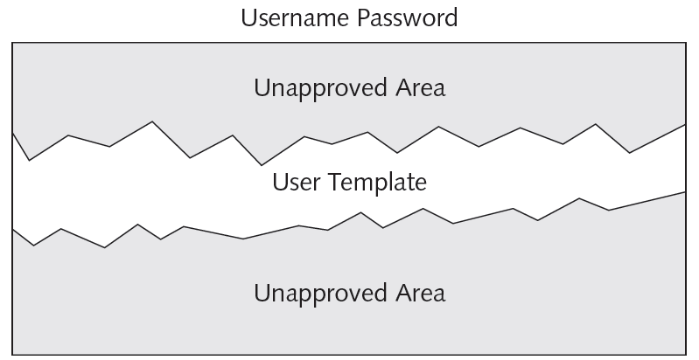
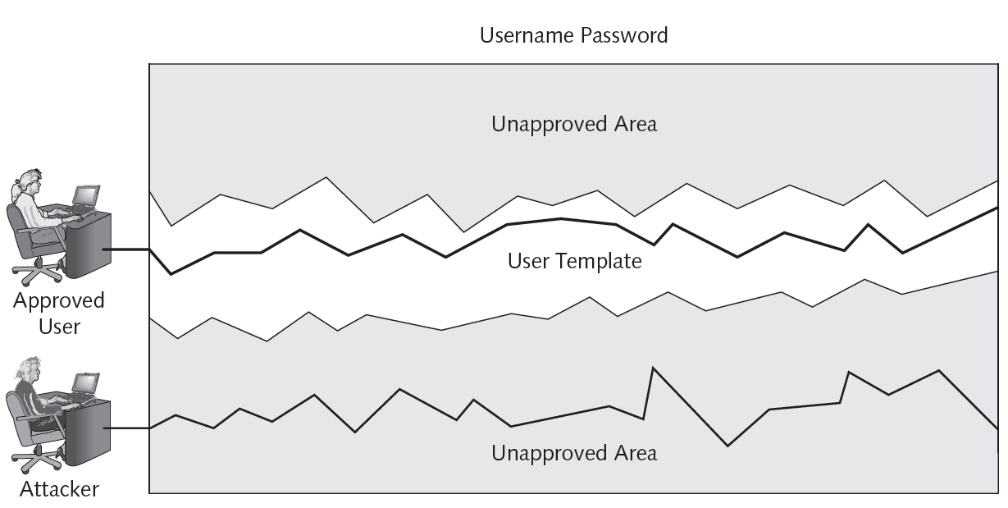
Figure 10-8 Typing template
© Cengage Learning 2012
Figure 10-9 Authentication by keystroke dynamics
© Cengage Learning 2012

Slide 37
What You Are: Biometrics (cont’d.)
Voice recognition
Several characteristics make each person’s voice unique
Voice template can be created
Difficult for an attacker to authenticate using a recording of user’s voice
Phonetic cadence of putting words together is part of real speech pattern

Slide 38
What You Are: Biometrics (cont’d.)
Computer footprinting
Relies on typical access patterns
Geographic location
Time of day
Internet service provider
Basic PC configuration

Slide 39
What You Are: Biometrics (cont’d.)
Cognitive biometrics
Relates to perception, thought process, and understanding of the user
Easier for user to remember because it is based on user’s life experiences
Difficult for an attacker to imitate
Example: identifying specific faces
Example: user selects memorable lifetime events and is asked for details about them
Predicted to become a key element of authentication in the future

Slide 40
Single Sign-On
Identity management
Using a single authentication credential shared across multiple networks
Called federated identity management (FIM) when networks are owned by different organizations
Single sign-on (SSO) holds promise to reduce burden of usernames and passwords to just one

Slide 41
Windows Live ID
Introduced in 1999 as .NET passport
Name changed to Microsoft Passport Network, then Windows Live ID
Designed as an SSO for Web commerce
Authentication process
User enters username and password
User given time limited “global” cookie stored on computer with encrypted ID tag
ID tag sent to Web site

Slide 42
Windows Live ID (cont’d.)
Authentication process (cont’d.)
Web site uses ID tag for authentication
Web site stores encrypted, time-limited “local” cookie on user’s computer
Windows Live ID was not widely supported
Currently used for authentication on:
Windows Live, Office Live, Xbox Live, MSN, and other Microsoft online services

Slide 43
OpenID
Decentralized open source FIM
Does not require specific software to be installed on the desktop
URL-based identity system
OpenID provides a means to prove a user owns the URL
Authentication process
User goes to free site and given OpenID account of Me.myopenID.com

Slide 44
OpenID (cont’d.)
Authentication process (cont’d.)
User visits Web commerce or other site and signs in using his Open ID
Site redirects user to MyOpenID.com where he enters password to authenticate
MyOpenID.com sends him back to Web site, now authenticated
Security weaknesses
Relies on DNS which may have own weaknesses
Not considered strong enough for most banking and e-commerce Web sites

Slide 45
Open Authorization (OAuth)
Permits users to share resources stored on one site with a second site
Without forwarding authentication credentials
Allows seamless data sharing among sites
Relies on token credentials
Replaces need to transfer user’s username and password
Tokens are for specific resources on a site
For a limited time period

Slide 46
Account Management
Managing user account passwords
Can be done by setting password rules
Too cumbersome to manage on a user-by-user basis
Security risk if one user setting is overlooked
Preferred approach: assign privileges by group
Microsoft Windows group password settings
Password Policy Settings
Account Lockout Policy

Slide 47
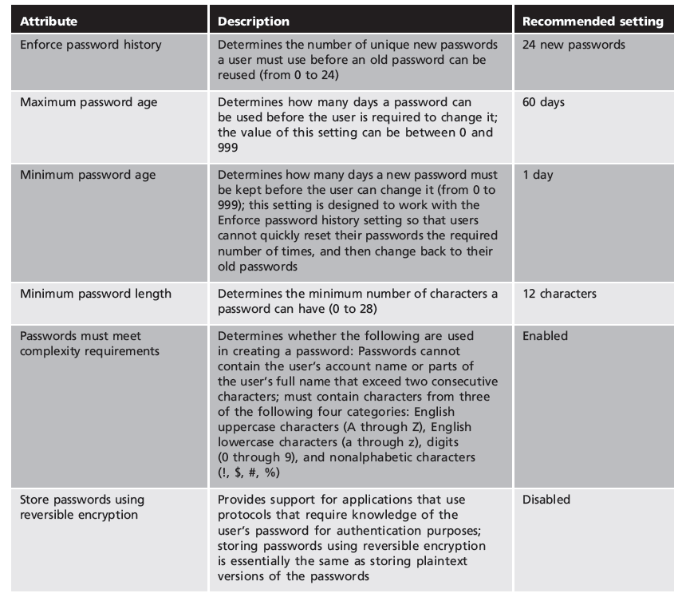
Table 10-2 Password policy settings (Windows group policy)

Slide 48
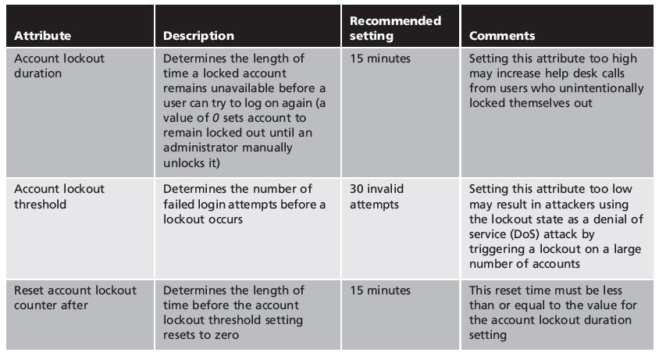
Table 10-3 Account lockout policy settings (Windows Active Directory)

Slide 49
Trusted Operating Systems
Operating system basic flaws
Size: millions of lines of code make vulnerabilities difficult to recognize
One compromised application can impact entire computer
Applications cannot authenticate themselves to each other
No trusted path between users and applications
Operating systems do not use principle of least privilege

Slide 50
Trusted Operating Systems (cont’d.)
Trusted operating system (trusted OS)
OS designed to be secure from the ground up
Can keep attackers from accessing critical parts of the system
Can prevent administrators from inadvertently making harmful changes
Vendors developing trusted OSs
Focusing on securing OS components and other platform elements
One approach: compartmentalize services within trusted OS for individual customers

Slide 51
Summary
Authentication credentials can be classified into three categories: what you know, what you have, and what you are
Passwords provide a weak degree of protection
Must rely on human memory
Most password attacks today use offline cracking
Attackers steal encrypted password file
A token is a small device that generates a code from an algorithm once every 30 to 60 seconds

Slide 52
Summary (cont’d.)
Biometrics bases authentication on characteristics of an individual
Standard, behavioral, and cognitive biometrics
Single sign-on allows a single username and password to gain access to all accounts
Group Policy settings allow an administrator to set password restrictions for an entire group at once
Trusted operating systems are designed for security from the ground up

Slide 53
References
Security+ Guide to Network Security Fundamentals, Fourth Edition

