Slide 1
HTML – Tables and Forms
Lecture 5
Sara Almudauh

Slide 2
HTML Tables
Tables represent tabular data
A table consists of one or several rows
Each row has one or more columns
Tables comprised of several core tags:
<table></table>: begin / end the table <tr></tr>: create a table row <td></td>: create tabular data (cell)

Slide 3
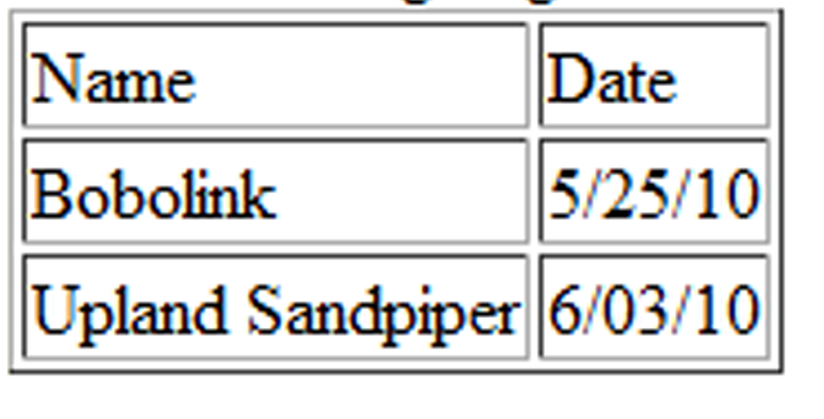
HTML Tables
<table> Contains the table and end with </table>
<tr> Contains a table row and end with </tr>
<td> Contains a table data cell and end with </td>. The table cell can contain text, graphics and other HTML elements.

Slide 4
Start and end of a table
Start and end of a row
Start and end of a cell in a row
<table> ... </table>
<tr> ... </tr>
<td> ... </td>

Slide 5
HTML Tables
We code the table row by row and then each row is coded cell by cell:
<table border="1”>
<tr>
<td>Name</td>
<td>Date</td>
</tr>
<tr>
<td>Bobolink</td>
<td>5/25/10</td>
</tr>
<tr>
<td>Upland Sandpiper</td>
<td>6/03/10</td>
</tr>
</table>
By default there is no border. We will add the border property in the HTML to display it in this practice only. Adding the border property to your html is obsolete in html5 but valid in XHTML. We will later use the border property in CSS.

Slide 6
HTML Tables heading
Similar to the table data element, but its purpose is to configure columns and rows headings.
The text will be displayed as Center and Bold.
Starts with <th> and ends with </th> instead of <td> tags.

Slide 7
HTML Tables
<table border="1">
<tr>
<th>Name</th>
<th>Birthday</th>
</tr>
<tr>
<td>James</td>
<td>11/08</td>
</tr>
<tr>
<td>Karen</td>
<td>4/17</td>
</tr>
<tr>
<td>Sparky</td>
<td>11/28</td>
</tr>
</table>
Using the <th> Element

Slide 8
HTML Tables caption
<caption> Configures a description of the table and ends with </caption>
Used to describe the data table content.
By default the caption displayed above the table. (later we will configure the placement of the caption with CSS)
How to code? In the line immediately after the <table> tag

Slide 9
HTML Tables
<table border="1">
<caption> Bird Sightings </caption>
<tr>
<th>Name</th>
<th>Birthday</th>
</tr>
<tr>
<td>James</td>
<td>11/08</td>
</tr>
<tr>
<td>Karen</td>
<td>4/17</td>
</tr>
<tr>
<td>Sparky</td>
<td>11/28</td>
</tr>
</table>

Slide 10
HTML Tables
Create a table that describes two schools you have attended.
Use the caption “school history”
The table has three rows and three columns
First row will have table header elements:
School attended Years Degree Awarded
Use border=“1” property

Slide 11
Your table should look like this

Slide 12
HTML Tables

Slide 13
HTML Common Table Attributes
align (obsolete)
bgcolor (obsolete)
border (obsolete)
cellpadding (obsolete)
cellspacing (obsolete)
summary (obsolete but may be reinstated)
width (obsolete)
Use CSS to configure table characteristics instead of HTML attributes

Slide 14
HTML colspan Attribute
Number of columns that a cell will occupy
<table border="1">
<tr>
<td colspan=“2”> Birthday List</td>
</tr>
<tr>
<td>James</td>
<td>11/08</td>
</tr>
<tr>
<td>Karen</td>
<td>4/17</td>
</tr>
</table>

Slide 15
HTML rowspan Attribute
Number of rows that a cell will occupy
<table border="1">
<tr>
<td rowspan="2">This spans two rows</td>
<td>Row 1 Column 2</td>
</tr>
<tr>
<td>Row 2 Column 2</td>
</tr>
</table>
2 td
1 td

Slide 16
Modify the table you created in Practice 1 to look like this:

Slide 17
HTML Tables

Slide 18
Using CSS to Style a Table
HTML Attribute | CSS Property
Align X | Align a table: table { width: 75%; margin: auto; } Align items within a table cell: text-align
Bgcolor X | background-color
Cellpadding X | padding
Cellspacing X | border-spacing or border-collapse
height | height
Valign X | vertical-align: the vertical placement of content values: sub, super, top, text-top, text-bottom, middle
width | width
Border X | border, border-style, or border-spacing
-- | background-image
-- | Caption-side specifies the placement of the caption. Values: top and bottom

Slide 19
HTML Tables
Before the CSS
After the CSS

Slide 20
The CSS

Slide 21
HTML Tables
Table rows split into three semantic sections: header, body and footer
<thead> denotes table header and contains <th> elements, instead of <td> elements
<tbody> denotes collection of table rows that contain the very data
<tfoot> denotes table footer but comes BEFORE the <tbody> tag
<colgroup> and <col> define columns (most often used to set column widths)

Slide 22
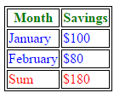
Table Row Groups
<thead> table head rows
<tfoot> table footer rows
<tbody > table body rows. Required if you configure thead or tfoot. Thead & tfoot section must be coded before tbody

Slide 23
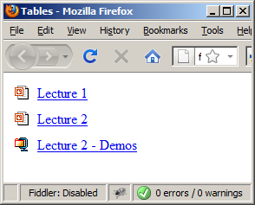
Example
<table cellspacing="0" cellpadding="5">
<tr>
<td><img src="ppt.gif"></td>
<td><a href="lecture1.ppt">Lecture 1</a></td>
</tr>
<tr>
<td><img src="ppt.gif"></td>
<td><a href="lecture2.ppt">Lecture 2</a></td>
</tr>
<tr>
<td><img src="zip.gif"></td>
<td><a href="lecture2-demos.zip">
Lecture 2 - Demos</a></td>
</tr>
</table>

Slide 24
Example
<table>
<colgroup>
<col style="width:100px" /><col />
</colgroup>
<thead>
<tr><th>Column 1</th><th>Column 2</th></tr>
</thead>
<tfoot>
<tr><td>Footer 1</td><td>Footer 2</td></tr>
</tfoot>
<tbody>
<tr><td>Cell 1.1</td><td>Cell 1.2</td></tr>
<tr><td>Cell 2.1</td><td>Cell 2.2</td></tr>
</tbody>
</table>
columns
header
th
footer
Last comes the body (data)

Slide 25
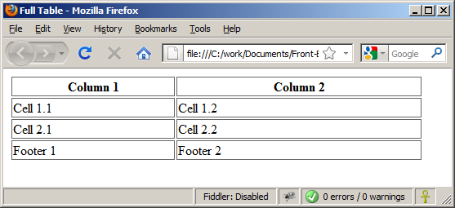
By default, header text is bold and centered.
<table>
<colgroup>
<col style="width:200px" /><col />
</colgroup>
<thead>
<tr><th>Column 1</th><th>Column 2</th></tr>
</thead>
<tfoot>
<tr><td>Footer 1</td><td>Footer 2</td></tr>
</tfoot>
<tbody>
<tr><td>Cell 1.1</td><td>Cell 1.2</td></tr>
<tr><td>Cell 2.1</td><td>Cell 2.2</td></tr>
</tbody>
</table>
Although the footer is before the data in the code, it is displayed last

Slide 26
<colgroup>
<table> <colgroup> <col span="2" style="background-color:red"> <col style="background-color:yellow"> </colgroup> <tr> <th>ISBN</th> <th>Title</th> <th>Price</th> </tr> <tr> <td>3476896</td> <td>My first HTML</td> <td>$53</td> </tr> </table>

Slide 27
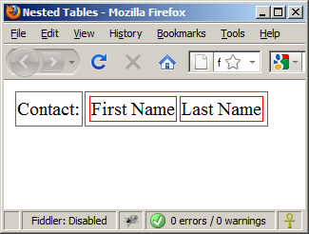
Tables
Table data “cells” (<td>) can contain nested tables (tables within tables):
<table>
<tr>
<td>Contact:</td>
<td>
<table>
<tr>
<td>First Name</td>
<td>Last Name</td>
</tr>
</table>
</td>
</tr>
</table>

Slide 28
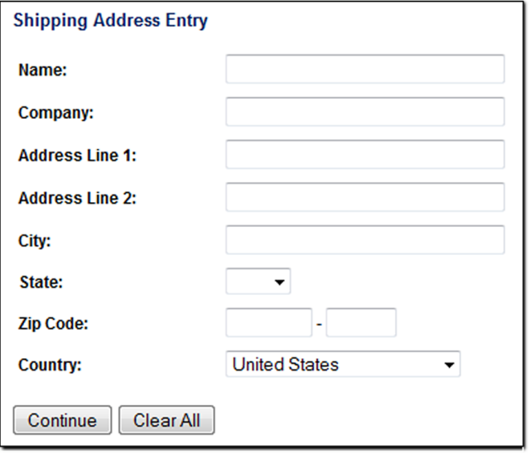
Overview of Forms
Form
An HTML element that contains and organizes
form controls such as text boxes, check boxes, and buttons that can accept information from website visitors.

Slide 29
Two Components of Using Forms
1. The HTML form
-- the web page user interface
and
2. The server-side processing
Server-side processing works with the form data and sends e-mail, writes to a text file, updates a database, or performs some other type of processing on the server.

Slide 30
HTML Using Forms
<form>
Contains the form elements on a web page
Container tag ends with </form>
Form elements cannot be nested inside each other
<input>
Configures a variety of form elements including text boxes, radio buttons, check boxes, and buttons
Stand alone tag
<textarea>
Configures a scrolling text box
Container tag ends with </textarea>
<select>
Configures a select box (drop down list)
Container tag ends with </select>
<option>
Configures an option in the select box
Container tag ends with </option>

Slide 31
Form control elements

Slide 32
HTML form element
The form element attributes:
action
URL or file name/path
Required
Specifies the server-side program or script that will process your form data
method
get – default value, form data passed in URL
post – more secure, form data passed in HTTP Entity Body
name
Identifies the form
id
Identifies the form
Autocomplete
Default value yes. Values: on & off.
<form name=“order” method=“post” id=“order” action=“demo.php>
…form controls go here…
</form>

Slide 33
HTML form Controls
1. The input element: <input>
A stand alone tag used to configure several different types of form controls.
Use the type attribute to specify the type of the form controls

Slide 34
Input Text box
<input>
Accepts text information
Attributes:
type=“text”
name
id
Size: numeric value
Maxlength: numeric value
Value: text or numeric characters, assigns an initial value to the textbox
readonly: display only and cannot be edited
autocomplete
autofocus
Placeholder: text or numeric, brief info to assist the user
required: value is “required”
Accesskey: keyboard characters
tabindex: numeric, tab key order

Slide 35
Why use both name & id?
The name attribute so it can be easily accessed by the client-side scripting language such as JavaScript or by server-side processing such as PHP.
The id is for CSS & scripting.
The values assigned to the name or id attribute on a particular element are the same.

Slide 36
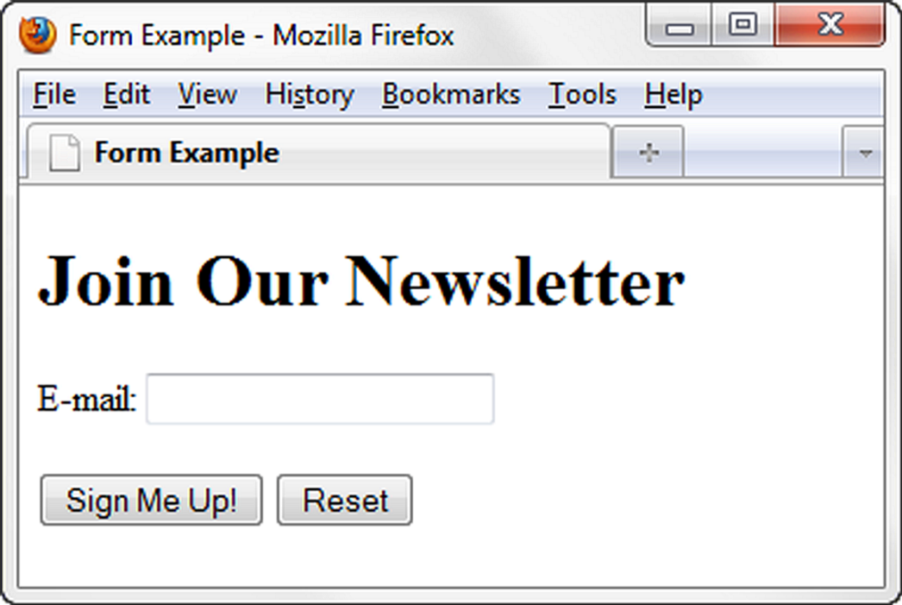
Sample Form HTML
<form>
E-mail: <input type="text" name ="email" id="email"><br> <input type="submit"> <input type=“reset">
</form>

Slide 37
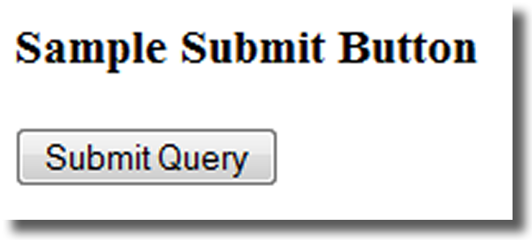
input Submit Button
<input>
Submits the form information
When clicked:
Triggers the action method on the <form> tag
Sends the form data (the name=value pair for each form element) to the web server.
Attributes:
type=“submit”
name
id
Value: configures the text displays on the button
e.g <input type=“submit”>

Slide 38
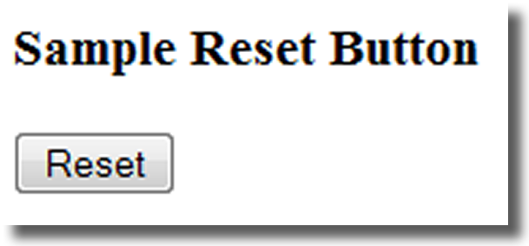
input Reset Button
<input>
Resets the form fields to their initial values
Attributes:
type=“reset”
name
id
Value: configures the text displays on the button
e.g <input type=“reset”>

Slide 39
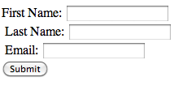
Hands-On Practice1
Create this form:

Slide 40
The code
______________________________________________________
Add the attribute value of to the submit button and render your page
<input type=“submit” value=“Sign Up”>

Slide 41
input Password box
<input>
Accepts text information that needs to be hidden as it is entered
Different browsers use different symbols (shown as asterisks or circles)
Attributes:
type=“password”
name
id
Size
maxlength
e.g Password: <input type=“password” name=“pword” id=“pword”>

Slide 42
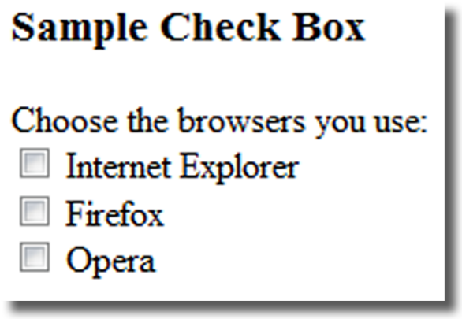
input Check box
<input>
Allows the user to select one or more of a group of predetermined items
Attributes:
type=“checkbox”
name
Id
checked: value of “checked”
value: The value attribute defines this value which is send by a post request. All check boxes can have the same value
Required
readonly
autofocus
accesskey
tabindex
e.g <input type="checkbox" name=”IE” id=“IE” value=“yes">Internet Explorer<br>
<input type="checkbox" name=”Firefox” id=“Firefox” value=“yes">Firefox<br>
<input type="checkbox" name=”Opera” id=“opera” value=“yes">Opera<br>

Slide 43
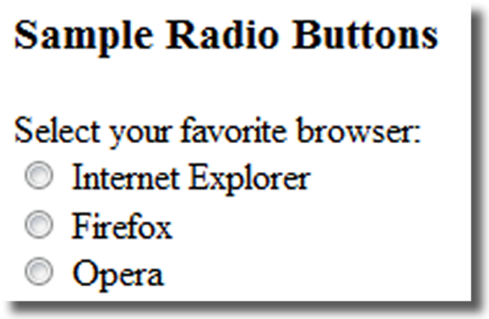
input Radio Button
<input>
Allows the user to select exactly one from a group of predetermined items
Each radio button in a group is given the same name and a unique value
Attributes:
type=“radio”
name
Id
checked: value of “checked”
value: The value attribute defines this value which is send by a post request. Should be a unique value for each radio button in the group.
Required
readonly
Autofocus
accesskey
tabindex
e.g <input type=“radio” name=“Favbrowser” id=“favIE” value=“IE">Internet Explorer<br>
<input type=“radio” name=“Favbrowser” id=“favfirefox” value=“Firefox">Firefox<br>
<input type=“radio” name=“Favbrowser” id=“favOpera” value=“Opera">opera<br>

Slide 44
input Hidden form data
<input>
This form control is not displayed on the web page.
Hidden form fields
Can be accessed by both client-side and server-side scripting
Sometimes used to contain information needed as the visitor moves from page to page.
Use hidden fields to pass along information to the forms that is generated by the program, script, or web page.
Remember that hidden fields are not hidden from view. Your readers can see them if they view the source of your web page. So you should never use a hidden input field to store passwords or any other sensitive information.
Attributes:
type=“hidden”
name
id
value
e.g <input type=“hidden” name=“sendto” id=“sendto” value=order@site.com>

Slide 45
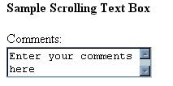
textarea Scrolling Text Box
<textarea> </textarea>
Configures a scrolling text box
Attributes:
name
id
Cols: the width in characters (required)
Rows: the height (required)
Wrap: values: hard or soft, configures the line breaks.
maxlength, disabled, readonly, placeholder, required, accesskey, tabindex
e.g. <textarea name=“comments” cols=“40” rows=“2”> enter your comments here </textarea>

Slide 46
Select List
<select></select>
Configures a select list (along with option elements)
Also known as: Select Box, Drop-Down List, Drop-Down Box, and Option Box.
Allows the user to select one or more items from a list of predetermined choices.
Attributes:
name
id
Size: no. of choices the browser will display
Multiple: value: multiple, to accept more than one choice

Slide 47
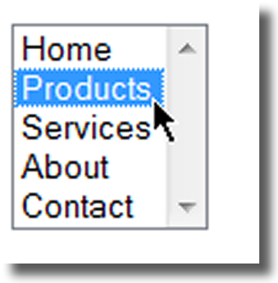
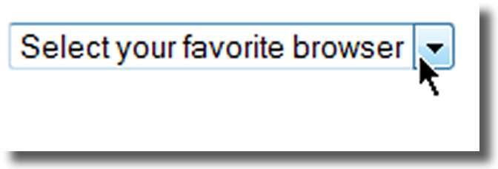
Options in a Select List
<option></option>
Configures the options in a Select List
Attributes:
Value: assigns a value to the option
Selected: the initial option selected

Slide 48
Options in a Select List
<select size=“1” name=“favbrowser” id=“favbrowser”>
<option> select your favorite browser </option>
<option value=“internet Explorer”> Internet Explorer</option>
<option value=“Firefox”> Firefox</option>
<option value=“Opera”> Opera</option>
</select>

Slide 49
Options in a Select List
<select size=“5” name=“jumpmenu” id=“jumpmenu”>
<option value=“index.html”> Home</option>
<option value=“product.html”> Products</option>
<option value=“services.html”> Services</option>
<option value=“about.html”> About</option>
<option value=“contact.html”> Contact</option>
</select>

Slide 50
More Information
Forms: http://www.w3schools.com/html/html_forms.asp
Form Attributes: http://www.w3schools.com/html/html_form_attributes.asp
Form Types: http://www.w3schools.com/html/html_form_input_types.asp

Slide 51
HTML Forms
Forms are the primary method for gathering data from site visitors
Create a form block with
Example:
The “method" attribute tells how the form data should be sent – via GET or POST request
<form></form>
<form name="myForm" method="post" action="path/to/some-script.php">
...
</form>
The "action" attribute tells where the form data should be sent

Slide 52
HTML Forms
Single-line text input fields:
Multi-line textarea fields:
Hidden fields contain data not shown to the user:
Often used by JavaScript code
<input type="text" name="FirstName" value="This is a text field" />
<textarea name="Comments">This is a multi-line text field</textarea>
<input type="hidden" name="Account" value="This is a hidden text field" />

Slide 53
HTML Forms
Fieldsets are used to enclose a group of related form fields:
The <legend> is the fieldset's title.
<form method="post" action="form.aspx">
<fieldset>
<legend>Client Details</legend>
<input type="text" id="Name" />
<input type="text" id="Phone" />
</fieldset>
<fieldset>
<legend>Order Details</legend>
<input type="text" id="Quantity" />
<textarea cols="40" rows="10" id="Remarks"></textarea>
</fieldset>
</form>

Slide 54
HTML Forms
Checkboxes:
Radio buttons:
Radio buttons can be grouped, allowing only one to be selected from a group:
<input type="checkbox" name="fruit" value="apple" />
<input type="radio" name="title" value="Mr." />
<input type="radio" name="city" value="Lom" />
<input type="radio" name="city" value="Ruse" />

Slide 55
HTML Forms
Dropdown menus:
Submit button:
<select name="gender">
<option value="Value 1"
selected="selected">Male</option>
<option value="Value 2">Female</option>
<option value="Value 3">Other</option>
</select>
<input type="submit" name="submitBtn" value="Apply Now" />

Slide 56
HTML Forms
Reset button – brings the form to its initial state
Image button – acts like submit but image is displayed and click coordinates are sent
Ordinary button – used for Javascript, no default action
<input type="reset" name="resetBtn" value="Reset the form" />
<input type="image" src="submit.gif" name="submitBtn" alt="Submit" />
<input type="button" value="click me" />

Slide 57
HTML Forms
Password input – a text field which masks the entered text with * signs
Multiple select field – displays the list of items in multiple lines, instead of one
<input type="password" name="pass" />
<select name="products" multiple="multiple">
<option value="Value 1"
selected="selected">keyboard</option>
<option value="Value 2">mouse</option>
<option value="Value 3">speakers</option>
</select>

Slide 58
HTML Forms
Form labels are used to associate an explanatory text to a form field using the field's ID.
Clicking on a label focuses its associated field (checkboxes are toggled, radio buttons are checked)
Labels are both a usability and accessibility feature and are required in order to pass accessibility validation.
<label for="fn">First Name</label>
<input type="text" id="fn" />

Slide 59
<form method="post" action="apply-now.php">
<input name="subject" type="hidden" value="Class" />
<fieldset><legend>Academic information</legend>
<label for="degree">Degree</label>
<select name="degree" id="degree">
<option value="BA">Bachelor of Art</option>
<option value="BS">Bachelor of Science</option>
<option value="MBA" selected="selected">Master of
Business Administration</option>
</select>
<br />
<label for="studentid">Student ID</label>
<input type="password" name="studentid" />
</fieldset>
<fieldset><legend>Personal Details</legend>
<label for="fname">First Name</label>
<input type="text" name="fname" id="fname" />
<br />
<label for="lname">Last Name</label>
<input type="text" name="lname" id="lname" />

Slide 60
<br />
Gender:
<input name="gender" type="radio" id="gm" value="m" />
<label for="gm">Male</label>
<input name="gender" type="radio" id="gf" value="f" />
<label for="gf">Female</label>
<br />
<label for="email">Email</label>
<input type="text" name="email" id="email" />
</fieldset>
<p>
<textarea name="terms" cols="30" rows="4"
readonly="readonly">TERMS AND CONDITIONS...</textarea>
</p>
<p>
<input type="submit" name="submit" value="Send Form" />
<input type="reset" value="Clear Form" />
</p>
</form>

Slide 61
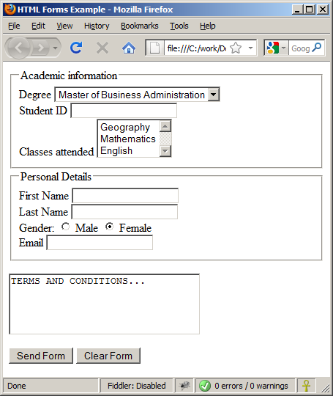

Slide 62
Questions !! ☺

