Slide 1
SCIENTIFIC COMMUNICATION Data Bases and Referencing Systems.
490MIC
الدكتورة أسماء الصالح
رقم المكتب 5T201
الموقع: http://fac.ksu.edu.sa/asmalsaleh
إيميل asmalsaleh@KSU.EDU.SA

Slide 2
What are data bases?
Databases:
Collections of online journals that can be used to search for articles.
Databases are often subject-specific.
Many contain the entire text of articles, but some only contain abstracts, which you can use to find the article elsewhere.
KING SAUD UNIVERSITY DATABASE?

Slide 3
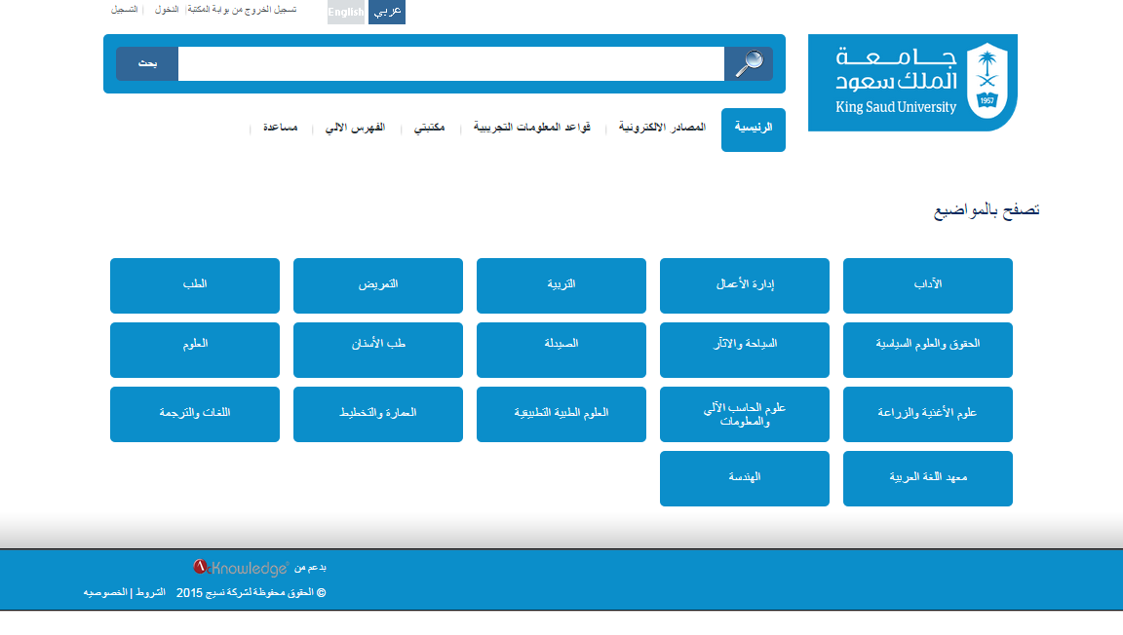
What are data bases?
KING SAUD UNIVERSITY DATABASE?

Slide 4
What are Scholarly Journals?
Scholarly Journals:
Scholarly journals (also called "professional" or "peer reviewed" journals) are a type of periodical.
Most college instructors require that the majority of articles for a research paper be from scholarly journals.
Articles report on original research or experiments (as opposed to news or opinion pieces).
Articles written by a scholar/author who has done research in a particular field or discipline.
Language is technical and specialized.
Sources cited in the form of footnotes or bibliographies.
Often published by universities or professional societies.

Slide 5
What are Scholarly Journals?

Slide 6
How to organize your references.
Referencing:
Presents three systems for referring to references (also known as citations):
Within the text of a journal article, book, or other scientific publication.
Citation–sequence (Based on APA referencing system)
Name–year (Based on Harvard referencing system)
Citation–name.
These abbreviated references are called in-text references.
They refer to a list of references at the end of the document.
The system of in-text references that you use will determine the order of references at the end of your document. These end references have essentially the same format in all three systems, except for the placement of the date of publication in the name–year system.

Slide 7
Examples of referencing systems.
Hundreds of different referencing styles.
Different academic disciplines and different journals have differing priorities and requirements
A few of the common referencing styles, and their origins, are explained below:
APA stands for "American Psychological Association" and comes from the association of the same name. Although originally drawn up for use in psychological journals, the APA style is now widely used in the social sciences, in education, in business, and numerous other disciplines.
MLA comes from the "Modern Language Association of America" and is used mainly in English and the Humanities.

Slide 8
Examples of referencing systems.
Hundreds of different referencing styles.
Different academic disciplines and different journals have differing priorities and requirements
A few of the common referencing styles, and their origins, are explained below:
Chicago is sometimes referred to as Turabian or Chicago/Turabian. It comes from the "Chicago Manual of Style" and the simplified version of it, "A Manual for Writers of Term Papers, Theses, and Dissertations", that Kate Turabian wrote [Source: The Writing Center at the University of North Carolina at Chapel Hill]. Chicago is used mainly in the social sciences, including history, political studies, and theology.
Vancouver originally came from The International Committee of Medical Journal Editors which produced the "Uniform Requirements for Manuscripts Submitted to Biomedical Journals" following a meeting that was held in Vancouver in 1978 [Source: Jönköping University Library]. The Vancouver style is used mainly in the medical sciences.

Slide 9
Examples of referencing systems.
Hundreds of different referencing styles.
Different academic disciplines and different journals have differing priorities and requirements
A few of the common referencing styles, and their origins, are explained below:
Harvard came originally from "The Bluebook: A Uniform System of Citation" published by the Harvard Law Review Association. The Harvard style and its many variations are used in law, natural sciences, social and behavioural sciences, and medicine.

Slide 10
When to use the referencing system?
For your research proposal.
For your poster
For your mini-paper
It is not important which system you will use BUT:
BE CONSISTANT THROUGH THE SAME PROJECT.

