Slide 1
CHAPTER ONE : Fits and Tolerances
1
CHAPTER ONE
Fits and Tolerances
CONTENTS

Slide 2
Why tolerances and fits are required?
CHAPTER ONE : Fits and Tolerances
Due to the inevitable inaccuracy of manufacturing methods, a part
cannot be made precisely to a given dimension, the difference between maximum and minimum limits of size of a part is the tolerance.
Tolerance is the total amount that a specific dimension is permitted to vary.
There is no such thing as an "exact size". Tolerance is key to interchangeable parts.
When two parts are to be assembled, the relation resulting from the difference between their sizes before assembly is called a fit.

Slide 3
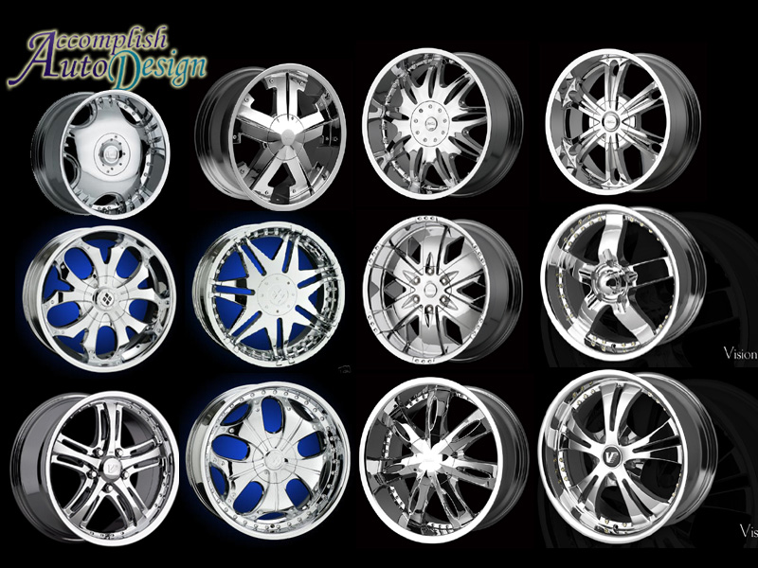
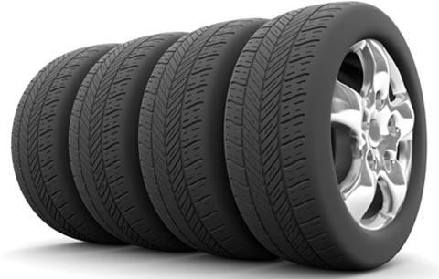
Examples of Interchangeable Manufacture
CHAPTER ONE : Fits and Tolerances
Bottle caps
Rims
Tires

Slide 4
Advantages For Interchangeable Manufacture
Replacement: One such part can freely replace another, without any custom fitting (such as filling).
Easy to Assembly: This interchangeability allows easy assembly of new devices
Repairing: Easier repair of existing devices.
Minimizing time and cost: Minimizing both the time and skill required of the person doing the assembly or repair.
Rapid Manufacturing: Machine tool enables the components to be manufactured more rapidly

Slide 5
How to decide tolerance?
CHAPTER ONE : Fits and Tolerances
Functional requirements of mating parts
Cost of production
Available manufacturing process
Choose as coarse tolerance as possible without compromising functional requirements.
Proper balance between cost and quality of parts.

Slide 6
CHAPTER ONE : Fits and Tolerances
1.1 Dimensional Tolerances Some of the dimensional tolerances terms are defined as following:
1. Dimension
2. Size (It is a number expressed in a particular unit in the measurement of length)
3. Actual size (of a part) (the measured size of the finished part after machining)
4. Basic size (the theoretical size used as a starting point for the application of tolerances)

Slide 7
CHAPTER ONE : Fits and Tolerances
5. Design size (The ideal size for each component (shaft and hole) based upon a selected fit)
6. Limits of size (the maximum and minimum sizes shown by the tolerance dimension)
7. Maximum limit of size (Is the maximum size permitted for the part)
8. Minimum limit of size (it is the minimum size permitted for the part limit of size)
9. Maximum material limit (is the condition of a part when it contains the most amount of material. The MMC of an external feature (such as a shaft) is the upper limit. The MMC of an internal feature(such as a hole) is the lower limit)
10. Minimum material limit (is the condition of a part when it contains the least amount of material possible. The LMC of an external feature is the lower limit of the part. The LMC of an internal feature is the upper limit of the part.)
11. Tolerance (Tolerance is the difference between maximum limit of size and minimum limit of size)
Notes:
http://homepages.cae.wisc.edu/~me232/tolerance_info/limits_fits.pdf (design size VS basic size)

Slide 8
CHAPTER ONE : Fits and Tolerances
12. Zero line (it represents the basic size)
13. Upper deviation (It is the algebraic difference between minimum limit of size and its corresponding basic size)
14. Lower deviation (It is the algebraic difference between minimum limit of size and its corresponding basic size)
15. Tolerance zone (a region representing the difference between the upper and the lower limits)
16. Unilateral tolerance (In this method of presenting the limits, variation is allowed only on one side of the zero line)
17. Bilateral tolerance (Here the limits variation is allowed on either sides of the zero line)
18. Shaft (it refers to any external feature of a part, including any non cylindrical features as well)
19. Hole (the term used for any internal feature of a part including any non cylindrical as well)

Slide 9
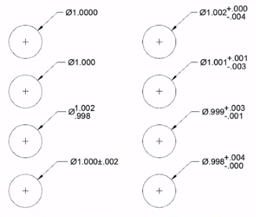
CHAPTER ONE : Fits and Tolerances
Notes:
https://www.youtube.com/watch?v=KiXHABfRHfQ

Slide 10
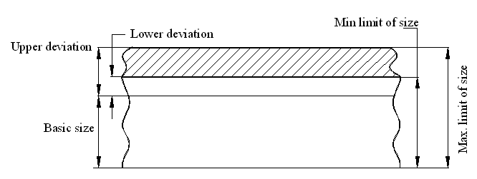
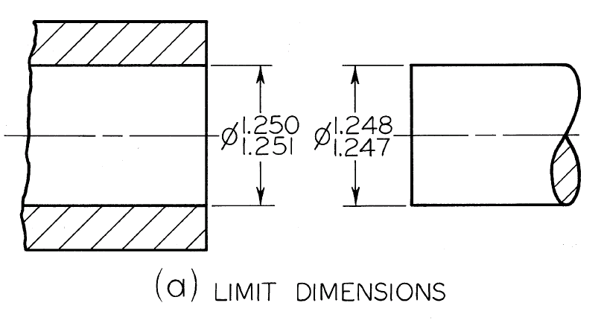
CHAPTER ONE : Fits and Tolerances
The Tolerance is 0.001” for the Hole as well as for the Shaft

Slide 11
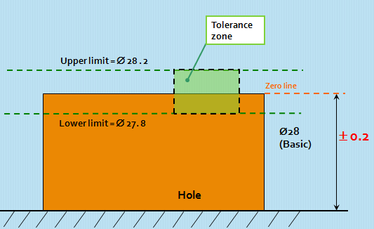
CHAPTER ONE : Fits and Tolerances

Slide 12
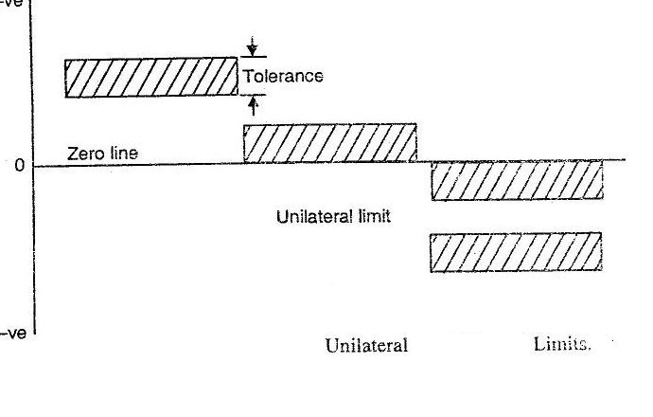
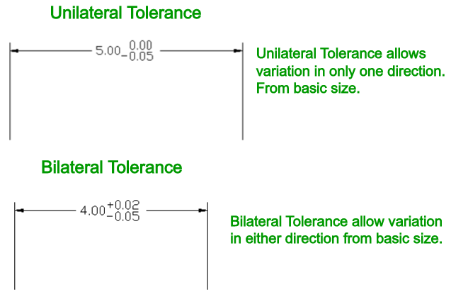
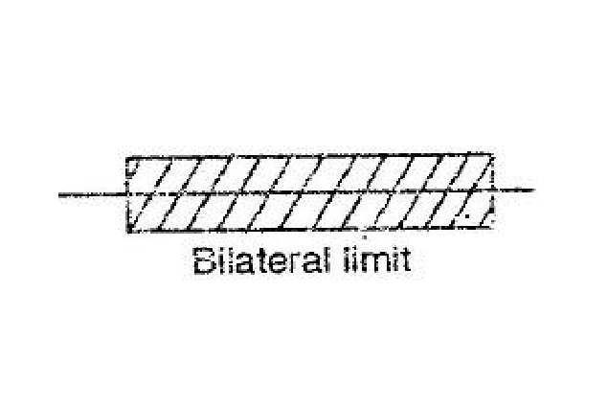
CHAPTER ONE : Fits and Tolerances
Unilateral tolerance
Bilateral tolerance
Zero line

Slide 13
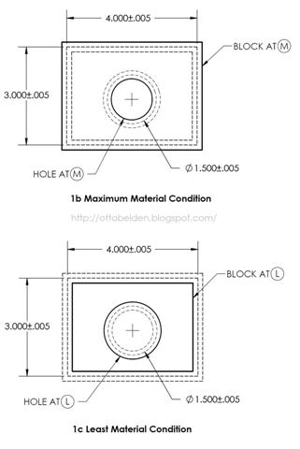
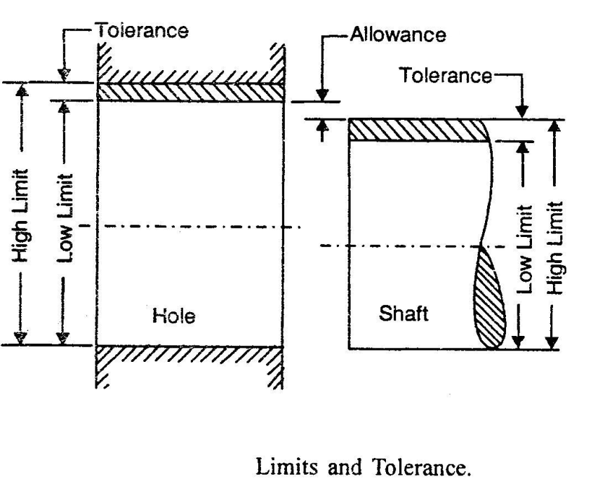
CHAPTER ONE : Fits and Tolerances

Slide 14
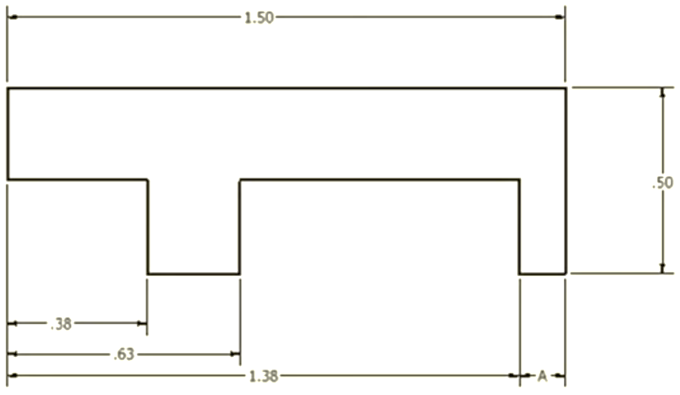
Calculate the maximum and minimum possible dimension for A
CHAPTER ONE : Fits and Tolerances
+0.01
-0.01
+0.01
-0.01

Slide 15
CHAPTER ONE : Fits and Tolerances
20. Basic shaft (the shaft chosen as a basis for the shaft basis system of fit)
21. Basic hole (the hole chosen as a basis for the hole basis system of fit)
22. Fit (Fit is the relationship that exists between two mating parts, a hole and shaft with respect to their dimensional difference )
23. Basic size of a fit (common value of the basic size of the two parts of a fit)

Slide 16
CHAPTER ONE : Fits and Tolerances
24. Clearance fit
25. Interference fit
26. Transition fit
Clearance fit
Hole
Shaft
Tolerance Zone of Hole
Tolerance Zone of Shaft
Shaft
Hole

Slide 17
CHAPTER ONE : Fits and Tolerances
27. Minimum clearance
28. Maximum clearance
29. Minimum interference

Slide 18
CHAPTER ONE : Fits and Tolerances
30. Maximum interference
31. Shaft-basis system of fits
32. Hole-basis system of fits
Figure 1.3: Basic hole and shaft system

Slide 19
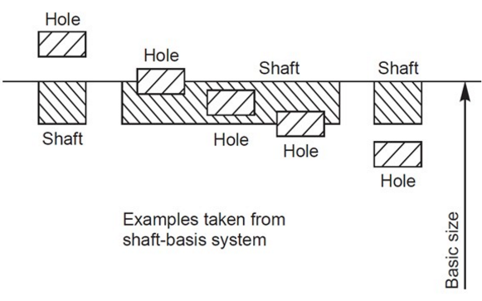
31 - Basic Shaft System of fits
CHAPTER ONE : Fits and Tolerances
In this system the size of the shaft remains the same and the hole size is varied to get the required fit. Maximum shaft size is taken as the basic size, an allowance is assigned, and tolerances are applied on both sides of and away from this allowance.

Slide 20
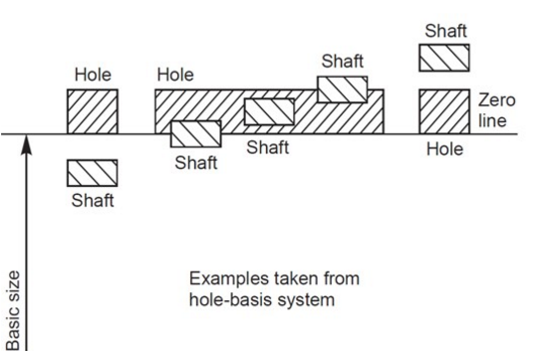
32 - Basic Hole System of fits
CHAPTER ONE : Fits and Tolerances
In this system the size of the hole remains the same and shaft size is varied to get the required fit. Minimum hole is taken as the basic size, an allowance is assigned, and tolerances are applied on both sides of and away from this allowance.

Slide 21
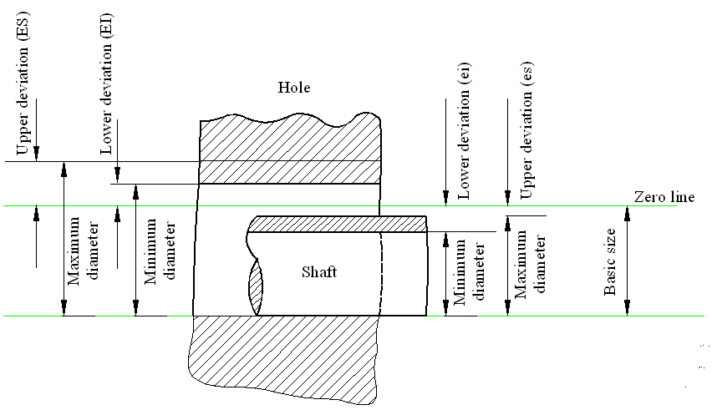
CHAPTER ONE : Fits and Tolerances
Or Zero deviation line

Slide 22
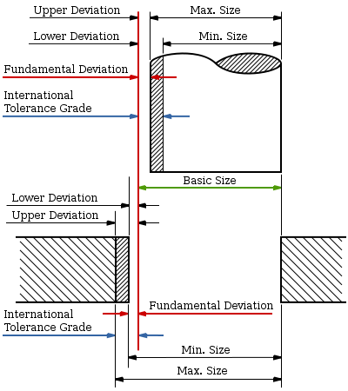
CHAPTER ONE : Fits and Tolerances
Notes:
https://en.wikipedia.org/wiki/Engineering_tolerance

Slide 23
Some definitions
CHAPTER ONE : Fits and Tolerances
Basic Size: is the size from which limits or deviations are assigned. Basic sizes, usually diameters, should be selected from a table of preferred sizes.
Deviation: is the difference between the basic size and the hole or shaft size.
Upper Deviation: is the difference between the basic size and the permitted maximum size of the part.
Lower Deviation: is the difference between the basic size and the minimum permitted size of the part.
Notes:
https://en.wikipedia.org/wiki/Engineering_tolerance
http://bukbazzar.blogspot.com/2015/04/limits-and-fits.html

Slide 24
Some Definitions
CHAPTER ONE : Fits and Tolerances
Fundamental Deviation: is the deviation closest to the basic size. This is identical to the upper deviation for shafts and the lower deviation for holes in a clearance fit.
Tolerance: is the difference between the permitted minimum and maximum sizes of a part.

Slide 25
Some Definitions
CHAPTER ONE : Fits and Tolerances
The hole-basis system of preferred fits is a system in which the basic diameter is the minimum size of the hole. For the generally preferred hole-basis system, the fundamental deviation is specified by the upper-case letter.
The shaft-basis system of preferred fits is a system in which the basic diameter is the maximum size of the shaft. The fundamental deviation is given by the lowercase letter.

Slide 26
Some Definitions
CHAPTER ONE : Fits and Tolerances
An interference fit results in an interference between two mating parts under all tolerance conditions.
A clearance fit results in a clearance between the two mating parts under all tolerance conditions.
A transition fit results in either a clearance or an interference condition between two assembled parts.

Slide 27
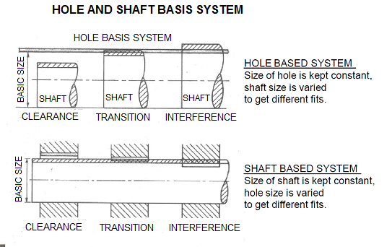
CHAPTER ONE : Fits and Tolerances

Slide 28
CHAPTER ONE : Fits and Tolerances
1.2 Symbols for Tolerances and Deviation and Symbols for Fits:
Tolerance values (The tolerance value is a function of the basic size and is indicated by a number called the grade. )
2. Tolerance zone position
The position of the tolerance zone with respect to the zero line, is indicated by a letter symbol, a capital letter for holes and a small letter The tolerance size thus defined by its basic value followed by a symbol composed of a letter and a number. It is established by a combination of the fundamental deviation indicated by a letter and the IT grade number. In the dimension 50H8, the H8 specifies the tolerance zone.
Example for shaft: 45 g7
International Tolerance Grade (IT)
Notes:
https://books.google.com.sa/books?id=iwcMo9neBRMC&pg=PA144&lpg=PA144&dq=fundamental+deviation+selection+fits&source=bl&ots=67sTVnD757&sig=rR2GRTtSKmuvsYzCwapuA5_9LGM&hl=en&sa=X&redir_esc=y#v=onepage&q=fundamental%20deviation%20selection%20fits&f=false

Slide 29
CHAPTER ONE : Fits and Tolerances
1.2 Symbols for Tolerances and Deviation and Symbols for Fits:
3.A fit (A fit is indicated by the basic size common to both components, followed by symbol corresponding to each component, the hole being quoted first)
Example: 45 H8 g7
Possibly 45 H8 – g7
Or 45 H8/g7
https://books.google.com.sa/books?id=2ck0AwAAQBAJ&pg=SA6-PA13&lpg=SA6-PA13&dq=fundamental+deviation+selection+fits+IT&source=bl&ots=ZO-M0zNqbP&sig=ofRGWezbxKzJe9uW9zwxVZRZPdk&hl=en&sa=X&redir_esc=y#v=onepage&q=fundamental%20deviation%20selection%20fits%20IT&f=false
Notes:
http://www.engineeringessentials.com/ege/tol/tol_page9.htm

Slide 30
CHAPTER ONE : Fits and Tolerances
1.3: Grades of tolerances:
Eighteen grades of tolerances are provided IT01, IT0 and IT1 to IT16 The Table 1.1 gives the possible degrees of precision or grade of tolerance, achieved with different machine tools.
Notes:
http://www.engineersedge.com/international_tol.htm

Slide 31
CHAPTER ONE : Fits and Tolerances
Table 1.1: degree of precision or grade of tolerance
Tolerance grade | Intended for | Applicable to components or machines
I T 01 | Gauges | Slip blocks, Reference gauges
I T 0
I T 1
I T 2 |  | High quality gauges
I T 3
I T 4
I T 5 | Fits | Ball bearing
I T 6 |  | Grinding, Honing
I T 7 |  | Broaching
I T 8 |  | Center lathe turning
I T 9 |  | Worn automatic lathe
I T 10 |  | Milling
I T 11 |  | Drilling, Rough turning
I T 12 | Not for fits | Light press work
I T 13 |  | Press work
I T 14 |  | Die casting
I T 15 |  | Stamping
I T 16 |  | Sand casting

Slide 32
Representation of Tolerance 2) Number or Grade IT01, IT0, IT1,….IT16
CHAPTER ONE : Fits and Tolerances
International Tolerance Grade Selection
Tolerance Grade defines range of dimensions (dimensional variation)
There are manufacturing constraints on tolerance grade chosen

Slide 33
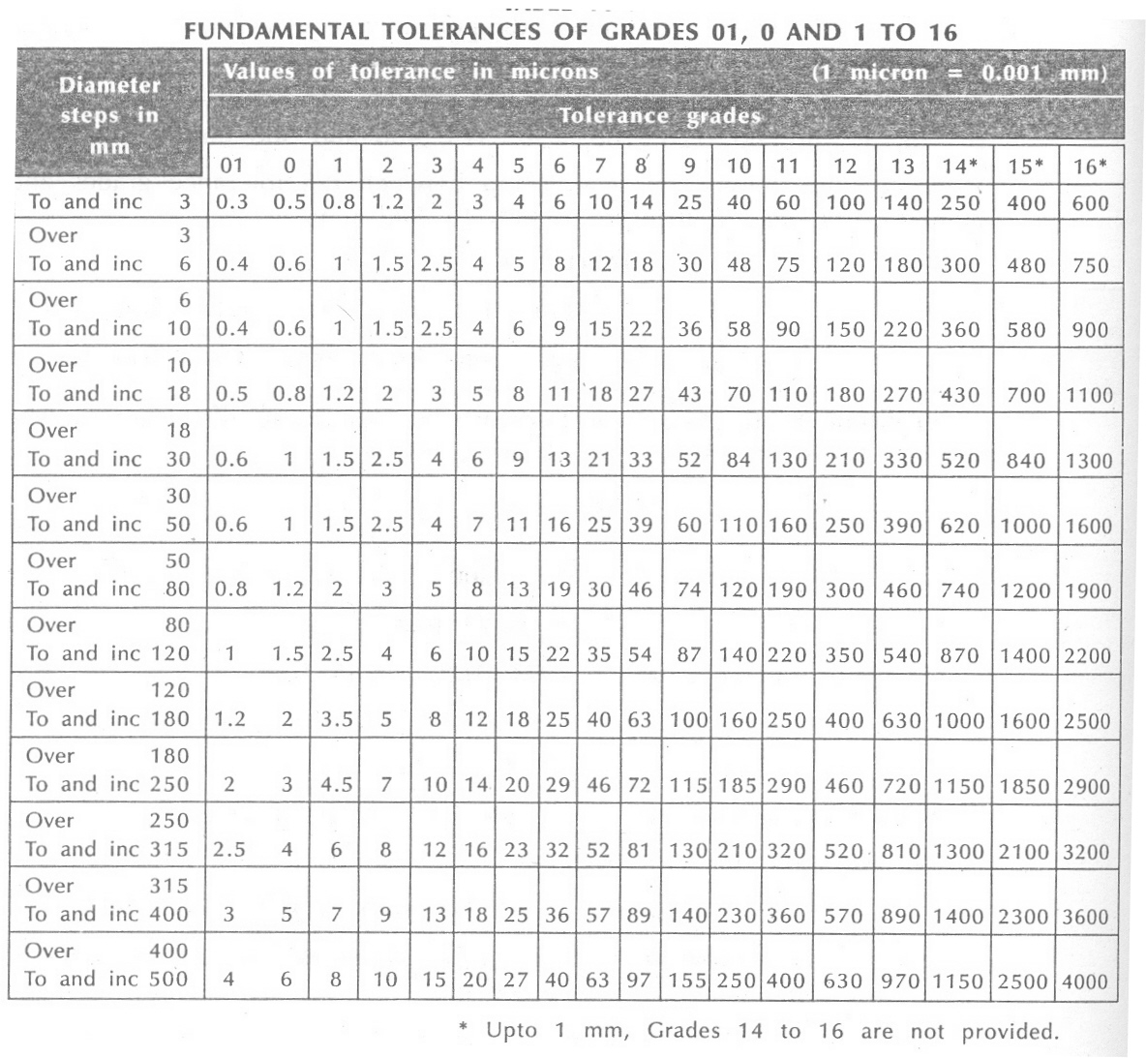
CHAPTER ONE : Fits and Tolerances

Slide 34
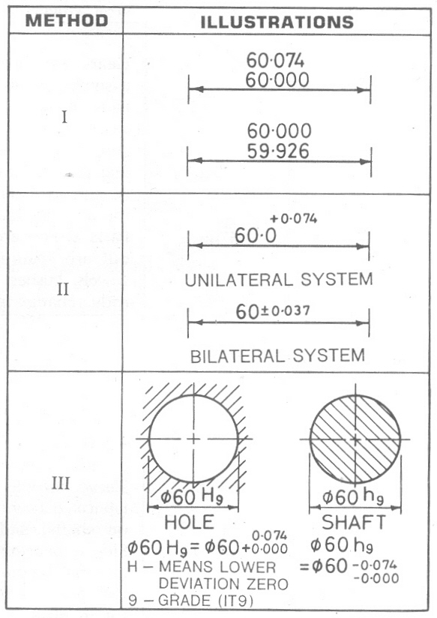
Example
CHAPTER ONE : Fits and Tolerances
Notes:
For both hole and the shaft only unilateral tolerances are selected bcz these are presented as basic hole and shaft for which lower and upper deviation respectively are zero.

Slide 35
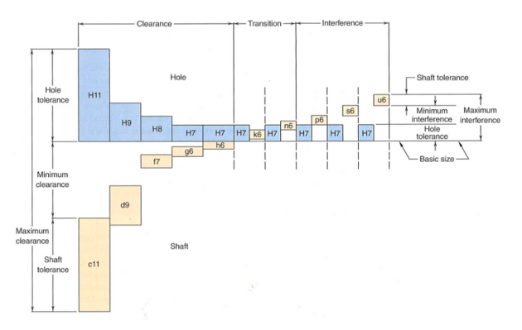
Metric Preferred Hole Based System of fit
CHAPTER ONE : Fits and Tolerances
Notes:
http://www.moorepants.info/jkm/courses/eng4/lectures/lecture14.html#slide-17

Slide 36
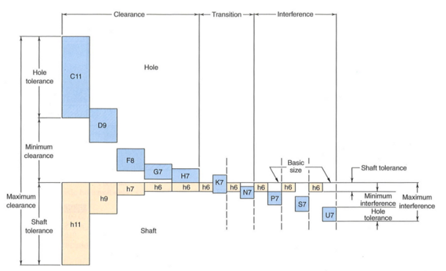
Metric Preferred shaft Based System of fit
CHAPTER ONE : Fits and Tolerances
Notes:
http://www.moorepants.info/jkm/courses/eng4/lectures/lecture14.html#slide-17

Slide 37
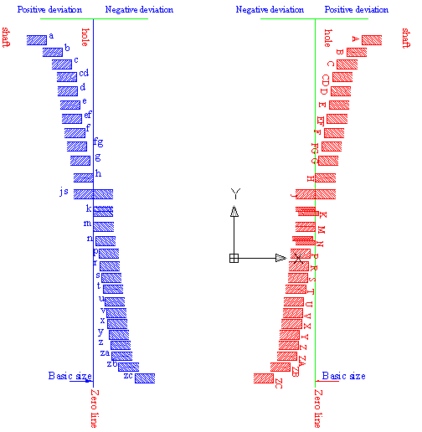
CHAPTER ONE : Fits and Tolerances
Shafts
Holes
Figure 1.5: Position of the various tolerance zones for a given diameter in the ISO system
Notes:
ISO Method to Determine Tolerance
Procedure
Basic size selection
Determine the preferred fit
International Grade
Determine tolerances

Slide 38
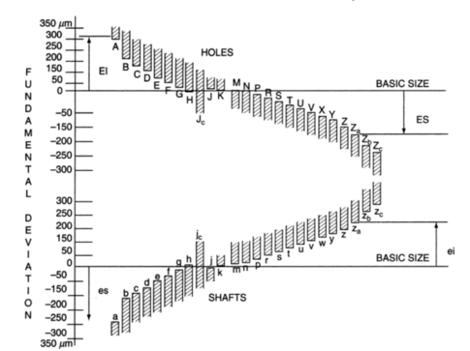
CHAPTER ONE : Fits and Tolerances
Notes:
https://books.google.com.sa/books?id=iwcMo9neBRMC&pg=PA144&lpg=PA144&dq=fundamental+deviation+selection+fits&source=bl&ots=67sTVnD757&sig=rR2GRTtSKmuvsYzCwapuA5_9LGM&hl=en&sa=X&redir_esc=y#v=onepage&q=fundamental%20deviation%20selection%20fits&f=false

Slide 39
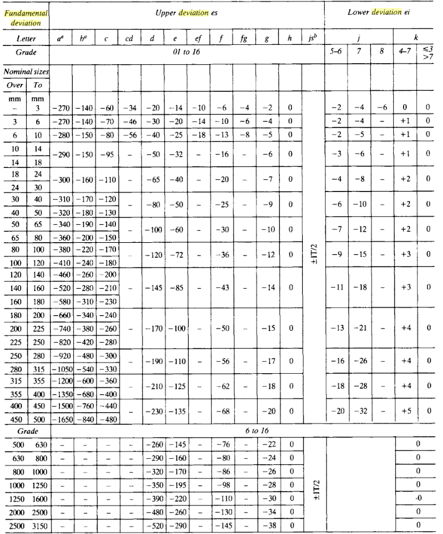
Table for fundamental deviations for shafts
Notes:
https://books.google.com.sa/books?id=2ck0AwAAQBAJ&pg=SA6-PA13&lpg=SA6-PA13&dq=fundamental+deviation+selection+fits+IT&source=bl&ots=ZO-M0zNqbP&sig=ofRGWezbxKzJe9uW9zwxVZRZPdk&hl=en&sa=X&redir_esc=y#v=onepage&q=fundamental%20deviation%20selection%20fits%20IT&f=false

Slide 40
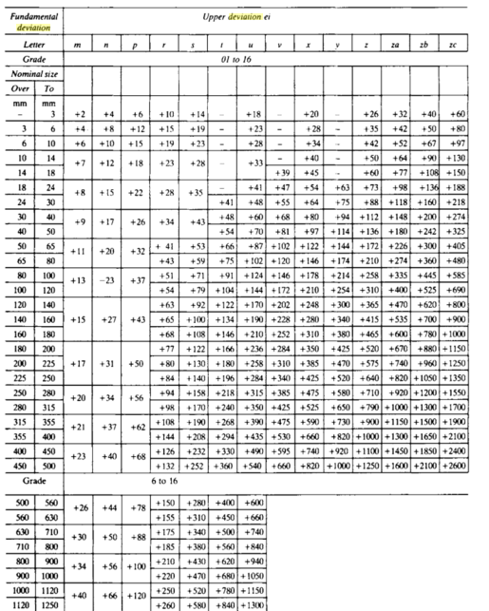
Table for fundamental deviations for shafts
CHAPTER ONE : Fits and Tolerances
Notes:
https://books.google.com.sa/books?id=2ck0AwAAQBAJ&pg=SA6-PA13&lpg=SA6-PA13&dq=fundamental+deviation+selection+fits+IT&source=bl&ots=ZO-M0zNqbP&sig=ofRGWezbxKzJe9uW9zwxVZRZPdk&hl=en&sa=X&redir_esc=y#v=onepage&q=fundamental%20deviation%20selection%20fits%20IT&f=false

Slide 41
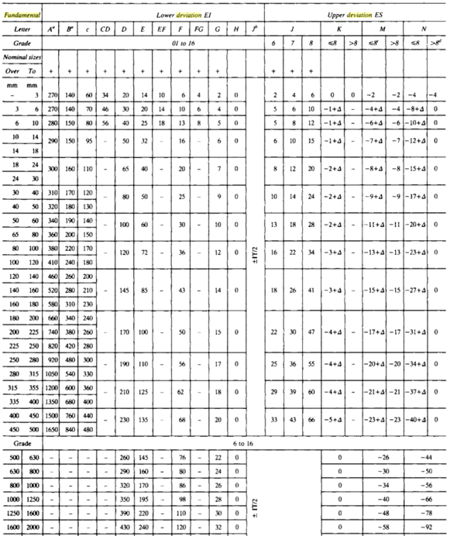
Table for fundamental deviations for holes
Notes:
https://books.google.com.sa/books?id=2ck0AwAAQBAJ&pg=SA6-PA13&lpg=SA6-PA13&dq=fundamental+deviation+selection+fits+IT&source=bl&ots=ZO-M0zNqbP&sig=ofRGWezbxKzJe9uW9zwxVZRZPdk&hl=en&sa=X&redir_esc=y#v=onepage&q=fundamental%20deviation%20selection%20fits%20IT&f=false

Slide 42
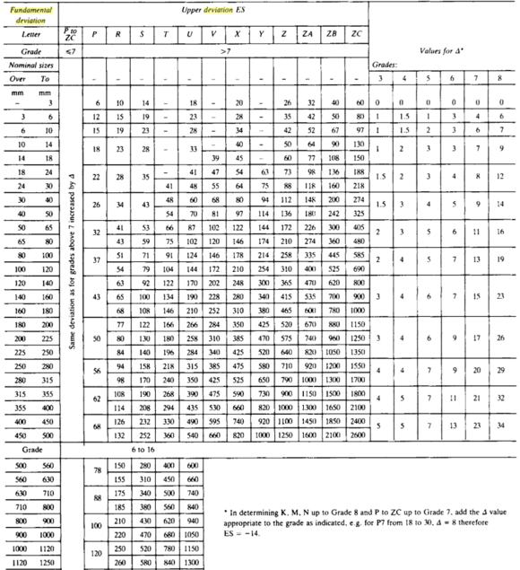
Table for fundamental deviations for holes
Notes:
https://books.google.com.sa/books?id=2ck0AwAAQBAJ&pg=SA6-PA13&lpg=SA6-PA13&dq=fundamental+deviation+selection+fits+IT&source=bl&ots=ZO-M0zNqbP&sig=ofRGWezbxKzJe9uW9zwxVZRZPdk&hl=en&sa=X&redir_esc=y#v=onepage&q=fundamental%20deviation%20selection%20fits%20IT&f=false

Slide 43
CHAPTER ONE : Fits and Tolerances
1.4 Fundamental tolerance unit:
1.4.1Values of standard tolerances:
T = 10 ^{0.2 (G – 1)} (0.45 3√D + 0.001D)
G = Tolerance grade IT6 – IT 16
1.4.2 Fundamental deviations:
1.4.2.1 Shaft deviation:
For each letter symbol defining the position of the tolerance zone, the magnitude and sign of one of the two deviations which is known as the fundamental deviations (upper deviation) “es” or lower deviation “ei”
The other deviation is derived from the first one using the magnitude of the standard tolerance “IT”, by means of the following algebraic relationship:
The fundamental deviation given by the formulae in above tables of deviations is, in principle, that corresponding to that limit closest to the zero line, in other words, the upper deviation “es” for shafts (a) to (h), and the lower deviation “ei” for shafts (j) to (Zc).
ei = es - IT
es = ei + IT

Slide 44
CHAPTER ONE : Fits and Tolerances
1.4.2.2 Hole deviation:
For each letter symbol, defining the position of the tolerance zone, the magnitude and sign of the fundamental deviation (lower deviation “EI” for holes (A) to (H) and upper deviation “ES” for holes (J) to (Zc),
The other deviation is derived from the first one, using the magnitude of the tolerance “IT” by means of the following relationships.
ES = EI + IT
OR
EI = ES - IT

Slide 45
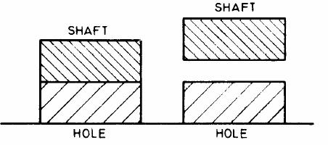
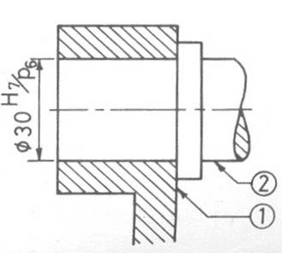
Example
Determine which type of fit is presented by H7/p6? For basic size of 30 mm determine the dimensions of the hole and the shaft for the given fit. (Fit: 30 H7/p6)
Capital H means basic hole system and upper deviation = zero
INTERFERENCE FIT
Φ30.035
H7 : Tol Grade 7 mean 21μ variation
Φ30.022
Φ30.021
Φ30.000
p6 : Tol Grade 6 means 13μ variation
(p means upper deviation is 22 μ)
Fit: 40 H8/e6

Slide 46
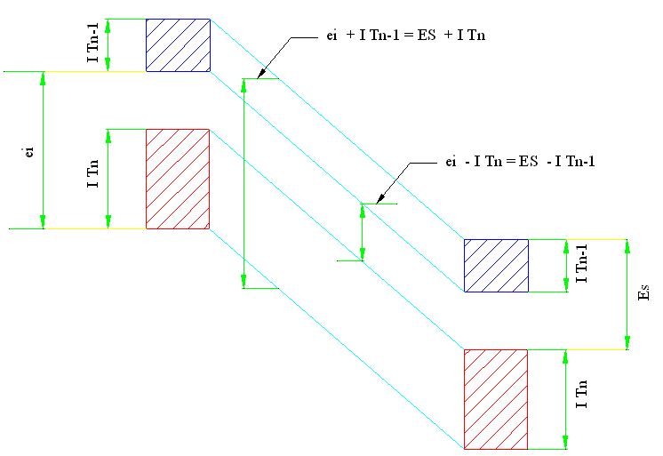
CHAPTER ONE : Fits and Tolerances
Figure 1.7: Two comparable fits, with basic hole and basic shaft, in which a hole of a given grade is associated with a shaft with next finer grade (H7/P6 and P7/h6), have exactly the same clearance or interference.

