Slide 1
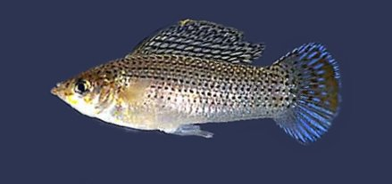
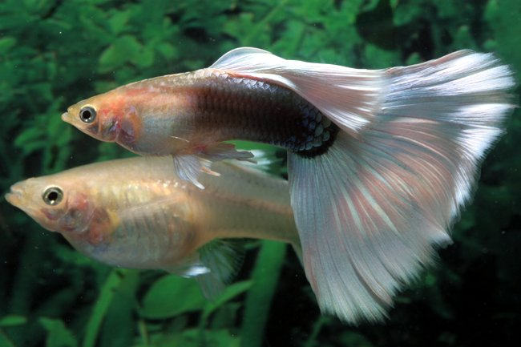
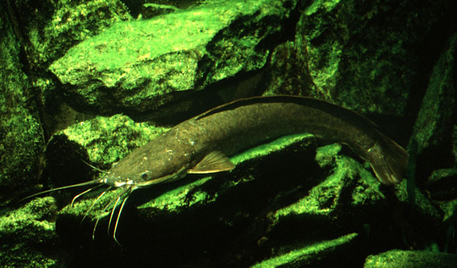
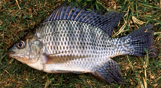
الأسماك في عالم الحيوانfish in the zoology

Slide 2
Fish are aquatic vertebrate chordates
► Chordates are characterized by having a notochord
► Vertebrates
notochord → vertebral column
►► Fish make up between 50-60% of the total vertebrate animals
► Amphibians 6%
► Reptiles 14%
► Bird Aves 20%
► Mammals 10%

Slide 3
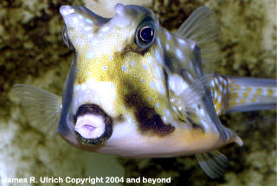
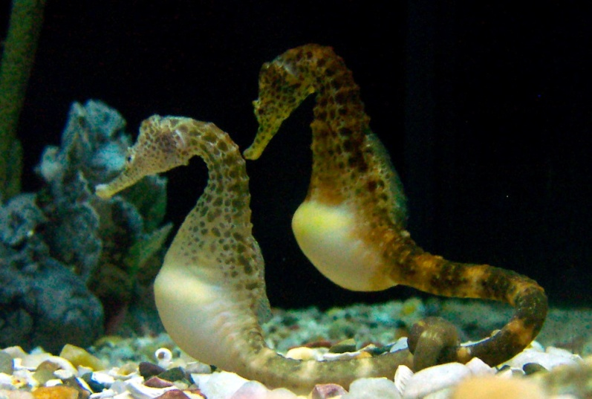
الخصائص العامة للأسماك General characteristics of fish
◄ الأسماك ذات دم بارد (Poikilothermic)
◄ The body is usually divided into a head, trunk, and tail
► Body shape varies greatly Fusiform - Anguilliform –
Sagittiform - Globiform Filiform Taeniform Compressiform Depressiform
And with anomalous shape such as sea horse and cow fish

Slide 4
◄ The skin in fish usually consists of two layers, the epidermis
and the dermis
► Epidermis: A thin outer layer composed of stratified squamous epithelial tissue
(Stratified Squamous Epithelium)
Dermis: thicker than the epidermis and made up of connective tissue.
► Epidermal cells contain mucous glands that secrete mucus, which consists of glycoproteins.
Benefits of mucus in fish
1- It forms a protective covering that contributes to the protection of the skin and makes it difficult to catch fish.
2- It reduces the force of friction between the water and the body of the fish
3- It inhibits the action of some irritating substances and heavy metal salts
4- Helps prevent bacteria and parasites from reaching skin cells
5- Contributes to the process of osmotic regulation in some types of fish
6- Fish also benefit from mucus in building their nests to lay eggs

Slide 5
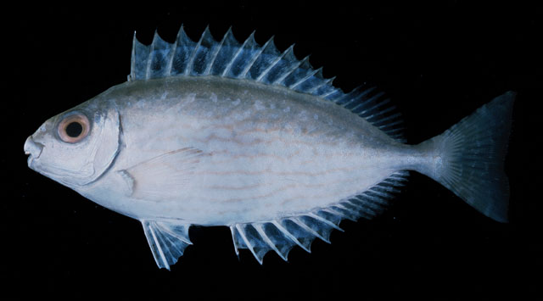
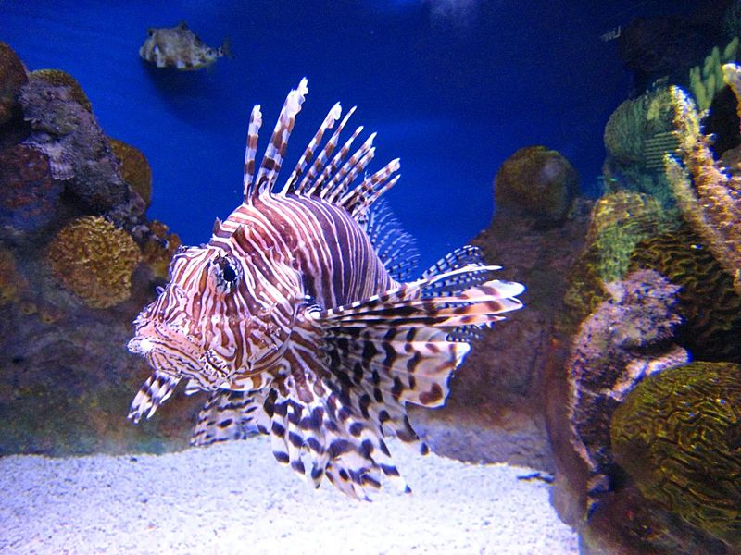
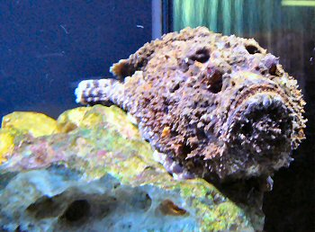
◄The epidermis of some fish contains cells that specialize in secreting venom
These cells are attached to the spines of the fins, hence the name (Ichthyoacnthotoxin).
As in the rock fish or stone scorpion Synanceja verrucosa and chicken fish
The sea, also known as the sea butterfly or sea lion, Pterois volitans, as well as some
Fishes of the Siganidae family, or Rabbit Fishes, such as a fish Sigan (pure) Siganus rivulatus

Slide 6
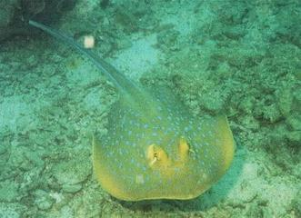
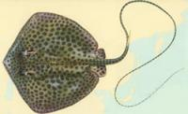
Epidermal cells specialized in producing venom (Ichthyoacnthotoxin) may be attached to spines on the body, as in some ornamental fish.
or attached to spines on the tail, such as fish of the stingray family Dasyatidae (large stingray or long-whip stingray Dasyatis uranak, small stingray Taeniura lymma)

Slide 7
►► Fish poison Ichthyotoxin:
A term given to a fishy source of poison, and these toxins are found either in the thorns
(Ichthyoacnthotoxin) or in meat (Ichthyosarcotoxin for fish meat)
As in the Baracudas fish, (the family of the pod Sphyrnidae), the snappers (the family of the snapper Lutjanidae), some grouper fish or the lighter groupers, where the poison is present in the meat of these fish as a result of their feeding on some marine algae that grow around the coral root, which are considered poisonous algae and as a result the poison is concentrated within the tissues of these fish.
Or in eggs or caviar (Ichthyootoxin, poison of fish eggs), as in some herring fish, and in these fish (the ovaries) contain toxins produced only during egg laying.
Or in the viscera (liver, stomach, and intestines) as in the anisotropic fish or puffer fish (family of spherical or quadrupedal fish Tetradontidae). The poison of these fish has been classified as a special type due to its strength. It is called the anisotropic poison Tetradotoxin. Which the Japanese accept greedily.

Slide 8
► Both epidermis and dermis contain chromatophores
However, they spread more in the dermis, and these cells usually have four colors: black, yellow, red, and blue. Fish control these cells through the nervous system.
Benefits of pigment cells in fish
1- Pigment cells abound more in colored fish, giving them a variety of bright colors.
2- The coloration of fish is a means of protection from enemies in its environment
when it is close to the color of the environment.
3- The male in many fish species may change color (especially the color of the fins)
during the breeding season strategy for this process
The dermis layer contains special organs called photophores or light carriers, which are composed of tubular glandular cells equipped with cerebral and spinal nerves and reflective cells that look like lenses.

Slide 9
In most fish, the skin, except for the head and fins, is covered with scales of different shapes
1- Placoid scales (some cartilaginous fishes) such as sharks
2- scales cycloid (bony fish scales)
3 - ctenoid scales (bony fish scales)
4- Rhombic or ganoid scales (primitive bony fish scales)
5- shiny or cosmoid scales (bony fish scales)
► Scales often arise from the dermis layer, with the exception of the armor scales, which arise from both the epidermis and the dermis together.
► Circular and comb scales are the most common
► The scales are shiny or cosmic, so named because they contain a layer of a solid substance called cosmine
► Some fish do not have scales, where the skin is naked or covered by bony plates, as in the sturgeon fish, which belongs to the class of cartilaginous bony fishes (chondrostei).

