Slide 1
MATH 153
Laila Al-Zaid
laalzaid@ksu.edu.sa

Slide 2
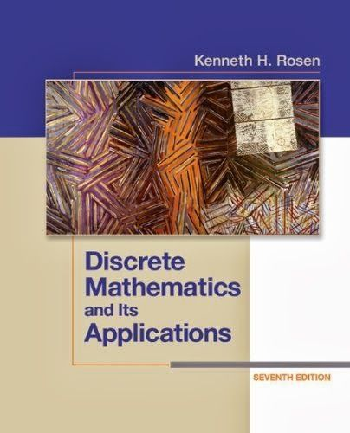
Reference:

Slide 3
Test dates
First Midterm: 7th week
Second Midterm: 14th week

Slide 4
Methods of Assessment:
Mark | Course Assessment
40 | Midterm exam
10 | HomeWorks
10 | Quizzes
40 | Final Examination
100 | Total

Slide 5
Methods of Proof
Direct Proof.
Indirect Proof (Proof by Contraposition).
Proof by Contradiction.
Mathematical Induction.

Slide 6
DEFINITION:
An integer number n is even if and only if there exists a number k such that n = 2k.
An integer number n is odd if and only if there exists a number k such that n = 2k + 1.
An integer a is a perfect square if there is an integer b such that $a=b^{2}$.)

Slide 7
DEFINITION:
The real number r is rational if there exist integers p and q with $q≠0$such that $r=\frac{p}{q}$.
p and q have no common factors (so that the fraction $\frac{p}{q}$is in lowest terms.)
A real number that is not rational is called irrational.

Slide 8
Direct Proof:
The simplest and easiest method of proof available to us. There are only two steps to a direct proof:
1. Assume that P is true.
2. Use P to show that Q must be true.

Slide 9
Example 1:
Directly prove that : If n is an odd integer then $n^{2}$ is also an odd integer.

Slide 11
Example2:
(Exr 2\91): Use a direct proof to show that the sum of two even integers is even.

Slide 12
Solution:
Suppose that m and n are two even integers , so ∃ 𝑘,𝑗 𝑠𝑢𝑐ℎ 𝑡ℎ𝑎𝑡 𝑚=2𝑘 𝑎𝑛𝑑 𝑛=2j.
Then 𝑚+𝑛=(2𝑘)+(2𝑗)
=2k+2j
=2(𝑘+𝑗)
=2𝑡 , 𝑤ℎ𝑒𝑟𝑒 𝑡=𝑘+𝑗.
Thus, 𝑚+𝑛 is even. □

Slide 13
Give a direct proof that if m and n are both perfect squares, then nm is also a perfect square
Example 3:

Slide 14
Solution:
Assume that m and n are integers and are perfect squares. Then by definition $m=k^{2}$ and $n=l^{2}$ for some integers k and $l$.
We will now use these facts to show that $mn$ is also a perfect square.
$mn=k^{2}l^{2}={(kl)}^{2}$ and $kl$ is an integer, therefore $mn$is a perfect square.

Slide 15
Indirect proof (Proof by Contraposition)
Recall that first-order logic shows that the statement P ⇒ Q is equivalent to ¬Q ⇒ ¬P.
1. Assume ¬Q is true.
2. Show that ¬P must be true.
3. Observe that P ⇒ Q by contraposition.

Slide 16
Example 4:
Let x be an integer. Prove that : If x² is even, then x is even. (by Contraposition proof)

Slide 18
Example 5:
Using by contraposition to show that:
For x is an integer:
If $7x+9$is even , then x is odd.

Slide 19
Proof:
Suppose that x is even so, $∃k∈ℤ$ such that
$x=2k,$
Now, $7x+9=7\left(2k\right)+9=14k+9$
$=2\left(7k+4\right)+1$
$=2t+1,$
Where $t=7k+4∈$ $ℤ$.
Thus $7x+9$ is odd

Slide 20
Proof by Contradiction.
The proof by contradiction is grounded in the fact that any proposition must be either true or false, but not both true and false at the same time.
1. Assume that P is true.
2. Assume that $¬Q$ is true.
3. Use P and $¬Q$ to demonstrate a contradiction.

Slide 21
Example 6:
Proof by contradiction : If $x^{2}$ is an odd then so is $x$.

Slide 23
Example 7:
Prove that if n = ab, where a and b are positive integers, then $a ≤\sqrt{n}$or $b ≤\sqrt{n}$. ( by Contradiction)

Slide 24
Proof:
Assume that $a>\sqrt{n}$ and $b>\sqrt{n}$
So $ab>\sqrt{n}.\sqrt{n}=n$, this implies $ab≠n$
$(→←)$this Contradiction

Slide 25
Pages 91: 1,5,8,9,15,16,18

